Slide 1
TOGAF 9 Fundamental: 2. TOGAF Concepts
Romi Satria Wahono romi@romisatriawahono.net http://romisatriawahono.net/tfu WA/SMS: +6281586220090

Slide 2
Romi Satria Wahono
SD Sompok Semarang (1987)
SMPN 8 Semarang (1990)
SMA Taruna Nusantara Magelang (1993)
B.Eng, M.Eng and Ph.D in Software Engineering from Saitama University Japan (1994-2004) Universiti Teknikal Malaysia Melaka (2014)
Research Interests: Software Engineering, Machine Learning
Founder IlmuKomputer.Com
PNS di PDII LIPI (1994-2007)
Founder dan CEO PT Brainmatics Cipta Informatika

Slide 3
Course Outline
Introduction
TOGAF Concepts
TOGAF ADM
BPMN Overview
UML Overview
TOGAF Case Study

Slide 4
2. TOGAF Concepts
2.1 What and Why TOGAF
2.2 TOGAF Certification
2.3 TOGAF Components

Slide 5
2.1 What and Why TOGAF

Slide 6
What is TOGAF?
TOGAF is a framework (a detailed method and a set of supporting tools) for developing an enterprise architecture
TOGAF provides the methods and tools for assisting in the acceptance, production, use, and maintenance of an enterprise architecture.
It is based on an iterative process model supported by best practices and a re-usable set of existing architecture assets
It may be used freely by any organization wishing to develop an enterprise architecture for use within that organization

Slide 7
Why TOGAF?
TOGAF has been developed through the collaborative efforts of over 300 Architecture Forum member companies from some of the world's leading companies and organizations
Using TOGAF results in enterprise architecture that is consistent, reflects the needs of stakeholders, employs best practice, and gives due consideration both to current requirements and to the perceived future needs of the business
TOGAF provides a best practice framework for adding value, and enables the organization to build workable and economic solutions which address their business issues and needs

Slide 8
What Kind of Architecture Does TOGAF Deal With?
Architecture Type | Description
Business Architecture | The business strategy, governance, organization, and key business processes
Data Architecture | The structure of an organization's logical and physical data assets and data management resources
Application Architecture | A blueprint for the individual applications to be deployed, their interactions, and their relationships to the core business processes of the organization
Technology Architecture | The logical software and hardware capabilities that are required to support the deployment of business, data, and application services. This includes IT infrastructure, middleware, networks, communications, processing, and standards

Slide 9
2.2 TOGAF Certification

Slide 10
TOGAF Certification
Certification is available to individuals who wish to demonstrate they have attained the required knowledge and understanding of TOGAF Version 9
There are two levels defined for TOGAF 9 People certification, denoted Level 1 and Level 2, which lead to certification at TOGAF 9 Foundation and TOGAF 9 Certified, respectively

Slide 11
TOGAF Certification Process

Slide 12
TOGAF Certification Principles

Slide 13
TOGAF 9 Foundation
The purpose of certification to TOGAF 9 Level 1 (TOGAF 9 Foundation) is to provide validation that the candidate has gained an acceptable level of knowledge of the terminology, structure, and basic concepts of TOGAF 9, and understands the core principles of enterprise architecture and TOGAF
The learning objectives at this level focus on knowledge and comprehension
The closed-book examination comprises 40 multiple choice questions to be completed in one hour
Individuals who have failed the examination are not allowed to retake the examination within one month of the first sitting

Slide 14
TOGAF 9 Foundation
The learning outcomes for TOGAF 9 Foundation are a subset of those for TOGAF 9 Certified
Candidates are able to choose whether they wish to become certified in a stepwise manner by:
Starting with TOGAF 9 Foundation and then at a later date TOGAF 9 Certified
Alternately to go direct to TOGAF 9 Certified by taking the combined examination

Slide 15
TOGAF 9 Foundation Syllabus
Basic Concepts (3 questions)
Core Concepts (3 questions)
Introduction to the ADM (3 questions)
The Enterprise Continuum and Tools (4 questions)
ADM Phases (9 questions)
ADM Guidelines and Techniques (6 questions)
Architecture Governance (4 questions)
Architecture Views, Viewpoints, and Stakeholders (2 questions)
Building Blocks (2 questions)
ADM Deliverables (2 questions)
TOGAF Reference Models (2 questions)

Slide 16
TOGAF 9 Certified
The purpose of certification to TOGAF 9 Certified is to provide validation that, in addition to the knowledge and comprehension of TOGAF 9 Foundation, the Candidate is able to analyze and apply this knowledge
The learning objectives at this level therefore focus on application and analysis in addition to knowledge and comprehension

Slide 17
TOGAF 9 Certified
The questions for the TOGAF 9 Part 2 Examination consist of eight complex scenario questions
Candidates must read a scenario describing a situation where TOGAF is being applied
The question will then ask how TOGAF would be used to address a particular point, and provide four possible answers, and the answers are graded
One answer is more correct than two of the others, and one is incorrect for the situation

Slide 18
TOGAF 9 Certification Syllabus
ADM Phases: Project Establishment (Phases Preliminary, A, Requirements Management)
ADM Phases: Architecture Definition (Phases B, C, D)
ADM Phases: Transition Planning (Phases E and F)
ADM Phases: Governance (Phases G and H)
Adapting the ADM
Architecture Content Framework
TOGAF Reference Models
Architecture Capability Framework

Slide 19
Test Yourself Questions
How many certification levels are there in the TOGAF 9 People certification program?
1
2
3
4

Slide 20
Test Yourself Questions
Which one of the following is the entry level certification for an individual?
A. TOGAF 9 Certified
B. TOGAF 9 Foundation
C. TOGAF 9 Professional
D. TOGAF 9 Architect

Slide 21
Test Yourself Questions
Which one of the following describes three principles of the TOGAF 9 People certification program?
Integrity, Scalability, Flexibility
Objectivity, Robustness, Simplicity
Openness, Fairness, Quality
Knowledge-based, Valuable, Simplicity
All of these

Slide 22
Test Yourself Questions
Which of the following topic areas is not included in the TOGAF 9 Foundation Syllabus?
Architecture Governance
Basic Concepts
Building Blocks
Guidelines for adapting the ADM: Iteration and Levels
Introduction to the ADM

Slide 23
Test Yourself Questions
All of the following apply to the TOGAF 9 Part 1 Examination, except which statement?
Candidates who fail cannot take the examination again within one (1) month
The examination consists of more than 100 questions
The examination has multiple-choice format questions
It is a closed-book examination

Slide 24
2.3 TOGAF Components

Slide 25
What does TOGAF Contain?
TOGAF reflects the structure and content of an architecture capability within an enterprise
Capability: An ability that an organization, person, or system possesses. Capabilities are typically require a combination of organization, people, processes, and technology to achieve
For example, marketing, customer contact, or outbound telemarketing
Architecture Capability: the ability for an organization to effectively undertake the activities of an enterprise architecture practice

Slide 26
What does TOGAF Contain?
Central to TOGAF is the Architecture Development Method
The architecture capability operates the method
The method is supported by a number of guidelines and techniques
This produces content to be stored in the repository, which is classified according to the Enterprise Continuum
The repository is initially populated with the TOGAF Reference Models

Slide 27
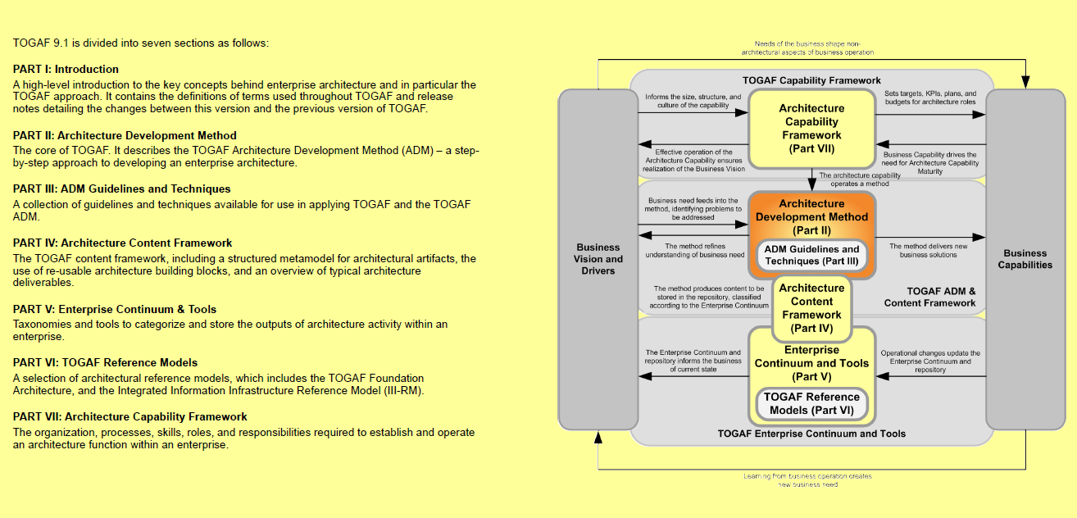
TOGAF Documents

Slide 28
1. The Architecture Development Method (ADM)
Describes a process for deriving an organization-specific enterprise architecture that addresses business requirements
The major component of TOGAF and provides guidance for architects on a number of levels:
It provides a number of architecture development phases (Business Architecture, Information Systems Architectures, Technology Architecture) in a cycle, as an overall process template for architecture development activity
It provides a narrative of each architecture phase, describing the phase in terms of objectives, approach, inputs, steps, and outputs. The inputs and outputs sections provide a definition of the architecture content structure and deliverables
It provides cross-phase summaries that cover requirements management

Slide 29
Architecture Development Method (ADM)
The TOGAF ADM provides a tested and repeatable process for developing architectures
The ADM includes establishing an architecture framework, developing architecture content, transitioning, and governing the realization of architectures
All of these activities are carried out within an iterative cycle of continuous architecture definition and realization that allows organizations to transform their enterprises in a controlled manner in response to business goals and opportunities

Slide 30
TOGAF ADM

Slide 31
ADM Phase
The Preliminary Phase: the preparation and initiation activities required to create an Architecture Capability including customization of TOGAF and definition of Architecture Principles
Phase A: Architecture Vision: the initial phase of an architecture development cycle. It includes information about defining the scope of the architecture development initiative, identifying the stakeholders, creating the Architecture Vision, and obtaining approval to proceed with the architecture development

Slide 32
ADM Phase
Phase B: Business Architecture: the development of a Business Architecture to support the agreed Architecture Vision
Phase C: Information Systems Architectures: the development of Information Systems Architectures to support the agreed Architecture Vision
Phase D: Technology Architecture: the development of the Technology Architecture to support the agreed Architecture Vision

Slide 33
ADM Phase
Phase E: Opportunities & Solutions conducts initial implementation planning and the identification of delivery vehicles for the architecture defined in the previous phases
Phase F: Migration Planning addresses how to move from the Baseline to the Target Architectures by finalizing a detailed Implementation and Migration Plan
Phase G: Implementation Governance provides an architectural oversight of the implementation
Phase H: Architecture Change Management establishes procedures for managing change to the new architecture
Requirements Management examines the process of managing architecture requirements throughout the ADM

Slide 35
2. ADM Guidelines and Techniques
ADM Guidelines and Techniques provides a number of guidelines and techniques to support the application of the ADM
The guidelines address adapting the ADM to deal with a number of usage scenarios, including different process styles (e.g., the use of iteration) and also specific specialty architectures (such as security)
The techniques support specific tasks within the ADM (such as defining principles, business scenarios, gap analysis, migration planning, risk management, etc.).

Slide 36
ADM Ouputs
During application of the ADM process, a number of outputs are produced
For example, process flows, architectural requirements, project plans, project compliance assessments, etc
In order to collate and present these major work products in a consistent and structured manner, TOGAF defines a structural model, in which to place them
the TOGAF Architecture Content Framework

Slide 37
3. Architecture Content Framework
Deliverable: a work product that is contractually specified and in turn formally reviewed, agreed, and signed off by the stakeholders. It will typically be archived at completion of a project, or transitioned into an Architecture Repository as a reference model
Artifact: an architectural work product that describes an aspect of the architecture. Artifacts are generally classified as:
Catalogs (lists of things)
Matrices (showing relationships between things)
Diagrams (pictures of things)
Building block: component of business, IT, or architectural capability that can be combined with other building blocks to deliver architectures and solutions

Slide 39
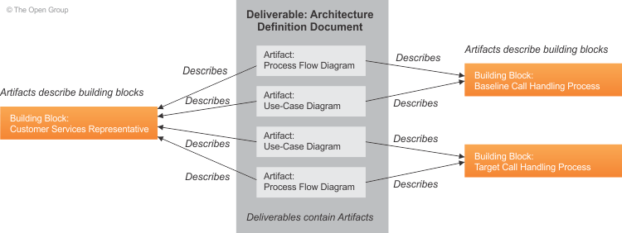

Slide 42
4. The Enterprise Continuum
A view of the Architecture Repository that provides methods for classifying architecture and solution artifacts as they evolve from generic Foundation Architectures to Organization-Specific Architectures
from generic to specific
from abstract to concrete
from logical to physical
The Enterprise Continuum comprises two complementary concepts: the Architecture Continuum and the Solutions Continuum

Slide 43
The Enterprise Continuum
The Enterprise Continuum provides a model for structuring a virtual repository and provides methods for classifying architecture and solution artifacts, showing how the different types of artifacts evolve, and how they can be leveraged and re-used
This is based on architectures and solutions (models, patterns, architecture descriptions, etc.) that exist within the enterprise and in the industry at large, and which the enterprise has collected for use in the development of its architectures

Slide 44
The Enterprise Continuum

Slide 45
The Architecture Repository
Supporting the Enterprise Continuum is the concept of an Architecture Repository which can be used to store different classes of architectural output at different levels of abstraction, created by the ADM
In this way, TOGAF facilitates understanding and co-operation between stakeholders and practitioners at different levels

Slide 47
Major Component of Architecture Repository
The Architecture Metamodel: the organizationally tailored application of an architecture framework, including a metamodel for architecture content
The Architecture Capability: the parameters, structures, and processes that support governance of the Architecture Repository
The Architecture Landscape: an architectural view of the building blocks that are in use within the organization today (e.g., a list of the live applications). The landscape is likely to exist at multiple levels of abstraction to suit different architecture objectives
The Standards Information Base (SIB): the standards with which new architectures must comply, which may include industry standards, selected products and services from suppliers, or shared services already deployed within the organization
The Reference Library: guidelines, templates, patterns, and other forms of reference material that can be leveraged in order to accelerate the creation of new architectures for the enterprise
The Governance Log: a record of governance activity across the enterprise

Slide 48
5. TOGAF Reference Models
TOGAF provides two reference models for possible inclusion in an enterprise's own Enterprise Continuum
Reference Model | Description
TOGAF Foundation Architecture Technical Reference Model | The TOGAF Technical Reference Model is an architecture of generic services and functions that provides a foundation on which specific architectures and Architecture Building Blocks (ABBs) can be built
Integrated Information Infrastructure Reference Model (III-RM) | The Integrated Information Infrastructure Reference Model (III-RM) is based on the TOGAF Foundation Architecture, and is specifically aimed at helping the design of architectures that enable and support the vision of Boundaryless Information Flow.

Slide 49
6. Architecture Capability Framework
The Architecture Capability Framework is a set of resources, guidelines, templates, background information, etc. provided to help the architect establish an architecture practice within an organization

Slide 50
Establishing and Maintaining an Enterprise Architecture Capability
TOGAF 9 provides an Architecture Capability Framework that is a set of reference materials and guidelines for establishing an architecture function or capability within an organization

Slide 52
Establishing an Operational Architecture Capability
An enterprise architecture practice must be run like any other operational unit within a business; i.e., it should be treated like a business
To this end, and over and above the core processes defined within the ADM, an enterprise architecture practice should establish capabilities in the following areas:
Financial Management
Performance Management
Service Management
Risk Management
Resource Management
Communications and Stakeholder Management
Quality Management
Supplier Management
Configuration Management
Environment Management

Slide 53
Using TOGAF with Other Frameworks
In all cases, it is expected that the architect will adapt and build on the TOGAF framework in order to define a tailored method that is integrated into the processes and organization structures of the enterprise
This architecture tailoring may include adopting elements from other architecture frameworks, or integrating TOGAF methods with other standard frameworks, such as ITIL, CMMI, COBIT, PRINCE2, PMBOK, and MSP
As a generic framework and method for enterprise architecture, TOGAF also complements other frameworks that are aimed at specific vertical business domains, specific horizontal technology areas (such as security or manageability), or specific application areas (such as e-Commerce)

Slide 54
Test Yourself Questions
Which one of the following statements best describes TOGAF?
TOGAF is a tool for developing Technology Architectures only
TOGAF is a framework and method for architecture development
TOGAF is a business model
TOGAF is a specific architecture pattern
TOGAF is a method for IT Governance

Slide 55
Test Yourself Questions
Which of the following is not considered one of the main constituent parts of the TOGAF document?
The Architecture Development Method
The Enterprise Continuum & Tools
The Technical Reference Model
The TOGAF Architecture Capability Framework

Slide 56
Test Yourself Questions
Which one of the types of architecture below is not commonly accepted as part of the enterprise architecture addressed by TOGAF?
Business Architecture
Data Architecture
Application Architecture
Technology Architecture
Pattern Architecture

Slide 57
Test Yourself Questions
Which of the TOGAF Architecture Development phases is the initial phase of an Architecture Development Cycle?
Preliminary Phase
Phase A
Phase B
Phase C
Phase D

Slide 58
Test Yourself Questions
Which of the TOGAF Architecture Development phases provides oversight of the implementation?
Phase D
Phase E
Phase F
Phase G
Phase H

Slide 59
Test Yourself Questions
Which of the TOGAF Architecture Development phases includes the creation and approval of the Architecture Vision document?
Preliminary Phase
Phase A
Phase B
Phase C
Phase D

Slide 60
Test Yourself Questions
Which of the following is not a phase of the ADM?
Preliminary
Phase C: Requirements Architecture
Phase F: Migration Planning
Phase D: Technology Architecture
Phase G: Implementation Governance

Slide 61
Test Yourself Questions
Which of the following is defined as a work product that describes an aspect of an architecture?
An artifact
A building block
A catalog
A deliverable
A matrix

Slide 62
Test Yourself Questions
Complete the sentence: The Enterprise Continuum is
An architecture framework
A database of open industry standards
A technical reference model
A model for classifying artifacts
A method for developing architectures

Slide 63
Test Yourself Questions
Which component of the Architecture Repository provides guidelines, templates, and patterns that can be used to create new architectures?
The Architecture Metamodel
The Architecture Capability
The Architecture Landscape
The Reference Library
The Governance Log

Slide 64
Read Articles
Yunis - Perancangan EA berbasis TOGAF - 2009

Slide 65
References
Rachel Harrison, Study Guide TOGAF® 9 Foundation 2nd Edition, The Open Group, 2011
Rachel Harrison, Study Guide TOGAF® 9 Certified 2nd Edition, The Open Group, 2011
Open Group Standard, TOGAF® Version 9.1 (G116), The Open Group, 2011
Open Group Standard, TOGAF® Version 9.1 – A Pocket Guide (G117), The Open Group, 2011
Daniel Minoli, Enterprise Architecture A to Z: Frameworks, Business Process Modeling, SOA, and Infrastructure Technology, Taylor & Francis, 2008
Jon Holt and Simon Perry, Modelling Enterprise Architectures, The Institution of Engineering and Technology, 2010
Alan Dennis et al, Systems Analysis and Design with UML 4th Edition, John Wiley and Sons, 2013

