Slide 1
BPMN Fundamentals: 2. BPMN Elements
Romi Satria Wahono romi@romisatriawahono.net http://romisatriawahono.net/bpmn WA: +6281586220090

Slide 2
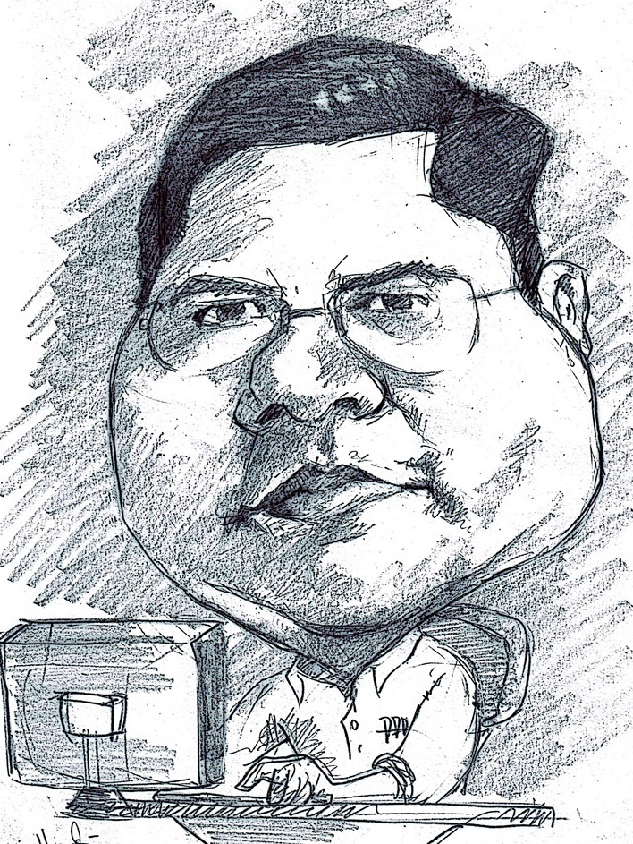
Romi Satria Wahono
SD Sompok Semarang (1987)
SMPN 8 Semarang (1990)
SMA Taruna Nusantara Magelang (1993)
B.Eng, M.Eng and Ph.D in Software Engineering from Saitama University Japan (1994-2004) Universiti Teknikal Malaysia Melaka (2014)
Research Interests: Software Engineering, Machine Learning
Founder dan Koordinator IlmuKomputer.Com
Peneliti LIPI (2004-2007)
Founder dan CEO PT Brainmatics Cipta Informatika

Slide 3
Course Outline
Introduction
BPMN Elements
3.1 Swimlane
3.2 Connecting Objects
3.3 Flow Objects
3.4 Artifacts
BPMN Simulation
BPMN Refactoring
BPMN Guide and Examples

Slide 4
2. BPMN Elements

Slide 5
BPMN Elements
Flow Objects
Connecting Objects
Swimlanes
Artifact

Slide 7
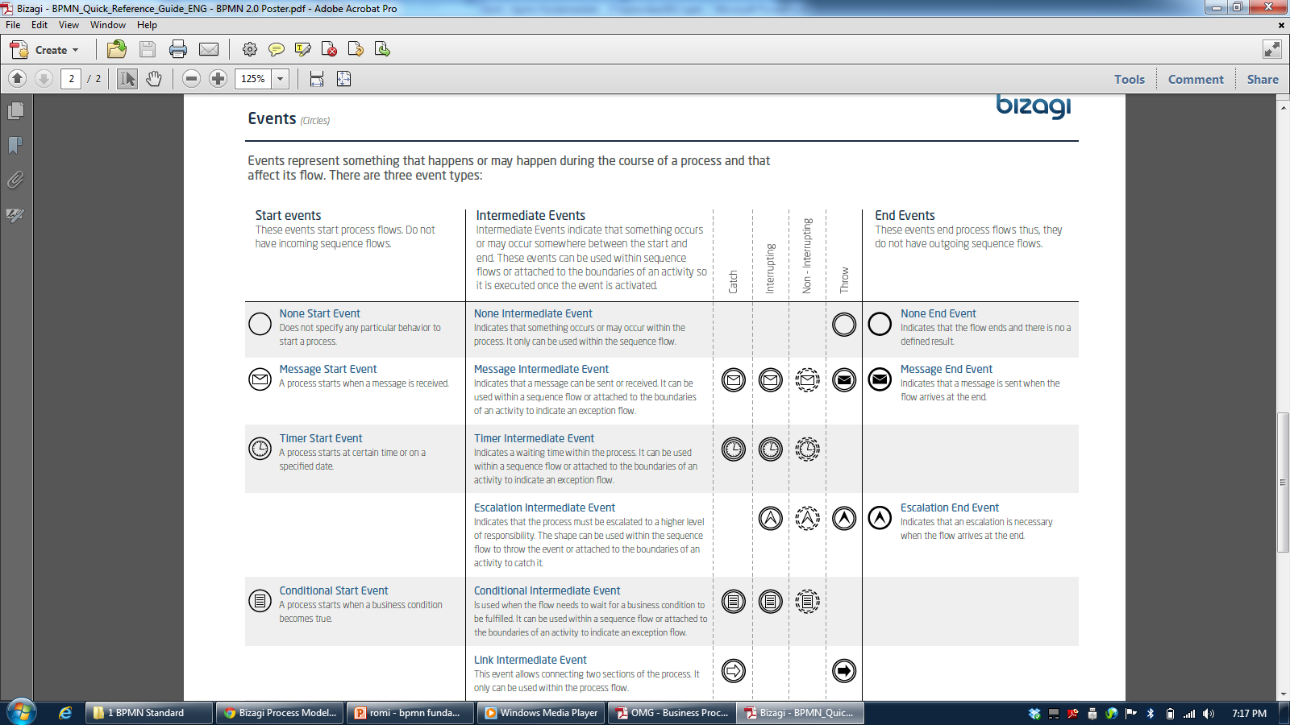

Slide 9
2.1 Swimlane

Slide 10
BPMN Modeling Elements
ELEMENT | DEFINITION | BPMN NAME
Flow Objects | Flow objects are the main graphic elements that define the behavior of the processes | Events
 |  | Activities
 |  | Gateways
Connecting Objects | Flow objects are connected to each other by means of connectors to create the basic framework of the business process structure | Sequence Flow
 |  | Message Flow
 |  | Association
Swimlane | Swimlanes are mechanisms to arrange activities in separate display categories to illustrate the different functional areas or persons in charge | Pools
 |  | Lanes
Artifacts | Artifacts are used to provide additional information about the process. They provide the notation with flexibility to express different contexts properly | Annotation
 |  | Group
 |  | Data Object
 |  | Data Store

Slide 11
Swimlane
At certain times, it happens that an activity diagram expands along more than one entity or player.
When this takes place, the activity diagram is broken down into swimlanes, where each lane represents the entity or player carrying out the activity
The lanes are used as a mechanism to arrange the activities in separate display categories to illustrate the different people in charge
Three types are used in BPMN: Pool, Lane, and Milestone (Bizagi)

Slide 12
Type of Swimlane
ELEMENT | DESCRIPTION | NOTATION
Pool | A Pool is a container of a single Process (contains the sequence flows between activities) A Process is fully contained within the Pool. There is always at least one Pool
Lane | Is a sub-partition within the Process Lanes are used to differentiate elements as internal roles, position, department, etc. They represent functional areas that may be responsible for tasks
Milestone | Is a sub-partition within the Process. It can indicate different stages during the Process

Slide 13
Pool
Represents a participant in a process
A Participant can be:
a specific Partner Entity (e.g., a company)
A general Partner Role (e.g., a buyer, seller, or manufacturer)
A pool is also can be defined as a container of a single Process (contains the sequence flows between activities)

Slide 14
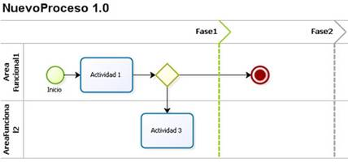
Lane
A sub-partition within a pool, which will be extended over of the pool horizontally or vertically
In Bizagi, there are vertical lanes, also known as phases. The lanes are used to arrange and categorize activities
Vertical line separating the different states within the process

Slide 15
Milestone
A milestone is a sub-partition within a lane and it is extended over it vertically
Milestone are used to arrange and categorize activities showing the possible statuses that a process can have during its life cycle

Slide 16
Tugas
Perbaiki Proses Pengajuan Kredit
Masukan dua lane:
Pemohon Kredit
Bank
Pindahkan notasi yang sudah dibuat ke lane Pemohon Kredit atau Bank

Slide 17
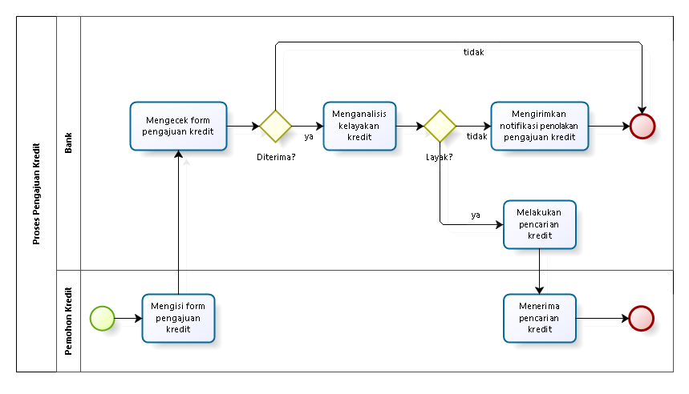
Proses Pengajuan Kredit

Slide 18
2.2 Connecting Objects

Slide 19
BPMN Modeling Elements
ELEMENT | DEFINITION | BPMN NAME
Flow Objects | Flow objects are the main graphic elements that define the behavior of the processes | Events
 |  | Activities
 |  | Gateways
Connecting Objects | Flow objects are connected to each other by means of connectors to create the basic framework of the business process structure | Sequence Flow
 |  | Message Flow
 |  | Association
Swimlane | Swimlanes are mechanisms to arrange activities in separate display categories to illustrate the different functional areas or persons in charge | Pools
 |  | Lanes
Artifacts | Artifacts are used to provide additional information about the process. They provide the notation with flexibility to express different contexts properly | Annotation
 |  | Group
 |  | Data Object
 |  | Data Store

Slide 20
Sequence Flow
Sequence lines are used to show the order in which activities will be carried out in the process
They are represented by an arrow indicating “from” and “to”
Types of sequence flow include Normal, Original, Default Flow

Slide 21
Type of Sequence Flow
ELEMENT | DEFINITION | NOTATION
Normal Flow | The normal line refers to the path of the flow between two shapes, and is not affected by conditions. The simplest use of this shape is a sequence between two activities.
Conditional Flow | This flow has a condition assigned that defines whether or not the flow is used. It can be assigned to any shape in the process that requires to evaluate a condition in order to follow a certain path
Default Flow | For decisions bases on inclusive decisions or data, a type of path of the flow is that of “default” conditions. This type of transitions takes place only if all the other conditions are false at the same time.

Slide 22
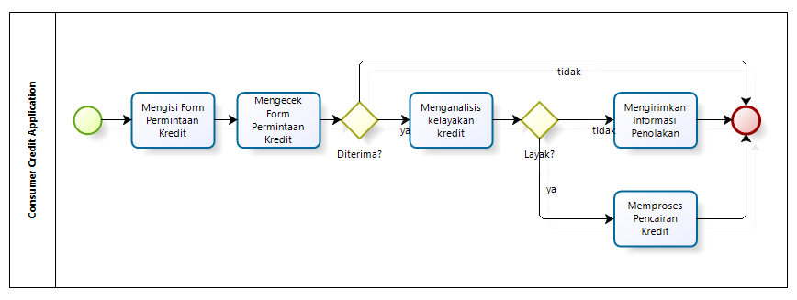
Example of Sequence Flow
In this process, there are normal sequence flows and two sequence flow conditioned by an Exclusive Gateway

Slide 23
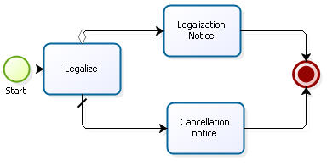
Example of Sequence Flow
In this process, there is a Conditional Flow and a Default Flow that evaluate if a Legalization was successful or not

Slide 24
Message Flow
A Message Flow is used to show the flow of messages between two entities that are prepared to send and receive them

Slide 25
Association
An Association is used to associate information and artifacts with flow objects

Slide 26
2.3 Flow Objects

Slide 27
BPMN Modeling Elements
ELEMENT | DEFINITION | BPMN NAME
Flow Objects | Flow objects are the main graphic elements that define the behavior of the processes | Events
 |  | Activities
 |  | Gateways
Connecting Objects | Flow objects are connected to each other by means of connectors to create the basic framework of the business process structure | Sequence Flow
 |  | Message Flow
 |  | Association
Swimlane | Swimlanes are mechanisms to arrange activities in separate display categories to illustrate the different functional areas or persons in charge | Pools
 |  | Lanes
Artifacts | Artifacts are used to provide additional information about the process. They provide the notation with flexibility to express different contexts properly | Annotation
 |  | Group
 |  | Data Object
 |  | Data Store

Slide 28
2.3.1 Events

Slide 29
Event
An event is something that happens during the course of the process, affecting the process flow and normally has a trigger or result
Types of events are classified depending on when they affect the flow
Within each type of event, they are classified as per the impact on the process flow
For instance, some subtypes are: messages, timer, cancellation, error, etc.

Slide 30
Type of Event
TYPE OF EVENT | DEFINITION | NOTATION
Start | As its name suggests, it represents the starting point of a process
Intermediate | This takes place between a start event and an end event. It will affect the process, but it will not cause it to start or end directly
End | Indicates when a process ends

Slide 31
2.3.1.1 Start Events

Slide 32
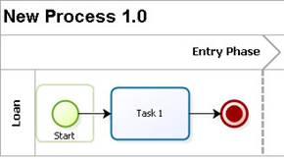
Start Event
All flows should have a beginning, regardless of whether they are referring to a process or a sub-process
Only one sequence flow can come out of this shape, and nothing can come before it
This shape should appear just once per process, although the process can be launched for multiple reasons

Slide 33
Type of Start Event
ELEMENT | DESCRIPTION | NOTATION
Start Event | Indicates where a particular Process starts. It does not have any particular behavior
Message Start Event | Is used when a message arrives from a participant and triggers the start of the Process.
Timer Start Event | Is used when the start of a Process occurs on a specific date or cycle time (e.g., every Friday)
Conditional Start Event | This type of Event triggers the start of a Process when a condition becomes true
Signal Start Event | The start of the Process is triggered by the arrival of a signal that has been broadcast from another Process. Note that the signal is not a message; messages have specific targets, signals do not
Parallel Multiple Start Event | Indicates that there are multiple triggers required to start the Process. ALL triggers must be triggered before the Process is instantiated
Multiple Start Event | This means that there are multiple ways of triggering the Process. Only one of them is required

Slide 34
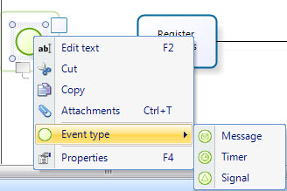
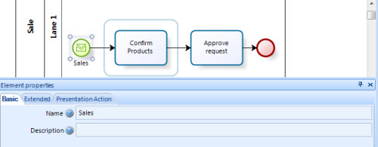
Message Start
An active process sends a message to another specific process in order to trigger its start
Message Start is always a catch shape. That is, in order to use a Message Start, there has to be a Message Event that throws the message

Slide 35
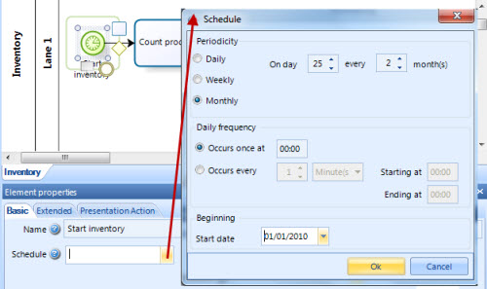
Timer Start
A specific time-date (e.g. every Monday at 9am) can be set in order to trigger the start of the process automatically:
an inventory process must be started every two months on the 25th

Slide 36
Timer Start

Slide 37
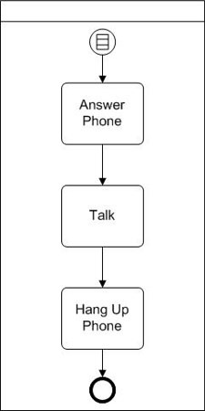
Conditional Start
The rule might be “If caller ID indicates a friend or family member.”
When the rule evaluates to true, the process is started
In this process we answer the phone, talk, and then hang up the phone. But we only do this if the call is from a friend or family member

Slide 38
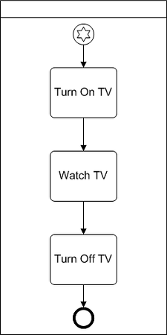
Multiple Start
Our television watching process (turn on tv, watch tv, turn off tv) could be initiated because:
we want to be entertained
we want to be educated
We might be turning it on at a precise time, every morning, to check for school closings
We might just want the tv for background noise while we do something else
Since we care about how the process is initiated, we use the multiple start event instead of the none start event

Slide 39
Signal Start
ADVANCE
An active process sends a signal and triggers the start of another process
Signal start is always a catch shape. That is, in order to use a Signal Start, there has to be a Signal Event that throws the message
A signal is sent to any process that can receive it, but it does not have a specific Source and Target. Any catch shape with the same name will be triggered

Slide 40
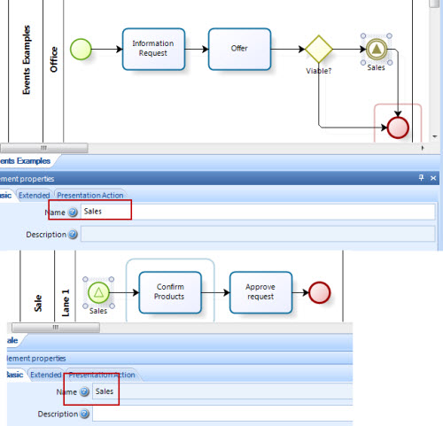
Signal Start
ADVANCE
The Credit Request process throws a signal to start a Sales process as soon as an offer is viable

Slide 41
Signal Intermediate Event
ADVANCE

Slide 42
Credit Analysis and Committee Analysis
ADVANCE

Slide 43
Latihan
ADVANCE
Lihat kembali Proses Pengajuan Kredit
Pada saat kredit layak diberikan, apabila jumlah kredit kurang dari 500 juta maka proses pencairan kredit langsung dilakukan
Akan tetapi apabila jumlah kredit melebihi 500 juta, maka harus menunggu proses analisis kredit skala besar dari board of director
Proses Analisis Kredit Skala Besar dari board of director dilakukan setiap tanggal 1, dan akan di-broadcast ke seluruh unit kerja pada hari yang sama
Gunakan Signal untuk memodelkan business process di atas

Slide 44
2.3.1.2 Intermediate Events

Slide 45
Intermediate Event
Intermediate Events are tasks that affect the normal flow of the process and can occur at any time
Intermediate Events do not depend on the user but on an external event
Intermediate Events may or may not occur within a process
The Intermediate Event can be triggered manually by the user or automatically by a business rule, but it must be available

Slide 46
Type of Intermediate Event
ELEMENT | DESCRIPTION | NOTATION
Intermediate Event | Indicates where something happens somewhere between the start and end of a Process. It will affect the flow of the Process, but will not start or (directly) terminate the Process
Message Event | Indicates that a message can be sent or received. If a Process is waiting for a message and it is caught the Process will continue its flow. A catch Message Event waits for a message to arrive and once the message has been received, the Process will continue.
Timer Event | Indicates a delay within the Process. This type of Event can be used within the sequential flow indicating a waiting time between activities
Escalation Event | The Event indicates an escalation through the Process
Compensation Event | Enables the handling of compensations. When used within the sequential flow of a Process they indicate that compensation is necessary
Conditional Event | This Event is triggered when a condition becomes true

Slide 47
Type of Intermediate Event
ELEMENT | DESCRIPTION | NOTATION
Link Event | This Event is used to connect two sections of the Process. Link Events can be used to create looping situations or to avoid long Sequence Flow lines
Signal Event | These Events are used to send or receive signals within or across the Process. A signal is similar to a signal flare that is shot into the sky for anyone who might be interested to notice and then react
Multiple Event | This means that there are multiple triggers assigned to the Event. When used to catch the trigger, only one of the assigned triggers is required and the Event marker will be unfilled.
Parallel multiple Event | This means that there are multiple triggers assigned to the Event. Unlike the normal Multiple Intermediate Event, ALL of the assigned triggers are required for the Event to be triggered

Slide 48
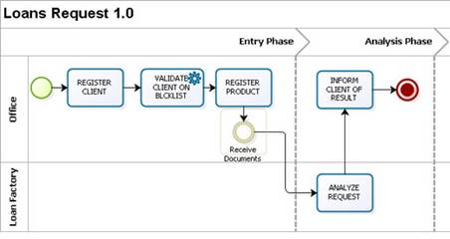
Intermediate Event
The following example contains the Intermediate Event to wait for documents before carrying on with the analysis of the loan request

Slide 49
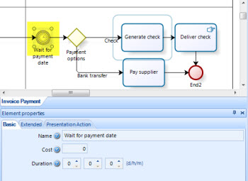
Timer Intermediate Event
This shape represents a delay (period of time) within the process
The time can be defined at design time or as part of the process data (Date or length in any unit of time)
The duration is a Basic Property of the event. It is constant

Slide 50
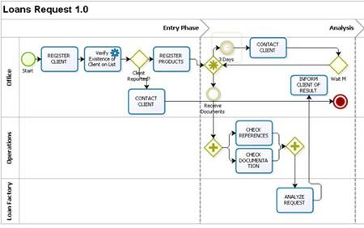
Timer Intermediate Event
This case shows a “Wait” period of three days. In the Intermediate Event that the Document Delivery does not occur before the Wait time (3 day), the client should be contacted

Slide 51
Timer Intermediate Event
The length or the time assigned to the Timer Intermediate Event can be fixed or variable and is defined in minutes
For instance, if the process flows arrives to an Event Timer which has defined duration of 120 minutes at 17:00 (5:00 p.m.) on Friday and the work shift has been defined from Monday to Friday at 9:00 (9:00 a.m.), then the process will wait before continuing to the following activity

Slide 52
Message Intermediate Event
This shape has a throw and a catch option, which is to send a Message or receive a Message
If a process is waiting for the message, it will be paused until the message arrives or it will change the flow for exception handling
In order to use a throw Message, there has to be a catch Message Event that catches the message. It can be a Message Intermediate Event or a Message Start
The catch and throw messages must have the exact same name and they must be in different Processes

Slide 53
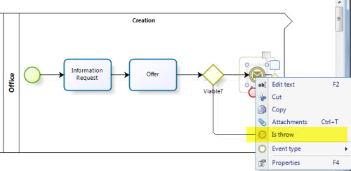
Message Intermediate Event
The Credit Request process throws a message to start a Sales process as soon as an offer is viable
In the Process Modeler configure the throw and the catch message so they have the exact same name

Slide 54
Link Intermediate Event
A Link is a mechanism for connecting two sections of a Process
Link Events can be used to create looping situations or to avoid long Sequence Flow lines
This shape has a throw and a catch option, which is to throw a connecting point to a catch shape
Link Event uses are limited to a single Process level. That is, they are used only within the same process
The catch and throw links must have the exact same name

Slide 55
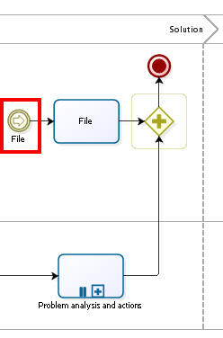
Link Intermediate Event
Imagine the Complaint Handling process is very large, and the File activity is far right in the diagram
To link the flow together without using a very long Sequence Flow, use a Link Event

Slide 56
Tugas: Proses Penentuan Beasiswa
Buat BPMN dari proses penentuan beasiswa mahasiswa di Universitas Suka Belajar:
Proses dimulai dari Administrasi universitas mengumumkan lowongan beasiswa menggunakan berbagai media
Mahasiswa menerima informasi lowongan beasiswa, melakukan pendaftaran dan mengirimkan dokumen persyaratan

Slide 57
Signal Intermediate Event
ADVANCE
Signals are used for sending or receiving general communication within and across Processes
Signal is similar to a signal flare that shot into the sky for anyone who might be interested to notice and then react. Thus, there is a source of the Signal, but no specific intended target
A signal is sent to any shape that is configured to receive it, that is, has the same Name. There is no specific target, so any shape that is available will be triggered
This shape has a throw and a catch option, which is to send a Signal or receive a Signal

Slide 58
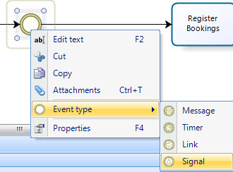
Signal Intermediate Event
ADVANCE
In order to transform an event into a signal, right click the Event and select Event Type -> Signal as shown in the image below

Slide 59
Signal Intermediate Event
ADVANCE
The Credit Request process throws a signal to start a Sales process as soon as an offer is viable

Slide 60
Signal Intermediate Event
ADVANCE

Slide 61
2.3.1.2 End Events

Slide 62
Type of End Event
ELEMENT | DESCRIPTION | NOTATION
End Event | Indicates when the Process ends
Message End | Indicates that a message is sent when the flow has ended
Escalation End | Indicates that an Escalation is necessary when the flow ends
Error End | Indicates that a named Error should be generated. All currently active threads of the Process are terminated. The Error will be caught by a Catch Error Intermediate Event.
Cancel End | Is used within a Transaction Sub-Process. It indicates that the Transaction should be canceled and an alternative flow can be performed.
Compensation End | Handles compensations. If an activity is identified, and it was successfully completed, the activity will be compensated.
Signal End | Indicates that a signal is sent when the flow has ended
Multiple End | This means that there are multiple consequences of ending the flow. All of them will occur
Terminate End | Ends the Process and all its activities immediately.

Slide 63
End Event
This shape indicates a temporary end in the process
It is used when, after an activity, intermediate event or Exclusive Gateway (divergence element) nothing else needs to be carried out
Unlike the Terminate End Event, this shape does not close the process directly unless there are no pending tokens when it is reached
There are no more pending manual activities or points waiting for something else to be done (for instance, a Timer Intermediate Event)

Slide 64
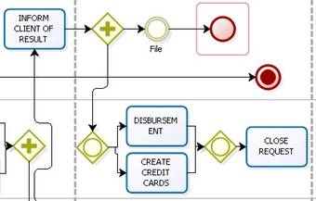
Loan Request
Suppose that parallel to the disbursement and preparation of the credit cards, documents that are still at the office are filed
The filing activity is not required and therefore, it may or may not be carried out
Once it is performed, the process should not end until the request has been closed. In this case, after the Filing activity, an “End Event” is included, indicating that after this activity, there is nothing more to be done on this path

Slide 65
Terminate End Event
Event that constitutes the end of the process
There can be more than one in a flow. If a process reaches this event, it will be closed
All flows should have a Terminate End event, regardless of whether they are referring to a process, a sub-process or a module
Note: The Terminate End event is an optional shape in diagramming the process. However, it is advisable to use it in the diagram
A sequence flow goes into this shape (nothing ever comes out of it)

Slide 66
None End and Terminate End Event

Slide 67
Message End Event
This type of End indicates that a Message is sent to a specific process or active case, at the conclusion of the Process
Message End is always a throw shape. That is, in order to use a Message End, there has to be a Message Event, or Message Start that catches the message
The Message End should be configured to identify the target Process and the target Element

Slide 68
Message End Event

Slide 69
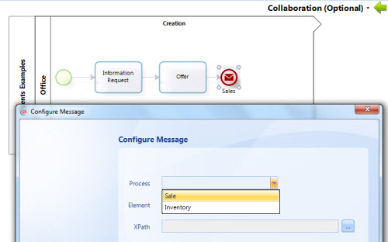
Message End Event
The shape that catches the message and the Message End should have the exact same name
Example: The Credit Request process throws a message to start a Sales process as soon as the process is finished

Slide 70
Tugas: Proses Penentuan Beasiswa
Buat BPMN dari proses penentuan beasiswa di Universitas Suka Belajar:
Proses dimulai dari Administrasi universitas mengumumkan lowongan beasiswa menggunakan berbagai media
Mahasiswa melakukan pendaftaran dan mengirimkan dokumen persyaratan ke Administratif, yang kemudian melakukan seleksi administratif
Komite Universitas melakukan seleksi (seleksi profile dan seleksi wawancara)
Pengumuman hasil penerimaan beasiswa akan disebarkan oleh Administrasi melalui berbagai media massa
Tugas terakhir dari Administrasi adalah melakukan pencairan beasiswa

Slide 71
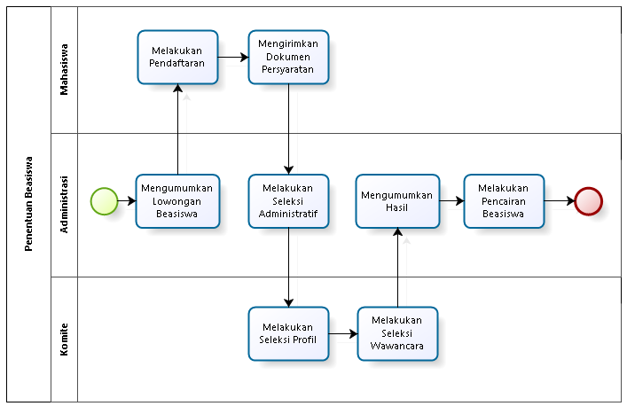
Proses Penentuan Beasiswa

Slide 72
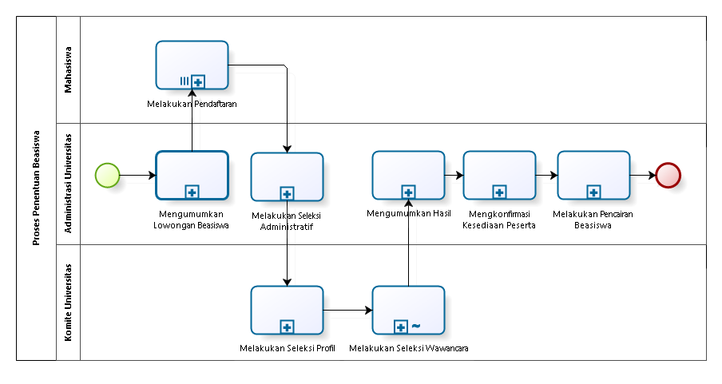
Proses Penentuan Beasiswa

Slide 73
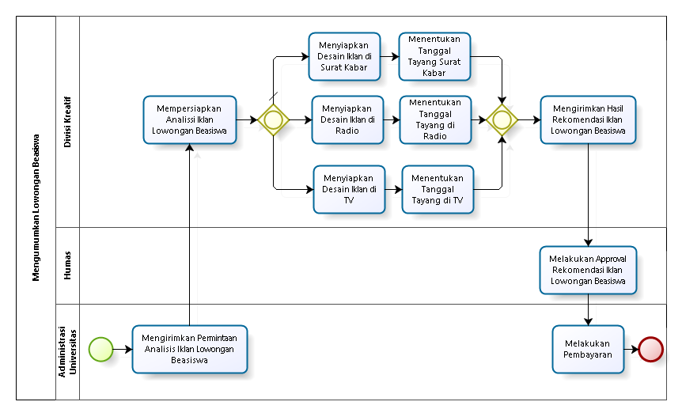
Mengumumkan Lowongan Beasiswa

Slide 74
Signal End Event
ADVANCE
This type of End indicates that a Signal will be broadcasted when the End has been reached
Signal End is always a throw shape. That is, in order to use a Signal End, there has to be a Signal Event that catches the message
A signal is sent to any Process that can receive it, but it does not have a specific Source and Target. Any catch shape with the same name will be triggered

Slide 75
Signal End Event
ADVANCE

Slide 76
Tugas: Proses Penentuan Beasiswa
ADVANCE
Buat BPMN dari proses penentuan beasiswa di Universitas Suka Belajar:
Proses dimulai dari Administrasi universitas mengumumkan lowongan beasiswa menggunakan berbagai media
Mahasiswa melakukan pendaftaran dan mengirimkan dokumen persyaratan ke Administratif, yang kemudian melakukan seleksi administratif
Komite Universitas melakukan seleksi (seleksi profile dan seleksi wawancara)
Pengumuman hasil penerimaan beasiswa akan disebarkan oleh Administrasi melalui berbagai media massa
Tugas terakhir dari Administrasi adalah melakukan pencairan beasiswa
Terapkan Signal Event pada business process tersebut

Slide 77
2.3.2 Activities

Slide 78
BPMN Modeling Elements
ELEMENT | DEFINITION | BPMN NAME
Flow Objects | Flow objects are the main graphic elements that define the behavior of the processes | Events
 |  | Activities
 |  | Gateways
Connecting Objects | Flow objects are connected to each other by means of connectors to create the basic framework of the business process structure | Sequence Flow
 |  | Message Flow
 |  | Association
Swimlane | Swimlanes are mechanisms to arrange activities in separate display categories to illustrate the different functional areas or persons in charge | Pools
 |  | Lanes
Artifacts | Artifacts are used to provide additional information about the process. They provide the notation with flexibility to express different contexts properly | Annotation
 |  | Group
 |  | Data Object
 |  | Data Store

Slide 79
Activities
Activities represent work or tasks carried out by members of the organization
This element stands for manual or automatic tasks performed by an external system or user
They are classified into tasks and sub-processes
Sub-processes are distinguished by a plus sign at the bottom center of the shape

Slide 80
2.3.2.1 Task

Slide 81
Type of Task
ELEMENTS | DESCRIPTION | NOTATION
Task | Is an atomic Activity within a Process flow. It is used when the work in the Process cannot be broken down to a finer level of detail
User Task | Is a typical workflow Task where a person performs the Task with the assistance of a software application
Service Task | Is a Task that uses some sort of service that could be a Web service or an automated application
Receive Task | Is a Task designed to wait for a message to arrive from an external participant (relative to the Process)
Send Task | Is a Task designed to send a message to an external participant (relative to the Process)

Slide 82
Type of Task
Script Task | Is a Task that is executed by a Business Process Engine. The modeler defines a script in a language that the engine can interpret. Emails automatically sent to notify participant is an example of script task
Manual Task | Is a Task that is expected to be performed without the aid of any business process execution or any application.
Business Rule Task | Offers a mechanism for the process to provide input to a Business Rule Engine and get the output of calculations that the engine might provide
Multi-Instance Loop | Tasks may be repeated sequentially, behaving like a loop. The Multi-instance Loop iterates a predetermined number of times. The iterations occur sequentially or in parallel (simultaneously)
Standard Loop | Tasks may be repeated sequentially, behaving like a loop. This feature defines a looping behavior based on a boolean condition. The Activity will loop as long as the boolean condition is true

Slide 83
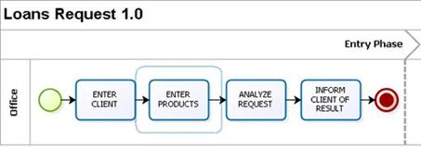
User Task
Is a typical workflow Task where a human performer performs the Task with the assistance of software application, and to be completed in a certain amount of time
Example: The following is the illustration of a Loan request process with just User Tasks performed by the commercial consultant in the office

Slide 84
Service Task
Service Task is a task carried out by the system with no human intervention. For instance, interfaces with other systems and computer activities, among others
Example: The following figure displays a simplified loan request process, in which there is an automatic activity to verify whether or not the client has been reported on a blacklist.

Slide 85
Send and Receive tasks
Send and Receive tasks are throw and catch options used to send a Message or receive a Message
When used to throw (send) the message, the shape has an arrow pointing to the right. When used to catch (receive) the message, the shape has an arrow pointing to the left
If a process is waiting for a message, it will be paused until the message arrives or it will change the flow for exception handling
In order to use a throw Message, there has to be a catch Message Event that catches the message. It can be a Message Intermediate Event, a Message Start or a receive Task
The Send Task should be configured to identify the target Process and the target Element

Slide 86
Script Task
A Script Task is an automatic task in which a script is executed by the server
It has no human intervention and does not connect to any external service
In Bizagi this shape is recommended to send e-Mail Messages or execute Scripting Expressions

Slide 87
Manual Task
This is a Task that is expected to be performed without the aid of any business process execution engine or any application
An example of this could be secretary filing physical documents

Slide 88
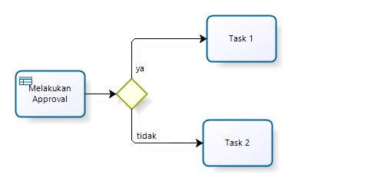
Business Rule Task
Offers a mechanism for the process to provide input to a Business Rule Engine and get the output of calculations that the engine might provide

Slide 89
Disbursement with Some Type of Tasks

Slide 90
Tugas: Proses Penentuan Beasiswa
Buat BPMN dari proses penentuan beasiswa di Universitas Suka Belajar
Proses dimulai dari Administrasi universitas mengumumkan lowongan beasiswa menggunakan berbagai media
Mahasiswa melakukan pendaftaran dan mengirimkan dokumen persyaratan ke Administratif, yang kemudian melakukan seleksi administratif
Komite Universitas melakukan seleksi (seleksi profile dan seleksi wawancara)
Pengumuman hasil penerimaan beasiswa akan disebarkan oleh Administrasi melalui berbagai media massa
Tugas terakhir dari Administrasi adalah melakukan pencairan beasiswa
Tentukan Task apa yang sebaiknya menjadi jenis: User, Manual, Send, Receive, Script, Service, Business Rule

Slide 91
Intermediate Events Attached to an Activity Boundary
ADVANCE

Slide 92
Timer Boundary Event
ADVANCE

Slide 93
Timer Boundary Event
ADVANCE

Slide 94
Timer Boundary Event
ADVANCE

Slide 95
Error Boundary Event
ADVANCE

Slide 96
Error Boundary Event
ADVANCE

Slide 97
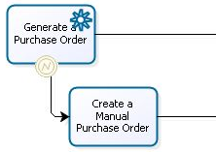
Error Boundary Event
ADVANCE

Slide 98
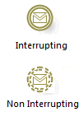
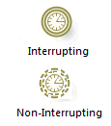
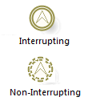
Intermediate Events Attached to an Activity Boundary
ELEMENT | DESCRIPTION | NOTATION
Message Event | If a message Event is attached to the boundary of an activity, it will change the normal flow into an exception flow when a message is received. If the Event interrupts the activity to which it is attached, the boundary of the Event is solid, if not it is dashed
Timer Event | If a Timer Event is attached to the boundary of an activity, it will change the normal flow into an exception flow when a cycle time is completed or a specific time-date is reached.
Escalation Event | If attached to the boundary of an Activity, the Intermediate Event catches an Escalation.
Error Event | A catch Intermediate Error Event can only be attached to the boundary of an Activity. It reacts to (catches) a named Error, or to any Error if a name is not specified. An Error Event always interrupts the Activity to which it is attached
Cancel Event | This Event is used within a Transaction Sub-Process and must be attached to the boundary of one. It shall be triggered if a Cancel End Event is reached within the Transaction Sub-Process. It also shall be triggered if a Transaction Protocol Cancel Message has been received while the transaction is being performed. A Cancel Event always interrupts the Activity to which it is attached

Slide 99
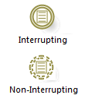
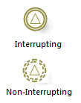
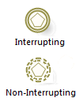
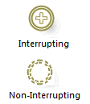
Compensation Event | When attached to the boundary of an Activity, this Event is used to catch the Compensation Event. When it occurs, the compensation activity will be performed
Conditional Event | If a Conditional Event is attached to the boundary of an Activity, it will change the normal flow into an exception flow when a business condition is fulfilled
Signal Event | If a Signal Event is attached to the boundary of an Activity, it will change the normal flow into an exception flow when a signal is received
Multiple Event | When attached to the boundary of an Activity, it will change the normal flow into an exception flow when one of the assigned triggers is caught
Parallel multiple Event | Unlike the Multiple Event, when attached to the boundary of an Activity, it will change the normal flow into an exception flow when ALL of the assigned triggers are caught

Slide 100
Tugas: Proses Penentuan Beasiswa
ADVANCE
Kembangkan BPMN dari proses penentuan beasiswa di Universitas Suka Belajar
Pada Proses Mengumumkan Hasil, apabila ada revisi hasil penilaian dari Komite, administrasi dapat mengubah daftar penerima beasiswa, dan daftar penerima beasiswa yang sudah direvisi tersebut, dapat dikirimkan ke berbagai media untuk dimuat
Terapkan Message Boundary Event pada Proses Mengumumkan Hasil tersebut

Slide 101
Tugas: Proses Penentuan Beasiswa
ADVANCE
Kembangkan BPMN dari proses penentuan beasiswa di Universitas Suka Belajar
Beasiswa akan dicairkan apabila laporan pendidikan penerima beasiswa sudah diterima oleh Administrasi sebelum tanggal 1. Apabila laporan dikirim setelah tanggal 1, maka nilai beasiswa akan dikurangi pinalti sebesar 10%, dan akan dikirimkan di bulan berikutnya
Terapkan Timer Boundary Event pada Proses Mengumumkan Hasil tersebut

Slide 102
Tugas: Proses Penentuan Beasiswa
ADVANCE
Kembangkan BPMN dari proses penentuan beasiswa di Universitas Suka Belajar
Beasiswa akan dikirimkan dengan menggunakan transfer bank, apabila ada error maka akan diberikan secara cash ke penerima beasiswa
Terapkan Error Boundary Event pada Proses Mengumumkan Hasil tersebut

Slide 103
2.3.2.2 Subproses

Slide 104
Subprocess
A SubProcess is a set of activities that have a logical sequence that meet a clear purpose
A SubProcess is a process in itself, whose functionality is part of a larger process
When the sub-process is collapsed, the details of the sub-process cannot be viewed (plus sign (+))
When the sub-process is expanded, the details of the sub-process can be seen within the limits
A SubProcess can be defined as:
Embedded
Reusable
Adhoc
Multiple
Transactional

Slide 105
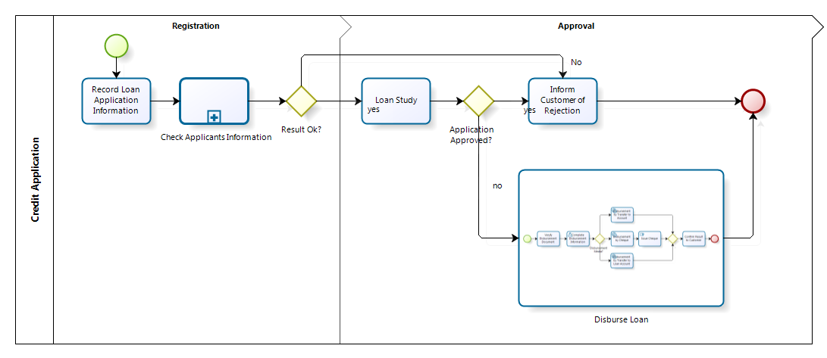
Subprocess

Slide 106
Type of Subprocess
ELEMENT | DESCRIPTION | NOTATION
Sub-process | Is an Activity which internal details have been modeled using activities, gateways, Events, and sequence flows. The elements has a thin border
Reusable Sub-process | Identifies a point in the process where a predefined process is used. A reusable Sub-process is called a Call Activity in BPMN. The element has a thick border
Event Sub-process | A Sub-process is defined as an Event Sub-process when it is triggered by an Event. An Event Sub-Process is not part of the normal flow of its parent Process - there are no incoming or outgoing Sequence Flows.
Transaction | Is a Sub-process whose behavior is controlled through a transaction protocol. It includes the three basic outcomes of a transaction: Successful Completion, Failed Completion and Cancel Intermediate Event
Ad-Hoc Sub-process | Is a group of activities that has no REQUIRED sequence relationships. A set of activities can be defined, but the sequence and number of performances for the activities is determined by the performers of the activities
Standard loop | Sub-processes may be repeated sequentially, behaving like a loop. This feature defines a looping behavior based on a boolean condition. The activity will loop as long as the boolean condition is true
Multi-Instance loop | Sub-processes may be repeated sequentially, behaving like a loop. The Multi-instance Loop iterates a predetermined number of times. The iterations occur sequentially or in parallel (simultaneously)

Slide 107
Embedded SubProcess
Embedded SubProcesses contain a set of activities that are not independent of the Parent process
They share the same information or data. They are usually a section or module of a same process but have a clear objective and so, can be defined with a beginning and an end
They do not need mapping data and cannot be configured as multiple SubProcesses

Slide 108
Credit Application with Subprocess

Slide 109
Information Checking Subprocess

Slide 110
Credit Application with Expanded Subprocess

Slide 111
Reusable SubProcess
Reusable Sub Processes contain a set of activities that are independent from the Parent process, which is the process that calls upon them
The purpose of a reusable Sub Process is different from the Parent process and can be considered as a black box

Slide 112
Tugas: Proses Penentuan Beasiswa
Buat BPMN dari proses penentuan beasiswa mahasiswa di Universitas Suka Belajar
Proses dimulai dari Administrasi universitas mengumumkan lowongan beasiswa menggunakan berbagai media
Mahasiswa melakukan pendaftaran dan mengirimkan dokumen persyaratan ke Administratif, yang kemudian melakukan seleksi administratif
Komite Universitas melakukan seleksi (seleksi profile dan seleksi wawancara)
Pengumuman hasil penerimaan beasiswa akan disebarkan oleh Administrasi melalui berbagai media massa
Tugas terakhir dari Administrasi adalah melakukan pencairan beasiswa
Tentukan Task apa yang sebaiknya diubah menjadi SubProcess dengan jenis: Embedded, Reusable
Isi Sub Process di atas dengan flow baru

Slide 113
Tugas: Proses Penentuan Beasiswa
Pada aktifitas pengumuman lowongan beasiswa, ada proses yang lebih detail yang berisi:
Membuat desain iklan lowongan beasiswa
Menentukan media massa dan waktu penayangan
Mengirimkan desain iklan lowongan beasiswa dan melakukan pembayaran biaya iklan
Gambarkan aktifitas di atas dalam bentuk subproses dari task pengumuman lowongan beasiswa
Tentukan task type yang tepat untuk masing-masing task

Slide 114
Proses Mengumumkan Lowonan Beasiswa

Slide 115
Ad Hoc Sub Process
It is fairly common that businesses need to manage unstructured processes (ad hoc) rather than well predefined business processes
An ad hoc subprocess is one in which the specified steps are defined, but the order of operations is not
Ad hoc processes consist of a series of activities which cannot be predefined

Slide 116
Ad Hoc Sub Process

Slide 117
Ad Hoc Sub Process

Slide 118
Tugas: Proses Penentuan Beasiswa
Buat BPMN dari proses penentuan beasiswa mahasiswa di Universitas Suka Belajar
Proses dimulai dari Administrasi universitas mengumumkan lowongan beasiswa menggunakan berbagai media
Mahasiswa melakukan pendaftaran dan mengirimkan dokumen persyaratan ke Administratif, yang kemudian melakukan seleksi administratif
Komite Universitas melakukan seleksi (seleksi profile dan seleksi wawancara)
Pengumuman hasil penerimaan beasiswa akan disebarkan oleh Administrasi melalui berbagai media massa
Tugas terakhir dari Administrasi adalah melakukan pencairan beasiswa
Tentukan Task apa yang sebaiknya diubah menjadi SubProcess dengan jenis: Adhoc, Embedded, Reusable
Isi Sub Process di atas dengan flow baru

Slide 119
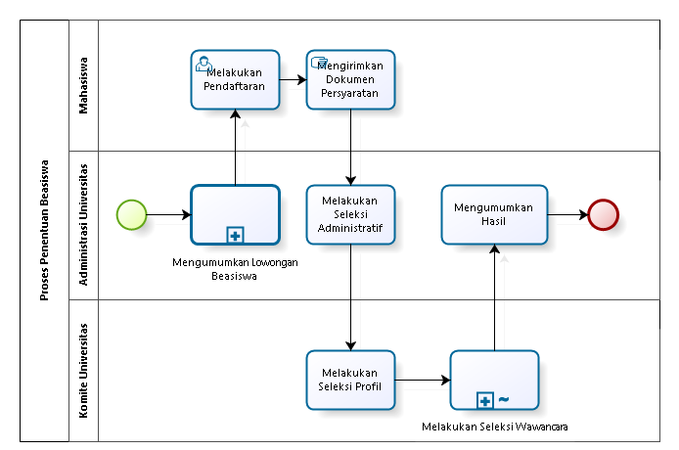
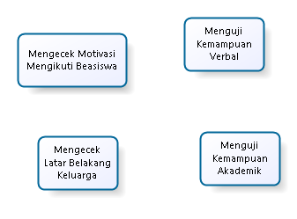
Adhoc Subprocess

Slide 120
Multiple SubProcess
Sub-processes may be repeated sequentially, behaving like a loop
The Multi-instance Loop iterates a predetermined number of times
The iterations occur sequentially or in parallel (simultaneously)
Parallel Sequential

Slide 121
Multiple SubProcess

Slide 122
Multiple SubProcess - Parallel

Slide 123
Tugas: Proses Penentuan Beasiswa
Buat BPMN dari proses penentuan beasiswa mahasiswa di Universitas Suka Belajar
Proses dimulai dari Administrasi universitas mengumumkan lowongan beasiswa menggunakan berbagai media
Mahasiswa melakukan pendaftaran dan mengirimkan dokumen persyaratan ke Administratif, yang kemudian melakukan seleksi administratif
Komite Universitas melakukan seleksi (seleksi profile dan seleksi wawancara)
Pengumuman hasil penerimaan beasiswa akan disebarkan oleh Administrasi melalui berbagai media massa
Tugas terakhir dari Administrasi adalah melakukan pencairan beasiswa
Tentukan SubProcess apa yang sebaiknya diubah menjadi Multiple SubProcess

Slide 124
Transactional SubProcess
ADVANCE
A transaction is:
A series of tasks that are closely related to each other
A series of tasks that are meaningful only when all of the tasks are completed appropriately
The execution result of a transaction is:
Successful Completion
Unsuccessful Completion (Cancel)
Hazard (Exception)
A transaction or transactional sub process is performed successfully when the changes to be implemented (update, addition or deletion of records) are saved in the database, the commit of the changes is performed once the transaction has ended

Slide 125
Business Trip Arrangement
ADVANCE
If the train and hotel reservations are completed (Successful completion)
If the train can not be reserved, the result is set to be successful if the airline reservation is done (Compensation)
If the reservations can not be made business process proceeds to "Date Change," which is an abnormal flow (Unsuccessful completion)
If any kind of problem happens Business process is aborted (Exception)

Slide 126
Cancelation Intermediate Event
ADVANCE
This type of intermediate event is used in transactional sub-processes
It must always be attached (diagramed) to the ends of the sub-process and should be launched if a cancellation exception is reached while the sub-process is being carried out

Slide 127
Compensation Intermediate Event
ADVANCE
This type of intermediate event is used in transactional sub-processes
They are also used to handle compensations. It is used reactively when drawn at the ends of an activity

Slide 128
Transferring Money between Accounts
ADVANCE
Transferring money between accounts is a typical transaction sample
The execution of two different web services can be required by the transaction of transferring money such as debiting from one account and crediting to another account
A debit must be reversed when the second web service has a problem (wrong account number, inactive client, and so on)
Thus, the execution of a new web service can be required to reverse or compensate the transaction
The external system will be notified by the new web service, so that the amount debited from one account can be reversed

Slide 129
Transferring Funds for Disbursement
ADVANCE
The debit from the merchant account and the corresponding credit in the client’s account are performed after the credit is approved and the authorization of the bank is issued
These processes of interface with the bank are performed through Web Services that executes the transactions independently

Slide 130
Tugas: Proses Penentuan Beasiswa
ADVANCE
Buat BPMN dari proses penentuan beasiswa mahasiswa di Universitas Suka Belajar
Proses dimulai dari Administrasi universitas mengumumkan lowongan beasiswa menggunakan berbagai media
Mahasiswa melakukan pendaftaran dan mengirimkan dokumen persyaratan
Komite Universitas melakukan seleksi (seleksi profile dan seleksi wawancara)
Pengumuman penerima beasiswa akan disebarkan melalui email dan papan pengumuman
Kembangkan Task Mengirimkan Dana Beasiswa menjadi Transaction Subprocess, dimana:
Sukses: Pengiriman melalui Internet Banking dilakukan, kompensasinya mengirim melalui ATM
Cancel: Mengubah waktu pengiriman dana beasiswa
Error: Memberi dana beasiswa secara cash ke penerima
Tambahkan Transaction Sub Process untuk mendukung requirement ke 5

Slide 131
2.3.3 Gateway

Slide 132
BPMN Modeling Elements
ELEMENT | DEFINITION | BPMN NAME
Flow Objects | Flow objects are the main graphic elements that define the behavior of the processes | Events
 |  | Activities
 |  | Gateways
Connecting Objects | Flow objects are connected to each other by means of connectors to create the basic framework of the business process structure | Sequence Flow
 |  | Message Flow
 |  | Association
Swimlane | Swimlanes are mechanisms to arrange activities in separate display categories to illustrate the different functional areas or persons in charge | Pools
 |  | Lanes
Artifacts | Artifacts are used to provide additional information about the process. They provide the notation with flexibility to express different contexts properly | Annotation
 |  | Group
 |  | Data Object
 |  | Data Store

Slide 133
Gateway
Gateways are used to control the divergence and convergence of the flow. They determine ramifications, bifurcations, combinations and merges in the process.
They are represented by a diamond shape. Internal markers will show the type of control being used
Icons in the diamond shape indicate the type of behavior of the flow control

Slide 134
Type of Gateway
ELEMENT | DESCRIPTION | NOTATION
Exclusive Gateway | As Divergence: It is used to create alternative paths within the Process, but only one is chosen. As Convergence: It is used to merge alternative paths.
Event Based Gateway | Represents a branching point in the Process where the alternative paths that follow the Gateway are based on Events that occur. When the first Event is triggered, the path that follows that Event will be used. All the remaining paths will no longer be valid.
Exclusive Event Based Gateway | Is a variation of the Event based gateway and it is used to instantiate Processes. One the Events of the Gateway configuration must be triggered in order to create a Process instance.
Parallel Event Based Gateway | Unlike the the exclusive Event based Gateway, ALL the Events of the Gateway configuration must be triggered in order to create a Process instance
Parallel Gateway | As Divergence: is used to create alternative paths without checking any conditions. As Convergence: is used to merge alternative paths, the gateways waits for all incoming flows before it continues.
Complex Gateway | As Divergence: is used to control complex decision points in the Process. It creates alternative paths within the Process using expressions. As Convergence: Allow continuing to the next point of the Process when a business condition becomes true.
Inclusive Gateway | As Divergence: represents a branching point where alternatives are based on conditional expressions. The TRUE evaluation of one condition does not exclude the evaluation of the other conditions. All evaluations of a TRUE condition will be traversed by a token. As Convergence: is used to merge a combination of alternative and parallel paths.

Slide 135
Exclusive Gateway (Divergence)
As a divergence shape, the Exclusive Gateway is used when two or more alternative paths appear at one point in the process, and just one of them is valid at a given time. Data-based decision of the system.

Slide 136
Exclusive Gateway (Convergence)
Three paths exit the parallel gateway (divergence element) and three paths are subsequently synchronized
If the exclusive gateway were not synchronized, four transitions would enter the parallel gateway (convergence element) which would be wrong, given the fact that the process would be waiting for 4 paths that would never be completed

Slide 137
Event Based Gateway
Indicates points of the process in which the Exclusive Gateway is not based on process data, but rather on external messages or events. This shape is used to exercise control over the execution of certain activities to the extent that it enables keeping them available until one of them is executed
Unlike the Exclusive Gateway, the activities that come from this shape will always be triggered, that is to say, their activation does not depend on system data

Slide 138
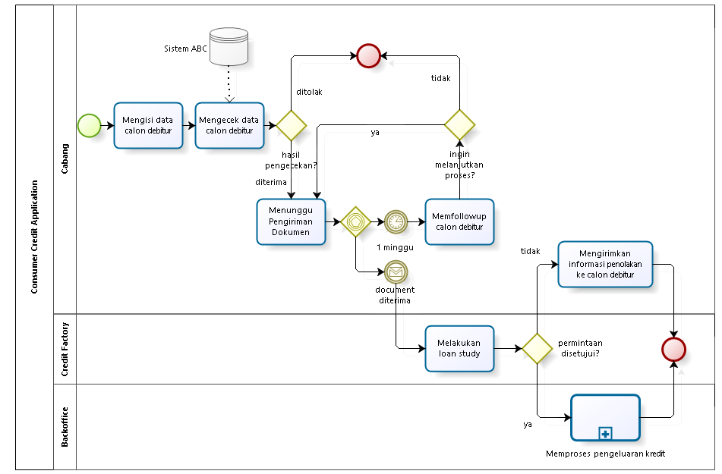
Credit Application with Event-Based Gateway

Slide 139
Tugas: Proses Penentuan Beasiswa
Buat BPMN dari proses penentuan beasiswa mahasiswa di Universitas Suka Belajar
Proses dimulai dari Administrasi universitas mengumumkan lowongan beasiswa menggunakan berbagai media
Mahasiswa melakukan pendaftaran dan mengirimkan dokumen persyaratan ke Administratif, yang kemudian melakukan seleksi administratif
Komite Universitas melakukan seleksi (seleksi profile dan seleksi wawancara)
Pengumuman hasil penerimaan beasiswa akan disebarkan oleh Administrasi melalui berbagai media massa
Tugas terakhir dari Administrasi adalah melakukan pencairan beasiswa
Calon penerima wajib mengirimkan surat kesediaan menerima beasiswa dalam batas 1 minggu setelah pengumuman, supaya beasiswa bisa mulai dicairkan (letakkan di dalam Subprocess“Melakukan Pencairan Beasiswa”
Tambahkan Event based Gateway untuk mendukung requirement ke 5

Slide 140
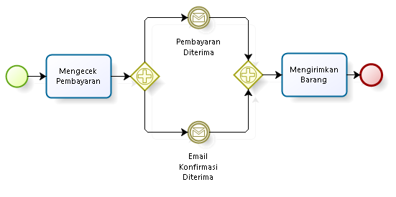
Paralell Event Based Gateway
All the Events of the Gateway configuration must be triggered in order to create a Process instance

Slide 141
Tugas: Proses Penentuan Beasiswa
Buat BPMN dari proses penentuan beasiswa mahasiswa di Universitas Suka Belajar
Proses dimulai dari Administrasi universitas mengumumkan lowongan beasiswa menggunakan berbagai media
Mahasiswa melakukan pendaftaran dan mengirimkan dokumen persyaratan ke Administratif, yang kemudian melakukan seleksi administratif
Komite Universitas melakukan seleksi (seleksi profile dan seleksi wawancara)
Pengumuman hasil penerimaan beasiswa akan disebarkan oleh Administrasi melalui berbagai media massa
Tugas terakhir dari Administrasi adalah melakukan pencairan beasiswa
Mahasiswa mengajukan permohonan surat bebas narkoba, surat tidak mampu dan surat kelakukan baik dari berbagai instansi. Dokumen-dokumen tersebut adalah dokumen persyaratan. Masukkan sebagai subprocess di Mengirimkan Dokumen Persyaratan
Tambahkan Paralel Event based Gateway untuk mendukung requirement ke 5

Slide 142
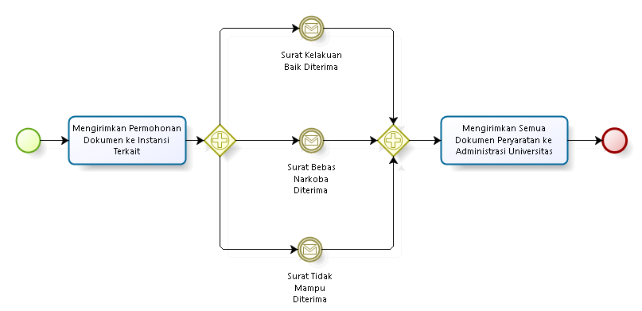
Tugas: Proses Penentuan Beasiswa

Slide 143
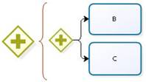
Parallel Gateway (Divergence)
As a divergence element, this shape is used when many activities have to be carried out at the same time and in any order, which indicates that all transitions or paths that exit this shape will always be enabled

Slide 144
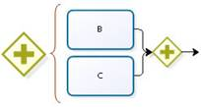
Parallel Gateway (Convergence )
As a point of convergence, this shape is used to synchronize paths that exit a Parallel Gate (convergence element)
The Parallel gateway (divergence element) enables the flow to carry on, only until all the transitions indicated have reached the shape

Slide 145
Tugas: Proses Penentuan Beasiswa
Buat BPMN dari proses penentuan beasiswa mahasiswa di Universitas Suka Belajar
Proses dimulai dari Administrasi universitas mengumumkan lowongan beasiswa menggunakan berbagai media
Mahasiswa melakukan pendaftaran dan mengirimkan dokumen persyaratan ke Administratif, yang kemudian melakukan seleksi administratif
Komite Universitas melakukan seleksi (seleksi profile dan seleksi wawancara)
Pengumuman hasil penerimaan beasiswa akan disebarkan oleh Administrasi melalui berbagai media massa
Tugas terakhir dari Administrasi adalah melakukan pencairan beasiswa
Komite Universitas melakukan Seleksi Profile dengan menilai prestasi akademik, non akademik dan kondisi keuangan mahasiswa
Tambahkan Paralel Gateway untuk mendukung requirement ke 5

Slide 146
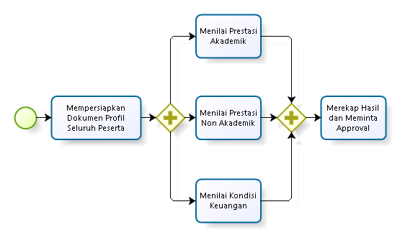
Parallel Gateway

Slide 147
Tugas: Proses Penentuan Beasiswa
Buat BPMN dari proses penentuan beasiswa di Universitas Suka Belajar
Proses dimulai dari Administrasi universitas mengumumkan lowongan beasiswa menggunakan berbagai media
Mahasiswa melakukan pendaftaran dan mengirimkan dokumen persyaratan ke Administratif, yang kemudian melakukan seleksi administratif
Komite Universitas melakukan seleksi (seleksi profile dan seleksi wawancara)
Pengumuman hasil penerimaan beasiswa akan disebarkan oleh Administrasi melalui berbagai media massa
Tugas terakhir dari Administrasi adalah melakukan pencairan beasiswa
Setelah penerimaan, uang beasiswa akan dikirimkan ke mahasiswa setiap bulan melalui ATM
Terapkan parallel gateway, parallel event based gateway, exclusive gateway, event based gateway pada proses

Slide 148
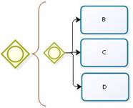
Inclusive Gateway (Divergence)
This shape is used when one or more paths are enabled based on an Exclusive Gateway or work flow control data
When you use a Inclusive Gateway (divergence element), make sure there is at least one valid path. If not, add a transition with an Else condition associated to it in case none of the conditions associated to each Transition is fulfilled

Slide 149
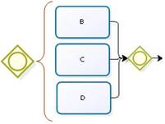
Inclusive Gateway (Convergence)
Inclusive gateways must be defined in pairs when is desired that all the previous activations of an Inclusive Gateway have been executed in order to carry on with the process
So, it must be defined an inclusive gateway (divergent element) to activate the paths and another one (convergent element ) to synchronize them

Slide 150
Inclusive Gateway (Convergence)

Slide 151
Inclusive Gateway (Convergence)

Slide 152
Tugas: Proses Penentuan Beasiswa
Buat BPMN dari proses penentuan beasiswa di Universitas Suka Belajar
Proses dimulai dari Administrasi universitas mengumumkan lowongan beasiswa menggunakan berbagai media
Mahasiswa melakukan pendaftaran dan mengirimkan dokumen persyaratan
Komite Universitas melakukan seleksi (seleksi profile dan seleksi wawancara)
Pengumuman penerima beasiswa akan disebarkan melalui email dan papan pengumuman
Pada proses penentuan media massa dan waktu tayang divisi humas diminta melakukan analisis, dan diperbolehkan memilih beberapa media massa yang relevan. Masukan ke subprocess Mengumumkan Lowongan Beasiswa.
Terapkan inclusive gateway untuk mendukung requirement ke 5

Slide 153
Complex Gateway
ADVANCE

Slide 154
Complex Gateway
ADVANCE
Loan Request Process:
An employee requests a loan from the company
This must be approved by his boss, the financial area or the vice-presidency
When at least two of the three approve the request, the money is given to the employee (disburse loan)

Slide 155
Complex Gateway
ADVANCE

Slide 156
Complex Gateway
ADVANCE

Slide 157
Tugas: Proses Penentuan Beasiswa
ADVANCE
Buat BPMN dari proses penentuan beasiswa di Universitas Suka Belajar
Proses dimulai dari Administrasi universitas mengumumkan lowongan beasiswa menggunakan berbagai media
Mahasiswa melakukan pendaftaran dan mengirimkan dokumen persyaratan ke Administratif, yang kemudian melakukan seleksi administratif
Komite Universitas melakukan seleksi (seleksi profile dan seleksi wawancara)
Pengumuman hasil penerimaan beasiswa akan disebarkan oleh Administrasi melalui berbagai media massa
Tugas terakhir dari Administrasi adalah melakukan pencairan beasiswa
Pencairan beasiswa harus mendapatkan minimal approval dari dua pihak, dimana approvalnya sendiri diajukan ke Rektor, Dekan, Kaprodi, Administrasi Universitas
Terapkan complex gateway untuk mendukung requirement ke 5

Slide 158
Tugas
Buat BPMN untuk Proses Pengadaan Barang
Unit kerja yang berhubungan dengan proses ini adalah Divisi Pemohon, Divisi Pengadaan Barang, Divisi Keuangan, dan Supplier
BPMN harus mudah dipahami proses besarnya, dengan menggunakan milestone dan subprocess
BPMN tersebut, wajib memasukkan notasi di bawah:
Gateway: Parallel, Event-based, Inclusive, Complex
Task: User, Manual, Script, Service, Business Rule
Sub process: Embedded, Reusable, Ad-hoc
Event: Timer, Message
Swimlane: Pool, Lane

Slide 159
2.4 Artifacts

Slide 160
BPMN Modeling Elements
ELEMENT | DEFINITION | BPMN NAME
Flow Objects | Flow objects are the main graphic elements that define the behavior of the processes | Events
 |  | Activities
 |  | Gateways
Connecting Objects | Flow objects are connected to each other by means of connectors to create the basic framework of the business process structure | Sequence Flow
 |  | Message Flow
 |  | Association
Swimlane | Swimlanes are mechanisms to arrange activities in separate display categories to illustrate the different functional areas or persons in charge | Pools
 |  | Lanes
Artifacts | Artifacts are used to provide additional information about the process. They provide the notation with flexibility to express different contexts properly | Annotation
 |  | Group
 |  | Data Object
 |  | Data Store

Slide 161
Artifacts
Artifacts are graphical object that provides supporting information about the Process or elements within the Process
However, they do not directly affect the flow of the Process
An Artifact MUST NOT be a target for Sequence Flow

Slide 162
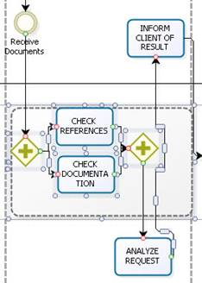
Groups
Used to group together a set of activities, whether for the effects of documentation or analysis, however, it does not affect the flow sequence

Slide 163
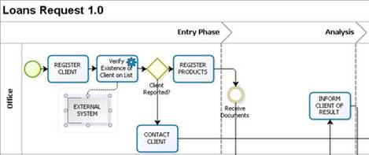
Annotations
Mechanisms for a modeler to be able to provide additional information in a BPMN diagram

Slide 164
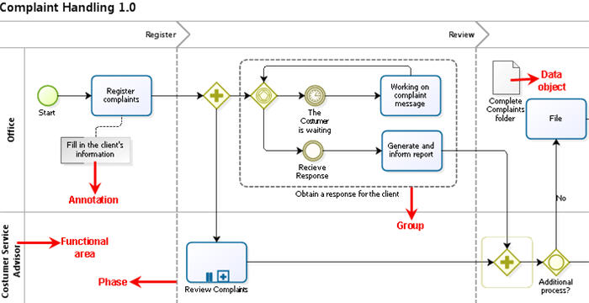
Data Object
Provide information about how documents, data and other objects are used and updated during the process. Can be used to represent electronic and physical objects

Slide 165
Data Store
Provides a mechanism for activities to retrieve or update stored information that will exist beyond the scope of the process

Slide 166
Tugas: Proses Penentuan Beasiswa
Buat BPMN dari proses penentuan beasiswa di Universitas Suka Belajar
Proses dimulai dari Administrasi universitas mengumumkan lowongan beasiswa menggunakan berbagai media
Mahasiswa melakukan pendaftaran dan mengirimkan dokumen persyaratan ke Administratif, yang kemudian melakukan seleksi administratif
Komite Universitas melakukan seleksi (seleksi profile dan seleksi wawancara)
Pengumuman hasil penerimaan beasiswa akan disebarkan oleh Administrasi melalui berbagai media massa
Tugas terakhir dari Administrasi adalah melakukan pencairan beasiswa
Setelah penerimaan, uang beasiswa akan dikirimkan ke mahasiswa setiap bulan tanggal 1
Terapkan milestone dan artifacts (annotation, data object, data store) pada proses

Slide 167
Tugas
Buat BPMN untuk Proses Pengadaan Barang
Unit kerja yang berhubungan dengan proses ini adalah Divisi Pemohon, Divisi Pengadaan Barang, Divisi Keuangan, dan Supplier
BPMN harus mudah dipahami proses besarnya, dengan menggunakan milestone dan subprocess
BPMN tersebut, wajib memasukkan notasi di bawah:
Gateway: Parallel, Inclusive, Event-based, Complex
Task: User, Manual, Script, Service, Business Rule
Sub process: Embedded, Reusable, Ad-hoc, Multiple
Event: Timer, Message, Conditional
Swimlane: Pool, Lane, Milestone
Artifacts: Annotation, Data Store, Data Object

Slide 168
Tugas
Buat BPMN dari salah satu business process di bawah:
Rekrutmen Pegawai
Help Desk Layanan Pelanggan
Perjalanan Dinas Pegawai
Pengunduran Diri Pegawai
Peminjaman Uang
Pengajuan Cuti Pegawai
Punishment Pelanggaran Pegawai
Pengiriman Tugas Belajar Pegawai
Permintaan Pengembangan Sistem
Pemrosesan Surat Masuk
Business process lain di unit kerja organisasi kita yang kita pahami
BPMN baru tersebut, wajib memasukkan notasi di bawah:
Gateway: Exclusive, Parallel, Inclusive, Event-based, Complex
Task: User, Manual, Script, Service, Timer/Message Boundary Event
Sub process: Embedded, Reusable, Ad-hoc, Multiple, Transaction
Event: Timer, Message, Conditional
Swimlane: Pool, Lane, Milestone
Artifacts: Annotation, Data Store, Data Object

Slide 169
Reference
Object Management Group, Business Process Model and Notation (BPMN), OMG Document Number: formal/2011-01-04, 2011
Object Management Group, BPMN 2.0 by Example, OMG Document Number: dtc/2010-06-02, 2011
Bruce Silver, BPMN Method and Style Second Edition, Cody-Cassidy Press, 2011
Layna Fischer (edt.), BPMN 2.0 Handbook Second Edition, Future Strategies, 2012
Tom Debevoise, Rick Geneva, and Richard Welke, The Microguide to Process Modeling in BPMN 2.0 Second Edition, CreateSpace, 2011
Bizagi Proses Modeler User Guide, Bizagi, 2012
Bizagi BPM Suite User Guide, Bizagi, 2013
Thomas Allweyer, BPMN 2.0, BoD, 2010

