Slide 1
TOGAF 9 Fundamental:
6. TOGAF Case Study
Romi Satria Wahono
romi@romisatriawahono.net
http://romisatriawahono.net/tfu
WA/SMS: +6281586220090

Slide 2
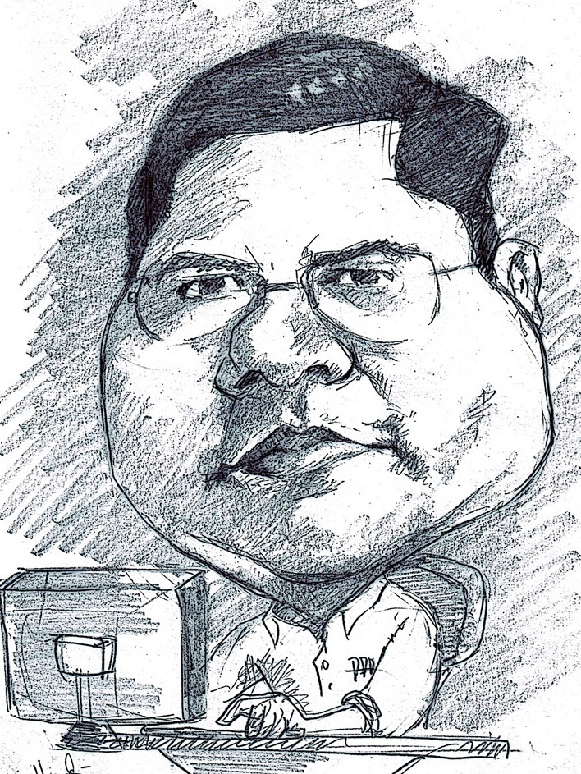
Romi Satria Wahono
SD Sompok Semarang (1987)
SMPN 8 Semarang (1990)
SMA Taruna Nusantara Magelang (1993)
B.Eng, M.Eng and Ph.D in Software Engineering from
Saitama University Japan (1994-2004)
Universiti Teknikal Malaysia Melaka (2014)
Research Interests: Software Engineering,
Machine Learning
Founder IlmuKomputer.Com
PNS di PDII LIPI (1994-2007)
Founder dan CEO PT Brainmatics Cipta Informatika

Slide 3
Course Outline
Introduction
TOGAF Concepts
TOGAF Architecture Development Method
BPMN Overview
UML Overview
TOGAF Case Study

Slide 4
6. TOGAF Case Study
Romi Satria Wahono – Brainmatics Enterprise Architecture - 2015
Balasubramanian - EA Child Wear Pte Ltd - 2013
Open Group -World Class EA Framework Guidance & TOGAF 9 Example
Enterprise Architecture Blueprint Cancer Care Ontario – 2011

Slide 5
6.1 Romi Satria Wahono – Brainmatics Enterprise Architecture - 2015

Slide 6
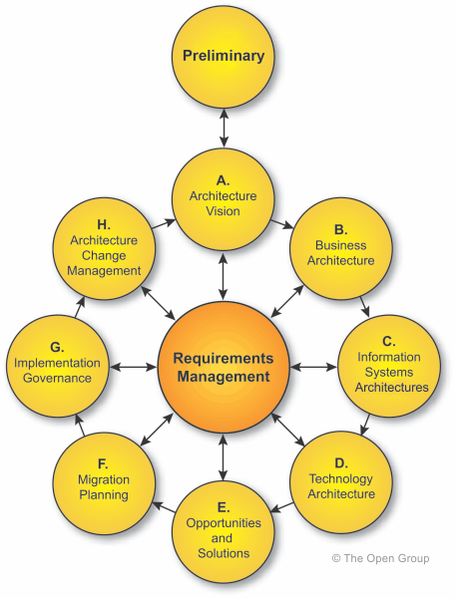
TOGAF Architecture Development Method (ADM)

Slide 7
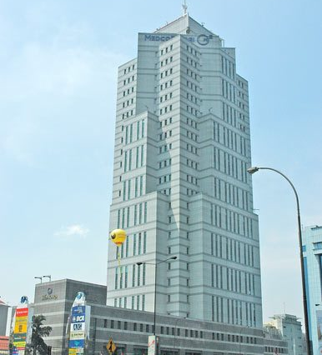
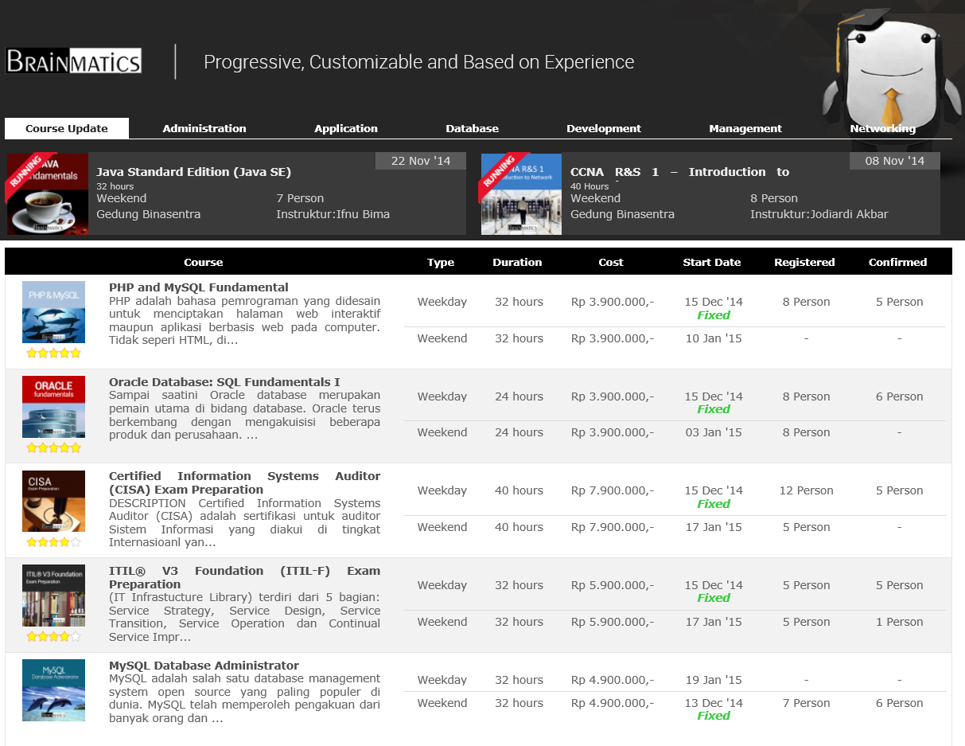
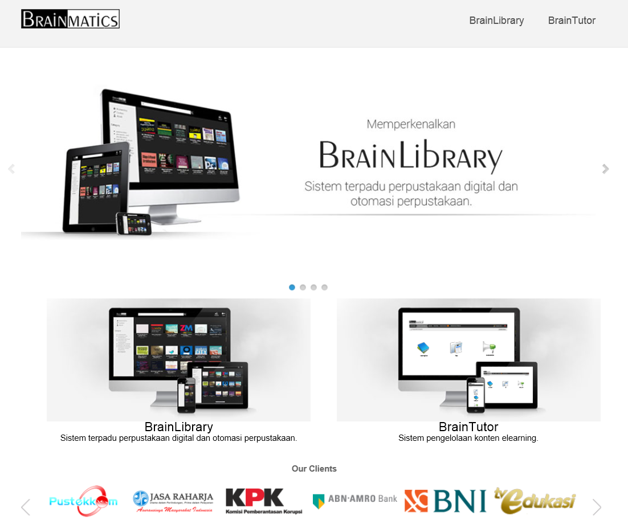
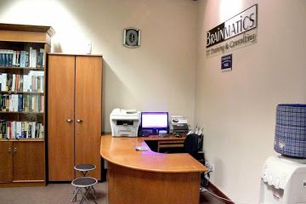
Case Study: PT Brainmatics Cipta Informatika

Slide 8
EA Tools Yang Digunakan
Sparx Enterprise Architect
  Use Case Diagram
  Logical Data Diagram
Bizagi Modeler
  Business Process Model and Notation (BPMN)
MS Power Point
  Text, Catalog dan Matrix
  Presentation
Avolution Abacus
No Magic MagicDraw

Slide 9
Key Competencies to Create an Enterprise Architecture
Enterprise Architecture Framework
Enterprise Architecture Tools
Business Strategy and Organization Analysis → Business Model Canvas
Business Process Model and Notation (BPMN)
Data Modeling and Mining
Unified Modeling Language (UML)

Slide 10
TOGAF Architecture Development Method (ADM)
Architecture Governance

Slide 11
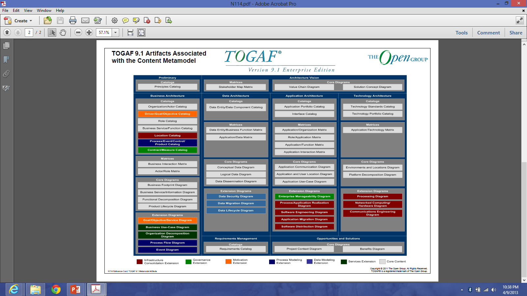
TOGAF Artifacts

Slide 12
Brainmatics Enterprise Architecture (Customized)
Preliminary
Architecture Vision
Architecture Principles
Vision and Mission
Business Model Canvas
Organization Decomposition Diagram
Architecture Goals
Value Chain Diagram
Solution Concept Diagram
Stakeholder Map Matrix
Business
Architecture
Data
Architecture
Application Architecture
Technology Architecture
Business Principles
Data Principles
Application Principles
Technology Principles
Functional Decomposition Diagram
Data Entity/Business Function Matrix
Application Portfolio Catalog
Technology Standard Catalog
Business Interaction Matrix
Application/Data Matrix
Application Use Case Diagram
Application/Technology Matrix
Organizational/Actor Catalog
Logical Data Diagram
Environment and Location Diagram
General Business Process Diagram
Business Process Diagram
Text
Diagram
Matrix
Catalog

Slide 13
Preliminary

Slide 14
Architecture Principles
Rangka Kerja Terbuka. Pengembangan arsitektur menggunakan rangka kerja terbuka sehingga memudahkan dalam pemahaman dan pengembangan ke depan
Mudah Dipahami. Arsitektur menggambarkan perusahaan secara umum dalam bentuk helicopter view yang mudah dipahami oleh semua pihak yang terkait
Diperbarui Berkala. Arsitektur akan direview dan diupdate secara berkala setiap 2 tahun sekali untuk menjamin mengikuti perkembangan organisasi yang dinamis
Dikembangkan Bersama. Arsitektur dengan melibatkan seluruh SDM yang ada, sehingga arsitektur ini adalah milik bersama dan akan diterapkan secara gotong royong bersama sama
Mengikuti Kapabilitas Organisasi. Arsitektur yang dikembangkan akan diterapkan dengan mengikuti kemampuan perusahaan, baik secara organisasi maupun ekonomi

Slide 15
Architecture Goals
Peningkatan Performa. Meningkatkan performa perusahaan dalam menjalankan visi dan misi dengan memaksimalkan pemanfaatan teknologi informasi
Pedoman Terpadu. Menjadi pedoman yang konsisten dan terpadu dalam mengembangkan dan memilih solusi teknologi informasi, yang dapat digunakan untuk mengotomasi proses bisnis di perusahaan dengan lebih efektif dan efisien
Penggambaran Menyeluruh. Menggambarkan perusahaan secara menyeluruh, dari aspek bisnis, data, aplikasi dan teknologi, dalam bentuk yang mudah dipahami oleh semua pihak yang terkait
Solusi Tingginya Turn-Over. Keluar masuknya SDM membuat berhentinya beberapa proses bisnis perusahaan. Arsitektur ini didesain untuk menjadi solusi masalah turn-over pegawai yang tinggi di perusahaan ABC
Peningkatan Kolaborasi. Kolaborasi antar divisi yang selama ini terkendala karena kurangnya pemahaman proses bisnis global dapat diatasi dengan arsitektur ini

Slide 16
A. Architecture Vision

Slide 17
Brainmatics Enterprise Architecture (Customized)
Preliminary
Architecture Vision
Architecture Principles
Vision and Mission
Business Model Canvas
Organization Decomposition Diagram
Architecture Goals
Value Chain Diagram
Solution Concept Diagram
Stakeholder Map Matrix
Business
Architecture
Data
Architecture
Application Architecture
Technology Architecture
Business Principles
Data Principles
Application Principles
Technology Principles
Functional Decomposition Diagram
Data Entity/Business Function Matrix
Application Portfolio Catalog
Technology Standard Catalog
Business Interaction Matrix
Application/Data Matrix
Application Use Case Diagram
Application/Technology Matrix
Organizational/Actor Catalog
Logical Data Diagram
Environment and Location Diagram
General Business Process Diagram
Business Process Diagram
Text
Diagram
Matrix
Catalog

Slide 18
Vision and Mission
Visi:
  Menjadi perusahaan penyedia jasa training dan pengembang software dengan kualitas terbaik di Indonesia
Misi:
  Menyediakan layanan jasa training dan sertifikasi di bidang teknologi informasi dengan kurikulum internasional yang berkarakter progressive, customizable dan berbasis experience
  Menyediakan layanan pengembangan software custom dan generic dengan metodologi standard internasional dan berbasis pengalaman industri

Slide 19
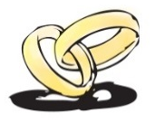
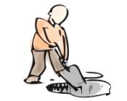
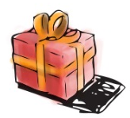





















Business Model Canvas
PT Brainmatics
Key Partners
Key Activities
Value
Propositions
Customer
Relationships
Customer
Segments
Pearson
Vue
Software
Development
Kurikulum Internasional dan Customizable dengan Kebutuhan
Offline: Kegiatan Workshop dan Training
Staff IT
Training
Center
Dosen
Kryterion Online
Pengajar dengan Kompetensi Terpadu Akademisi dan Industri
Online: Social Media Participation, Situs Brainmatics.Com
Certification
Examination
Mahasiswa
Prometrics
Key Resources
Peserta Ujian
Sertifikasi
Ruang Kelas Nyaman dan Posisi di Tengah Kota Jakarta
Channels
Percetakan
Kurikulum
Email
Pegawai
International Authorized Training and Testing Center
Telepon
Lembaga Pendidikan
Penerbit dan Distributor Buku
Brand Romi Satria Wahono
Brainmatics.Com
Lembaga
Pemerintahan
Online Market
Pengembangan Software dengan Metodologi Standard Internasional
Instant Messaging
(YM, WA, Line, BBM)
Food Court
Perusahaan Swasta
Brand IlmuKomputer.Com
Social Media
(Kaskus, Facebook, Twitter)
Cost Structure
Revenue Streams
Honor Pengajar
Biaya Operasional
Penjualan
Jasa Training
Penjualan
Produk Software
Gaji Pegawai
Biaya Infrastruktur
Biaya Marketing

Slide 20
Value Chain Diagram (Function)
Baseline
Financial
Management
Training Service
Marketing Activities
SUPPORTING ACTIVITIES
PRIMARY ACTIVITIES

Slide 21
Value Chain Diagram (Function)
Target
Financial
Management
Human Resource
Management
Software Development Service
Training Service
Marketing Activities
SUPPORTING ACTIVITIES
PRIMARY ACTIVITIES

Slide 22
Value Chain Diagram (Organization)
Baseline
Finance
Division
Training Division
Marketing Division
SUPPORTING ACTIVITIES
PRIMARY ACTIVITIES

Slide 23
Value Chain Diagram (Organization)
Target
Finance
Division
Human Resource Division
Development Division
Training Division
Marketing Division
SUPPORTING ACTIVITIES
PRIMARY ACTIVITIES

Slide 24
Organization Decomposition Diagram
Chief Executive Officer
General Manager
Finance Division
Marketing Division
Technology Course
Creative Course
Development Course
Human Resource Division
Development Division
Creative Product
Software Product
Training Division
Infrastructure
Training

Slide 25
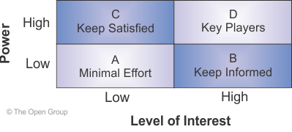
Stakeholder Map Matrix
Stakeholder | Key Concern | Class | Artifacts
Chief Executive Officer | The high-level drivers, goals, and objectives of the organization, and how these are translated into an effective business process to advance the business | Keep Satisfied | 1. Value Chain Diagram 2. Functional Decomposition Diagram
General Manager | General business process monitoring and maintenance | Key Players | 1. Functional Decomposition Diagram 2. Business Interaction Matrix 3. General Business Process Diagram
* Manager | Business process monitoring and maintenance | Key Players | 1. General Business Process Diagram 2. Business Process Diagram
Head of * | Business process implementation | Key Players | Business Process Diagram
Assistants | Assisting the business process implementation | Keep Informed | Business Process Diagram

Slide 26
Solution Concept Diagram (Baseline)
Desktop
Brainmatics Portal
Aplikasi Tidak Terintegrasi
Finance
Module
Training Management Module
Customer Relationship Module
Internet Low Speed
Business Process Automation
Penggajian Karyawan
Pelaksanaan Training
Pemasaran Training
Pelaksanaan Ujian
Penagihan Pembayaran
KPI
Finance Division
1. Keseimbangan Neraca Keuangan
2. Keteraturan Administrasi
KPI
Training Division
1. Kuantitas dan Kualitas Pelaksanaan Training
2. Kuantitas dan Kualitas Kurikulum
KPI
Marketing Division
1. Pendapatan dari Penjualan Training
2. Pendapatan dari Penjualan Sofware

Slide 27
Solution Concept Diagram (Target)
Mobile
Desktop
Brainmatics Portal
Brainmatics ERP System
Single Sign On
Finance
Module
Human Resource Module
Project Management
Module
Training Management Module
Customer Relationship Module
High Speed Broadband Network
Business Process Automation
Penggajian Karyawan
Penerimaan Magang
Pengembangan Custom Software
Pelaksanaan Training
Pemasaran Training
Belanja Bulanan
Penerimaan Pegawai
Maintenance Custom Software
Pelaksanaan Ujian
Monitoring Tender
Pembayaran Honor Instruktur
Pengajuan Cuti
Pengembangan Generic Software
Maintenance Infrastructure
Penagihan Pembayaran
Pengunduran Diri
Maintenance Generic Software
KPI
Finance Division
1. Keseimbangan Neraca Keuangan
2. Keteraturan Administrasi
KPI
Human Resource Division
1. Disiplin Pegawai
2. Kesejahteraan Pegawai
KPI
Development Division
1. Kuantitas dan Kualitas Software Generic
2. Kuantitas dan Kualitas Software Custom
KPI
Training Division
1. Kuantitas dan Kualitas Pelaksanaan Training
2. Kuantitas dan Kualitas Kurikulum
KPI
Marketing Division
1. Pendapatan dari Penjualan Training
2. Pendapatan dari Penjualan Sofware

Slide 28
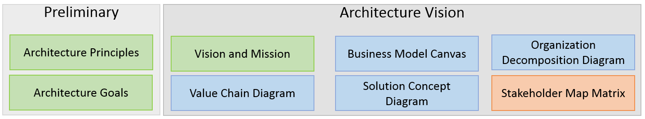
Tugas
Seandainya kita menjadi project manager (CIO) untuk pengembangan EA di perusahaan kita
Lakukan fase Preliminary dan Phase A: Architecture Vision
Susun artifak berikut untuk direktorat kita:

Slide 29
B. Business Architecture

Slide 30
Brainmatics Enterprise Architecture (Customized)
Preliminary
Architecture Vision
Architecture Principles
Vision and Mission
Business Model Canvas
Organization Decomposition Diagram
Architecture Goals
Value Chain Diagram
Solution Concept Diagram
Stakeholder Map Matrix
Business
Architecture
Data
Architecture
Application Architecture
Technology Architecture
Business Principles
Data Principles
Application Principles
Technology Principles
Functional Decomposition Diagram
Data Entity/Business Function Matrix
Application Portfolio Catalog
Technology Standard Catalog
Business Interaction Matrix
Application/Data Matrix
Application Use Case Diagram
Application/Technology Matrix
Organizational/Actor Catalog
Logical Data Diagram
Environment and Location Diagram
General Business Process Diagram
Business Process Diagram
Text
Diagram
Matrix
Catalog

Slide 31
Business Principles
Fleksibilitas Organisasi. Memperhatikan kebutuhan organisasi jangka pendek, menengah dan panjang sehingga KPK memiliki kemampuan untuk beradaptasi dan berubah
Standard Proses Bisnis. Proses kerja, kegiatan dan aturan bisnis yang terkait harus dipahami dan didokumentasikan dengan baik dengan standar pemodelan yang baku
Kesamaan Pemahaman. Mengurangi resiko multitafsir terhadap ketentuan proses bisnis tertentu sehingga semua pihak yang terkait di KPK mempunyai pemahaman yang sama terhadap proses bisnis yang telah ditentukan

Slide 32
Functional Decomposition Diagram
Finance
Division
Human Resource Division
Development Division
Training Division
Marketing Division
SUPPORTING ACTIVITIES
PRIMARY ACTIVITIES
Pinjaman Karyawan
Penerimaan Magang
Pengembangan Custom Software
Pelaksanaan Training
Pemasaran Training
Penggajian Karyawan
Penerimaan Pegawai
Maintenance Custom Software
Pelaksanaan Ujian
Monitoring Tender
Belanja Bulanan
Pengajuan Cuti
Pengembangan Generic Software
Maintenance Infrastruktur
Pembayaran Honor Instruktur
Pengunduran Diri
Maintenance Generic Software

Slide 33
Business Interaction Matrix
 | Finance Division | Human Resource Division | Development Division | Training Division | Marketing Division
Finance Division |  | Request budget | Request budget | Request budget | Request budget
Human Resource Division | Apply for staffing issues |  | Apply for staffing issues | Apply for staffing issues | Apply for staffing issues
Development Division | Request systems and maintenance | Request systems and maintenance |  | Request systems and maintenance | Request systems and maintenance
Training Division | Request infrastructure maintenance | Request infrastructure maintenance | Request infrastructure maintenance |  | Request product knowledge
Marketing Division |  |  | Apply for software product marketing | Apply for training product marketing

Slide 34
Organization/Actor Catalog
Organization | Actor
Board | CEO
 | General Manager
Finance Division | Financial Manager
Human Resource Division | Human Resource Manager
 | Employee
 | Assistant
Development Division | Development Manager
 | Project Manager
 | Programmer
Training Division | Training Manager
 | Trainer
 | Participant
Marketing Division | Marketing Manager
 | Marketer
 | Customer

Slide 35
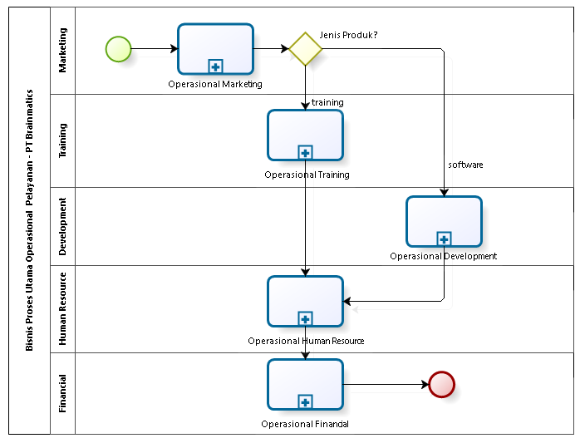
General Business Process Diagram
(level 1)

Slide 36
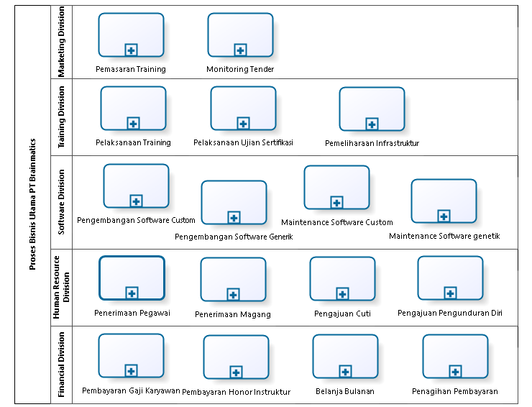

Slide 37
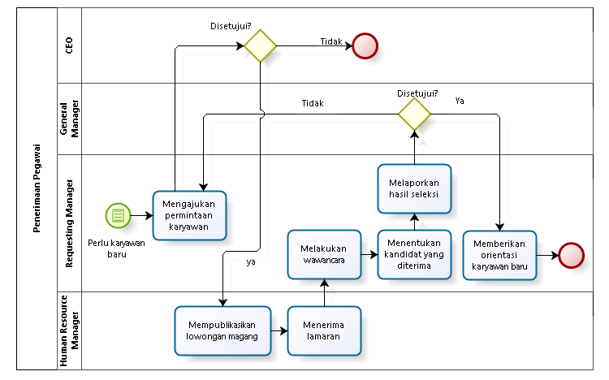
HRD Level 1: Penerimaan Pegawai

Slide 38
C. Application Architecture

Slide 39
Brainmatics Enterprise Architecture (Customized)
Preliminary
Architecture Vision
Architecture Principles
Vision and Mission
Business Model Canvas
Organization Decomposition Diagram
Architecture Goals
Value Chain Diagram
Solution Concept Diagram
Stakeholder Map Matrix
Business
Architecture
Data
Architecture
Application Architecture
Technology Architecture
Business Principles
Data Principles
Application Principles
Technology Principles
Functional Decomposition Diagram
Data Entity/Business Function Matrix
Application Portfolio Catalog
Technology Standard Catalog
Business Interaction Matrix
Application/Data Matrix
Application Use Case Diagram
Application/Technology Matrix
Organizational/Actor Catalog
Logical Data Diagram
Environment and Location Diagram
General Business Process Diagram
Business Process Diagram
Text
Diagram
Matrix
Catalog

Slide 40
Application Principles
Keselarasan Kebutuhan Aplikasi. Aplikasi harus dikembangkan berdasarkan kebutuhan pengguna dan harus memiliki manfaat yang dapat diukur secara kuantitatif untuk mencapai tujuan perusahaan
Independensi Aplikasi. Aplikasi harus independen terhadap pilihan teknologi tertentu, mengikuti standar industri, arsitektur terbuka, dan oleh karenanya dapat dioperasikan pada beragam platform terbuka
Penggunaan Kembali Aplikasi. Pengembangan aplikasi harus mempertimbangkan kembali penggunaan aplikasi, sistem dan infrastruktur yang ada sebelum berinvestasi kepada solusi baru. Re-use sebelum membeli, membeli sebelum membangun.
Dokumentasi Aplikasi. Aplikasi harus memiliki dokumentasi yang menyeluruh dimulai dari tahapan planning, analisis, desain dan implementasi, sehingga memudahkan modifikasi dan pengembangan di masa depan

Slide 41
Application Portfolio Catalog
Organization | Application
Finance Division | Finance Module
Human Resource Division | Human Resource Module
Development Division | Project Management Module
Training Division | Training Management Module
Marketing Division | Customer Relationship Module

Slide 42
Application Portfolio Catalog
Organization | Application | Nilai Kelayakan | Komentar dan Saran
All Units | App 1 App 2 App 3 | 1 4 3 | Banyak bug dan ga dibutuhkan Ribet pakainya Sebaiknya ditambahi fitur abc
Unit A | App 4 App 5 App 6
Unit B | App 7
Unit C | App 8 App 9
Unit D | App 10

Slide 43
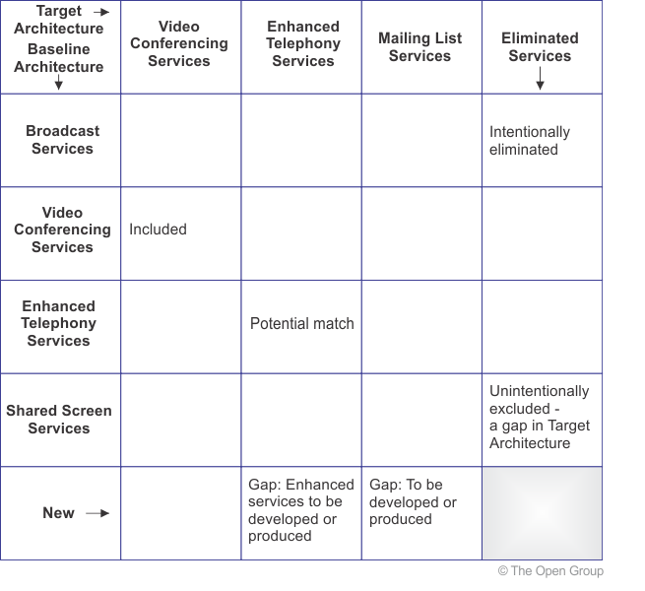
Gap Analysis

Slide 44
Application Use Case Diagram:
Global Package

Slide 45
Finance Module

Slide 46
Penggajian Karyawan (Submodule)

Slide 47
Tugas
Rapikan lagi proses bisnis utama dari direktorat kita
Bisa menggunakan Adhoc proses atau proses biasa (Lihat General Business Process Diagram)
Selesaikan beberapa proses bisnis yang kita pahami dengan menggunakan berbagai notasi BPMN yang sudah kita pelajari
Prioritaskan proses bisnis utama dan yang menurut kita relatig sulit digambarkan dengan BPMN → untuk direview bersama-sama

Slide 48
C2. Data Architecture

Slide 49
Data Principles
Data Creation: All enterprise data should be captured once at the point of its creation
Data Identifiers: Every object in the enterprise will contain a globally unique identifier. That identifier will be in the form of the Universally Unique Identifier (UUID)
Standard Data Elements: The use of standard data elements of universal fields will be used across the Enterprise for new development and system enhancements
Spatial Information is a valued investment and asset: Spatial information can accelerate and improve decision‐making, increase accountability, and improve services. Information must be shared to maximize effective decision making
Information Access based on access levels: Easy and timely access to data and information based on the access levels for various authorized personnel needs to be the rule rather than the exception

Slide 50
Application/Data Matrix
Module DB - Entity | Finance Module | Human Resource Module | Project Management Module | Training Management Module | Customer Relationship Module
HRM - Karyawan | R | CRUD | R
PM - Project |  |  | CRUD
TM - Peserta | R |  |  | CRUD | R
TM – Instruktur | R | R |  | CRUD | R
...... | …… | …… | …… | …… | ……

Slide 51
Data Entity/Business Function Matrix
Module DB - Entity | Business Process | Organization
HR - Karyawan | Pengajuan Cuti | Human Resource Division
PM - Project | Maintenance Software Custom | Development Division
TM - Peserta | Pelaksanaan Training | Training Division
TM – Instruktur | Persiapan Training | Training DIvision
……. | ......... | ........

Slide 52
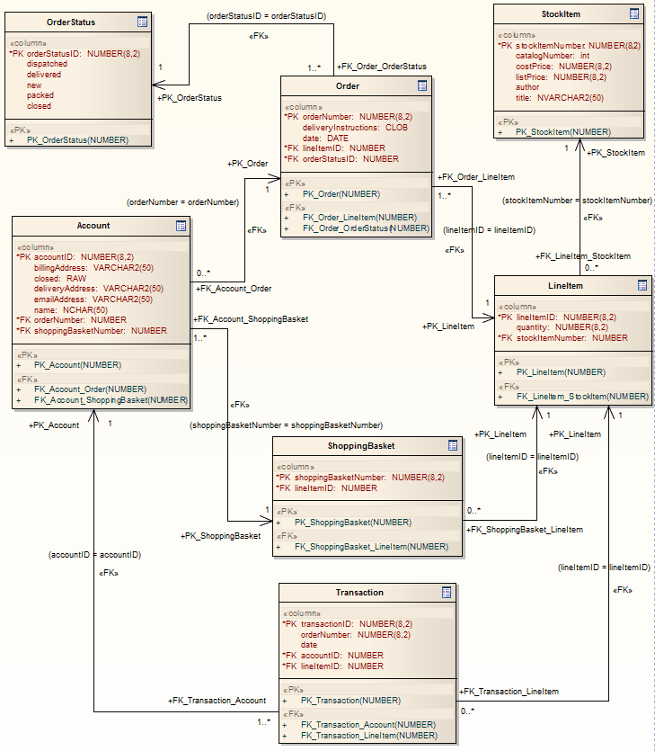
Logical Data Diagram

Slide 53
D. Technology Architecture

Slide 54
Brainmatics Enterprise Architecture (Customized)
Preliminary
Architecture Vision
Architecture Principles
Vision and Mission
Business Model Canvas
Organization Decomposition Diagram
Architecture Goals
Value Chain Diagram
Solution Concept Diagram
Stakeholder Map Matrix
Business
Architecture
Data
Architecture
Application Architecture
Technology Architecture
Business Principles
Data Principles
Application Principles
Technology Principles
Functional Decomposition Diagram
Data Entity/Business Function Matrix
Application Portfolio Catalog
Technology Standard Catalog
Business Interaction Matrix
Application/Data Matrix
Application Use Case Diagram
Application/Technology Matrix
Organizational/Actor Catalog
Logical Data Diagram
Environment and Location Diagram
General Business Process Diagram
Business Process Diagram
Text
Diagram
Matrix
Catalog

Slide 55
Technology Principles
Separation of Concerns: Following the “Modularity” and “Abstraction” approach for the developing the technical features
Systems and Network: All the system and network management application within Brainmatics should be consolidated and integrated for effective and efficient usage. Should ensure business continuity
Usability & Look‐Feel: The look and feel must be easy to use and consistent among all applications
Security: The computing system's assets can be read only by authorized parties and each of the transaction must be traceable. All the resources / services available within Brainmatics must be registered and maintained with Location and Directory service
Business Continuity: Transactions must roll back when the transaction fails and ensure business continuity. Also, monitor performance of the system and network continuously

Slide 56
Technology Standard Catalog
No | Technology
1 | RUP shall be used as the formal methodology for Brainmatics
2 | UML shall be used as the standard notation
3 | Sparx EA shall be used to facilitate the software engineering processes
4 | Java shall be the programming language
5 | Use JBoss 5.0 as the Application Server
6 | Browser: IE 4.0 +, Mozilla Firefox 1.0 HTML: 4.0 + Web 2.0
7 | Script Support: JavaScript 1.1
8 | Use IBM System x3850 M2 as the host server
9 | Symantec Network Security and Symantec AntiVirus for Security
10 | Oracle 10g for Database
11 | Hibernate Framework
12 | XML for Web Services
13 | Lightweight Directory Access Protocol (LDAP)
14 | SSL,PKI, Single Sign On

Slide 57
Application/Technology Matrix
Module Technology | Finance Module | Human Resource Module | Project Management Module | Training Module | Customer Relationship Module
JBOSS App Server | X
Oracle DBMS | X | X | X | X | X
Web Server |  | X |  |  | X
Javascript |  | X |  |  | X
OpenERP | X | X | X | X | X
…… | ........ | ........ | ........ | ........ | ........

Slide 58
Environment and Location Diagram

Slide 59
Tugas
Asumsikan bahwa kita diminta untuk mengembangkan enterprise architecture di organisasi tempat kita bekerja
Kita memutuskan menggunakan TOGAF sebagai framework
Mulai lakukan tahapan TOGAF ADM dengan dimulai dari tahapan Preliminary dengan menyusun artififact:
  Architecture Principle
  Architecture Goal
Lanjutkan dengan tahapan Architecture Vision dengan artifact:
  Organization Decomposition Diagram
  Value Chain Diagram
  Business Model Canvas
  Solution Concept Diagram

Slide 60
Tugas
Lanjutkan dengan tahapan pembuatan Business Architecture dengan artifact:
  Business Principle
  Functional Decomposition
  Business/Interaction Matrix
  Organizational Actor Catalog
  General Business Process Diagram
  Business Process Diagram

Slide 61
6.2 Balasubramanian - EA Child Wear

Slide 62
TOGAF ADM

Slide 64
TOGAF ADM and Artifacts
Preliminary
  Architecture Principles
  Architecture Goals
  Solution Concept Diagram
Architecture Vision
  Organization Decomposition Diagram
  Stakeholder Map Matrix
  Value Chain Diagram
  Solution Concept Diagram
Business Architecture
  Business Principles
  Functional Decomposition Diagram
  Business Interaction Matrix
  Organization/Actor Catalog
  Business Use Case Diagram
Data Architecture
  Data Principles
  Data Entity/Business Function Matrix
  Application/Data Matrix
  Logical Data Diagram
Application Architecture
  Application Principles
  Application Portfolio Catalog
  Application Use Case Diagram
Technology Architecture
  Technology Principles
  Technology Standard Catalog
  Application/Technology Matrix
  Environtment and Location Diagram
Opportunities and Solution
  Opportunities and Solution Catalog

Slide 65
1. Preliminary

Slide 66
Architecture Principles
Deliver the most good to the broadest range of IT users
Implement Enterprise‐wide EA. EA compliance for every program and project
The planning and management of Enterprise Architecture must be unified and have a planned evolution that is governed across the enterprise.
Information Is an Enterprise Asset. Focus on Boundaryless Information Flow.
Facilitate the sharing of information to accelerate and improve overall decision‐making
Reduce integration and interoperability complexity and increase agility for enterprise change
Reuse common solutions. Practice Modular Solutions

Slide 67
Architecture Goals
Enable effective and efficient communication with the users/ management/customers/ suppliers
To leverage the existing business processes
Reduce overall cost – Production & Overhead
Use the power of internet to widen existing customer base
To improve service levels to the customers
Improvise Supply Chain Management Process
Minimize processes and system redundancies

Slide 68
2. Architecture Vision

Slide 69
Organization Decomposition Diagram
CEO
CIO
CFO
COO
Information Technology Manager
Human Resource Manager
Manufacturing Manager
Sales Manager
Financial Manager

Slide 70
Stakeholder Map Matrix
Stakeholder | Key Concern | Class | Artifacts
CxO | The high-level drivers, goals, and objectives of the organization, and how these are translated into an effective process and IT architecture to advance the business. | Keep Satisfied | Value Chain Diagram Functional Decomposition Diagram
Human Resource Manager |  | Keep Satisfied
Information Technology Manager |  | Key Players
Financial Manager |  | Keep Satisfied
Manufacturing Manager |  | Keep Informed
Sales Manager |  | Keep Informed

Slide 71
Baseline Value Chain Diagram
Information Technology
Finance
Manufacturing
Sales
SUPPORTING ACTIVITIES
PRIMARY ACTIVITIES

Slide 72
Target Value Chain Diagram
Human Resource
Information Technology
Finance
Manufacturing
Sales
SUPPORTING ACTIVITIES
PRIMARY ACTIVITIES

Slide 73
Baseline Solution Concept Diagram
Aplikasi Tidak Terintegrasi
HRM System
System Request and Versioning System
Accounting System
Manufacturing
System
eCommerce System
MySQL
DBMS
MySQL
DBMS
Oracle
DBMS
PostgreSQL
DBMS
MySQL
DBMS
ADSL Network
Business Process Automation
Procurement
Help Desk
Manages Payable
Manufacturing
Sales
Manage Receivable
Inventory
Manage Assets

Slide 74
Target Solution Concept Diagram
Mobile
Desktop
SMS
CRM Portal
Sistem ERP
Modul HRM
Modul PM
Modul Accounting
Modul Manufacturing
Modul CRM
Oracle DBMS
High Speed Fiber Optic Network
Business Process Automation
Onboarding
Systems Development
Loan Request
Procurement
Marketing
Offboarding
Help Desk
Manages Payable
Manufacturing
Sales
Promotion
Systems Maintenance
Manage Receivable
Inventory
Vacation Request
Manage Assets
KPI HRM
KPI IT
KPI Accounting
KPI Manufacturing
KPI Sales

Slide 75
3. Business Architecture

Slide 76
Business Principles
The entire organization own and implements business processes and the IT systems that supports them.
Business strategy, supported by well‐defined business objectives and justified business value, shall drive the IT investments of Child‐Wear.
Business process re‐engineering should be easily possible through appropriate use of technology.
Business processes shall be automated where technology allow, to reduce processing time and cost and increase per process throughput.
Child‐Wear provides secure "anytime / anywhere" business services to its customer community.
Child‐Wear operations are maintained in spite of any system disruption.
Information management processes must comply with all relevant laws, policies and regulations.
Enable Interoperability with suppliers.
Provide effective and efficient customer services.

Slide 77
Functional Decomposition Diagram (Baseline)
Information Technology
Finance
Manufacturing
Sales
Help Desk
Manages Payable
Procurement
Sales
Manage Receivable
Manufacturing
Manage Assets
Inventory

Slide 78
Functional Decomposition Diagram (Target)
Human Resource
Information Technology
Finance
Manufacturing
Sales
Onboarding
Systems Development
Loan Request
Procurement
Marketing
Offboarding
Help Desk
Manages Payable
Manufacturing
Sales
Promotion
Systems Maintenance
Manage Receivable
Inventory
Vacation Request
Manage Assets

Slide 79
Business Interaction Matrix
 | Human Resource | Information Technology | Finance | Manufacturing | Sales
Human Resource
Information Technology | Request systems and maintenance |  | Request systems and maintenance | Request systems and maintenance | Request systems and maintenance
Finance | Request budget | Request budget |  | Request budget | Request budget
Manufacturing |  |  |  |  | Request product knowledge
Sales

Slide 80
Organization/Actor Catalog
Organization | Actor
Human Resource | Human Resource Manager
 | Trainer
 | Psycholog
Information Technology | Information Technology Manager
 | System Analyst
 | Programmer
 | Tester
 | Teknisi
Finance | Financial Manager
 | Bendahara
Manufacturing | Manufacturing Manager
 | Engineer
Sales | Sales Manager
 | Marketer

Slide 81
Business Use Case Diagram:
Global Package

Slide 82
Business Use Case Diagram:
Human Resource - Onboarding

Slide 83
Business Use Case Diagram:
Human Resource - Onboarding

Slide 84
Business Use Case Diagram:
Information Technology – Systems Development

Slide 85
Business Use Case Diagram:
Sales - Marketing

Slide 86
4. Application Architecture

Slide 87
Application Principles
All Applications should align with the business vision and requirements.
Cost effectiveness and Operational Effectiveness ‐ Reduction of TCO (Total Cost of Ownership)
Reduced integration complexity by adhering to industry standards
Ease of use to enable the users to work without any dependencies.
Component‐based model and reuse – all functions, modules, tools and services will be designed such that they support reusability.
Changes to Application are to be made only based on Business Need
Software and Hardware conform to defined standards to promote interoperability of data, applications and technology.

Slide 88
Application Portfolio Catalog (Baseline)
Organization | Application
Information Technology | System Request and Change System
 | Application Versioning System
Finance | Accounting System
Manufacturing | Manufacturing Planning System
 | Inventory System
Sales | Sales Record System
 | Child-Wear eCommerce System

Slide 89
Baseline Application Architecture

Slide 90
Application Portfolio Catalog (Target)
Organization | Application
Human Resource | ERP Module HRM
Information Technology | ERP Module Project Management
Finance | ERP Module Accounting
Manufacturing | ERP Module Manufacturing
Sales | ERP Module CRM

Slide 91
Target Application Architecture

Slide 92
Gap Analysis
Target Baseline | ERP Module HRM | ERP Module PM | ERP Module Accounting | ERP Module Manufacturing | ERP Module CRM
System Request and Change System |  | included
Application Versioning System |  | included
Accounting System |  |  | potentially match
Manufacturing Planning System |  |  |  | potentially match
Inventory System |  |  |  | gap: enhanced service to be developed
Sales Record System |  |  |  |  | included
eCommerce System |  |  |  |  | included

Slide 93
Application Use Case Diagram:
Global Package

Slide 94
Application Use Case Diagram:
Module HRM – Aplikasi Onboarding

Slide 95
5. Data Architecture

Slide 96
Data Principles
Data Creation: All enterprise data should be captured once at the point of its creation.
Data Identifiers: Every object in the enterprise will contain a globally unique identifier. That identifier will be in the form of the Universally Unique Identifier (UUID).
Standard Data Elements: The use of standard data elements of universal fields will be used across the Enterprise for new development and system enhancements.
Spatial Information is a valued investment and asset: Spatial information can accelerate and improve decision‐making, increase accountability, and improve services. Information must be shared to maximize effective decisionmaking.
Information Access based on access levels: Easy and timely access to data and information based on the access levels for various authorized personnel needs to be the rule rather than the exception. This needs to be accomplished without compromising security, confidentiality, and privacy.

Slide 97
Application/Data Matrix
Module DB - Entity | ERP Module HRM | ERP Module PM | ERP Module Accounting | ERP Module Manufacturing | ERP Module CRM
HRM - Karyawan | CRUD | R | R
PM - Project |  | CRUD

Slide 98
Data Entity/Business Function Matrix
Module DB - Entity | Business Function | Organization
HRM - Karyawan | Onboarding | HRM

Slide 99
Logical Data Diagram

Slide 100
6. Technology Architecture

Slide 101
Technology Principles
Separation of Concerns: Following the “Modularity” and “Abstraction” approach for the developing the technical features.
Systems and Network: All the system and network management application within Child‐Wear should be consolidated and integrated for effective and efficient usage. Should ensure business continuity.
Usability & Look‐Feel: The look and feel must be easy to use and consistent among all applications.
Security: The computing system's assets can be read only by authorized parties and each of the transaction must be traceable. All the resources / services available within Child‐Wear must be registered and maintained with Location and Directory service.
Business Continuity: Transactions must roll back when the transaction fails and ensure business continuity. Also, monitor performance of the system and network continuously.

Slide 102
Technology Standard Catalog
RUP shall be used as the formal methodology for Child‐Wear.
UML shall be used as the standard notation.
Java shall be the programming language.
Use JBoss 5.0 as the Application Server
Browser: IE 4.0 +, Mozilla Firefox 1.0 HTML: 4.0 + Web 2.0
Script Support: JavaScript 1.1
Use IBM System x3850 M2 as the host server.
Sparx EA shall be used to facilitate the Software Engineering processes.
Symantec Network Security and Symantec AntiVirus for Security
Oracle 10g for Database
Hibernate Framework
XML for Webservices
Java Naming and Directory Interface (JNDI)
Lightweight Directory Access Protocol (LDAP)
SSL,PKI, Single Sign On
OpenERP

Slide 103
Application/Technology Matrix
Module Technology | ERP Module HRM | ERP Module PM | ERP Module Accounting | ERP Module Manufacturing | ERP Module CRM
JBOSS App Server | X
Oracle DBMS | X | X | X | X | X
Web Server |  | X |  |  | X
Javascript |  | X |  |  | X
OpenERP | X | X | X | X | X

Slide 104
Environment and Location Diagram

Slide 105
7. Opportunities and Solution

Slide 106
Opportunities and Solution Catalog
Initiative | Priority | Category
New Centralized Sales and Billing System(SBS) | HIGH | BA,AA
New Centralized Manufacturing and Inventory System (MIS) | HIGH | BA,AA
Integrated System Authentication and Authorization for all systems | HIGH | IA,AA,TA
Oracle Servers to ensure 24x7 Data Availability | HIGH | TA
Web Store for retail and corporate customers for Ordering. | HIGH | BA/IA/AA/TA
Web Services for integrating with Customers from SBS | MEDIUM | BA, AA
Web Services for integrating with Suppliers from MIS | MEDIUM | BA, AA
IT Infrastructure to enhance business needs(PDA's for sales team, Laptop's, Workstation's etc) | MEDIUM | TA
Implement Enterprise Service Bus (ESB) to integrate all IT Systems | HIGH | BA/IA/AA/TA

Slide 107
8.3 Open Group -World Class EA Framework Guidance & TOGAF 9 Example

Slide 108
8.4 Enterprise Architecture Blueprint Cancer Care Ontario – 2011

Slide 109
References
Rachel Harrison, Study Guide TOGAF® 9 Foundation 2nd Edition, The Open Group, 2011
Rachel Harrison, Study Guide TOGAF® 9 Certified 2nd Edition, The Open Group, 2011
Open Group Standard, TOGAF® Version 9.1 (G116), The Open Group, 2011
Open Group Standard, TOGAF® Version 9.1 – A Pocket Guide (G117), The Open Group, 2011
Daniel Minoli, Enterprise Architecture A to Z: Frameworks, Business Process Modeling, SOA, and Infrastructure Technology, Taylor & Francis, 2008
Jon Holt and Simon Perry, Modelling Enterprise Architectures, The Institution of Engineering and Technology, 2010
Alan Dennis et al, Systems Analysis and Design with UML 4th Edition, John Wiley and Sons, 2013

