Slide 1
TOGAF 9 Fundamental: 4. BPMN Overview
Romi Satria Wahono romi@romisatriawahono.net http://romisatriawahono.net/tfu WA/SMS: +6281586220090

Slide 2
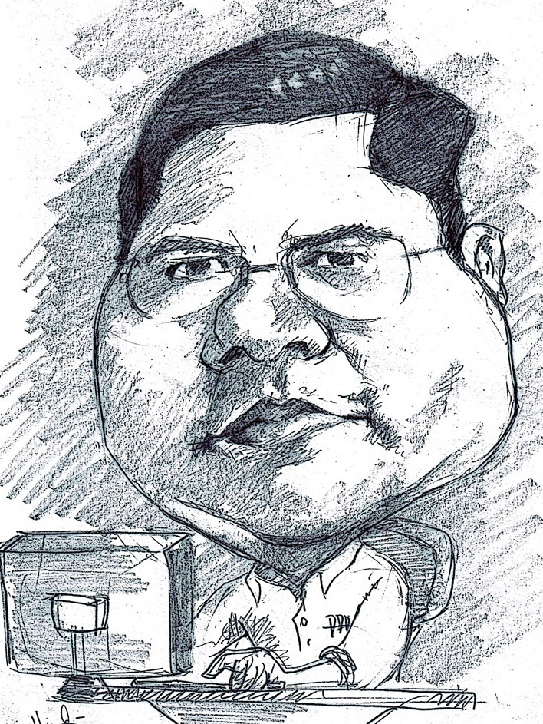
Romi Satria Wahono
SD Sompok Semarang (1987)
SMPN 8 Semarang (1990)
SMA Taruna Nusantara Magelang (1993)
B.Eng, M.Eng and Ph.D in Software Engineering from Saitama University Japan (1994-2004) Universiti Teknikal Malaysia Melaka (2014)
Research Interests: Software Engineering, Machine Learning
Founder IlmuKomputer.Com
PNS di PDII LIPI (1994-2007)
Founder dan CEO PT Brainmatics Cipta Informatika

Slide 3
Course Outline
Introduction
TOGAF Concepts
TOGAF ADM
BPMN Overview
UML Overview
TOGAF Case Study

Slide 4
4. BPMN Overview
4.1 What and Why BPMN
4.2 Swimlane
4.3 Connecting Objects
4.4 Flow Objects
4.5 Artifacts

Slide 5
4.1 What and Why BPMN

Slide 6
What is BPMN
Business Process Modeling Notation (BPMN) is a graphic notation that describes the logic of the steps in a Business Process
This notation has been especially designed to coordinate the sequence of processes and messages that flow between participants of different activities
It was developed by the organization BPM Initiative, made by the Object Management Goup (OMG)
This means great possibilities for BPMN to become the standard language regarding business processes, like UML which has become the standard for software modeling

Slide 7
Why BPMN?
Permenpan No 12 Tahun 2011 tentang Pedoman Penataan Tata Laksana (Business Process) yang merekomendasikan BPMN sebagai notasi untuk pemodelan business process

Slide 8
BPMN Modeling Elements
One of the guidelines for the development of BPMN is to create a simple mechanism to diagram process flows, which in turn can handle the complexity inherent to business processes
The approach taken to handle these two conflicting requirements was to organize the graphic aspects of the notation in specific categories
This provides a category system that helps the reader of a BPMN diagram to easily recognize the basic types of elements and understand the diagram

Slide 9
BPMN Elements
Flow Objects
Connecting Objects
Swimlanes
Artifact

Slide 10
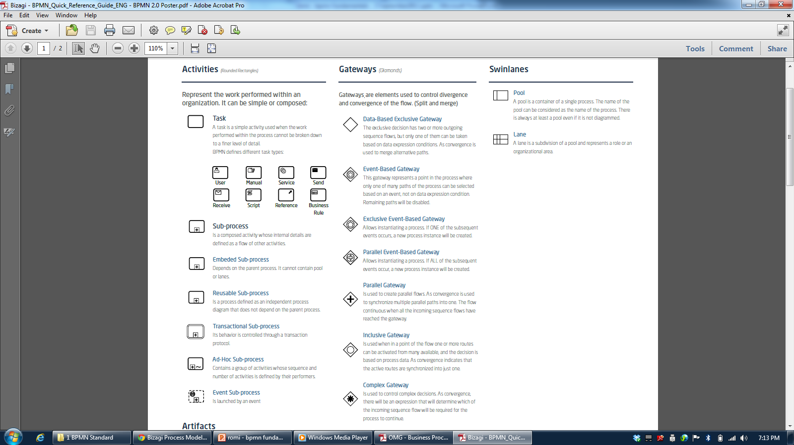
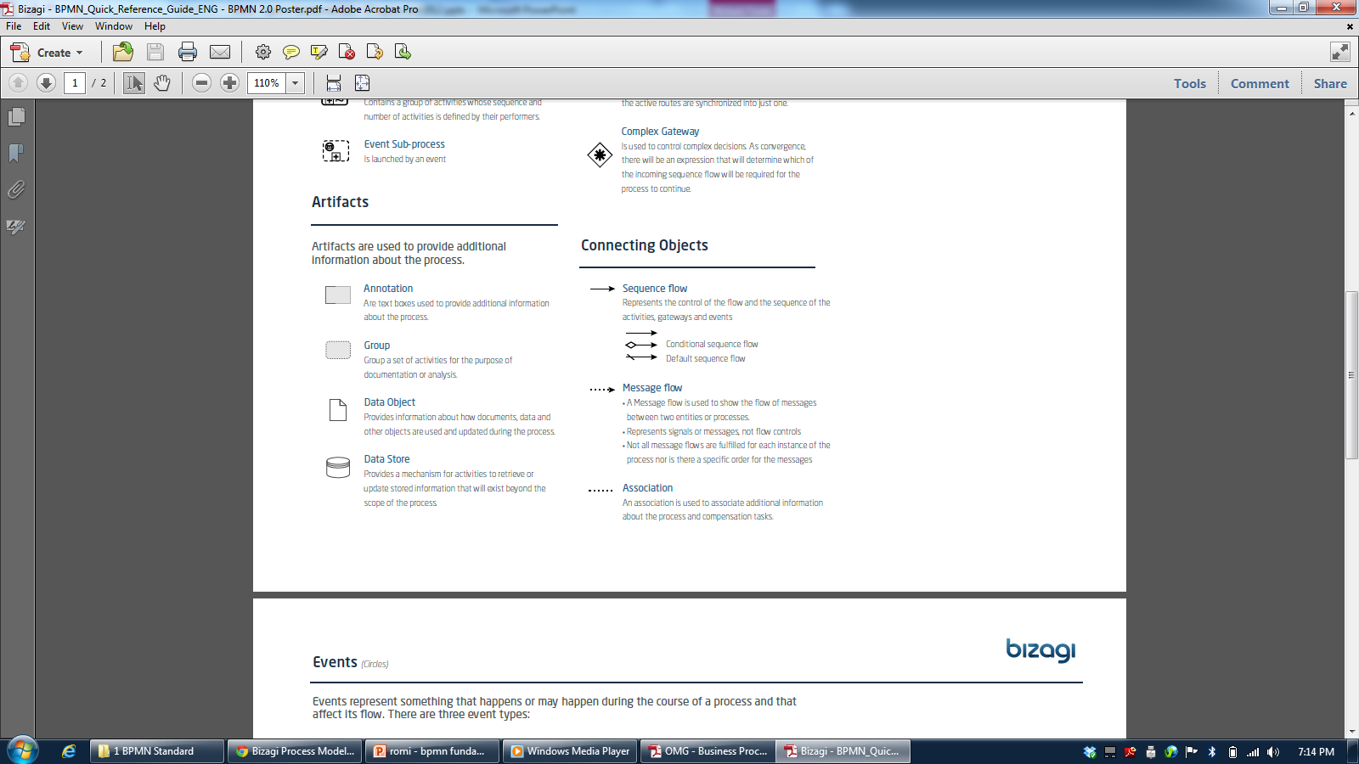

Slide 11
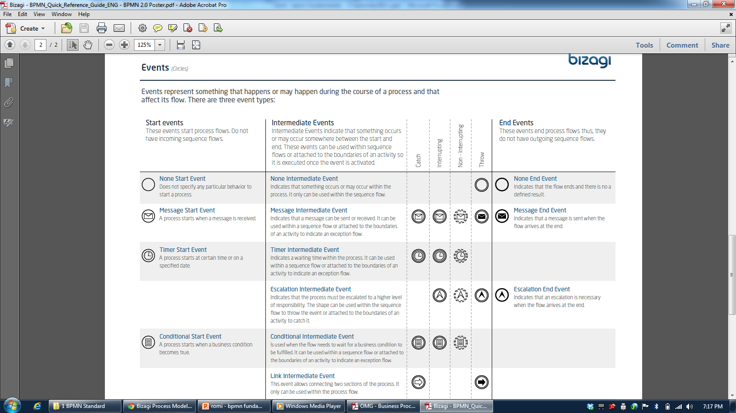

Slide 12
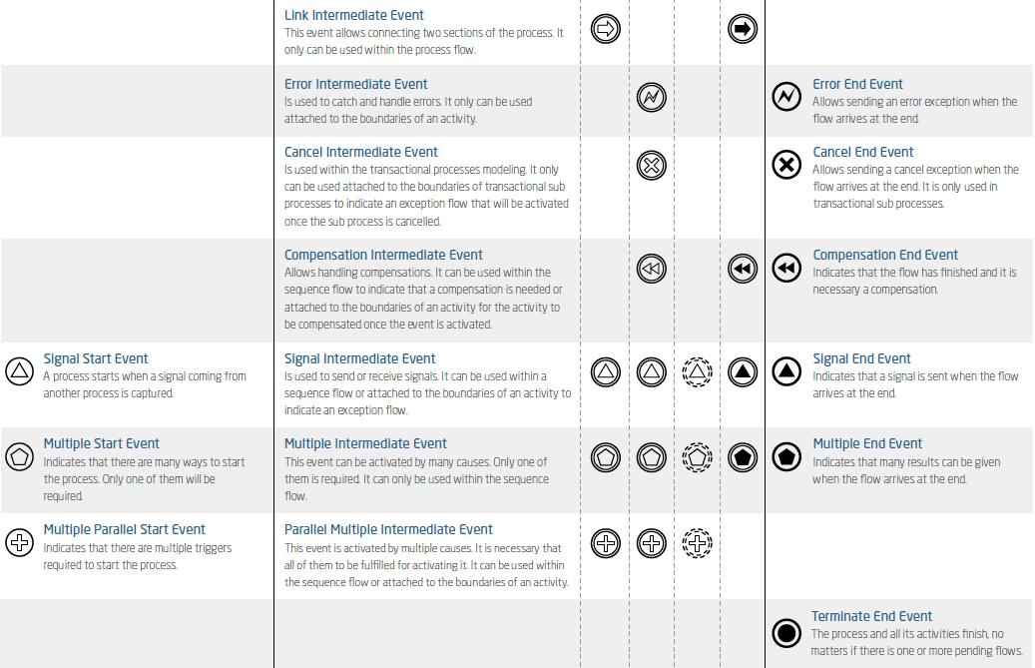

Slide 13
4.2 Swimlane

Slide 14
BPMN Elements
ELEMENT | DEFINITION | BPMN NAME
Flow Objects | Flow objects are the main graphic elements that define the behavior of the processes | Events
 |  | Activities
 |  | Gateways
Connecting Objects | Flow objects are connected to each other by means of connectors to create the basic framework of the business process structure | Sequence Flow
 |  | Message Flow
 |  | Association
Swimlane | Swimlanes are mechanisms to arrange activities in separate display categories to illustrate the different functional areas or persons in charge | Pools
 |  | Lanes
Artifacts | Artifacts are used to provide additional information about the process. They provide the notation with flexibility to express different contexts properly | Annotation
 |  | Group
 |  | Data Object
 |  | Data Store

Slide 15
Swimlane
At certain times, it happens that an activity diagram expands along more than one entity or player.
When this takes place, the activity diagram is broken down into swimlanes, where each lane represents the entity or player carrying out the activity
The lanes are used as a mechanism to arrange the activities in separate display categories to illustrate the different people in charge
Three types are used in BPMN: Pool, Lane, and Milestone (Bizagi)

Slide 16



Type of Swimlane
ELEMENT | DESCRIPTION | NOTATION
Pool | A Pool is a container of a single Process (contains the sequence flows between activities) A Process is fully contained within the Pool. There is always at least one Pool
Lane | Is a sub-partition within the Process Lanes are used to differentiate elements as internal roles, position, department, etc. They represent functional areas that may be responsible for tasks
Milestone | Is a sub-partition within the Process. It can indicate different stages during the Process

Slide 17

Pool
Represents a participant in a process
A Participant can be:
a specific Partner Entity (e.g., a company)
A general Partner Role (e.g., a buyer, seller, or manufacturer)
A pool is also can be defined as a container of a single Process (contains the sequence flows between activities)

Slide 18
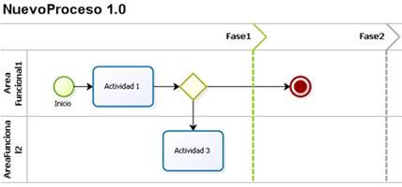
Lane
A sub-partition within a pool, which will be extended over of the pool horizontally or vertically
In Bizagi, there are vertical lanes, also known as phases. The lanes are used to arrange and categorize activities
Vertical line separating the different states within the process

Slide 19

Milestone
A milestone is a sub-partition within a lane and it is extended over it vertically
Milestone are used to arrange and categorize activities showing the possible statuses that a process can have during its life cycle

Slide 20
Tugas
Buat Proses Pengajuan Kredit
Masukan dua lane:
Pemohon
Bank

Slide 21
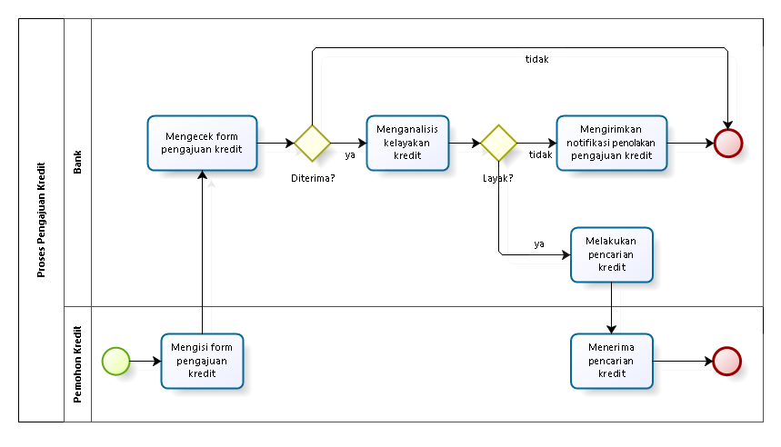
Proses Pengajuan Kredit

Slide 22
4.3 Connecting Objects

Slide 23
BPMN Elements
ELEMENT | DEFINITION | BPMN NAME
Flow Objects | Flow objects are the main graphic elements that define the behavior of the processes | Events
 |  | Activities
 |  | Gateways
Connecting Objects | Flow objects are connected to each other by means of connectors to create the basic framework of the business process structure | Sequence Flow
 |  | Message Flow
 |  | Association
Swimlane | Swimlanes are mechanisms to arrange activities in separate display categories to illustrate the different functional areas or persons in charge | Pools
 |  | Lanes
Artifacts | Artifacts are used to provide additional information about the process. They provide the notation with flexibility to express different contexts properly | Annotation
 |  | Group
 |  | Data Object
 |  | Data Store

Slide 24
Sequence Flow
Sequence lines are used to show the order in which activities will be carried out in the process
They are represented by an arrow indicating “from” and “to”
Types of sequence flow include Normal, Original, Default Flow

Slide 25
Type of Sequence Flow
ELEMENT | DEFINITION | NOTATION
Normal Flow | The normal line refers to the path of the flow between two shapes, and is not affected by conditions. The simplest use of this shape is a sequence between two activities.
Conditional Flow | This flow has a condition assigned that defines whether or not the flow is used. It can be assigned to any shape in the process that requires to evaluate a condition in order to follow a certain path
Default Flow | For decisions bases on inclusive decisions or data, a type of path of the flow is that of “default” conditions. This type of transitions takes place only if all the other conditions are false at the same time.

Slide 26
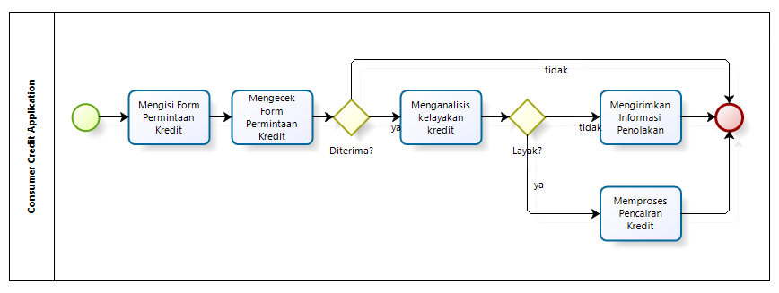
Example of Sequence Flow
In this process, there are normal sequence flows and two sequence flow conditioned by an Exclusive Gateway

Slide 27
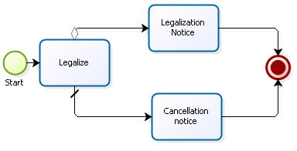
Example of Sequence Flow
In this process, there is a Conditional Flow and a Default Flow that evaluate if a Legalization was successful or not

Slide 28
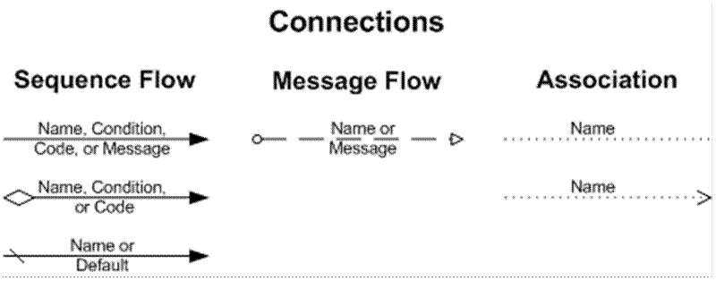
Message Flow
A Message Flow is used to show the flow of messages between two entities that are prepared to send and receive them

Slide 29
Association
An Association is used to associate information and artifacts with flow objects

Slide 30
4.4 Flow Objects

Slide 31
BPMN Elements
ELEMENT | DEFINITION | BPMN NAME
Flow Objects | Flow objects are the main graphic elements that define the behavior of the processes | Events
 |  | Activities
 |  | Gateways
Connecting Objects | Flow objects are connected to each other by means of connectors to create the basic framework of the business process structure | Sequence Flow
 |  | Message Flow
 |  | Association
Swimlane | Swimlanes are mechanisms to arrange activities in separate display categories to illustrate the different functional areas or persons in charge | Pools
 |  | Lanes
Artifacts | Artifacts are used to provide additional information about the process. They provide the notation with flexibility to express different contexts properly | Annotation
 |  | Group
 |  | Data Object
 |  | Data Store

Slide 32
4.4.1 Events

Slide 33
Event
An event is something that happens during the course of the process, affecting the process flow and normally has a trigger or result
Types of events are classified depending on when they affect the flow
Within each type of event, they are classified as per the impact on the process flow
For instance, some subtypes are: messages, timer, cancellation, error, etc.

Slide 34



Type of Event
TYPE OF EVENT | DEFINITION | NOTATION
Start | As its name suggests, it represents the starting point of a process
Intermediate | This takes place between a start event and an end event. It will affect the process, but it will not cause it to start or end directly
End | Indicates when a process ends

Slide 35
Start Events

Slide 36







Type of Start Event
ELEMENT | DESCRIPTION | NOTATION
Start Event | Indicates where a particular Process starts. It does not have any particular behavior
Message Start Event | Is used when a message arrives from a participant and triggers the start of the Process.
Timer Start Event | Is used when the start of a Process occurs on a specific date or cycle time (e.g., every Friday)
Conditional Start Event | This type of Event triggers the start of a Process when a condition becomes true
Signal Start Event | The start of the Process is triggered by the arrival of a signal that has been broadcast from another Process. Note that the signal is not a message; messages have specific targets, signals do not
Parallel Multiple Start Event | Indicates that there are multiple triggers required to start the Process. ALL triggers must be triggered before the Process is instantiated
Multiple Start Event | This means that there are multiple ways of triggering the Process. Only one of them is required

Slide 37
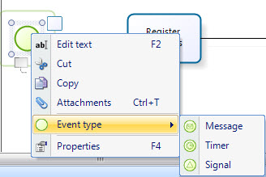
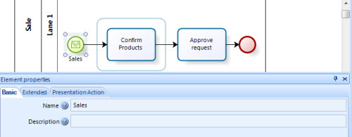
Message Start
An active process sends a message to another specific process in order to trigger its start
Message Start is always a catch shape. That is, in order to use a Message Start, there has to be a Message Event that throws the message

Slide 38
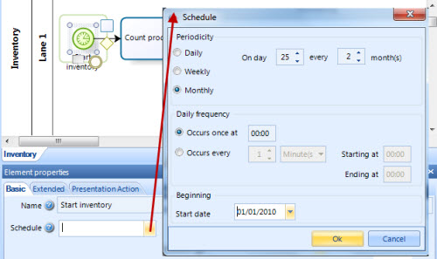
Timer Start
A specific time-date (e.g. every Monday at 9am) can be set in order to trigger the start of the process automatically:
an inventory process must be started every two months on the 25th

Slide 39
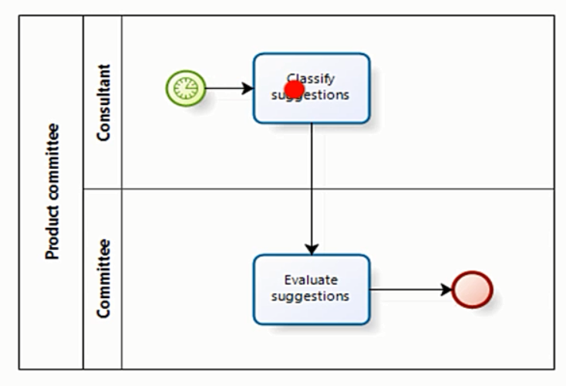
Timer Start

Slide 40
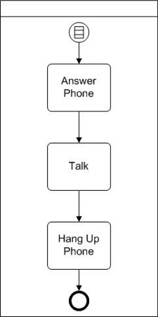
Conditional Start
The rule might be “If caller ID indicates a friend or family member.”
When the rule evaluates to true, the process is started
In this process we answer the phone, talk, and then hang up the phone. But we only do this if the call is from a friend or family member

Slide 41
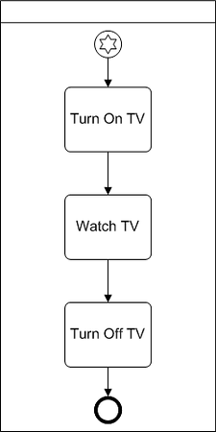
Multiple Start
Our television watching process (turn on tv, watch tv, turn off tv) could be initiated because:
we want to be entertained
we want to be educated
We might be turning it on at a precise time, every morning, to check for school closings
We might just want the tv for background noise while we do something else
Since we care about how the process is initiated, we use the multiple start event instead of the none start event

Slide 42
Intermediate Events

Slide 43






Type of Intermediate Event
ELEMENT | DESCRIPTION | NOTATION
Intermediate Event | Indicates where something happens somewhere between the start and end of a Process. It will affect the flow of the Process, but will not start or (directly) terminate the Process
Message Event | Indicates that a message can be sent or received. If a Process is waiting for a message and it is caught the Process will continue its flow. A catch Message Event waits for a message to arrive and once the message has been received, the Process will continue.
Timer Event | Indicates a delay within the Process. This type of Event can be used within the sequential flow indicating a waiting time between activities
Escalation Event | The Event indicates an escalation through the Process
Compensation Event | Enables the handling of compensations. When used within the sequential flow of a Process they indicate that compensation is necessary
Conditional Event | This Event is triggered when a condition becomes true

Slide 44




Type of Intermediate Event
ELEMENT | DESCRIPTION | NOTATION
Link Event | This Event is used to connect two sections of the Process. Link Events can be used to create looping situations or to avoid long Sequence Flow lines
Signal Event | These Events are used to send or receive signals within or across the Process. A signal is similar to a signal flare that is shot into the sky for anyone who might be interested to notice and then react
Multiple Event | This means that there are multiple triggers assigned to the Event. When used to catch the trigger, only one of the assigned triggers is required and the Event marker will be unfilled.
Parallel multiple Event | This means that there are multiple triggers assigned to the Event. Unlike the normal Multiple Intermediate Event, ALL of the assigned triggers are required for the Event to be triggered

Slide 45
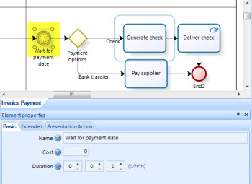
Timer Intermediate Event
This shape represents a delay (period of time) within the process
The time can be defined at design time or as part of the process data (Date or length in any unit of time)
The duration is a Basic Property of the event. It is constant

Slide 46
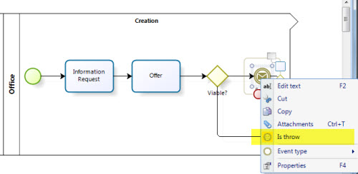
Message Intermediate Event
The Credit Request process throws a message to start a Sales process as soon as an offer is viable
In the Process Modeler configure the throw and the catch message so they have the exact same name

Slide 47
End Events

Slide 48









Type of End Event
ELEMENT | DESCRIPTION | NOTATION
End Event | Indicates when the Process ends
Message End | Indicates that a message is sent when the flow has ended
Escalation End | Indicates that an Escalation is necessary when the flow ends
Error End | Indicates that a named Error should be generated. All currently active threads of the Process are terminated. The Error will be caught by a Catch Error Intermediate Event.
Cancel End | Is used within a Transaction Sub-Process. It indicates that the Transaction should be canceled and an alternative flow can be performed.
Compensation End | Handles compensations. If an activity is identified, and it was successfully completed, the activity will be compensated.
Signal End | Indicates that a signal is sent when the flow has ended
Multiple End | This means that there are multiple consequences of ending the flow. All of them will occur
Terminate End | Ends the Process and all its activities immediately.

Slide 49
End Event
This shape indicates a temporary end in the process
It is used when, after an activity, intermediate event or Exclusive Gateway (divergence element) nothing else needs to be carried out
Unlike the Terminate End Event, this shape does not close the process directly unless there are no pending tokens when it is reached, that is to say, there are no more pending manual activities or points waiting for something else to be done (for instance, a Timer Intermediate Event)

Slide 50
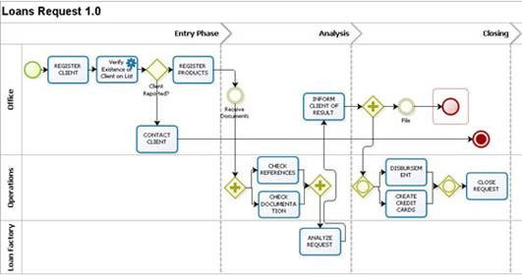
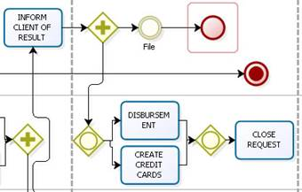
Loan Request
Suppose that parallel to the disbursement and preparation of the credit cards, documents that are still at the office are filed
The filing activity is not required and therefore, it may or may not be carried out
Once it is performed, the process should not end until the request has been closed. In this case, after the Filing activity, an “End Event” is included, indicating that after this activity, there is nothing more to be done on this path

Slide 51
Terminate End Event
Event that constitutes the end of the process
There can be more than one in a flow. If a process reaches this event, it will be closed
All flows should have a Terminate End event, regardless of whether they are referring to a process, a sub-process or a module
Note: The Terminate End event is an optional shape in diagramming the process. However, it is advisable to use it in the diagram
A sequence flow goes into this shape (nothing ever comes out of it)

Slide 52
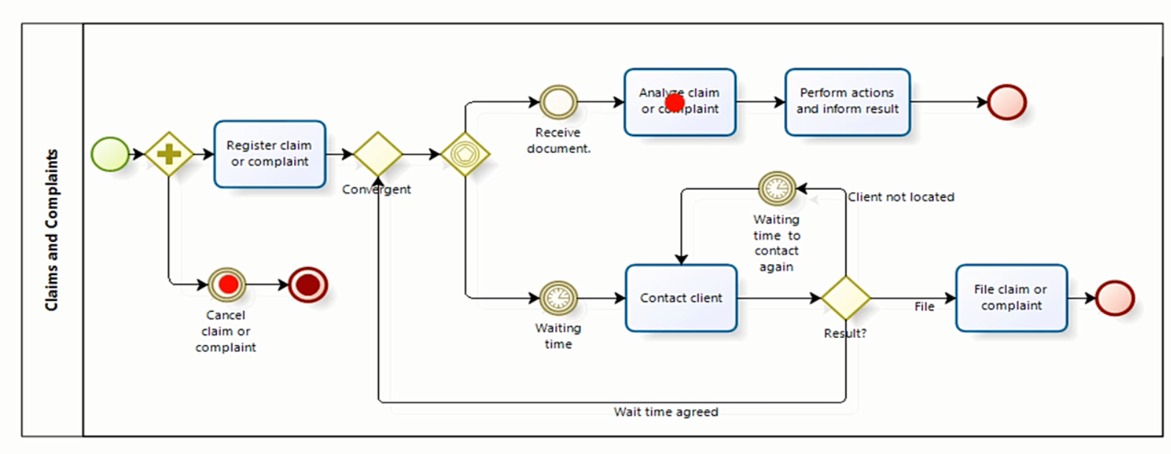
None End and Terminate End Event

Slide 53
Message End Event
This type of End indicates that a Message is sent to a specific process or active case, at the conclusion of the Process
Message End is always a throw shape. That is, in order to use a Message End, there has to be a Message Event, or Message Start that catches the message
The Message End should be configured to identify the target Process and the target Element

Slide 54
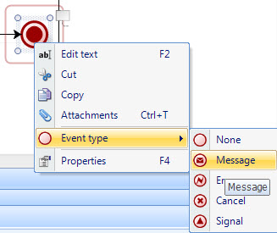
Message End Event

Slide 55
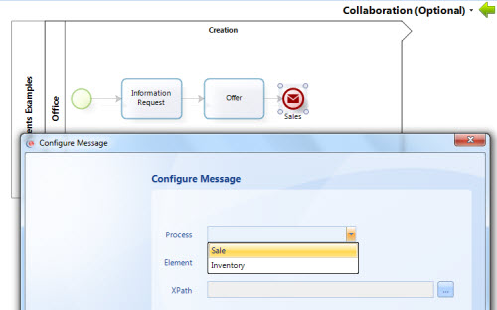
Message End Event
The shape that catches the message and the Message End should have the exact same name
Example: The Credit Request process throws a message to start a Sales process as soon as the process is finished

Slide 56
Tugas: Proses Penentuan Beasiswa
Buat BPMN dari proses penentuan beasiswa di Universitas Suka Belajar:
Proses dimulai dari Administrasi universitas mengumumkan lowongan beasiswa menggunakan berbagai media
Mahasiswa melakukan pendaftaran dan mengirimkan dokumen persyaratan ke Administratif, yang kemudian melakukan seleksi administratif
Komite Universitas melakukan seleksi (seleksi profile dan seleksi wawancara)
Pengumuman hasil penerimaan beasiswa akan disebarkan oleh Administrasi melalui berbagai media massa
Tugas terakhir dari Administrasi adalah melakukan pencairan beasiswa

Slide 57
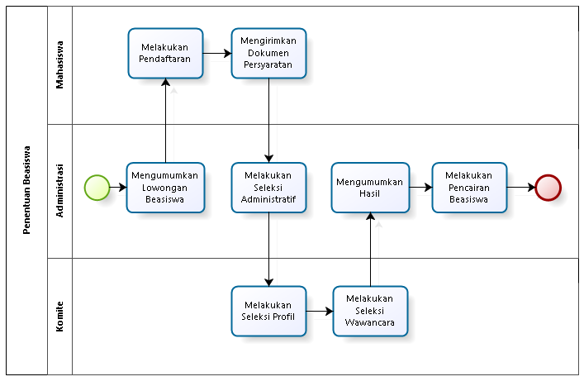
Proses Penentuan Beasiswa

Slide 58
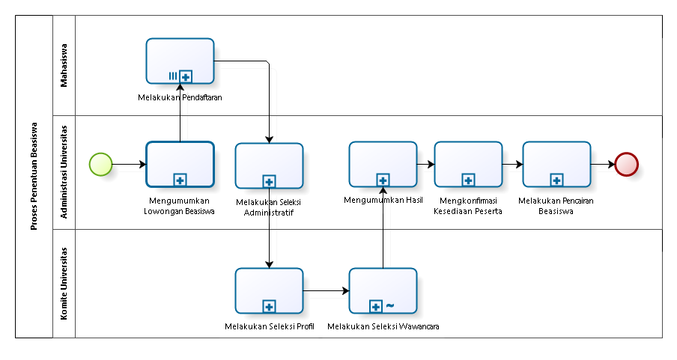
Proses Penentuan Beasiswa

Slide 59
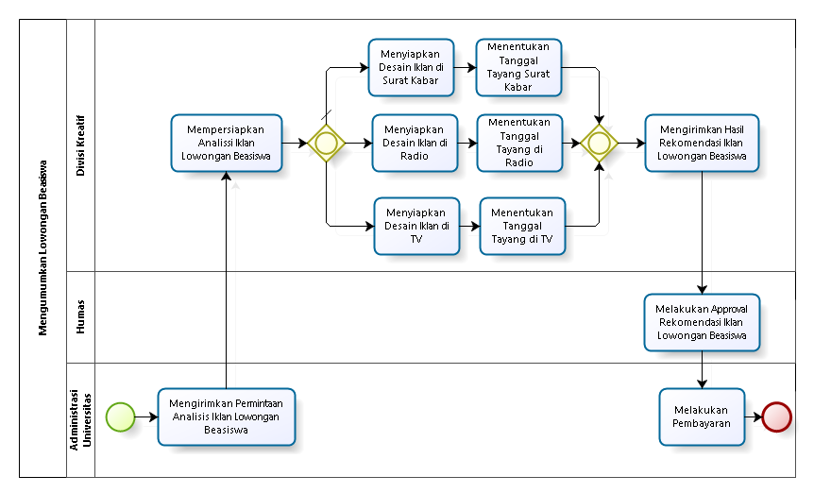
Mengumumkan Lowongan Beasiswa

Slide 60
4.4.2 Activities

Slide 61
BPMN Elements
ELEMENT | DEFINITION | BPMN NAME
Flow Objects | Flow objects are the main graphic elements that define the behavior of the processes | Events
 |  | Activities
 |  | Gateways
Connecting Objects | Flow objects are connected to each other by means of connectors to create the basic framework of the business process structure | Sequence Flow
 |  | Message Flow
 |  | Association
Swimlane | Swimlanes are mechanisms to arrange activities in separate display categories to illustrate the different functional areas or persons in charge | Pools
 |  | Lanes
Artifacts | Artifacts are used to provide additional information about the process. They provide the notation with flexibility to express different contexts properly | Annotation
 |  | Group
 |  | Data Object
 |  | Data Store

Slide 62
Activities
Activities represent work or tasks carried out by members of the organization
This element stands for manual or automatic tasks performed by an external system or user
They are classified into:
Tasks
Sub-processes
Sub-processes are distinguished by a plus sign at the bottom center of the shape

Slide 63
Task

Slide 64





Type of Task
ELEMENTS | DESCRIPTION | NOTATION
Task | Is an atomic Activity within a Process flow. It is used when the work in the Process cannot be broken down to a finer level of detail
User Task | Is a typical workflow Task where a person performs the Task with the assistance of a software application
Service Task | Is a Task that uses some sort of service that could be a Web service or an automated application
Receive Task | Is a Task designed to wait for a message to arrive from an external participant (relative to the Process)
Send Task | Is a Task designed to send a message to an external participant (relative to the Process)

Slide 65





Type of Task
Script Task | Is a Task that is executed by a Business Process Engine. The modeler defines a script in a language that the engine can interpret. Emails automatically sent to notify participant is an example of script task
Manual Task | Is a Task that is expected to be performed without the aid of any business process execution or any application.
Business Rule Task | Offers a mechanism for the process to provide input to a Business Rule Engine and get the output of calculations that the engine might provide
Multi-Instance Loop | Tasks may be repeated sequentially, behaving like a loop. The Multi-instance Loop iterates a predetermined number of times. The iterations occur sequentially or in parallel (simultaneously)
Standard Loop | Tasks may be repeated sequentially, behaving like a loop. This feature defines a looping behavior based on a boolean condition. The Activity will loop as long as the boolean condition is true

Slide 66
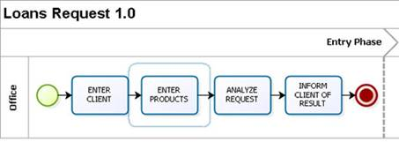
User Task
Is a typical workflow Task where a human performer performs the Task with the assistance of software application, and to be completed in a certain amount of time
Example: The following is the illustration of a Loan request process with just User Tasks performed by the commercial consultant in the office

Slide 67
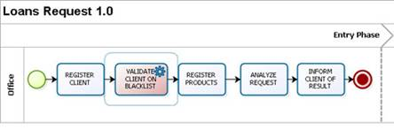
Service Task
Service Task is a task carried out by the system with no human intervention. For instance, interfaces with other systems and computer activities, among others
Example: The following figure displays a simplified loan request process, in which there is an automatic activity to verify whether or not the client has been reported on a blacklist.

Slide 68
Send and Receive tasks
Send and Receive tasks are throw and catch options used to send a Message or receive a Message
When used to throw (send) the message, the shape has an arrow pointing to the right. When used to catch (receive) the message, the shape has an arrow pointing to the left
If a process is waiting for a message, it will be paused until the message arrives or it will change the flow for exception handling
In order to use a throw Message, there has to be a catch Message Event that catches the message. It can be a Message Intermediate Event, a Message Start or a receive Task
The Send Task should be configured to identify the target Process and the target Element

Slide 69
Script Task
A Script Task is an automatic task in which a script is executed by the server
It has no human intervention and does not connect to any external service
In Bizagi this shape is recommended to send e-Mail Messages or execute Scripting Expressions

Slide 70
Manual Task
This is a Task that is expected to be performed without the aid of any business process execution engine or any application
An example of this could be secretary filing physical documents

Slide 71
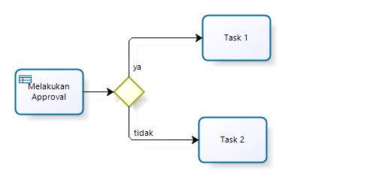
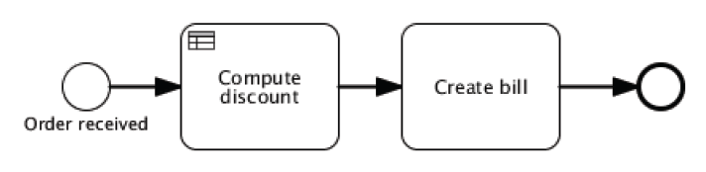
Business Rule Task
Offers a mechanism for the process to provide input to a Business Rule Engine and get the output of calculations that the engine might provide

Slide 72
Tugas: Proses Penentuan Beasiswa
Buat BPMN dari proses penentuan beasiswa di Universitas Suka Belajar
Proses dimulai dari Administrasi universitas mengumumkan lowongan beasiswa menggunakan berbagai media
Mahasiswa melakukan pendaftaran dan mengirimkan dokumen persyaratan ke Administratif, yang kemudian melakukan seleksi administratif
Komite Universitas melakukan seleksi (seleksi profile dan seleksi wawancara)
Pengumuman hasil penerimaan beasiswa akan disebarkan oleh Administrasi melalui berbagai media massa
Tugas terakhir dari Administrasi adalah melakukan pencairan beasiswa
Tentukan Task apa yang sebaiknya menjadi jenis: User, Manual, Send, Receive, Script, Service, Business Rule

Slide 73
Subproses

Slide 74
Subprocess
A SubProcess is a set of activities that have a logical sequence that meet a clear purpose
A SubProcess is a process in itself, whose functionality is part of a larger process
When the sub-process is collapsed, the details of the sub-process cannot be viewed (plus sign (+))
When the sub-process is expanded, the details of the sub-process can be seen within the limits
A SubProcess can be defined as:
Embedded
Reusable
Adhoc

Slide 75
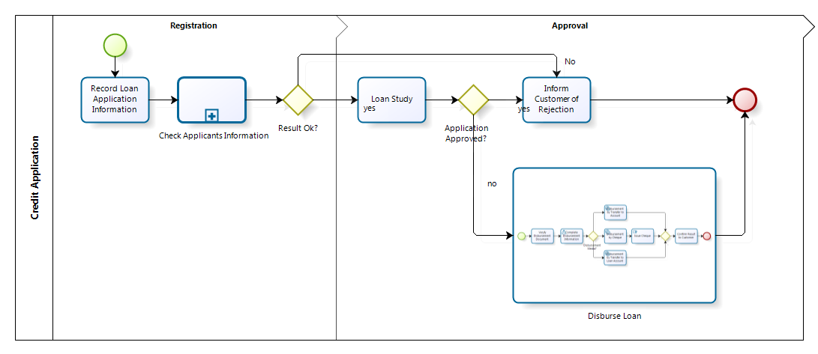
Subprocess

Slide 76








Type of Subprocess
ELEMENT | DESCRIPTION | NOTATION
Sub-process | Is an Activity which internal details have been modeled using activities, gateways, Events, and sequence flows. The elements has a thin border
Reusable Sub-process | Identifies a point in the process where a predefined process is used. A reusable Sub-process is called a Call Activity in BPMN. The element has a thick border
Event Sub-process | A Sub-process is defined as an Event Sub-process when it is triggered by an Event. An Event Sub-Process is not part of the normal flow of its parent Process - there are no incoming or outgoing Sequence Flows.
Transaction | Is a Sub-process whose behavior is controlled through a transaction protocol. It includes the three basic outcomes of a transaction: Successful Completion, Failed Completion and Cancel Intermediate Event
Ad-Hoc Sub-process | Is a group of activities that has no REQUIRED sequence relationships. A set of activities can be defined, but the sequence and number of performances for the activities is determined by the performers of the activities
Standard loop | Sub-processes may be repeated sequentially, behaving like a loop. This feature defines a looping behavior based on a boolean condition. The activity will loop as long as the boolean condition is true
Multi-Instance loop | Sub-processes may be repeated sequentially, behaving like a loop. The Multi-instance Loop iterates a predetermined number of times. The iterations occur sequentially or in parallel (simultaneously)

Slide 77

Embedded SubProcess
Embedded SubProcesses contain a set of activities that are not independent of the Parent process
They share the same information or data. They are usually a section or module of a same process but have a clear objective and so, can be defined with a beginning and an end
They do not need mapping data and cannot be configured as multiple SubProcesses

Slide 78
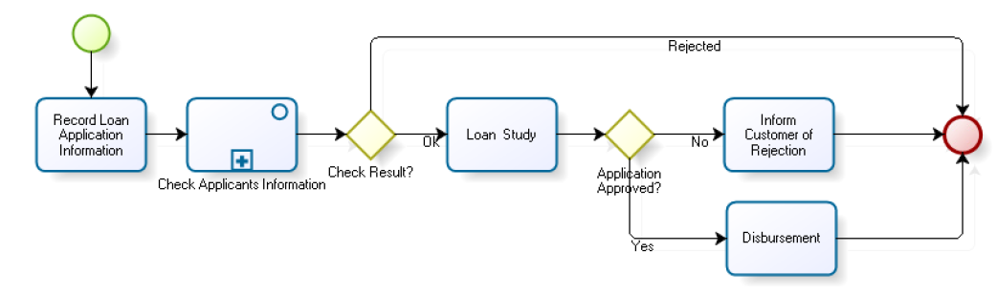
Credit Application with Subprocess

Slide 79
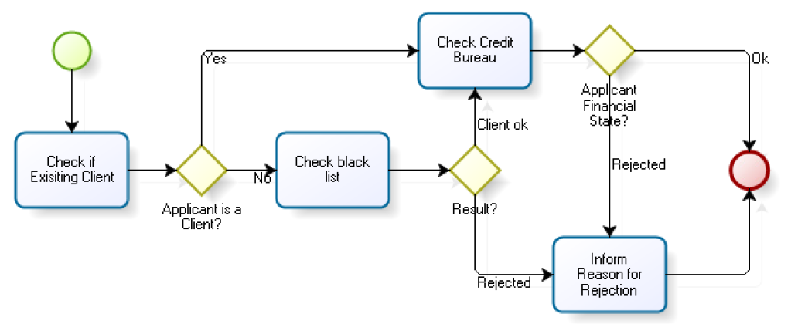
Information Checking Subprocess

Slide 80
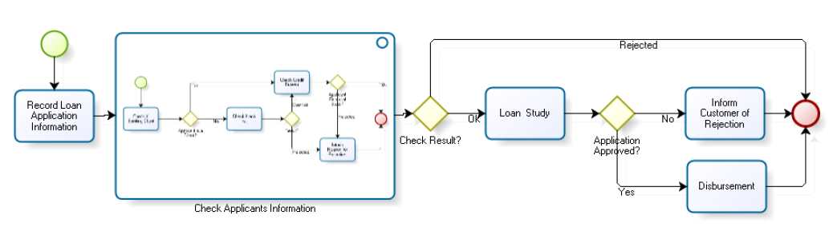
Credit Application with Expanded Subprocess

Slide 81

Reusable SubProcess
Reusable Sub Processes contain a set of activities that are independent from the Parent process, which is the process that calls upon them
The purpose of a reusable Sub Process is different from the Parent process and can be considered as a black box

Slide 82
Tugas: Proses Penentuan Beasiswa
Buat BPMN dari proses penentuan beasiswa mahasiswa di Universitas Suka Belajar
Proses dimulai dari Administrasi universitas mengumumkan lowongan beasiswa menggunakan berbagai media
Mahasiswa melakukan pendaftaran dan mengirimkan dokumen persyaratan ke Administratif, yang kemudian melakukan seleksi administratif
Komite Universitas melakukan seleksi (seleksi profile dan seleksi wawancara)
Pengumuman hasil penerimaan beasiswa akan disebarkan oleh Administrasi melalui berbagai media massa
Tugas terakhir dari Administrasi adalah melakukan pencairan beasiswa
Tentukan Task apa yang sebaiknya diubah menjadi SubProcess dengan jenis: Embedded, Reusable
Isi Sub Process di atas dengan flow baru

Slide 83
Tugas: Proses Penentuan Beasiswa
Pada aktifitas pengumuman lowongan beasiswa, ada proses yang lebih detail yang berisi:
Membuat desain iklan lowongan beasiswa
Menentukan media massa dan waktu penayangan
Mengirimkan desain iklan lowongan beasiswa dan melakukan pembayaran biaya iklan
Gambarkan aktifitas di atas dalam bentuk subproses dari task pengumuman lowongan beasiswa
Tentukan task type yang tepat untuk masing-masing task

Slide 84
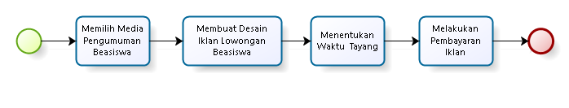
Proses Mengumumkan Lowonan Beasiswa

Slide 85
Ad Hoc Sub Process
It is fairly common that businesses need to manage unstructured processes (ad hoc) rather than well predefined business processes
An ad hoc subprocess is one in which the specified steps are defined, but the order of operations is not
Ad hoc processes consist of a series of activities which cannot be predefined

Slide 86
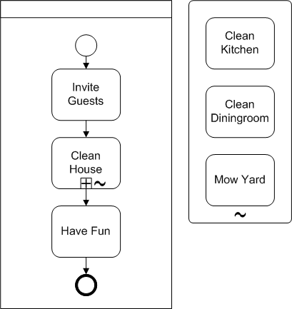
Ad Hoc Sub Process

Slide 87
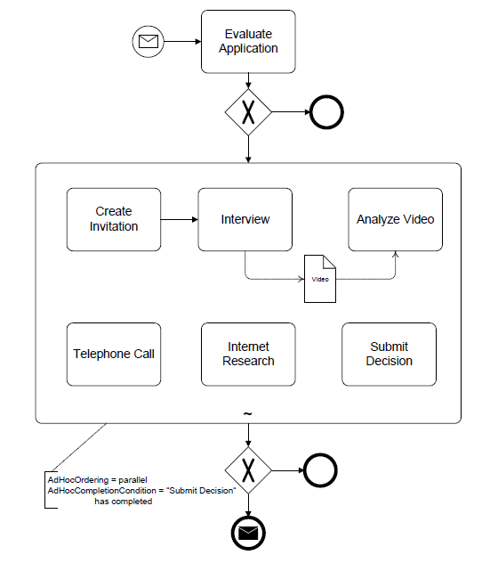
Ad Hoc Sub Process

Slide 88
Tugas: Proses Penentuan Beasiswa
Buat BPMN dari proses penentuan beasiswa mahasiswa di Universitas Suka Belajar
Proses dimulai dari Administrasi universitas mengumumkan lowongan beasiswa menggunakan berbagai media
Mahasiswa melakukan pendaftaran dan mengirimkan dokumen persyaratan ke Administratif, yang kemudian melakukan seleksi administratif
Komite Universitas melakukan seleksi (seleksi profile dan seleksi wawancara)
Pengumuman hasil penerimaan beasiswa akan disebarkan oleh Administrasi melalui berbagai media massa
Tugas terakhir dari Administrasi adalah melakukan pencairan beasiswa
Tentukan Task apa yang sebaiknya diubah menjadi SubProcess dengan jenis: Adhoc, Embedded, Reusable
Isi Sub Process di atas dengan flow baru

Slide 89
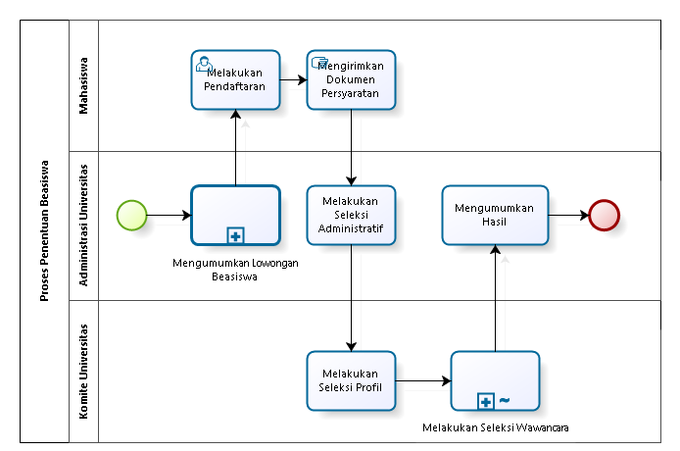
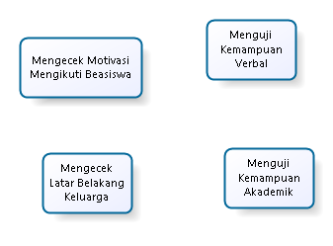
Adhoc Subprocess

Slide 90
4.4.3 Gateway

Slide 91
BPMN Elements
ELEMENT | DEFINITION | BPMN NAME
Flow Objects | Flow objects are the main graphic elements that define the behavior of the processes | Events
 |  | Activities
 |  | Gateways
Connecting Objects | Flow objects are connected to each other by means of connectors to create the basic framework of the business process structure | Sequence Flow
 |  | Message Flow
 |  | Association
Swimlane | Swimlanes are mechanisms to arrange activities in separate display categories to illustrate the different functional areas or persons in charge | Pools
 |  | Lanes
Artifacts | Artifacts are used to provide additional information about the process. They provide the notation with flexibility to express different contexts properly | Annotation
 |  | Group
 |  | Data Object
 |  | Data Store

Slide 92

Gateway
Gateways are used to control the divergence and convergence of the flow. They determine ramifications, bifurcations, combinations and merges in the process.
They are represented by a diamond shape. Internal markers will show the type of control being used
Icons in the diamond shape indicate the type of behavior of the flow control

Slide 93







Type of Gateway
ELEMENT | DESCRIPTION | NOTATION
Exclusive Gateway | As Divergence: It is used to create alternative paths within the Process, but only one is chosen. As Convergence: It is used to merge alternative paths.
Event Based Gateway | Represents a branching point in the Process where the alternative paths that follow the Gateway are based on Events that occur. When the first Event is triggered, the path that follows that Event will be used. All the remaining paths will no longer be valid.
Exclusive Event Based Gateway | Is a variation of the Event based gateway and it is used to instantiate Processes. One the Events of the Gateway configuration must be triggered in order to create a Process instance.
Parallel Event Based Gateway | Unlike the the exclusive Event based Gateway, ALL the Events of the Gateway configuration must be triggered in order to create a Process instance
Parallel Gateway | As Divergence: is used to create alternative paths without checking any conditions. As Convergence: is used to merge alternative paths, the gateways waits for all incoming flows before it continues.
Complex Gateway | As Divergence: is used to control complex decision points in the Process. It creates alternative paths within the Process using expressions. As Convergence: Allow continuing to the next point of the Process when a business condition becomes true.
Inclusive Gateway | As Divergence: represents a branching point where alternatives are based on conditional expressions. The TRUE evaluation of one condition does not exclude the evaluation of the other conditions. All evaluations of a TRUE condition will be traversed by a token. As Convergence: is used to merge a combination of alternative and parallel paths.

Slide 94

Exclusive Gateway (Divergence)
As a divergence shape, the Exclusive Gateway is used when two or more alternative paths appear at one point in the process, and just one of them is valid at a given time. Data-based decision of the system.

Slide 95
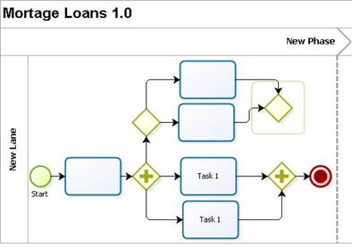
Exclusive Gateway (Convergence)
Three paths exit the parallel gateway (divergence element) and three paths are subsequently synchronized
If the exclusive gateway were not synchronized, four transitions would enter the parallel gateway (convergence element) which would be wrong, given the fact that the process would be waiting for 4 paths that would never be completed

Slide 96
Event Based Gateway
Indicates points of the process in which the Exclusive Gateway is not based on process data, but rather on external messages or events. This shape is used to exercise control over the execution of certain activities to the extent that it enables keeping them available until one of them is executed
Unlike the Exclusive Gateway, the activities that come from this shape will always be triggered, that is to say, their activation does not depend on system data

Slide 97
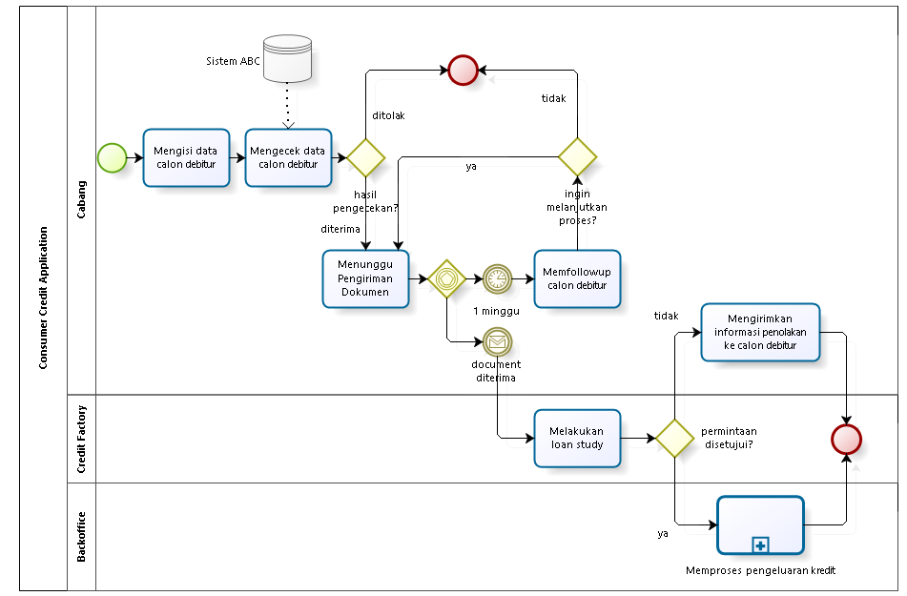
Credit Application with Event-Based Gateway

Slide 98
Tugas: Proses Penentuan Beasiswa
Buat BPMN dari proses penentuan beasiswa mahasiswa di Universitas Suka Belajar
Proses dimulai dari Administrasi universitas mengumumkan lowongan beasiswa menggunakan berbagai media
Mahasiswa melakukan pendaftaran dan mengirimkan dokumen persyaratan ke Administratif, yang kemudian melakukan seleksi administratif
Komite Universitas melakukan seleksi (seleksi profile dan seleksi wawancara)
Pengumuman hasil penerimaan beasiswa akan disebarkan oleh Administrasi melalui berbagai media massa
Tugas terakhir dari Administrasi adalah melakukan pencairan beasiswa
Calon penerima wajib mengirimkan surat kesediaan menerima beasiswa dalam batas 1 minggu setelah pengumuman, supaya beasiswa bisa mulai dicairkan (letakkan di dalam Subprocess“Melakukan Pencairan Beasiswa”
Tambahkan Event based Gateway untuk mendukung requirement ke 5

Slide 99
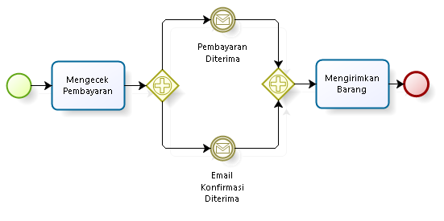
Paralell Event Based Gateway
All the Events of the Gateway configuration must be triggered in order to create a Process instance

Slide 100
Tugas: Proses Penentuan Beasiswa
Buat BPMN dari proses penentuan beasiswa mahasiswa di Universitas Suka Belajar
Proses dimulai dari Administrasi universitas mengumumkan lowongan beasiswa menggunakan berbagai media
Mahasiswa melakukan pendaftaran dan mengirimkan dokumen persyaratan ke Administratif, yang kemudian melakukan seleksi administratif
Komite Universitas melakukan seleksi (seleksi profile dan seleksi wawancara)
Pengumuman hasil penerimaan beasiswa akan disebarkan oleh Administrasi melalui berbagai media massa
Tugas terakhir dari Administrasi adalah melakukan pencairan beasiswa
Mahasiswa mengajukan permohonan surat bebas narkoba, surat tidak mampu dan surat kelakukan baik dari berbagai instansi. Dokumen-dokumen tersebut adalah dokumen persyaratan. Masukkan sebagai subprocess di Mengirimkan Dokumen Persyaratan (Lane: Mahasiswa, Polres, Kelurahan)
Tambahkan Paralel Event based Gateway untuk mendukung requirement ke 5

Slide 101
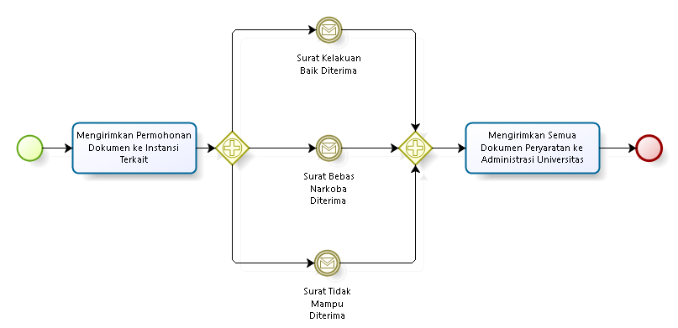
Tugas: Proses Penentuan Beasiswa

Slide 102
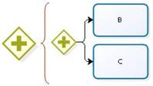
Parallel Gateway (Divergence)
As a divergence element, this shape is used when many activities have to be carried out at the same time and in any order, which indicates that all transitions or paths that exit this shape will always be enabled

Slide 103
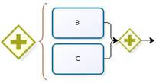
Parallel Gateway (Convergence )
As a point of convergence, this shape is used to synchronize paths that exit a Parallel Gate (convergence element)
The Parallel gateway (divergence element) enables the flow to carry on, only until all the transitions indicated have reached the shape

Slide 104
Tugas: Proses Penentuan Beasiswa
Buat BPMN dari proses penentuan beasiswa mahasiswa di Universitas Suka Belajar
Proses dimulai dari Administrasi universitas mengumumkan lowongan beasiswa menggunakan berbagai media
Mahasiswa melakukan pendaftaran dan mengirimkan dokumen persyaratan ke Administratif, yang kemudian melakukan seleksi administratif
Komite Universitas melakukan seleksi (seleksi profile dan seleksi wawancara)
Pengumuman hasil penerimaan beasiswa akan disebarkan oleh Administrasi melalui berbagai media massa
Tugas terakhir dari Administrasi adalah melakukan pencairan beasiswa
Komite Universitas melakukan Seleksi Profile dengan menilai prestasi akademik, non akademik dan kondisi keuangan mahasiswa
Tambahkan Paralel Gateway untuk mendukung requirement ke 5

Slide 105
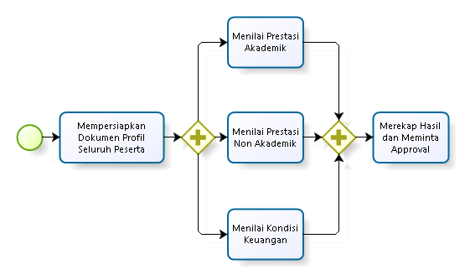
Parallel Gateway

Slide 106
Tugas: Proses Penentuan Beasiswa
Buat BPMN dari proses penentuan beasiswa di Universitas Suka Belajar
Proses dimulai dari Administrasi universitas mengumumkan lowongan beasiswa menggunakan berbagai media
Mahasiswa melakukan pendaftaran dan mengirimkan dokumen persyaratan ke Administratif, yang kemudian melakukan seleksi administratif
Komite Universitas melakukan seleksi (seleksi profile dan seleksi wawancara)
Pengumuman hasil penerimaan beasiswa akan disebarkan oleh Administrasi melalui berbagai media massa
Tugas terakhir dari Administrasi adalah melakukan pencairan beasiswa
Setelah penerimaan, uang beasiswa akan dikirimkan ke mahasiswa setiap bulan melalui ATM
Terapkan parallel gateway, parallel event based gateway, exclusive gateway, event based gateway pada proses

Slide 107
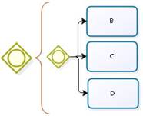
Inclusive Gateway (Divergence)
This shape is used when one or more paths are enabled based on an Exclusive Gateway or work flow control data
When you use a Inclusive Gateway (divergence element), make sure there is at least one valid path. If not, add a transition with an Else condition associated to it in case none of the conditions associated to each Transition is fulfilled

Slide 108
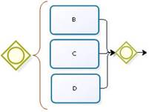
Inclusive Gateway (Convergence)
Inclusive gateways must be defined in pairs when is desired that all the previous activations of an Inclusive Gateway have been executed in order to carry on with the process
So, it must be defined an inclusive gateway (divergent element) to activate the paths and another one (convergent element ) to synchronize them

Slide 109
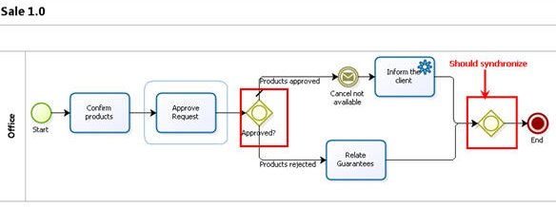
Inclusive Gateway (Convergence)

Slide 110
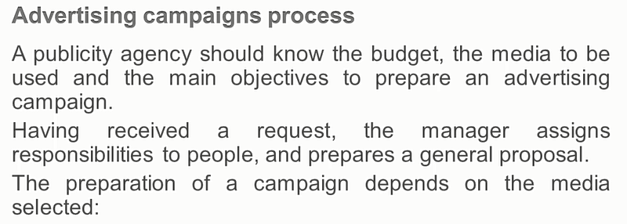

Inclusive Gateway (Convergence)

Slide 111
Tugas: Proses Penentuan Beasiswa
Buat BPMN dari proses penentuan beasiswa di Universitas Suka Belajar
Proses dimulai dari Administrasi universitas mengumumkan lowongan beasiswa menggunakan berbagai media
Mahasiswa melakukan pendaftaran dan mengirimkan dokumen persyaratan
Komite Universitas melakukan seleksi (seleksi profile dan seleksi wawancara)
Pengumuman penerima beasiswa akan disebarkan melalui email dan papan pengumuman
Pada proses penentuan media massa dan waktu tayang divisi humas diminta melakukan analisis, dan diperbolehkan memilih beberapa media massa yang relevan. Masukan ke subprocess Mengumumkan Lowongan Beasiswa.
Terapkan inclusive gateway untuk mendukung requirement ke 5

Slide 112

Complex Gateway

Slide 113

Complex Gateway
Loan Request Process:
An employee requests a loan from the company
This must be approved by his boss, the financial area or the vice-presidency
When at least two of the three approve the request, the money is given to the employee (disburse loan)

Slide 114

Complex Gateway

Slide 115

Complex Gateway

Slide 116
Tugas: Proses Penentuan Beasiswa
Buat BPMN dari proses penentuan beasiswa di Universitas Suka Belajar
Proses dimulai dari Administrasi universitas mengumumkan lowongan beasiswa menggunakan berbagai media
Mahasiswa melakukan pendaftaran dan mengirimkan dokumen persyaratan ke Administratif, yang kemudian melakukan seleksi administratif
Komite Universitas melakukan seleksi (seleksi profile dan seleksi wawancara)
Pengumuman hasil penerimaan beasiswa akan disebarkan oleh Administrasi melalui berbagai media massa
Tugas terakhir dari Administrasi adalah melakukan pencairan beasiswa
Pencairan beasiswa harus mendapatkan minimal approval dari dua pihak, dimana approvalnya sendiri diajukan ke Rektor, Dekan, Kaprodi, Administrasi Universitas
Terapkan complex gateway untuk mendukung requirement ke 5

Slide 117
4.5 Artifacts

Slide 118
BPMN Elements
ELEMENT | DEFINITION | BPMN NAME
Flow Objects | Flow objects are the main graphic elements that define the behavior of the processes | Events
 |  | Activities
 |  | Gateways
Connecting Objects | Flow objects are connected to each other by means of connectors to create the basic framework of the business process structure | Sequence Flow
 |  | Message Flow
 |  | Association
Swimlane | Swimlanes are mechanisms to arrange activities in separate display categories to illustrate the different functional areas or persons in charge | Pools
 |  | Lanes
Artifacts | Artifacts are used to provide additional information about the process. They provide the notation with flexibility to express different contexts properly | Annotation
 |  | Group
 |  | Data Object
 |  | Data Store

Slide 119
Artifacts
Artifacts are graphical object that provides supporting information about the Process or elements within the Process
However, they do not directly affect the flow of the Process
An Artifact MUST NOT be a target for Sequence Flow

Slide 120

Groups
Used to group together a set of activities, whether for the effects of documentation or analysis, however, it does not affect the flow sequence

Slide 121

Annotations
Mechanisms for a modeler to be able to provide additional information in a BPMN diagram

Slide 122

Data Object
Provide information about how documents, data and other objects are used and updated during the process. Can be used to represent electronic and physical objects

Slide 123

Data Store
Provides a mechanism for activities to retrieve or update stored information that will exist beyond the scope of the process

Slide 124
Tugas: Proses Penentuan Beasiswa
Buat BPMN dari proses penentuan beasiswa di Universitas Suka Belajar
Proses dimulai dari Administrasi universitas mengumumkan lowongan beasiswa menggunakan berbagai media
Mahasiswa melakukan pendaftaran dan mengirimkan dokumen persyaratan ke Administratif, yang kemudian melakukan seleksi administratif
Komite Universitas melakukan seleksi (seleksi profile dan seleksi wawancara)
Pengumuman hasil penerimaan beasiswa akan disebarkan oleh Administrasi melalui berbagai media massa
Tugas terakhir dari Administrasi adalah melakukan pencairan beasiswa
Setelah penerimaan, uang beasiswa akan dikirimkan ke mahasiswa setiap bulan tanggal 1
Terapkan milestone dan artifacts (annotation, data object, data store) pada proses

Slide 125
Tugas
Buat BPMN untuk Proses Pengadaan Barang
Unit kerja yang berhubungan dengan proses ini adalah Divisi Pemohon, Divisi Pengadaan Barang, Divisi Keuangan, dan Supplier
BPMN harus mudah dipahami proses besarnya, dengan menggunakan milestone dan subprocess
BPMN tersebut, wajib memasukkan notasi di bawah:
Gateway: Parallel, Inclusive, Event-based, Complex
Task: User, Manual, Script, Service, Business Rule
Sub process: Embedded, Reusable, Ad-hoc, Multiple
Event: Timer, Message, Conditional
Swimlane: Pool, Lane, Milestone
Artifacts: Annotation, Data Store, Data Object

Slide 126
Tugas
Buat BPMN dari salah satu business process di bawah:
Rekrutmen Pegawai
Help Desk Layanan Pelanggan
Perjalanan Dinas Pegawai
Pengunduran Diri Pegawai
Peminjaman Uang
Pengajuan Cuti Pegawai
Punishment Pelanggaran Pegawai
Pengiriman Tugas Belajar Pegawai
Permintaan Pengembangan Sistem
Pemrosesan Surat Masuk
Business process lain di unit kerja organisasi kita yang kita pahami
BPMN baru tersebut, wajib memasukkan notasi di bawah:
Gateway: Exclusive, Parallel, Inclusive, Event-based, Complex
Task: User, Manual, Script, Service, Timer/Message Boundary Event
Sub process: Embedded, Reusable, Ad-hoc, Multiple, Transaction
Event: Timer, Message, Conditional
Swimlane: Pool, Lane, Milestone
Artifacts: Annotation, Data Store, Data Object

Slide 127
Tugas
Analisis organisasi anda, business process apa saja yang ada pada organisasi anda?
Gunakan Functional Decomposition Diagram untuk mempermudah mem-breakdown business process organisasi anda

Slide 128
Reference
Object Management Group, Business Process Model and Notation (BPMN), OMG Document Number: formal/2011-01-04, 2011
Object Management Group, BPMN 2.0 by Example, OMG Document Number: dtc/2010-06-02, 2011
Bruce Silver, BPMN Method and Style Second Edition, Cody-Cassidy Press, 2011
Layna Fischer (edt.), BPMN 2.0 Handbook Second Edition, Future Strategies, 2012
Tom Debevoise, Rick Geneva, and Richard Welke, The Microguide to Process Modeling in BPMN 2.0 Second Edition, CreateSpace, 2011
Bizagi Proses Modeler User Guide, Bizagi, 2012
Bizagi BPM Suite User Guide, Bizagi, 2013
Thomas Allweyer, BPMN 2.0, BoD, 2010

