Slide 1
TOGAF 9 Fundamental:
3. TOGAF ADM
Romi Satria Wahono
romi@romisatriawahono.net
http://romisatriawahono.net/tfu
WA/SMS: +6281586220090

Slide 2

Romi Satria Wahono
SD Sompok Semarang (1987)
SMPN 8 Semarang (1990)
SMA Taruna Nusantara Magelang (1993)
B.Eng, M.Eng and Ph.D in Software Engineering from
Saitama University Japan (1994-2004)
Universiti Teknikal Malaysia Melaka (2014)
Research Interests: Software Engineering,
Machine Learning
Founder IlmuKomputer.Com
PNS di PDII LIPI (1994-2007)
Founder dan CEO PT Brainmatics Cipta Informatika

Slide 3
Course Outline
Introduction
TOGAF Concepts
TOGAF ADM
BPMN Overview
UML Overview
TOGAF Case Study

Slide 4
3. TOGAF ADM
3.1 ADM Iteration
3.2 ADM Process
3.2 TOGAF Artifacts

Slide 5
3.1 ADM Iteration

Slide 6
ADM Cycle
The ADM consists of a number of phases that cycle through a range of architecture domains that enable the architect to ensure that a complex set of requirements is adequately addressed
The ADM is applied iteratively throughout the entire process, between phases, and within them
Throughout the ADM cycle, there should be frequent validation of results against the original requirements, both those for the whole ADM cycle, and those for the particular phase of the process. Such validation should reconsider scope, detail, schedules, and milestones
Each phase should consider assets produced from previous iterations of the process and external assets from the marketplace, such as other frameworks or model

Slide 7
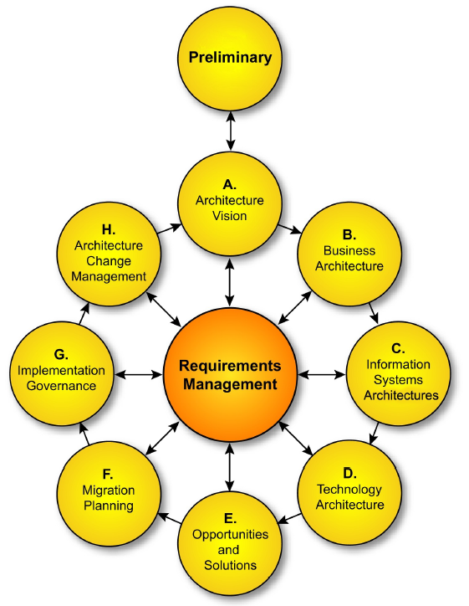

Slide 8
Three Levels of ADM Iteration
Cycling around the ADM: The ADM is presented in a circular manner indicating that the completion of one phase of architecture work directly feeds into subsequent phases of architecture work
Iterating between phases: TOGAF describes the concept of iterating across phases (e.g., returning to Business Architecture on completion of Technology Architecture)
Cycling around a single phase: TOGAF supports repeated execution of the activities within a single ADM phase as a technique for elaborating architectural content

Slide 9
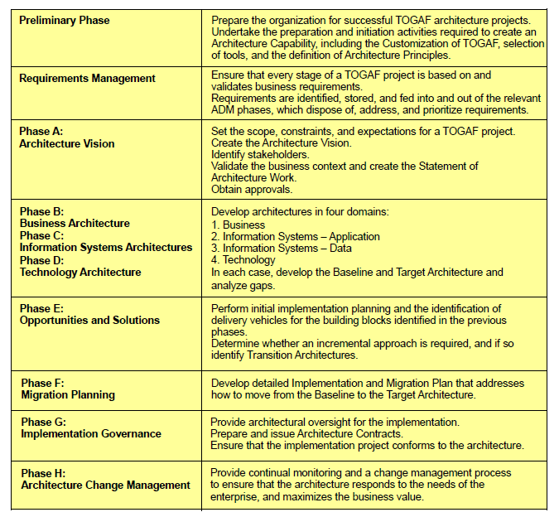

Slide 10
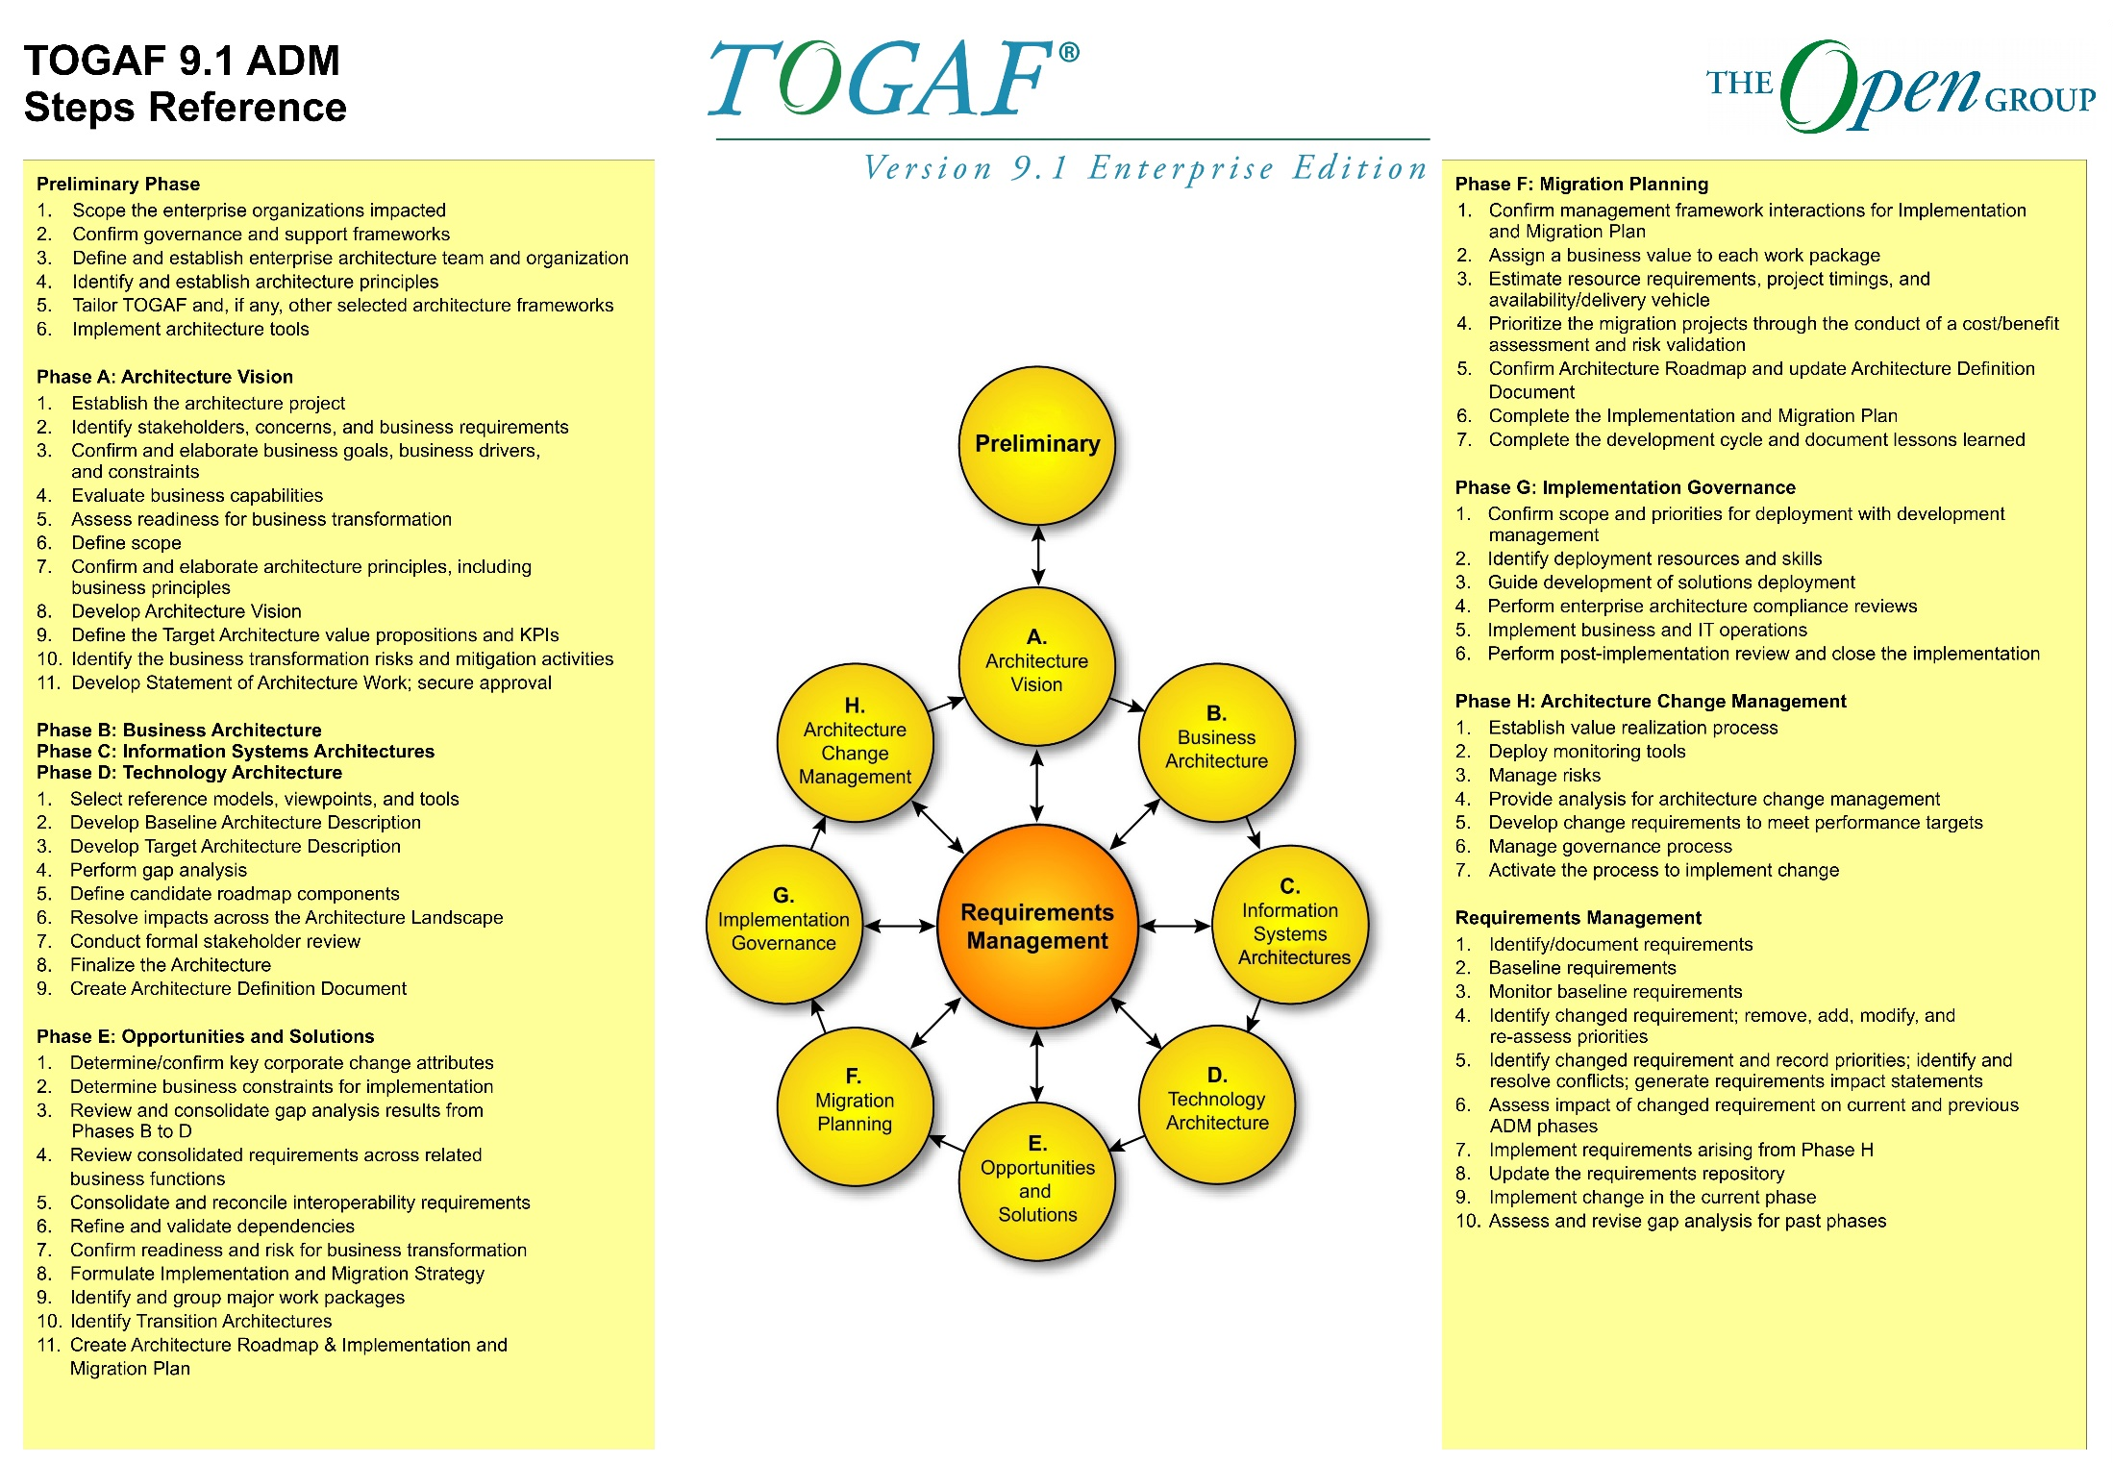

Slide 11
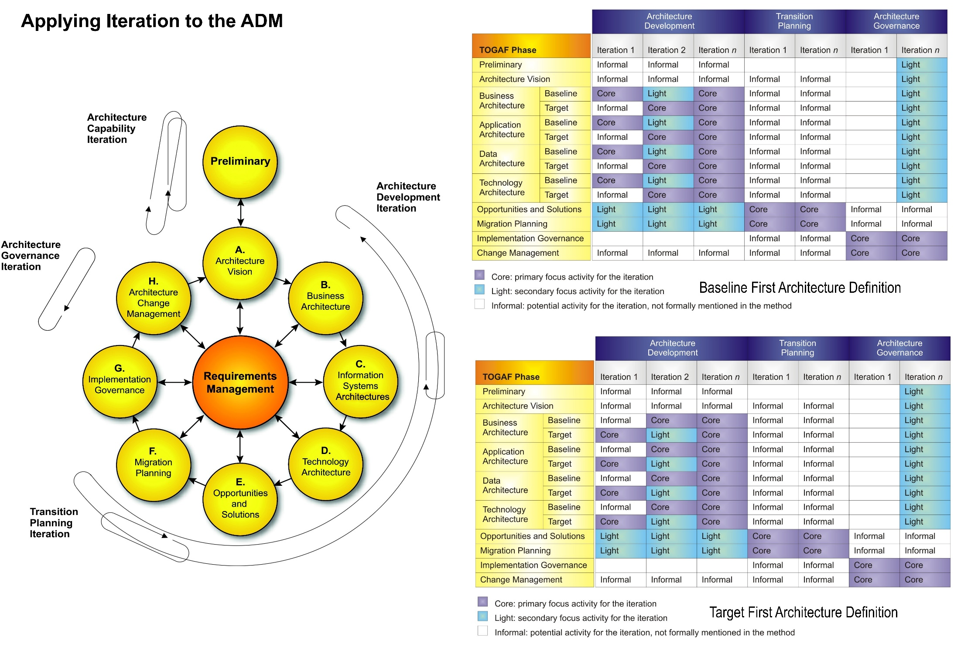

Slide 12
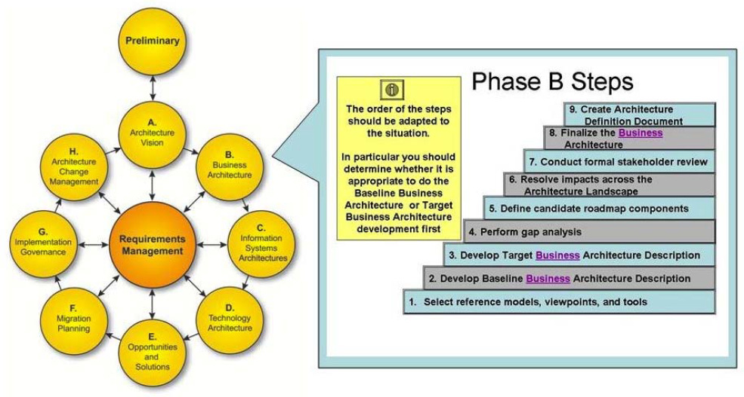
The Architecture Development Cycle
The phases of the ADM cycle are further divided into steps
  For example, the steps within the Business Architecture phase are as follows

Slide 13
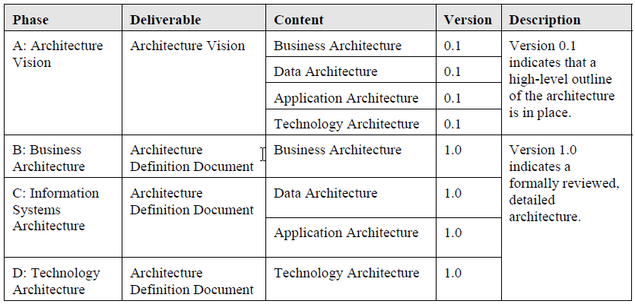
The Architecture Development Cycle
In particular, a version numbering convention is used within the ADM to illustrate the evolution of Baseline and Target Architecture Definitions, as follows:

Slide 14
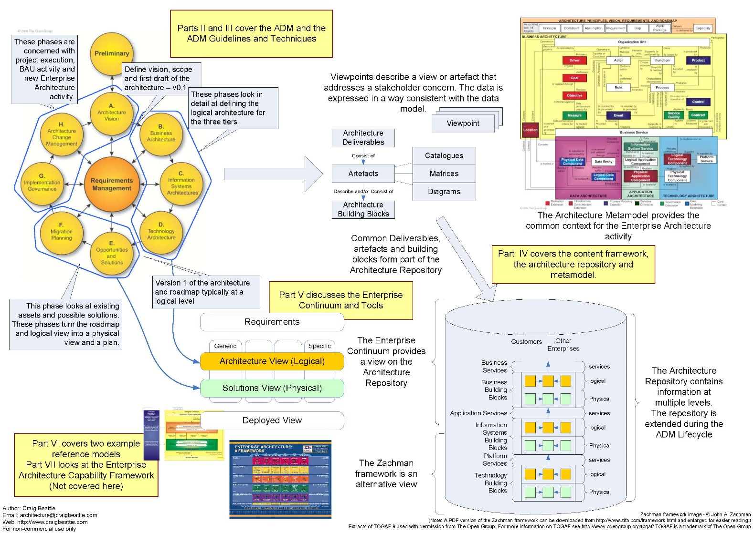

Slide 15
3.2 ADM Process

Slide 18
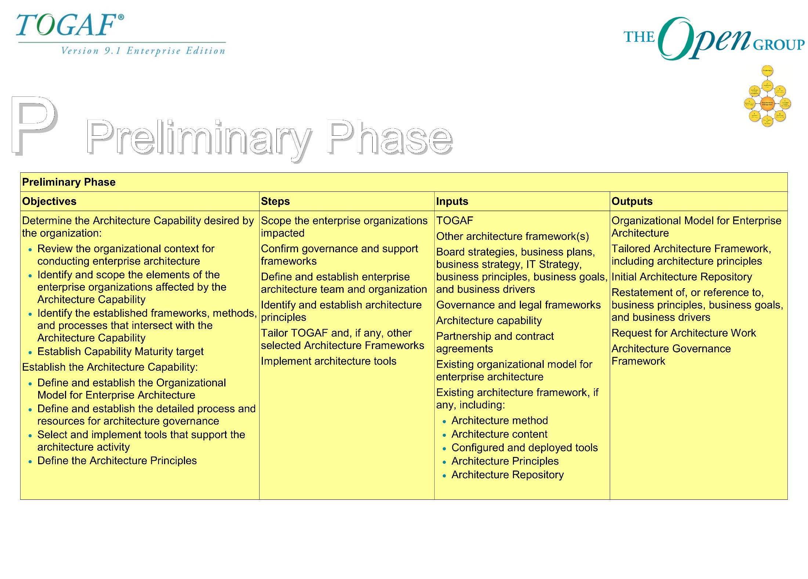

Slide 19
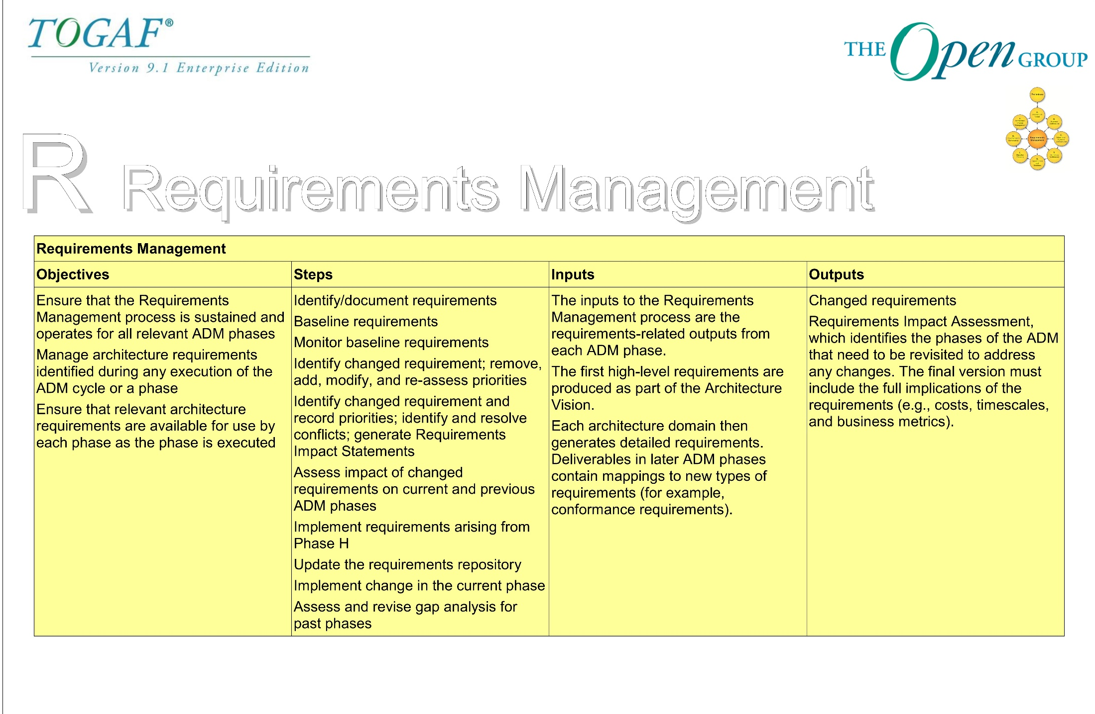

Slide 20
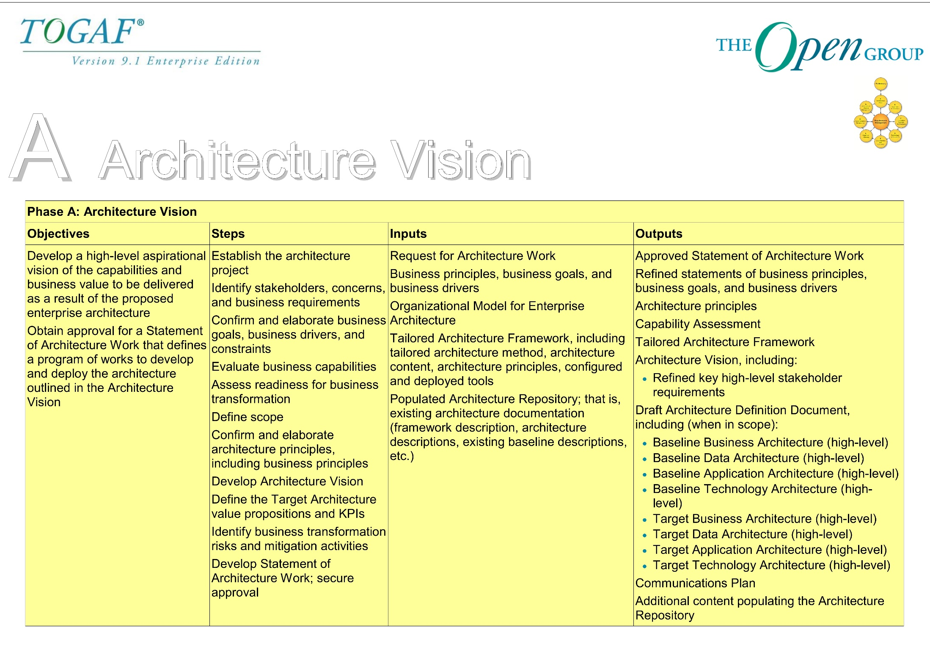

Slide 21
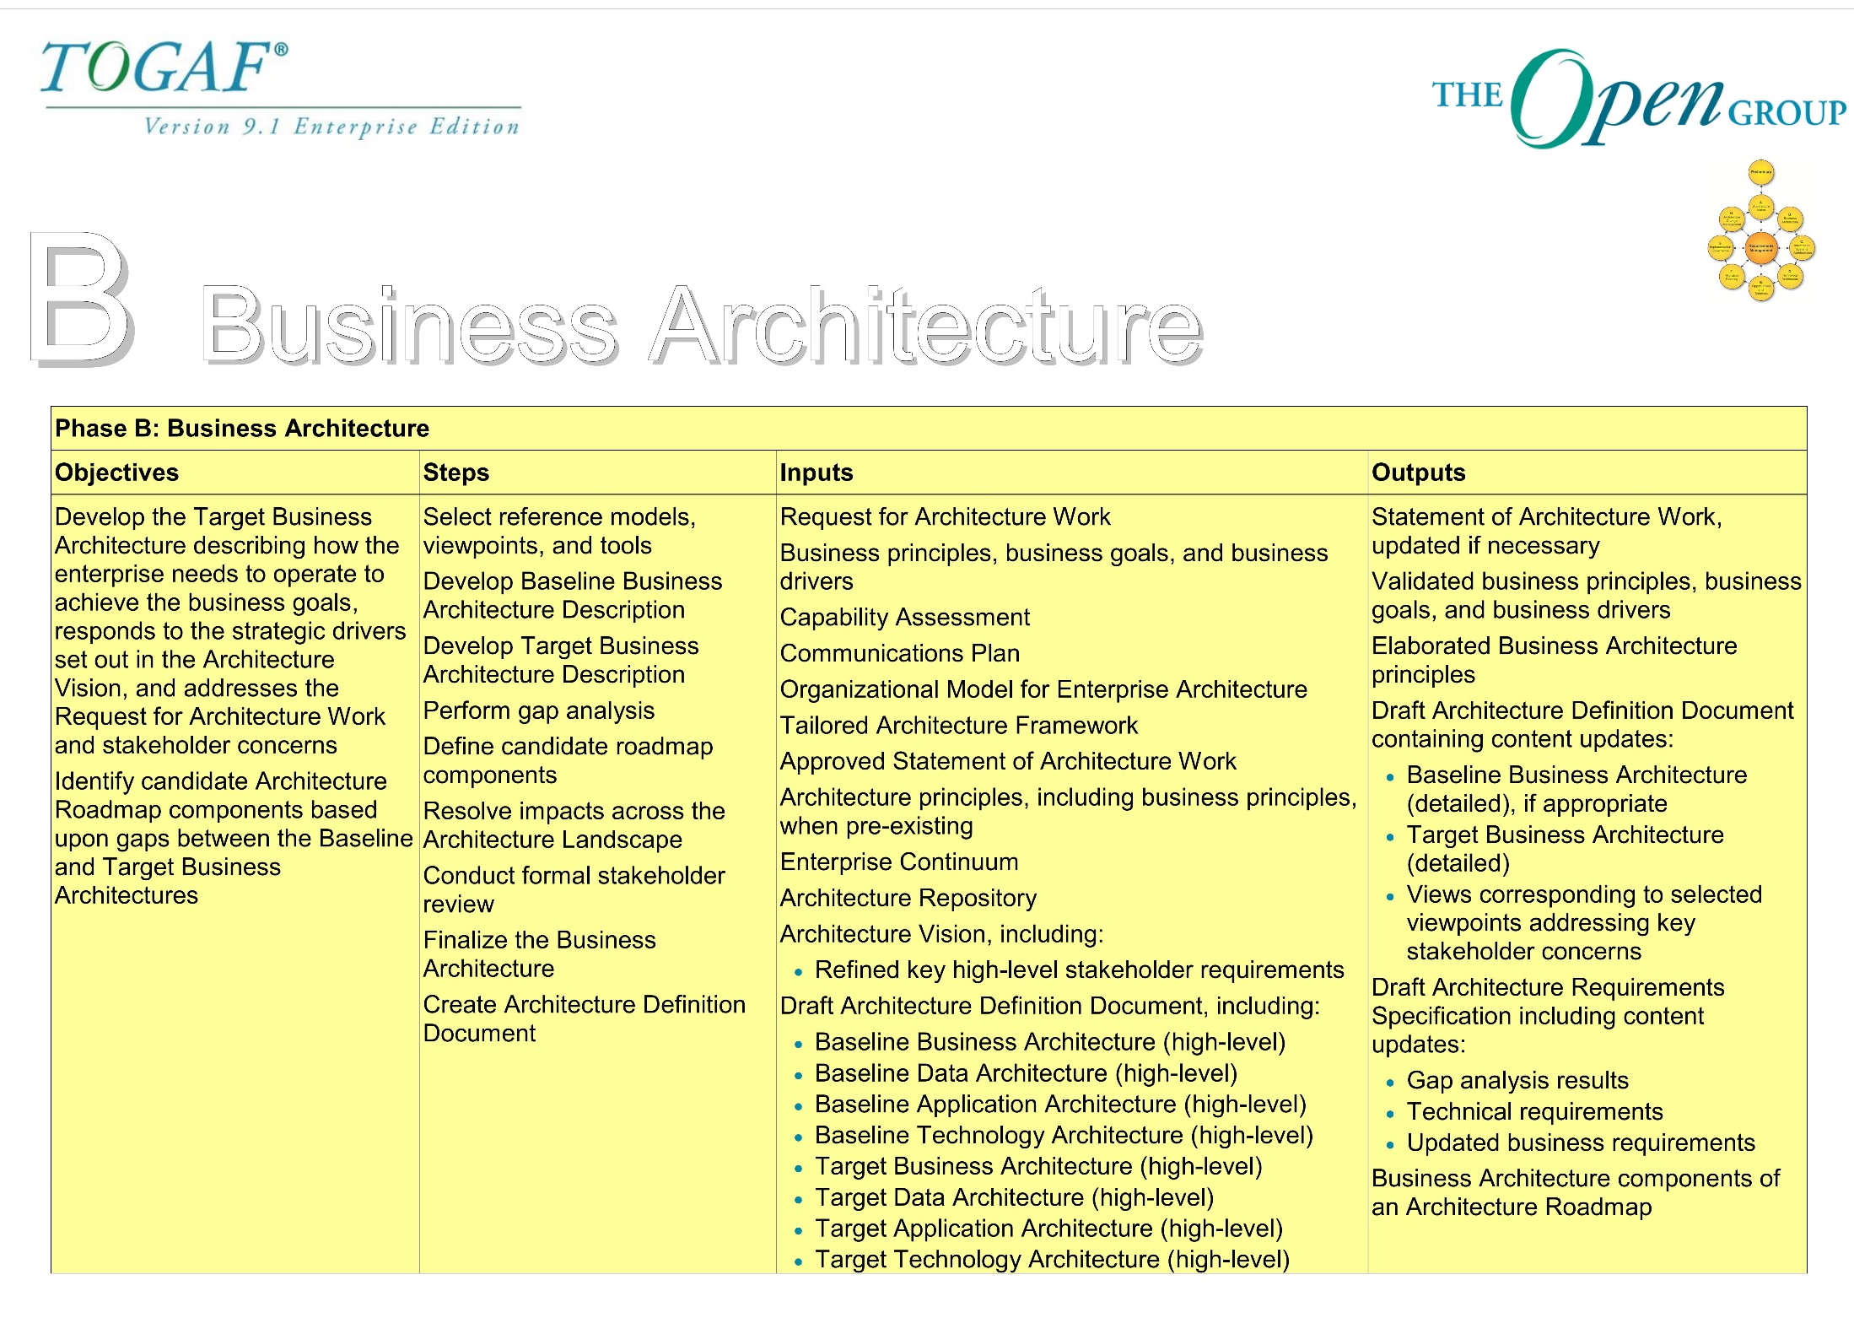

Slide 22
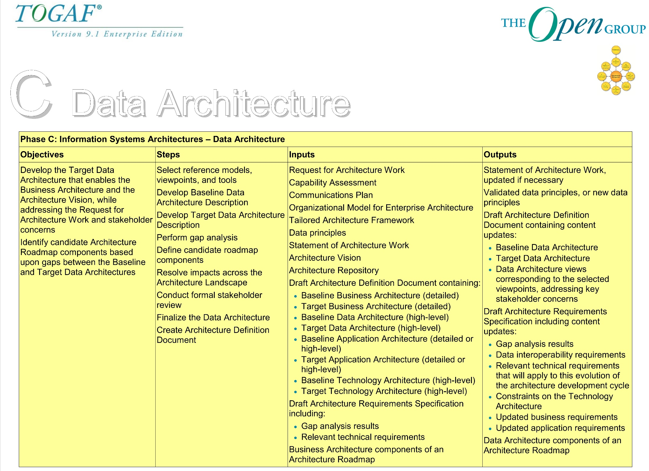

Slide 23
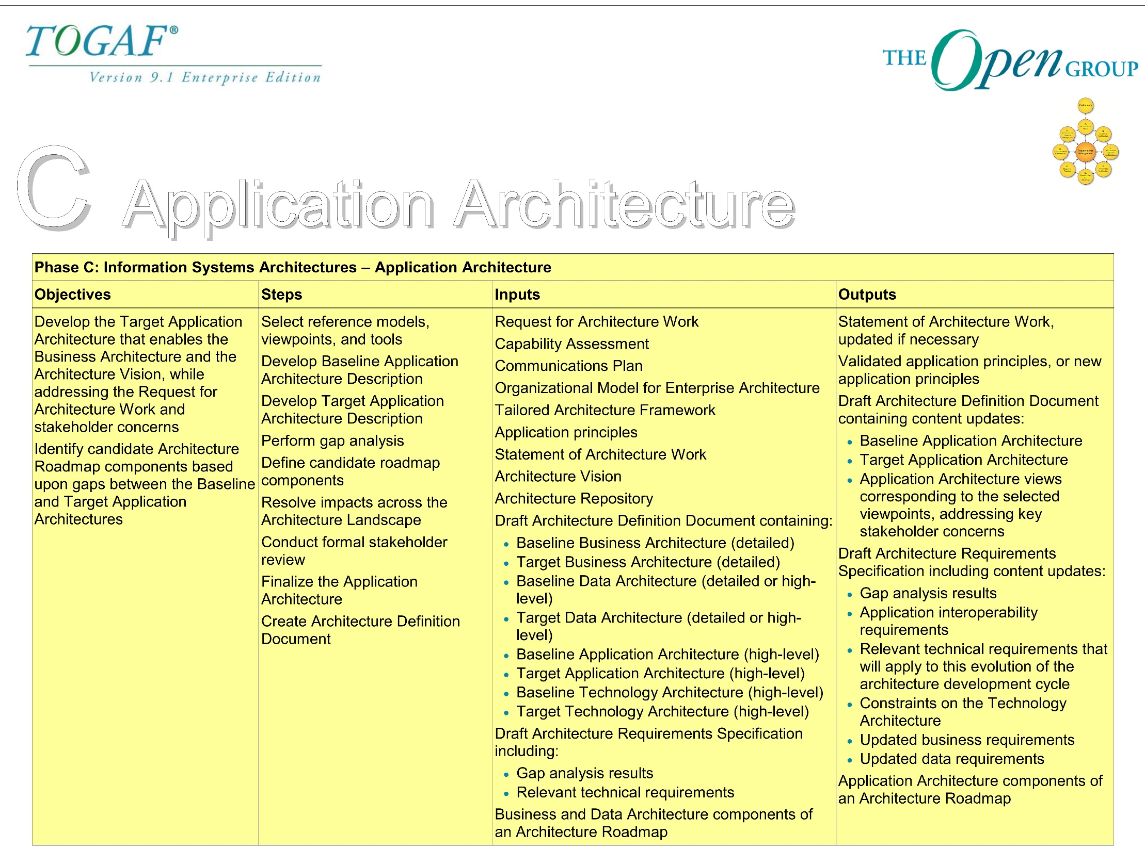

Slide 24
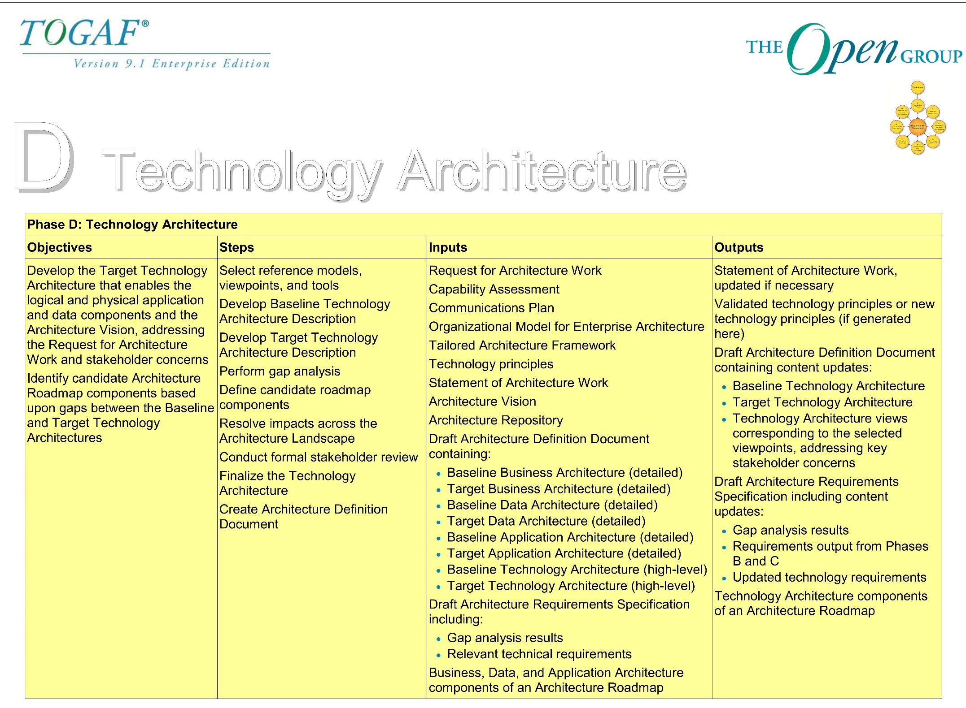

Slide 25
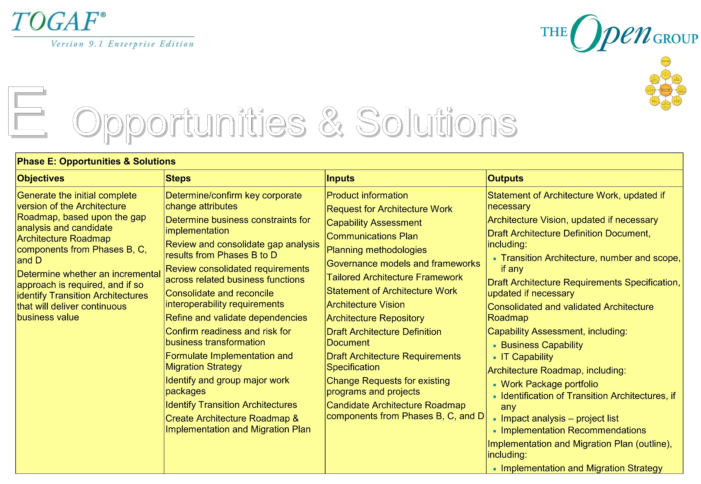

Slide 26
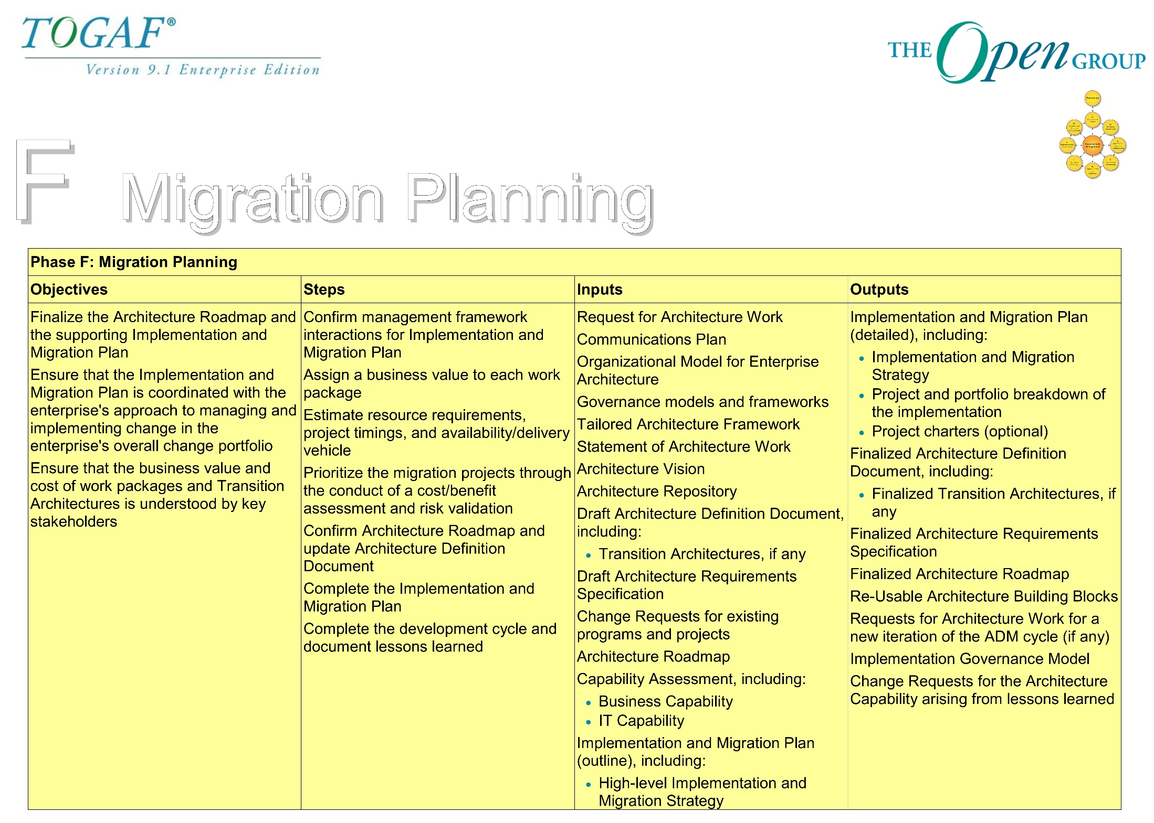

Slide 27
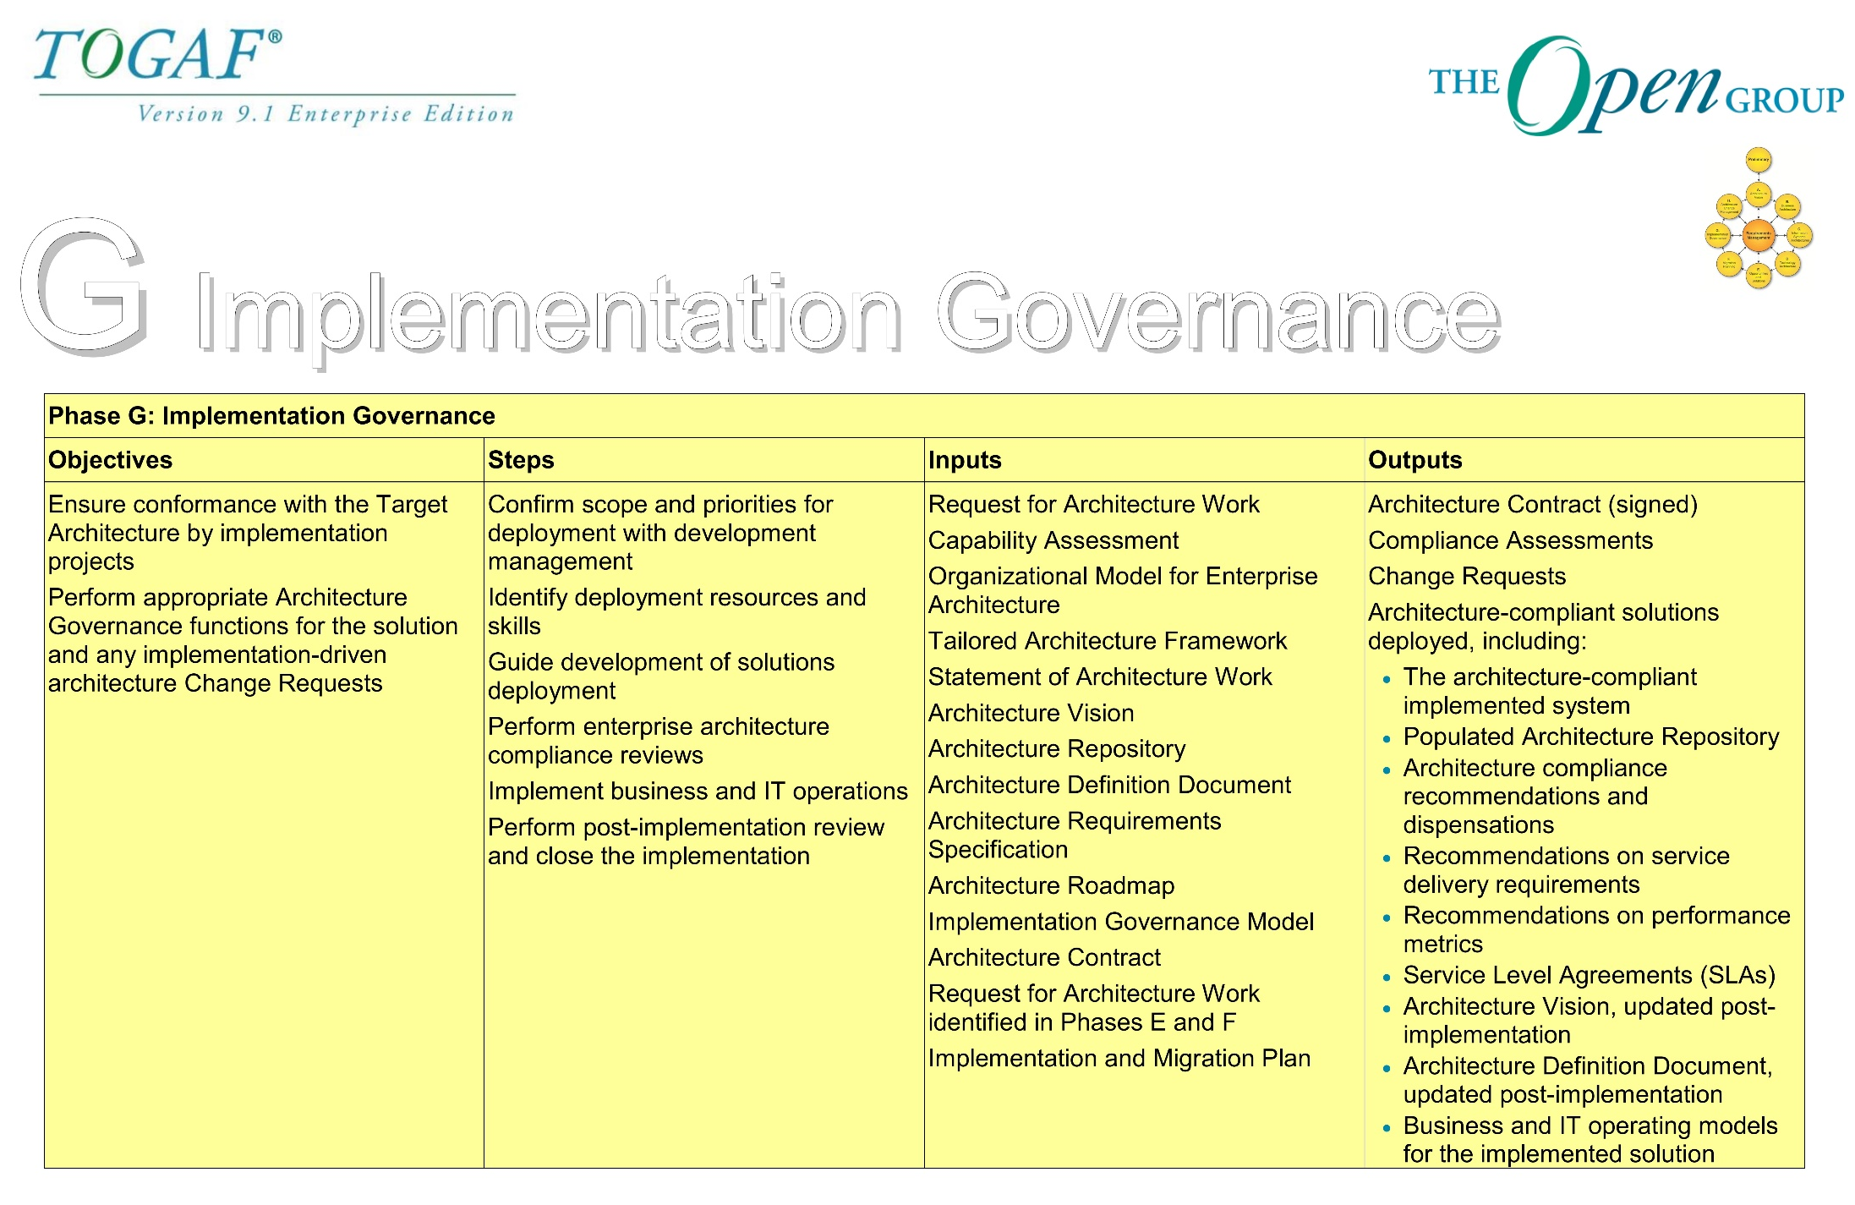

Slide 28
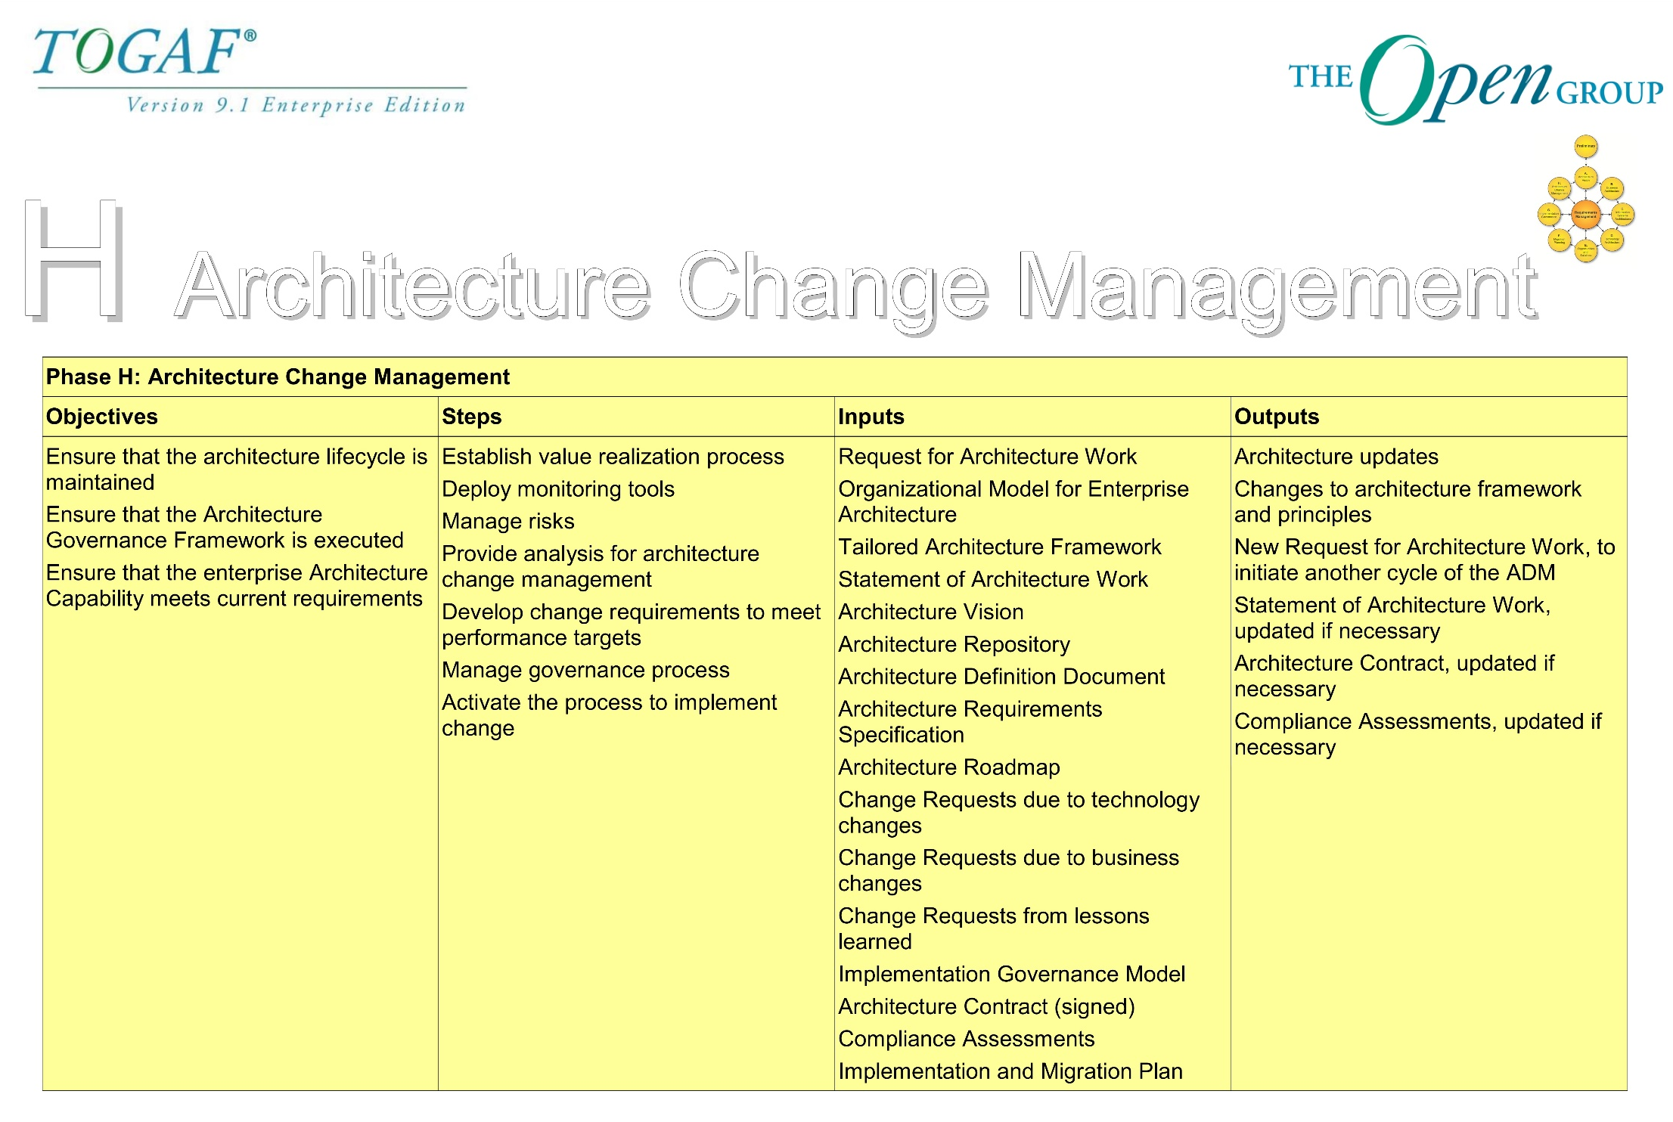

Slide 29
3.3 TOGAF Artifacts

Slide 30
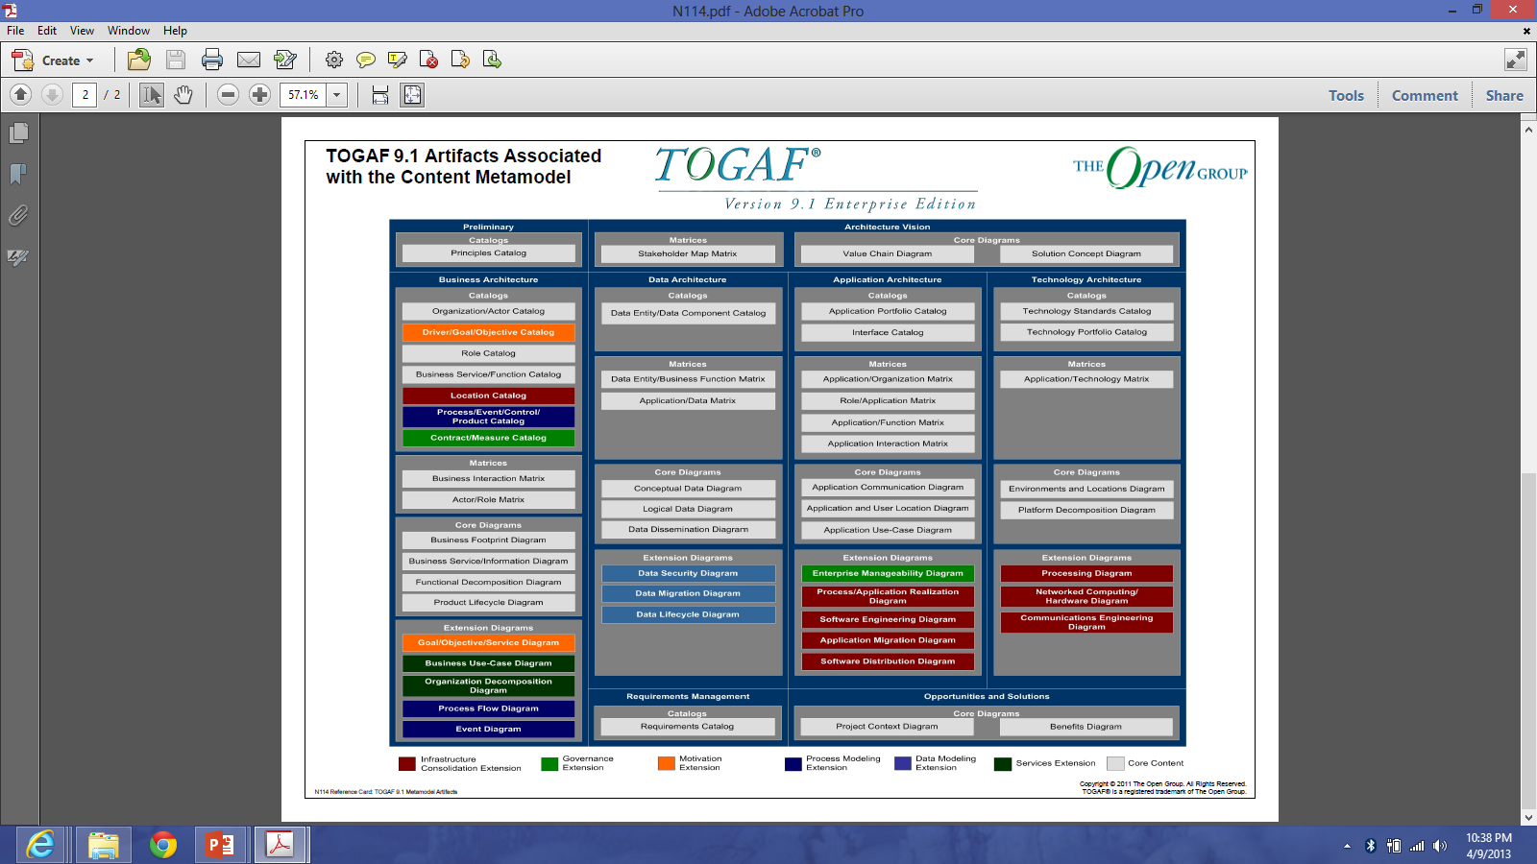

Slide 31
Architectural Artifacts: Preliminary Phase and Phase A
ADM Phase | Artifact
Preliminary Phase | Principles catalog
Phase A | Stakeholder Map matrix Value Chain diagram Solution Concept diagram

Slide 32
Architectural Artifacts: Phase B
ADM Phase | Artifact
Phase B (Business Architecture) | Organization/Actor catalog Driver/Goal/Objective catalog Role catalog Business Service/Function catalog Location catalog Process/Event/Control/Product catalog Contract/Measure catalog Business Interaction matrix Actor/Role matrix Business Footprint diagram Business Service/Information diagram Functional Decomposition diagram Product Lifecycle diagram Goal/Objective/Service diagram Business Use-Case diagram Organization Decomposition diagram Process Flow diagram Event diagram

Slide 33
Architectural Artifacts: Phase C
ADM Phase | Artifact
Phase C (Data Architecture) | Data Entity/Data Component catalog Data Entity/Business Function matrix Application/Data matrix Conceptual Data Diagram Logical Data Diagram Data Dissemination diagram Data Security diagram Data Migration diagram Data Lifecycle diagram

Slide 34
Architectural Artifacts: Phase C
ADM Phase | Artifact
Phase C (Application Architecture) | Application Portfolio catalog Interface catalog Application/Organization matrix Role/Application matrix Application/Function matrix Application Interaction matrix Application Communication diagram Application and User Location diagram Application Use-Case diagram Enterprise Manageability diagram Process/Application Realization diagram Software Engineering diagram Application Migration diagram Software Distribution diagram

Slide 35
Architectural Artifacts: Phase D
ADM Phase | Artifact
Phase D (Technology Architecture) | Technology Standards catalog Technology Portfolio catalog Application/Technology matrix Environments and Locations diagram Platform Decomposition diagram Processing diagram Networked Computing/Hardware diagram Communications Engineering diagram

Slide 36
Architectural Artifacts: Phase E dan Requirements Management
ADM Phase | Artifact
Phase E | Project Context diagram Benefits diagram
Requirements Management | Requirements catalog

Slide 37
Test Yourself Questions
Complete the sentence: Phase H _____________
  Prepares the organization for successful TOGAF architecture projects
  Develops Baseline and Target Architectures and analyzes the gaps
  Prepares and issues Architecture Contracts
  Ensures that the architecture responds to the needs of the enterprise
  All of these

Slide 38
Test Yourself Questions
Which of the following is the final step in development of the four architecture domains?
  Conduct formal stakeholder review
  Create Architecture Definition Document
  Perform gap analysis
  Select reference models, viewpoints, and tools

Slide 39
Test Yourself Questions
Which of the following version numbers is used by TOGAF as a convention to denote a high-level outline of an architecture?
Version 0
Version 0.1
Version 0.5
Version 1.0

Slide 40
Test Yourself Questions
Which one of the following does not complete the sentence: When executing the ADM, the architect is not only developing a snapshot of the enterprise, but is also populating the ___________________
  Architecture Repository
  Architecture Capability Framework
  Enterprise Continuum
  Foundation Architecture

Slide 41
Test Yourself Questions
Which of the following statements does not describe the phases of the ADM?
  They are cyclical.
  They are iterative.
  Each phase refines the scope.
  Each phase is mandatory.
  They cycle through a range of architecture views.

Slide 42
Test Yourself Questions
Which one of the following best describes a reason to adapt the ADM and take a federated approach?
  The maturity of the architecture discipline within the enterprise
  The use of the ADM in conjunction with another enterprise framework
  The ADM is being used by a lead contractor in an outsourcing situation
  The enterprise is very large and complex

Slide 43
Test Yourself Questions
Which of the following are the major information areas managed by a governance repository?
  Foundation Architectures, Industry Architectures, Organization-Specific Architectures
  Standards Information Base, Architecture Landscape, Governance Log
  Reference Data, Process Status, Audit Information
  Application Architecture, Business Architecture, Data Architecture

Slide 44
Test Yourself Questions
Which of these is not considered a dimension to consider when setting the scope of the architecture activity?
  Architecture Domains
  Breadth
  Depth
  Data Architecture
  Time Period

Slide 45
References
Rachel Harrison, Study Guide TOGAF® 9 Foundation 2nd Edition, The Open Group, 2011
Rachel Harrison, Study Guide TOGAF® 9 Certified 2nd Edition, The Open Group, 2011
Open Group Standard, TOGAF® Version 9.1 (G116), The Open Group, 2011
Open Group Standard, TOGAF® Version 9.1 – A Pocket Guide (G117), The Open Group, 2011
Daniel Minoli, Enterprise Architecture A to Z: Frameworks, Business Process Modeling, SOA, and Infrastructure Technology, Taylor & Francis, 2008
Jon Holt and Simon Perry, Modelling Enterprise Architectures, The Institution of Engineering and Technology, 2010
Alan Dennis et al, Systems Analysis and Design with UML 4th Edition, John Wiley and Sons, 2013

