Slide 1
Theory of Computation 6. Turing Machines
Romi Satria Wahono romi@romisatriawahono.net http://romisatriawahono.net/tc Mobile: +6281586220090

Slide 2
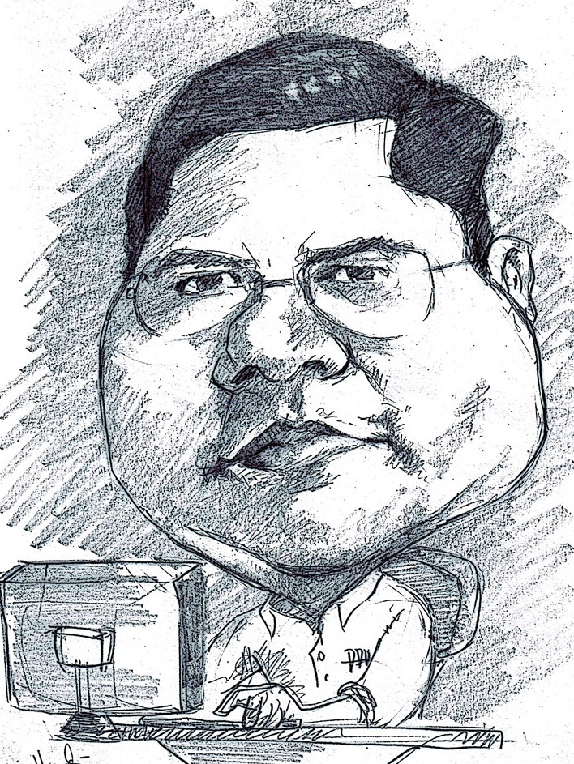
Romi Satria Wahono
SD Sompok Semarang (1987)
SMPN 8 Semarang (1990)
SMA Taruna Nusantara Magelang (1993)
B.Eng, M.Eng and Ph.D in Software Engineering from Saitama University Japan (1994-2004) Universiti Teknikal Malaysia Melaka (2014)
Research Interests: Software Engineering, Machine Learning
Founder dan Koordinator IlmuKomputer.Com
Peneliti LIPI (2004-2007)
Founder dan CEO PT Brainmatics Cipta Informatika

Slide 3
Course Outline
Introduction
Math Fundamental 1: Set, Sequence, Function
Math Fundamental 2: Graph, String, Logic
Finite Automata
Pushdown Automata
Turing Machines

Slide 4
6. Turing Machines
6.1 Turing Machines
6.2 Decidable Languages

Slide 5
6.1 Turing Machines

Slide 6
Recap: Models of Computation
Model | Language Recognition | Memory Management | Implementation
Finite Automata | Regular Languages | No temporary memory | Elevators, Vending Machines, Traffic Light, Neural Network (small computing power)
Pushdown Automata | Context-free Languages | Stack | Compilers for Programming Languages (medium computing power)
Turing machine | Unrestricted Grammar, Lambda Calculus (Computable Languages) | Random access memory | Any Algorithm (highest computing power)

Slide 7
Turing Machines
A Turing Machine is a finite state machine augmented with an infinite tape.
The tape head can go in both directions. It can read and write from/to any cell of the semi-infinite tape.
Once the TM reaches an accept (reject resp.) state it accepts (rejects resp.) immediately

Slide 8
Schematic of a Turing Machine
The tape head can go in both directions. It can read and write from/to any cell of the semi-infinite tape. The _ symbol marks the input’s end.
Finite control
input
a
a
b
a
c
_
_
_

Slide 9
TM – A Formal Definition
A Turing Machine is a 7-tuple , where:
is a finite set called the states
is the input alphabet not containing the blank symbol , _
is the tape alphabet, and
is the transition function.
is the start state
is the accept state, and
is the reject state

Slide 10
The Transition Function - Domain
Let M be a Turing machine defined by . at any given time M is in some state, , and its head is on some tape square containing some tape symbol . The transition function , depends on the machine state q and on the tape symbol

Slide 11
The Transition Function - Range
The range of the transition function are triples of the type , where is M’s next state, is the symbol written on the tape cell over which the head was at the beginning of the transition (namely is replaced with ) and is the direction towards which the tape head has made a step.

Slide 12
Turing machine – A Computation
Computation of M always starts at state , and the input is on the leftmost n cells where n is the input’s length. The tape’s head is over the tape’s cell 0 – the leftmost cell.
Computation of M ends either when it reaches - this is an Accepting Computation. Or when it reaches - this is a Rejecting Computation.

Slide 13
Configurations
A configuration of a Turing machine M is a concise description M’s state and tape contents. It is written as C=uqv . and its meaning is:
The state of M is q.
The content of M’s tape is uv , where u resides on the leftmost part of the tape.
The head of M resides over the leftmost (first) symbol of v.
The tape cells past the end of v hold blanks.

Slide 14
Configurations
Configuration of M yields Configuration , if M can legally go from to in a single step
For example:
Assume that , , and
We say that yields , if , for a leftward movement of the head.
We say that yields , if , for a rightward movement of the head.

Slide 15
Configurations – Special Cases
Configuration yields , if the head is at the beginning of the tape and the transition is left-moving, because the head cannot go off the left-hand end of the tape
Configuration is equivalent to , because the empty part of the tape is always filled out with blanks

Slide 16
Computations
The start Configuration of M on input w is , which indicates that M is at its initial state, it’s head is on the first cell of its tape and the tape’s content is the input w
Any configuration in which of M reaches state is an accepting configuration
Any configuration in which M reaches state is a rejecting configuration

Slide 17
Computations
Accepting and rejecting configurations are halting configurations.
A TM M accepts word w if there exists a computation (a sequence of configurations) of M, satisfying:
is the starting state of M on input w.
For each i, , yields , and
is an accepting configuration.

Slide 18
Computation Outcomes
A Computation of a Turing machine M may result in three different outcomes:
M may accept – By halting in
M may reject – By halting in
M may loop – By not halting for ever.
Note: When M is running, it is not clear whether it is looping Meaning M may stop eventually but nobody can tell

Slide 19
Turing Recognizers
The collection of strings that M accepts is the language of M , denoted
A language is Turing Recognizable if there exists a Turing machine that recognizes it

Slide 20
Turing Deciders
Since it is hard to tell whether a running machine is looping, we prefer machines that halt on all inputs. These machines are called deciders
A decider that recognizes a language L is said to decide L
A language is Turing decidable if there exists a Turing machine that decides it

Slide 21
An Example
Consider the language containing strings of 0-s whose length is an integral power of 2
Obviously, the language L is neither regular nor CFL (why?)
In the next slide we present a high level description of TM to decide L

Slide 22
An Example
“On input string w: 1. Sweep the tape left to right, crossing every second 0. 2. If in stage 1 the tape has a single 0, accept. 3. If in stage 1 the tape has an odd number of 0-s greater than 1, reject. 4. Return the head to the left-hand end of the tape. 5. Go to stage 1. “

Slide 23
Explanation
works as follows: Each iteration of stage 1 cuts the number of 0-s in half. As the sweeps across its tape on stage 1 it “calculates” whether the number of 0-s it sees is odd or even. If the number of 0-s is odd and greater than 1, the input length cannot be a power of 2, so it rejects. If the number of 0-s is 1, the input length is a power of 2 and it accepts.

Slide 24
An Example
In the following slide the transition function of is presented. Note: , .

Slide 25
An Example

Slide 26
Example2
Consider the language . A simple method to check whether a string w is in L is: Read the first character of w, store it, and mark it off. Then scan w until the character # is found, if the first character past # is equal to the stored character, cross it and go back to the last crossed character, On the tape’s beginning.

Slide 27
Example2
Repeat this procedure until all the string w is scanned. If an unexpected character is found, reject. Otherwise, accept.
In the next slide we present a high level description of TM to decide L. The description format follows the text book.

Slide 28
Example2
“On input string w: 1. Store the leftmost symbol on the tape and cross it out by writing x 2. Go right past #, if # not found, reject 3. compare the leftmost non x symbol to the stored symbol. If not equal, reject 4. Cross out the compared symbol. Return the head to the left-hand end of the tape 5. Go to stage 1 “

Slide 29
Example2
In the following slide the transition function of is presented
Note:
1. ,
2. In this description, state and all its incoming transitions are omitted. Wherever there is a missing transition, it goes to

Slide 31
Example2
Note: states and “store” the bit 0, while states and “store” the bit 1
In other words: These two segments are identical, but when the merge each segments uses the value it stored.

Slide 32
6.2 Decidable Languages

Slide 33
Decidable Languages (rerun)
A language L over is decidable if there exists a Turing machine recognizing L , that stops on every input.

Slide 34
Objects as Input
The input for a TM is always a string. If we want to give some other object, e.g. an automaton or a grammar, the object must be encoded as a string. Encoding can be straight forward
For example: An undirected graph G, is encoded by specifying its nodes and its edges. G’s encoding is denoted as

Slide 35
Objects as Input
A TM that gets as input the encoding of an undirected graph, , starts its computation by verifying that the encoding is well formed. If this is not the case, the input is rejected.
In the future we will regard input representations as implementation details and conveniently ignore them.

Slide 36
Example: Connected Graphs
Let A be the language of strings representing undirected connected graphs.
Note: in this way we form a computational problem as a language recognition problem.
In the next slide we present a high level description of a TM that decides A.

Slide 37
Example: Connected Graphs
M=“On input , the encoding of a graph G:
Select a node of G and mark it.
Repeat until no new nodes are marked:
3. For every node of G, v, if v is connected to a marked node, mark it as connected.
4. If all nodes are marked accept otherwise reject.”

Slide 38
Connected Graphs-Representation
Consider a representation of a graph by two lists:
List of nodes (natural numbers).
List of edges (pairs of nodes).
Note: We do not specify the alphabet which can be binary, decimal or other. The idea is to ignore insignificant implementation details.

Slide 39
Input Verification
Check that the input consists of:
A list of nodes (natural numbers) with no repetition. To check uniqueness use the machine presented on yesterday’s discussion.
A list of edges: A list of pairs of nodes that appear in the previous list.

Slide 40
Implementation
Select a node of G and mark it - Mark the first node on the list. One way to do it is to “dot” its leftmost digit.
Repeat until no new nodes are marked - Mark the first un-dotted node on the list by underlining (different from dotting) its leftmost digit .

Slide 41
Implementation
2. Repeat until no new nodes are marked: Underline first un-dotted node on list, n₁.
3. For every node of G, v, if v is connected to a marked node, mark it as connected – Underline the first dotted node on the list, n₂ . Search edges for (n₁ ,n₂) edge.

Slide 42
Implementation
2. Repeat until no new nodes are marked: Underline first un-dotted node on list as n₁
3. For every node of G, v, if v is connected to a marked node, mark it as connected – Underline the first dotted node on the list n₂ , search edges for (n₁ ,n₂) edge. If found mark n₁ as dotted. Remove underlines go back to 2.

Slide 43
Implementation
2. Repeat until no new nodes are marked: Underline first un-dotted node on list as n₁
3. For every node of G, v, if v is connected to a marked node, mark it as connected – Underline the first dotted node on the list n₂ , search edges for (n₁ ,n₂) edge. If not underline the next dotted node on the list as n₂.

Slide 44
Implementation
2. Repeat until no new nodes are marked:
3. For every node of G, v, if v is connected to a marked node, mark it as connected.
4. If all nodes are marked accept otherwise reject.”- Scan the node list. if you find an un-dotted node – reject. Otherwise – accept .

Slide 45
Decision Problems on Automatons
Now we turn do deal with some problems related to regular and CF Languages. Typical problems are:
Deciding whether a DFA accepts a language.
Deciding whether a language is empty.
Deciding whether two languages are equal, etc.

Slide 46
Finite Automatons are Decidable
Consider the language
Note that once again we formulate a computational problem as a membership problem
Theorem
A_{DFA} is a decidable language

Slide 47
Proof
Consider
M=“On a <DFA, string> input :
1. Simulate B on input w .
2. If B accepts - accept. Otherwise – reject.“

Slide 48
Implementation
The encoding of can be straight forward: The five components of B are listed on M‘s tape one after the other.
TM M starts its computation by verifying that the encoding is well formed. If this is not the case, the input is rejected.

Slide 49
Implementation
Following that M simulates on B‘s computation on w in a way, very similar to the way a computer program will do.

Slide 50
Simulation of a DFA Initialization
Assume that the DFA is encoded by a list of its components. TM M should first verify that the string representing B is well formed. Than it should use a “state dot” to mark B’s initial state as its current state and an “input dot” to mark w’s first symbol as the current input symbol.

Slide 51
Simulation of a DFA
Following that, M scans the substring representing B’s transition function to find the transition that should take place for the current state and the current input symbol. Once the right transition is found, the new current state is known.

Slide 52
Simulation of a DFA
At this point, M moves the “state dot” from the previous current state, to the new current state, and moves the “input dot” from the previous input symbol to the next input symbol.
This procedure repeats until the input is finished. If at this stage B’s current state is accepting, M accepts, otherwise it rejects.

Slide 53
Finite Automatons are Decidable
Now we turn to consider the language
and prove:
Theorem
A_{NFA} is a decidable language.

Slide 54
Proof
Consider
N=“On a <NFA, string> input :
1. Convert NFA B to an equivalent DFA C.
2. Simulate C on input w using TM M (See previous proof).
3. If C accepts - accept. Otherwise – reject.“

Slide 55
Implementation
Item 2 N’s high level description says: “Simulate C on input w using TM M.”
Here M is used by N as a procedure. This can be done as follows:
1. N is equipped with an additional tape on which M’s input will be written.
2. At the point in which M is called, a section in which M’s input is written on the additional tape is added to N.
3. Following this section we add to N a complete copy of M, using its input tape.
4. This procedure is repeated on each call to M.

Slide 56
Regular Expressions are Decidable
An additional way to describe Regular Languages is by use of regular expressions. Now we consider the language
and prove:
Theorem
A_{REX} is a decidable language.

Slide 57
Proof
Consider
P=“On a <RE, string> input :
1. Convert RE R to an equivalent NFA A.
2. Run TM N (See previous proof) 0n w.
3. If N accepts - accept. Otherwise – reject.“

Slide 58
The Emptiness Problem for DFA-s
In this problem it is required to compute whether a given DFA accepts at least one string: Consider the language
and prove:
Theorem
E_{DFA} is a decidable language.

Slide 59
Proof
Consider
T=“On a DFA input <A> :
Mark the start state of A.
Repeat until no new states are marked:
3. Mark any state that has an incoming transition from an already marked state.
4. If no accept state is marked - accept. Otherwise – reject.“

Slide 60
DFA Equivalence is Decidable
Our survey of decidability problems for regular languages is completed by considering
and proving:
Theorem
EQ_{DFA} is a decidable language.

Slide 61
Proof
In order to prove this theorem we use the TM T of the previous proof. The input for T is a DFA C satisfying:
This expression is called The symmetric difference of and and it can be proved that iff

Slide 62
Proof
DFA C is constructed using the algorithms for constructing Union, Intersection, and Complementation, Of Chapter 1.

Slide 63
Proof
The TM machine F for Deciding EQ_{DFA} gets as input to DFA-s A and B. This machine first activates the algorithms of Chapter 1 to construct DFA C and then it calls TM T to check whether If T accepts so does F. Otherwise F rejects.

Slide 64
Decidable CFG Related Languages
Now we consider the language
and prove:
Theorem
A_{CFG} is a decidable language.

Slide 65
Decidable CFG Related Languages
If we try to prove this theorem by checking all possible derivations of <G>, we may run into trouble on grammars containing cycles, e.g.
This grammar has an infinite derivation which is hard to deal with.

Slide 66
Decidable CFG Related Languages
The way to solve this problem is by using the following definition and theorem:
Definition
A context-free grammar is in Chomsky normal form (CNF) if every rule is of the form:

Slide 67
Decidable CFG Related Languages
Theorem
Every context-free grammar has an equivalent grammar in Chomsky normal form.
Note: In a CNF grammar every non-final derivation extends the current string.

Slide 68
Decidable CFG Related Languages
Result
If G is a context-free grammar in CNF then:
A derivation of 0-length string w takes a single production.
A derivation of an n-length string w takes a 2n-1 productions.

Slide 69
Proof of Theorem
Consider
S=“On <CFG, string> input
Convert G to an equivalent CNF grammar.
List al all derivations with 2n-1 productions.
If w is generated by one of these derivations - accept. Otherwise – reject.“

Slide 70
The Emptiness Problem for CFL-s
Consider the language
Theorem
E_{DFA} is a decidable language.
How can this be proved?

Slide 71
The Emptiness Problem for CFL-s
M=“On input , where G is a CFG:
Mark all terminal symbols in G.
Repeat until no new variables are marked:
Mark any variable A where G has a rule of the form and are all marked.
4. If the start variable is not marked accept otherwise reject.”

Slide 72
CFG Equivalence is not Decidable
Consider the language
Unlike DFA-s CFL-s are not closed under intersection and complementation. Therefore we cannot decide EQ_{CFG} using the method we used for EQ_{CFG} . In the near future we will prove:
Theorem
EQ_{CFG} is an undecidable language

Slide 73
CFL-s are Decidable
Our survey of decidability problems for CFL-s/CFG-s is completed by considering the decision problem for context Free Languages, namely: Given a context free language L, does there exist a TM that decides L?

Slide 74
CFL-s are Decidable
Recall that every CFL is recognized by some PDA. It is not hard to prove that a TM can simulate a PDA, but this is not enough?
For many CFL-s the PDA recognizing them is nondeterministic, which may cause the following problem:

Slide 75
CFL-s are Decidable
Let L be a CFL, let p a be a PDA recognizing L and let w be a string such that
PDA P may never stop on w and a TM simulating P may loop while a decider should stop on every input. Nevertheless there is a solution:
Theorem
Let L be a CFL. There exists a TM deciding L.

Slide 76
Proof
Since L is a CFL, there exist a CFG G that generates L. The problem is solved by TM that contains a copy of G, as follows.
“On input w:
1. RUN TM S on input
2. If S accepts - accept. Otherwise – reject.“

Slide 77
Referensi
Michael Sipser, Introduction to the Theory of Computation Third Edition, Cengage Learning, 2012
George Tourlakis, Theory of Computation, Wiley, 2012
John Martin, Introduction to Languages and the Theory of Computation, McGraw-Hill , 2010
Robert Sedgewick and Kevin Wayne, Introduction to Computer Science, Addison-Wesley, 2015 (http://introcs.cs.princeton.edu/java)
Albert Endres dan Dieter Rombach, A Handbook of Software and Systems Engineering, Pearson Education Limited, 2003

