Slide 1
Theory of Computation 4. Finite Automata
Romi Satria Wahono romi@romisatriawahono.net http://romisatriawahono.net/tc Mobile: +6281586220090

Slide 2
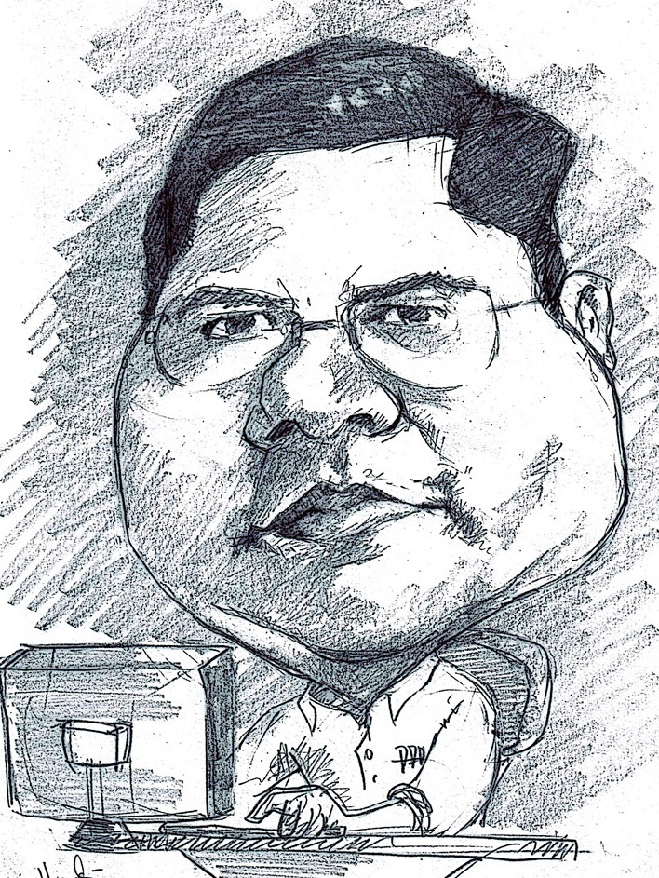
Romi Satria Wahono
SD Sompok Semarang (1987)
SMPN 8 Semarang (1990)
SMA Taruna Nusantara Magelang (1993)
B.Eng, M.Eng and Ph.D in Software Engineering from Saitama University Japan (1994-2004) Universiti Teknikal Malaysia Melaka (2014)
Research Interests: Software Engineering, Machine Learning
Founder dan Koordinator IlmuKomputer.Com
Peneliti LIPI (2004-2007)
Founder dan CEO PT Brainmatics Cipta Informatika

Slide 3
Course Outline
Introduction
Math Fundamental 1: Set, Sequence, Function
Math Fundamental 2: Graph, String, Logic
Finite Automata
Pushdown Automata
Turing Machines

Slide 4
4. Regular Languages
4.1 Automaton
4.2 Finite Automata
4.3 Nondeterminism
4.4 Regular Expression
4.5 Nonregular Language

Slide 5
4.1 Automaton

Slide 6
Automata Theory
Automata theory deals with the definitions and properties of mathematical models of computation
Models of Computation:
Finite Automata
Pushdown Automata
Turing machine

Slide 7
Models of Computation
Model | Language Recognition | Memory Management | Implementation
Finite Automata | Regular Languages | No temporary memory | Elevators, Vending Machines, Traffic Light, Neural Network (small computing power)
Pushdown Automata | Context-free Languages | Stack | Compilers for Programming Languages (medium computing power)
Turing machine | Unrestricted Grammar, Lambda Calculus (Computable Languages) | Random access memory | Any Algorithm (highest computing power)

Slide 8
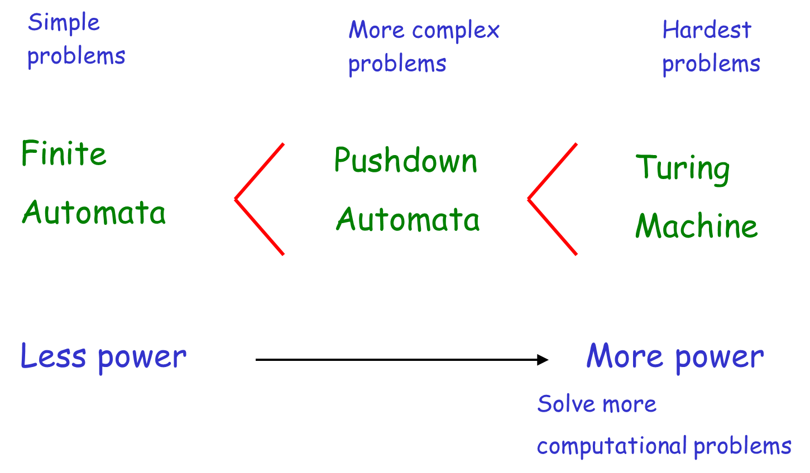
Power of Automata

Slide 9
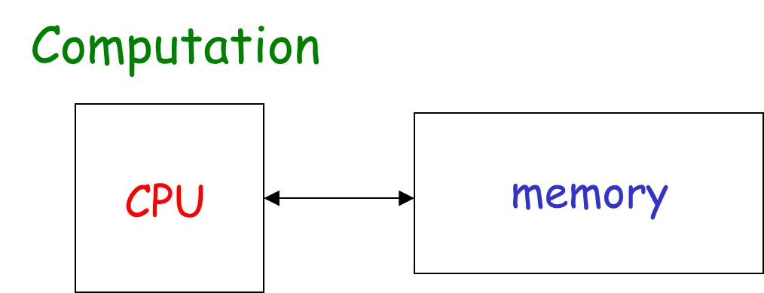

Slide 10
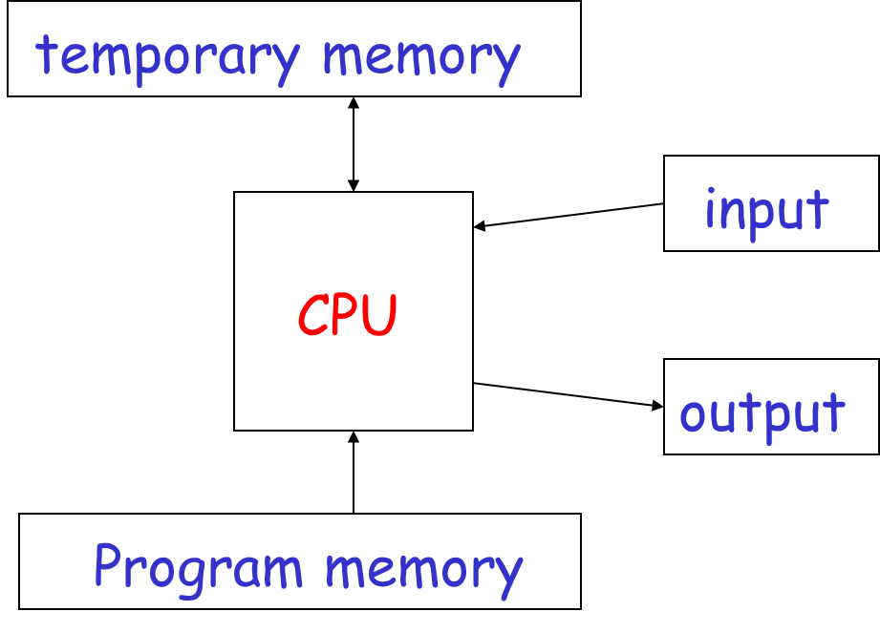

Slide 11
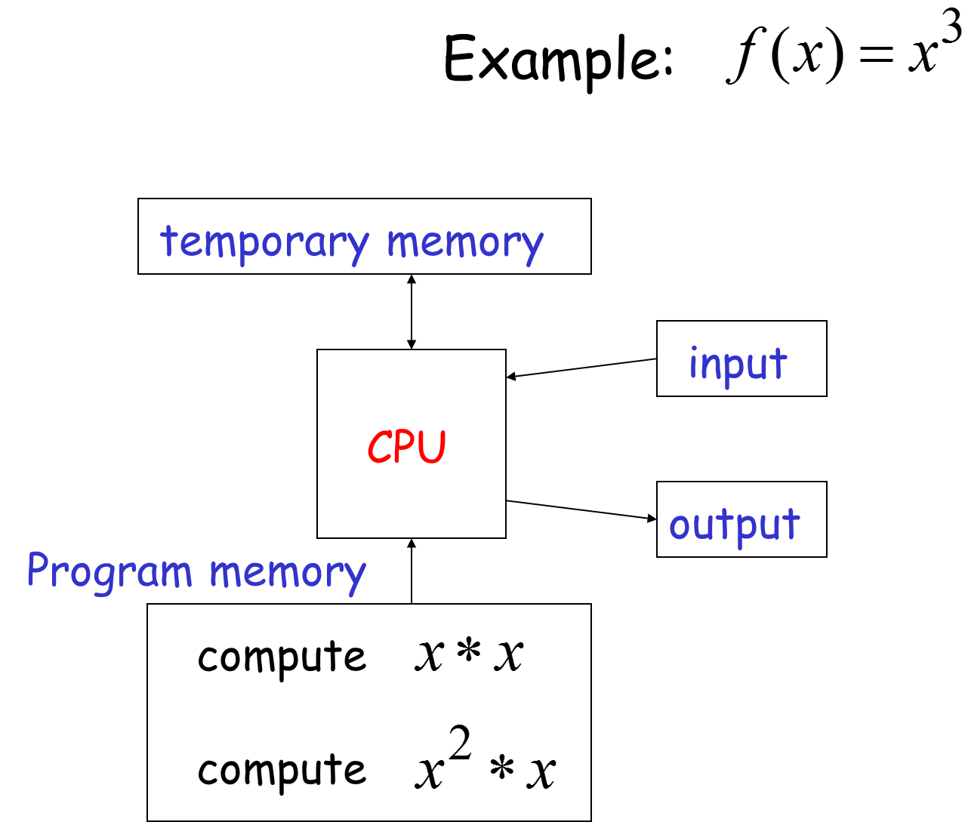

Slide 12
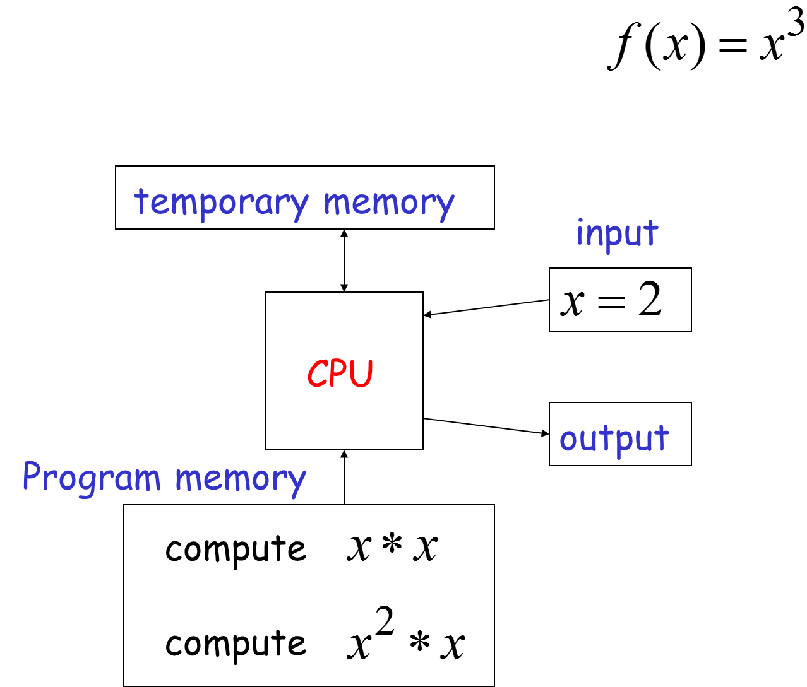

Slide 13
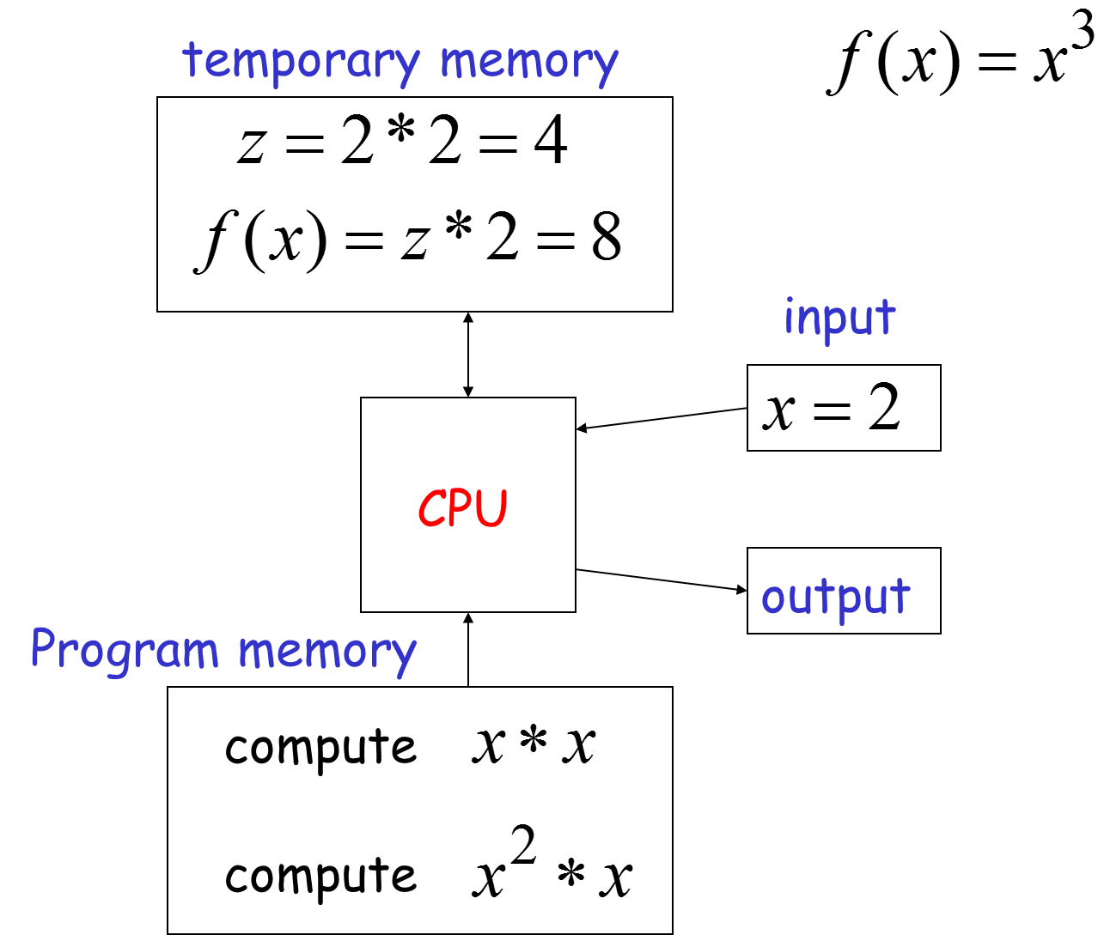

Slide 14
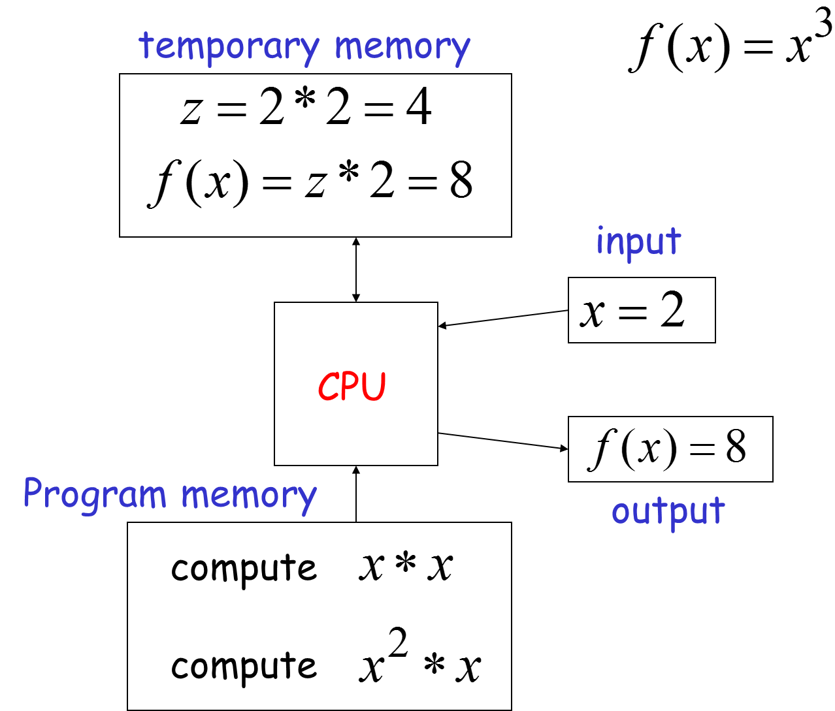

Slide 15
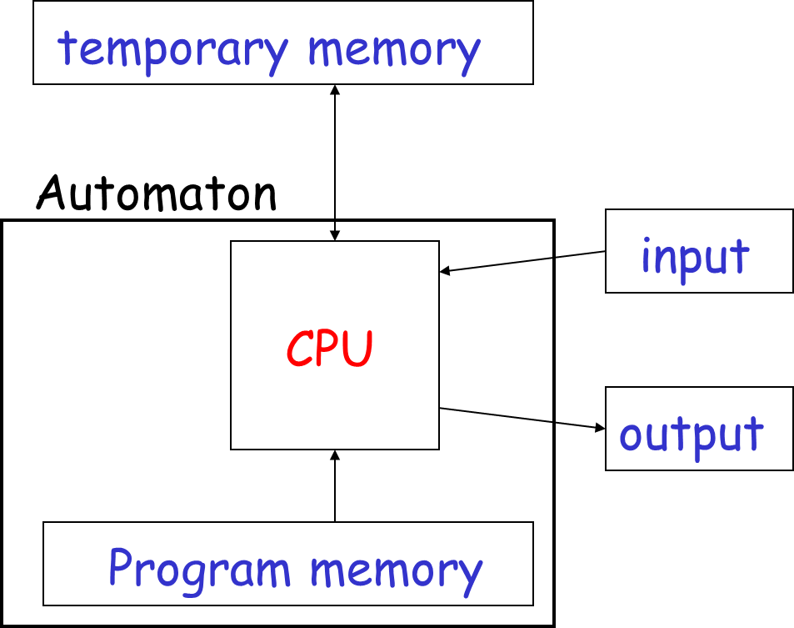
Automaton

Slide 16
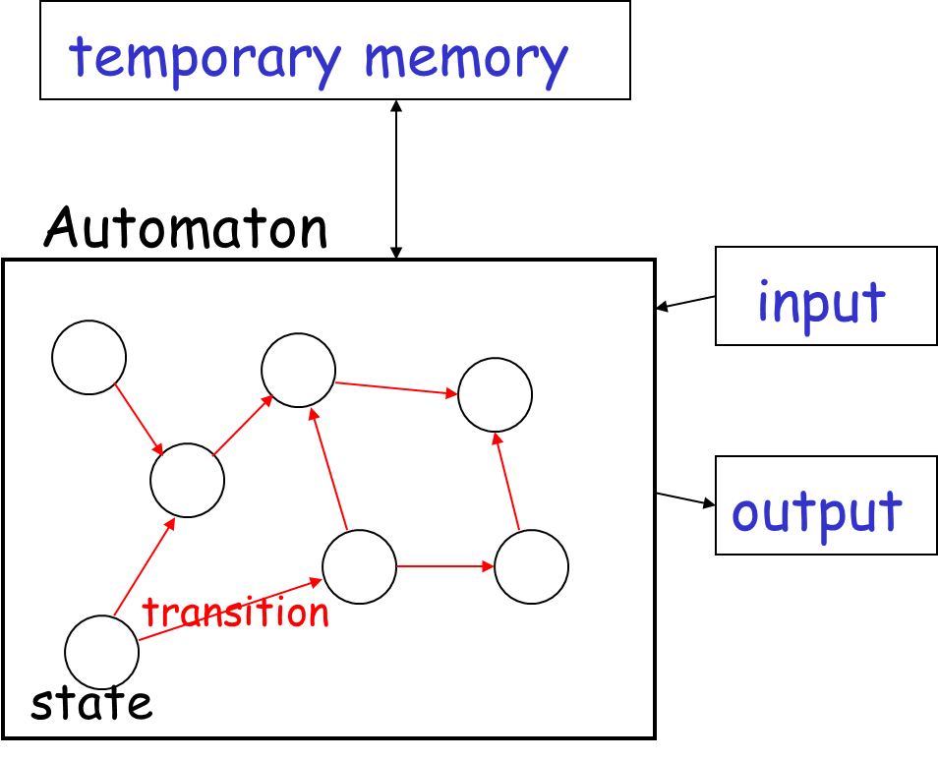
Automaton

Slide 17
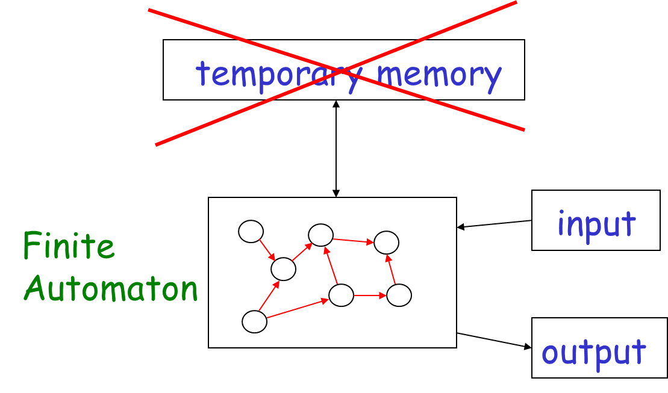
Finite Automata
Example: Elevators, Vending Machines (small computing power)

Slide 18
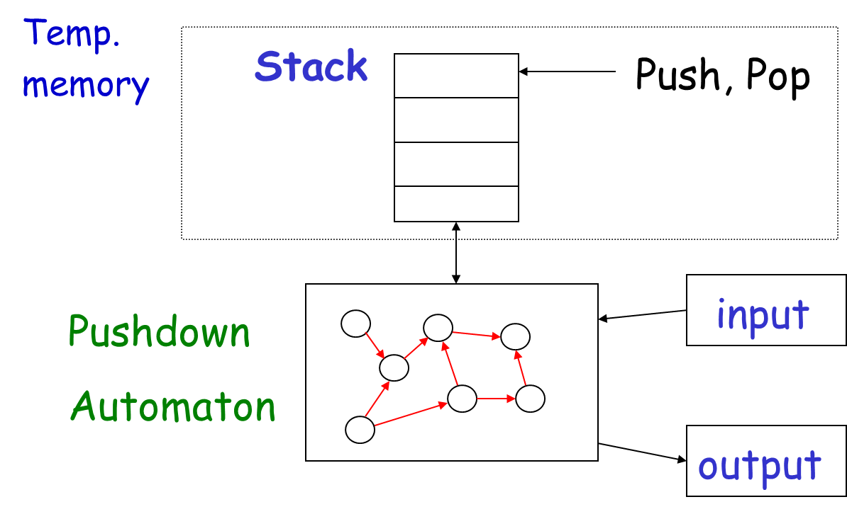
Pushdown Automata
Example: Compilers for Programming Languages (medium computing power)

Slide 19
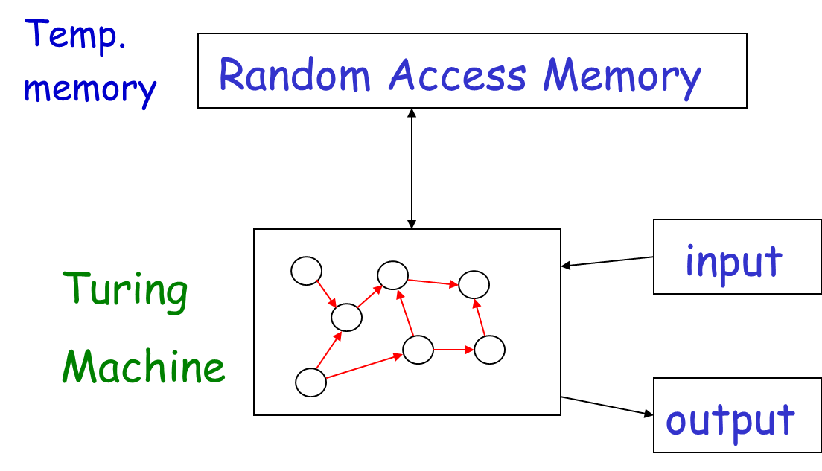
Turing Machines
Examples: Any Algorithm (highest computing power)

Slide 20
Alan Turing - A Short Detour
Dr. Alan Turing is an English Mathematician, and one of the founders of Computer Science. Important facts about him:
“Invented” Turing machines
“Invented” the Turing Test
Broke into the German submarine transmission encoding machine “Enigma”
Was arraigned for being gay and committed suicide soon after

Slide 21
4.2 Finite Automata

Slide 22
Finite Automata - A Short Example
The control of a washing machine is a very simple example of a finite automaton
The most simple washing machine accepts 25 cents and operation does not start until at least 3 coins of 25 cents were inserted

Slide 23
Simple Washing Machine 1
25
25
25
25
Accepts 25 cents
Operation starts after at least 3 coins of 25 cents were inserted
Accepted words:
252525
25252525

Slide 24
Simple Washing Machine 2
25
25
25,50
25,50
50
50
The second washing machine accepts 50 cents coins as well
Accepted words:
252525
2550
…

Slide 25
Simple Washing Machine 3
100
25
25
25,50,100
50
50,100
25,50,100
The most complex washing machine accepts 100 cents coins too
Accepted Words:?

Slide 26
Finite Automaton – Formal Definition
A finite automaton is a 5-tupple where:
is a finite set called the states
is a finite set called the alphabet
is the transition function
is the start state, and
is the set of accept states
Lihat lagi pembahasan tentang Set, Sequence dan Function

Slide 27
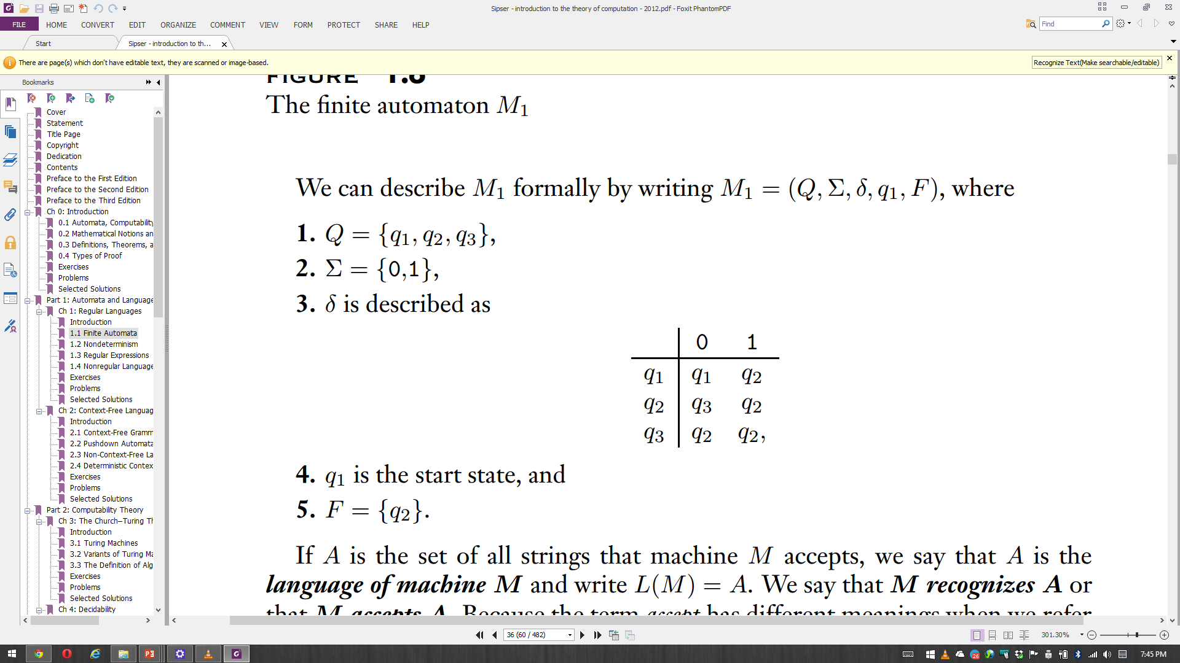
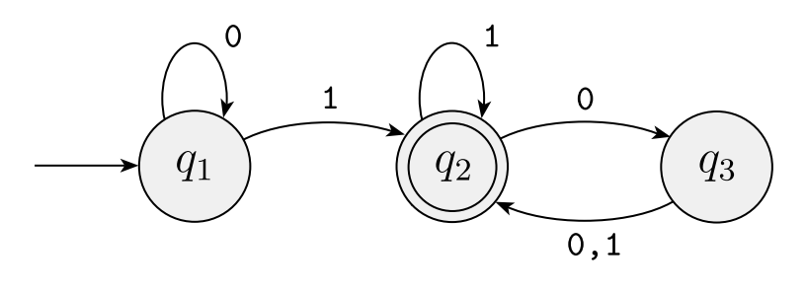
Finite Automaton M₁
M₁= (Q, Σ, δ, q1, F) or M₁ = ({q1, q2,q3}, {0,1}, δ, q1, {q2})
Accepted Strings or Words (w):
1, 01, 11, 100, 011, 0101, 0100, 110000, …
If A is the set of all strings that machine M₁ accepts, we say:
A is the language of machine M₁ and write L(M₁) = A
M₁ recognizes A or that M₁ accepts A
A = {1, 01, 11, 100, 011, 0101, 0100, 110000, …} or
A = {w| w contains at least one 1 and an even number of 0s follow the last 1}

Slide 28
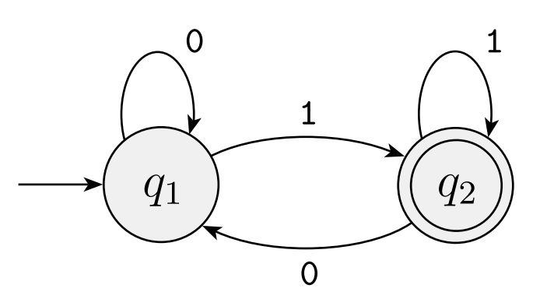
Finite Automaton M₂
Deskripsikan secara formal Finite Automaton M₂!
Tentukan accepted words dari Finite Automaton M₂

Slide 29
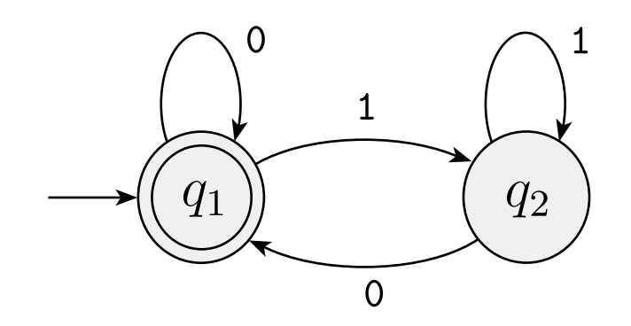
Finite Automaton M₃
Deskripsikan secara formal Finite Automaton M₃!
Tentukan accepted words dari Finite Automaton M₃

Slide 30
Finite Automaton M₆
0
0,1
1
0,1
Deskripsikan secara formal Finite Automaton M₆!
Tentukan accepted words dari Finite Automaton M₆

Slide 31
Languages
A language is a set of strings over some alphabet
A string over an alphabet is a finite sequence of symbols from that alphabet, usually written next to one another and not separated by commas
If Σ₁ = {0,1}, then 01001 is a string over Σ₁
If Σ₂ = {a, b, c, . . . , z}, then abracadabra is a string over Σ₂
Language Examples:
L₁ = {01, 101, 0101, 011}
L₂ = {w|w berakhiran 1}
A language is called a regular language if some finite automaton recognizes it

Slide 32
Languages
If w is a string over Σ, the length of w, written |w|, is the number of symbols that it contains
The string of length zero is called the empty string and is written ε
The empty string plays the role of 0 in a number system
If w has length n, we can write w = w₁w₂ · · · w_{n} where each w_{i} ∈ Σ
The reverse of w, written w_{R}, is the string obtained by writing w in the opposite order (i.e., w_{n}w_{n−1} · · · w₁)

Slide 33
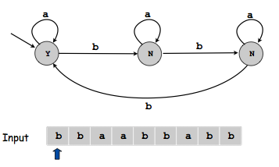
DFA.Java
public class DFA {
public static void main(String[] args) {
Scanner scan = new Scanner(System.in);
System.out.print("Input: ");
String input = scan.nextLine();
boolean[] accept = {true, false, false};
int[][] next = {{0, 1}, {1, 2}, {2, 0}};
int state = 0;
for (int i = 0; i < input.length(); i++) {
state = next[state][input.charAt(i) - 'a'];
}
System.out.println(accept[state]);
}
}

Slide 34
Finite Automaton M₂
Buat Code Java dari M₂!

Slide 35
Finite Automaton M₃
Buat Code Java dari M₃!

Slide 36
Finite Automaton M₆
0
0,1
1
0,1
Buat Code Java dari M₆!

Slide 37
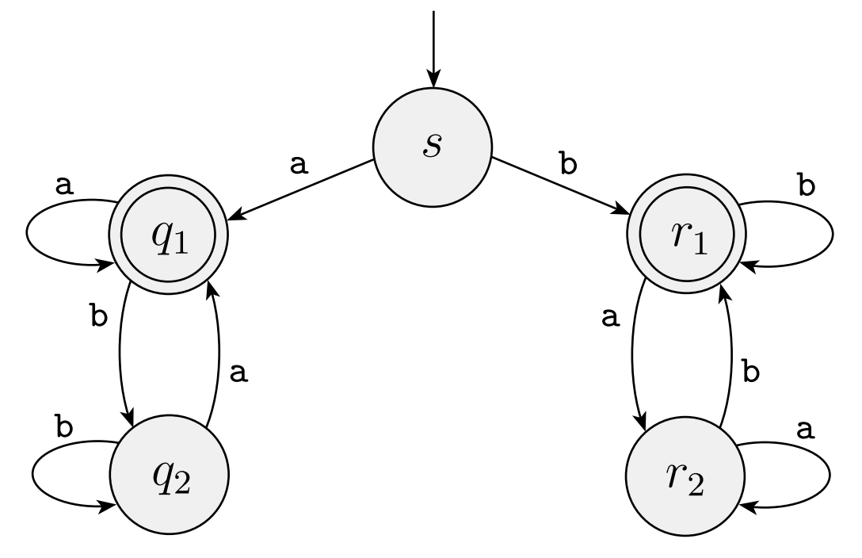
Finite Automaton M₄
Deskripsikan secara formal Finite Automaton M₄!
Tentukan accepted words dari Finite Automaton M₄
Buat Code Java dari M₄!

Slide 38
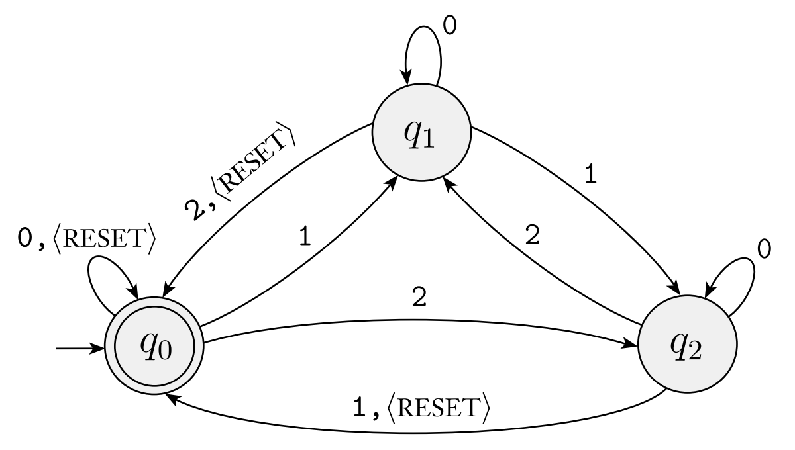
Finite Automaton M₅
Deskripsikan secara formal Finite Automaton M₅!
Tentukan accepted words dari Finite Automaton M₅
Buat Code Java dari M₅!

Slide 39
4.3 Nondeterminism

Slide 40
Nondeterminism
Nondeterminism is a useful concept that has had great impact on the theory of computation
Every step of a computation follows in a unique way from the preceding step
When the machine is in a given state and reads the next input symbol, we know what the next state will be—it is determined
We call this deterministic computation
In a nondeterministic machine, several choices may exist for the next state at any point
Nondeterminism is a generalization of determinism

Slide 41
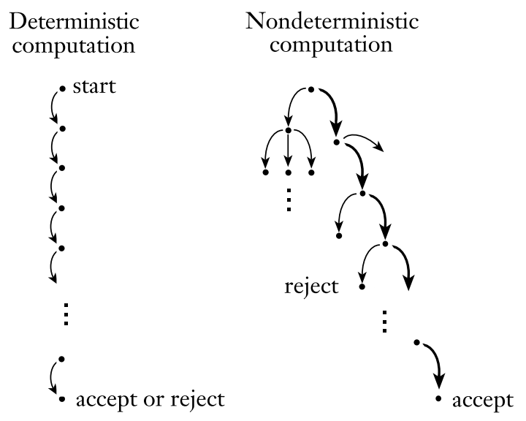

Slide 42
Nondeterminism
Instructions like "go down the hallway and turn either left or right“ are quite different from "go down the hallway and turn left if you see more than three people; otherwise turn right.“
The first instruction can be followed by turning left or right, but there is only one way to follow the second instruction
If you run a deterministic algorithm with the same input, it always produces the same output
In contrast, under identical conditions, a nondeterministic algorithm may make different "choices" each time the algorithm is executed

Slide 43
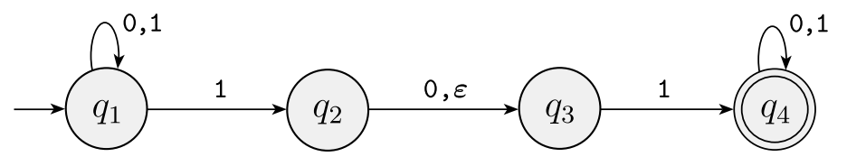
Nondeterminism
The difference between a deterministic finite automaton (DFA), and a nondeterministic finite automaton (NFA):
Every state of a DFA always has exactly one exiting transition arrow for each symbol in the alphabet. The NFA violates that rule!
q₁ has one exiting arrow for 0, but it has two for 1
q₂ has one arrow for 0, but it has none for 1
In an NFA, a state may have zero, one, or many exiting arrows for each alphabet symbol
In a DFA, labels on the transition arrows are symbols from the alphabet. This NFA has an arrow with the label ε
NFA may have arrows labeled with members of the alphabet or ε
Zero, one, or many arrows may exit from each state with the label ε

Slide 44
Adding Nondeterminism
a
b
1
2
b
a, b
Deterministic machine:
at every step, there is only one choice
Nondeterministic machine:
at some steps, there may be more than one choice

Slide 45
Nondeterministic Finite Automaton (NFA) – Formal Definition
A nondeterministic finite automaton (NFA) is a 5-tupple
where:
is a finite set of states
is a finite set alphabet
is the transition function
is the start state, and
is the set of accept states

Slide 46
Nondeterministic Finite Automaton (NFA) – Formal Definition
DFA and NFA differ in one essential way: in the type of transition function
In a DFA, the transition function takes a state and an input symbol and produces the next state
In an NFA, the transition function takes a state and an input symbol or the empty string and produces the set of possible next states
For any set Q we write P(Q) to be the collection of all subsets of Q. P(Q) is called the power set of Q
For any alphabet Σ we write Σ_{ε} to be Σ ∪ {ε}
The formal description of the type of the transition function in an NFA as δ: Q × Σ_{ε}→P(Q)

Slide 47
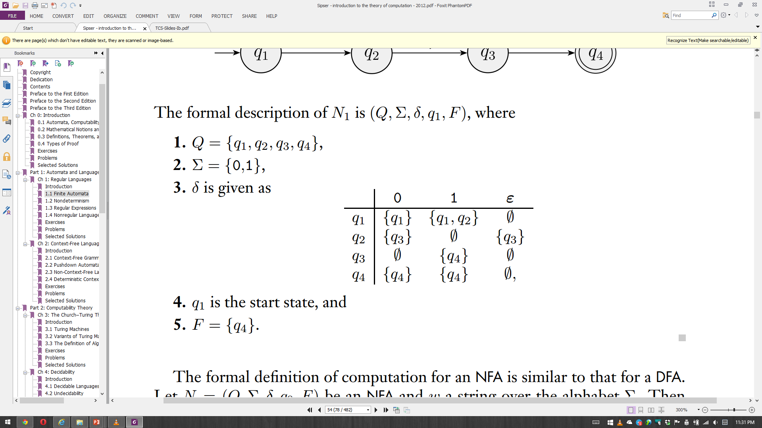
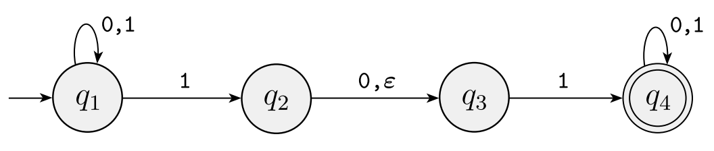
Nondeterministic Finite Automaton (NFA) N₁
N₁ accepts w if we can write w as w = y₁y₂ · · · y_{m}, where each y_{i} is a member of Σ_{ε} and a sequence of states r₀, r₁, . . . , r_{m} exists in Q with three conditions:
r₀ = q₀
r_{i}+1 ∈ δ(r_{i}, y_{i}+1), for i = 0, . . . , m-1
r_{m} ∈ F
Conditions:
The machine starts out in the start state
State r_{i}+1 is one of the allowable next states when N₁ is in state r_{i} and reading y_{i}+1
Observe that δ(r_{i} , y_{i}+1) is the set of allowable next states and so we say that r_{i}+1 is a member of that set
The machine accepts its input if the last state is an accept state

Slide 48
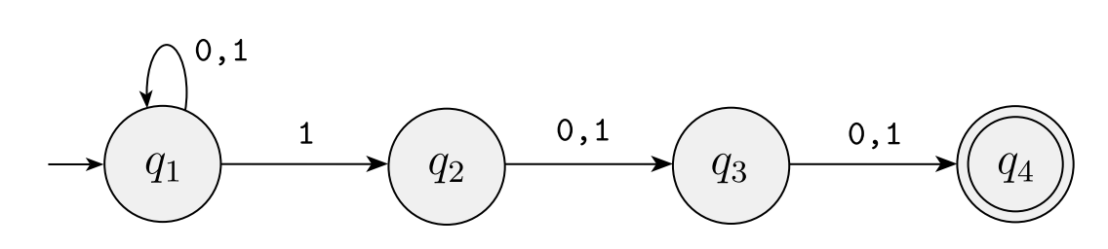
Nondeterministic Finite Automaton N₂
Deskripsikan secara formal NFA N₂!
Tentukan accepted words dari NFA N₂

Slide 49
Tugas
Pahami dengan Finite Automaton
Kumpulkan paper yang membahas penerapan dari finite automaton, boleh yang DFA atau NFA
Buat paper serupa dengan itu, dengan konsep dan pemanfaatan di bidang yang berbeda
Template penulisan, gunakan template paper journal di http://journal.ilmukomputer.org
Copy paste, translasi atau plagiat akan mendapatkan nilai E

Slide 50
4.4 Regular Expression

Slide 51
Basic Regular Expressions
A Regular Expression (RE) is a string of symbols that describes a regular Language
Let be an alphabet. For each , the symbol is an RE representing the set
The symbol is an RE representing the set (The set containing the empty string)
The symbol is an RE representing the empty set

Slide 52
Inductive Construction
Let and be two regular expressions representing languages and , resp
The string is a regular expression representing the set
The string is a regular expression representing the set
The string is a regular expression representing the set

Slide 53
Inductive Construction - Remarks
Note that in the inductive part of the definition larger RE-s are defined by smaller ones. This ensures that the definition is not circular
This inductive definition also dictates the way we will prove theorems: For any theorem T
Stage 1: Prove T correct for all base cases.
Stage 2: Assume T is correct for and . Prove correctness for , , and .

Slide 54
Some Useful Notation
Let be a regular expression:
The string represents , and it also holds that
The string represents .
The string represents .
The Language represented by R is denoted by

Slide 55
Precedence Rules
The star (*) operation has the highest precedence.
The concatenation ( ) operation is second on the preference order.
The union ( ) operation is the least preferred.
Parentheses can be omitted using these rules.

Slide 56
Examples
– .
–
–
–
–

Slide 57
Examples
- all words starting and ending with the same letter
- all strings of forms 1,1,…,1 and 0,1,1,…1
- A set concatenated with the empty set yields the empty set
-

Slide 58
Equivalence With Finite Automata
Regular expressions and finite automata are equivalent in their descriptive power. This fact is expressed in the following Theorem:
Theorem A set is regular if and only if it can be described by a regular expression.
The proof is by two Lemmata (Lemmas):

Slide 59
Lemma ->
If a language L can be described by regular expression then L is regular.

Slide 60
Proofs Using Inductive Definition
The proof follows the inductive definition of RE-s as follows:
Stage 1: Prove correctness for all base cases
Stage 2: Assume correctness for and , and show its correctness for , and

Slide 61
Induction Basis
For any , the expression describes the set , recognized by:
The set represented by the expression is recognized by:
The set represented by the expression is recognized by:

Slide 62
The Induction Step
Now, we assume that and represent two regular sets and claim that , and represent the corresponding regular sets.
The proof for this claim is straight forward using the constructions given in the proof for the closure of the three regular operations

Slide 63
Examples
Show that the following regular expressions represent regular languages:
To be demonstrated on the Blackboard.

Slide 64
Lemma <-
If a language L is regular then L can be described by some regular expression.

Slide 65
Proof Stages
The proof follows the following stages:
Define Generalized Nondeterministic Finite Automaton (GNFA in short).
Show how to convert any DFA to an equivalent GNFA.
Show an algorithm to convert any GNFA to an equivalent GNFA with 2 states.
Convert a 2-state GNFA to an equivalent RE.

Slide 66
Properties of a Generalized NFA
A GNFA is a finite automaton in which each transition is labeled with a regular expression over the alphabet
A single initial state with all possible outgoing transitions and no incoming trans.
A single final state without outgoing trans.
A single transition between every two states, including self loops.

Slide 67
Example of a Generalized NFA

Slide 68
A Computation of a GNFA
A computation of a GNFA is similar to a computation of an NFA
except:
In each step, a GNFA consumes a block of symbols that matches the RE on the transition used by the NFA.

Slide 69
Example of a GNFA Computation
Consider abba or bb or abbbaaaaabbbbb

Slide 70
Converting a DFA (or NFA) to a GNFA
Conversion is done by a very simple process:
Add a new start state with an - transition from the new start state to the old start state
Add a new accepting state with - transition from every old accepting state to the new accepting state
Replace any transition with multiple labels by a single transition labeled with the union of all labels.
Add any missing transition, including self transitions; label the added transition by

Slide 71
Stage 1: Convert D to a GNFA
1.0 Start with D

Slide 72
Stage 1: Convert D to a GNFA
1.1 Add 2 new states

Slide 73
Stage 1: Convert D to a GNFA
1.2 Make the initial state and the final state

Slide 74
Stage 1: Convert D to a GNFA
1.3 Replace multi label transitions by their union.

Slide 75
Stage 1: Convert D to a GNFA
1.4 Add all missing transitions and label them

Slide 76
Ripping a state from a GNFA
The final element needed for the proof is a procedure in which for any GFN G, any state of G, not including and , can be ripped off G, while preserving
This is demonstrated in the next slide by considering a general state, denoted by , and an arbitrary pair of states, and , as demonstrated in the next slide:

Slide 77
Removing a state from a GNFA
Before Ripping
After Ripping
Note: This should be done for every pair of outgoing and incoming outgoing

Slide 78
Ellaboration
Consider the RE , representing all strings that enable transition from via to
What we want to do is to augment the Regular expression of transition , namely , so These strings can pass through
This is done by setting it to

Slide 79
Ellaboration
Note:
In order to achieve an equivalent GNFA in which is disconnected, this procedure should be carried out separately, for every pair of transitions of the form and
Then can be removed, as demonstrated on the next slide:

Slide 80
Elaboration
Assume the following situation:
In order to rip , all pairs of incoming and outgoing transitions should be considered in the way showed on the previous slide namely consider one after the other
After that can be ripped while preserving

Slide 81
In Particular
Replace with .

Slide 82
A (half?) Formal Proof of Lemma<-
The first step is to formally define a GNFA.
Each transition should be labeled with an RE.
Define the transition function as follows:
where denotes all regular expressions over
Note: The def. of is different then for NFA

Slide 83
Changes in Definition
Note: The definition of as:
is different than the original definitions (For DFA and NFA)
In this definition we rely on the fact that every 2 states (except and ) are connected in both directions.

Slide 84
GNFA – A Formal Definition
A Generalized Finite Automaton is a 5-tupple where:
is a finite set called the states
is a finite set called the alphabet
* is the transition function
is the start state, and
is the accept state.

Slide 85
GNFA – Defining a Computation
A GNFA accepts a string if and there exists a sequence of states , satisfying:
For each , , , where , or in other words, is the expression on the arrow from to

Slide 86
Procedure CONVERT
Procedure CONVERT takes as input a GNFA G with k states.
If then these 2 states must be and , and the algorithm returns
If , the algorithm converts G to an equivalent G’ with states by use of the ripping procedure described before.

Slide 87
Procedure CONVERT
Convert
;
If return ;
;
;
For any and any
for return ;

Slide 88
4.5 Nonregular Language

Slide 89
Introduction and Motivation
We ask: Are all languages regular?
The answer is negative
The simplest example is the language
Try to think about this language

Slide 90
Introduction and Motivation
If we try to find a DFA that recognizes the language , it seems that we need an infinite number of states, to “remember” how many a-s we saw so far.
Note: This is not a proof!
Perhaps a DFA recognizing B exists, but we are not clever enough to find it?

Slide 91
Introduction and Motivation
The Pumping Lemma is the formal tool we use to prove that the language B (as well as many other languages) is not regular.

Slide 92
What is Pumping?
Consider the following NFA, denoted by N:
It accepts all words of the form .

Slide 93
What is Pumping?
Consider now the word
Pumping means that the word can be divided into two parts: 1 and 10, such that for any , the word
We say that the word 110 can be pumped
For this is called down pumping
For this is called up pumping

Slide 94
What is Pumping?
A more general description would be: A word , can be pumped if and for each , it holds that
Note: the formal definition is a little more complex than this one.

Slide 95
The Pumping Lemma
Let A be a regular language. There exists a number p such that for every , if then w may be divided into three parts satisfying:
for each , it holds that
Note: Without req. 2 the Theorem is trivial

Slide 96
Demonstration Continuation
In terms of the previous demonstration we have:
For , we get:

Slide 97
Proof of the Pumping Lemma
Let D be a DFA recognizing A and let p be the number of states of D. If A has no words whose length is at least p, the theorem holds vacuously. Let be an arbitrary word such that Denote the symbols of w by where

Slide 98
Proof of the Pumping Lemma
Assume that is the sequence of states that D goes through while computing with input w. For each , , Since ,
Since the sequence contains states and since the number of states of D is p, that there exist two indices such that

Slide 99
Proof of the Pumping Lemma
Denote , and
Note: Under this definition and .
By this definition, the computation of D on starting from , ends at
By this definition, the computation of D on , starting from , ends at which is an accepting state

Slide 100
Proof of the Pumping Lemma
The computation of D on starting from , ends at . Since , this computation starts and ends at the same state.
Since it is a circular computation, it can repeat itself k times for any
In other words: for each ,
Q.E.D.

Slide 101
Example:
Lemma: The language is not regular.
Proof: Assume towards a contradiction that L is regular and let p be the pumping length of L.
Let . By the Pumping Lemma there exists a division of w, , such that and w can be pumped.
This means that , where
Since we conclude

Slide 102
Example: (Cont.)
This however implies that in , the number of a-s is smaller then the number of b-s
It also means that for every , the number of a-s in is larger then the number of b-s Both cases constitute a contradiction
Note: Each one of these cases is separately sufficient for the proof

Slide 103
Discussion
This is what we got so far:
RL-s Ex:

Slide 104
Referensi
Michael Sipser, Introduction to the Theory of Computation Third Edition, Cengage Learning, 2012
George Tourlakis, Theory of Computation, Wiley, 2012
John Martin, Introduction to Languages and the Theory of Computation, McGraw-Hill , 2010
Robert Sedgewick and Kevin Wayne, Introduction to Computer Science, Addison-Wesley, 2015 (http://introcs.cs.princeton.edu/java)
Albert Endres dan Dieter Rombach, A Handbook of Software and Systems Engineering, Pearson Education Limited, 2003

