Slide 1
Theory of Computation
Romi Satria Wahono
romi@romisatriawahono.net
http://romisatriawahono.net/tc
Mobile: +6281586220090

Slide 2
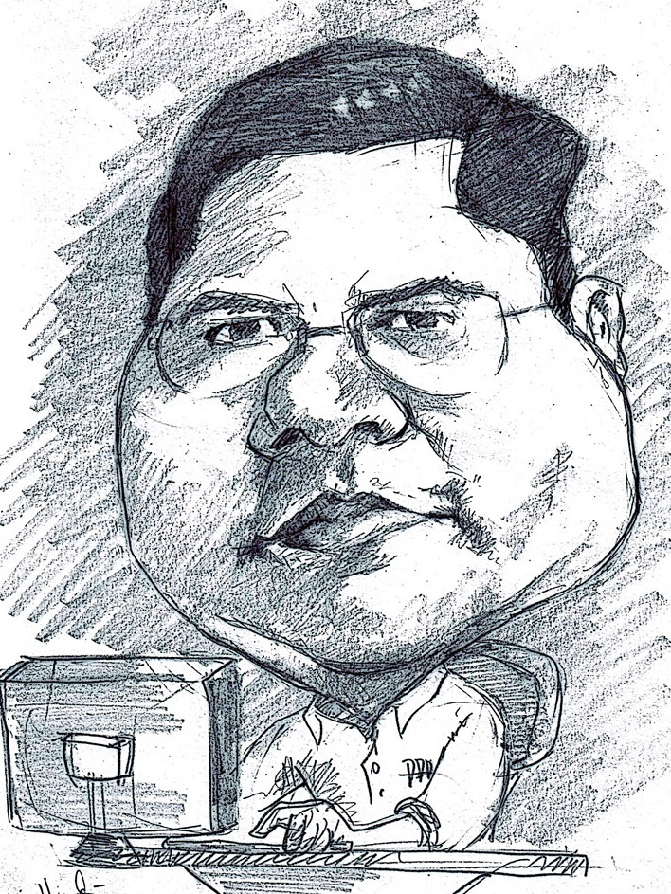
Romi Satria Wahono
SD Sompok Semarang (1987)
SMPN 8 Semarang (1990)
SMA Taruna Nusantara Magelang (1993)
B.Eng, M.Eng and Ph.D in Software Engineering from
Saitama University Japan (1994-2004)
Universiti Teknikal Malaysia Melaka (2014)
Research Interests: Software Engineering,
Machine Learning
Founder dan Koordinator IlmuKomputer.Com
Peneliti LIPI (2004-2007)
Founder dan CEO PT Brainmatics Cipta Informatika

Slide 3
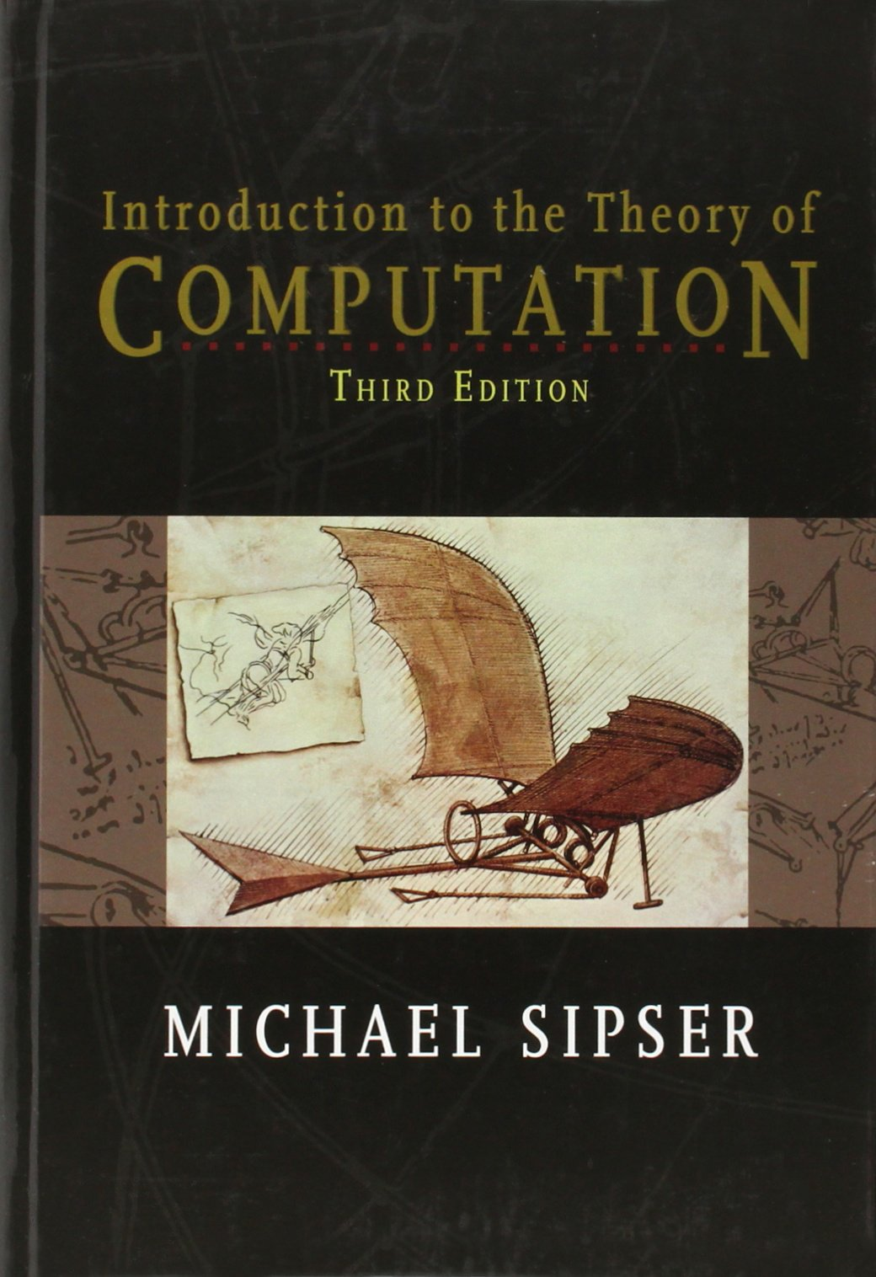
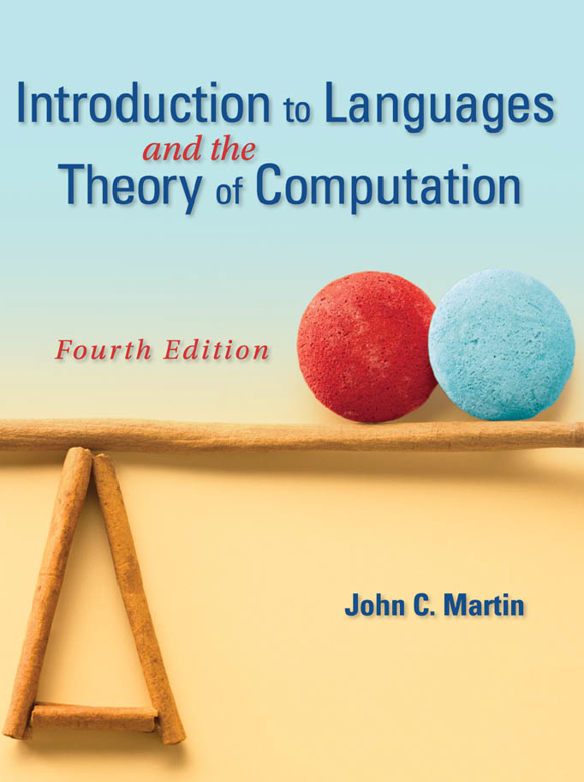
Textbooks

Slide 4
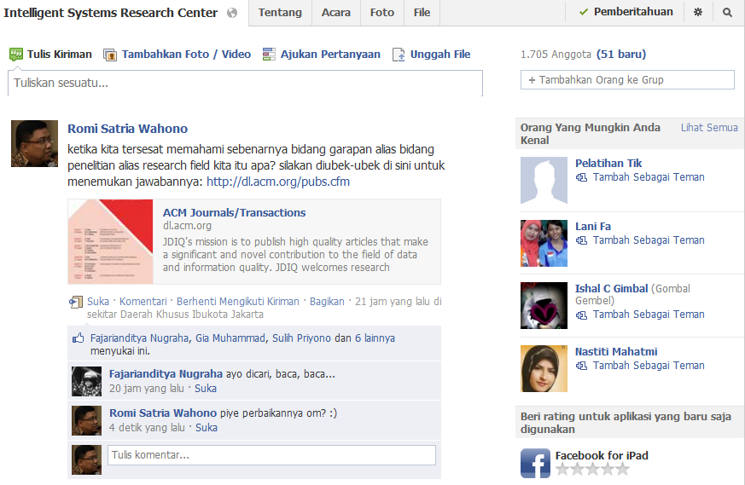

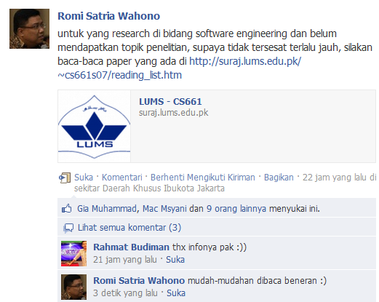
Forum Diskusi
Group FB: http://facebook.com/groups/intelligentsystems/

Slide 5
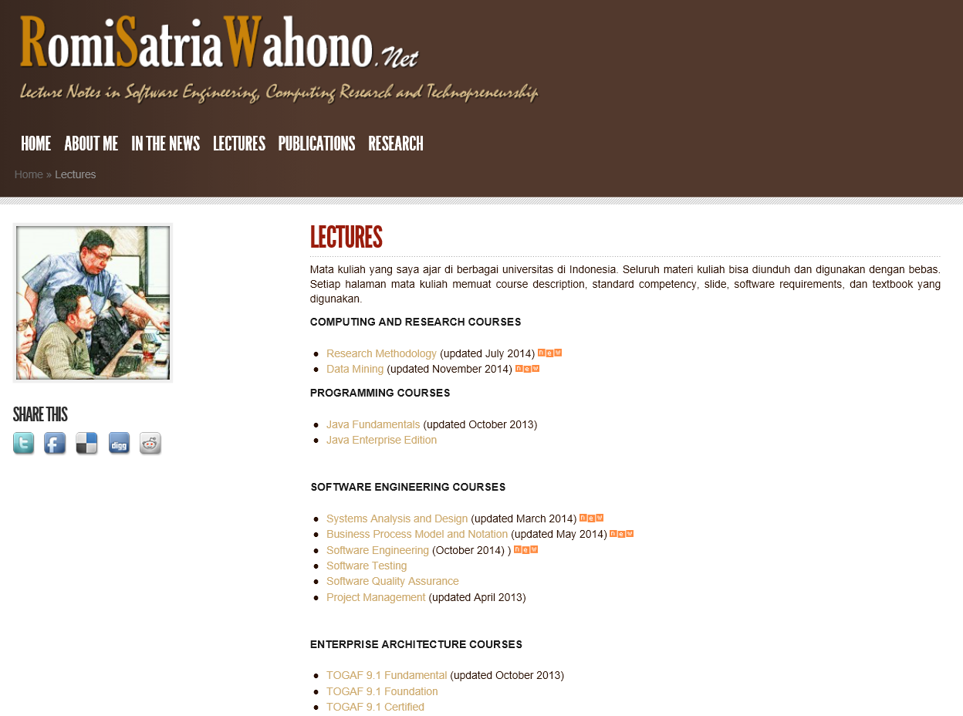

Slide 6
Sistem Penilaian Mata Kuliah
Penyelesaian exercise di setiap pertemuan kelas (Activities)
Penugasan (Assignments)
Penulisan Makalah Ilmiah (Scientific Paper)

Slide 7
Course Outline
Introduction
Math Fundamental 1: Set, Sequence, Function
Math Fundamental 2: Graph, String, Logic
Finite Automata
Pushdown Automata
Turing Machines

Slide 8
1. Introduction
1.1 Who Needs Theory?
1.2 Automata, Computability and Complexity

Slide 9
1.1 Who Need Theory?

Slide 10
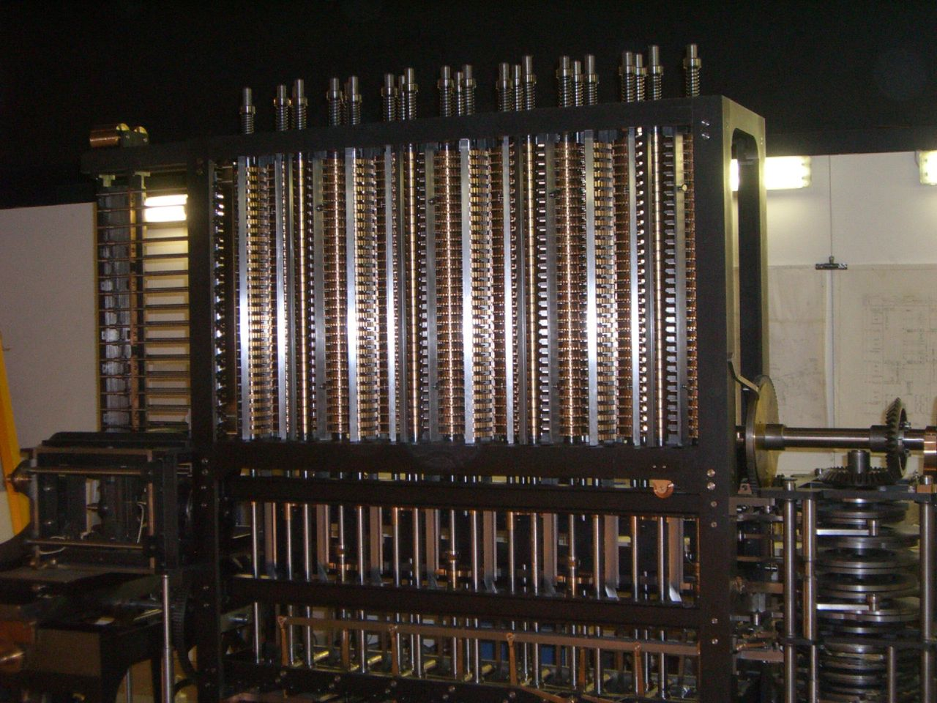
Computation is what Computers do, who needs theory?
Charles Babbage’s Difference Engine (1822)

Slide 11
Computation is what Computers do, who needs theory?
Babbage terinspirasi oleh Wilhelm Schickard, Blaise Pascal, dan Gottfried Leibniz (1642)
Babbage menginspirasi Howard H. Aiken yang bekerjasama dengan IBM membuat mesin Mark I (1937)
Dua tahun sesudah Mark I dioperasikan (1946), kelompok insinyur dan penemu lain menyelesaikan ENIAC, komputer elektronik pertama

Slide 12
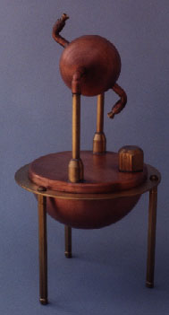
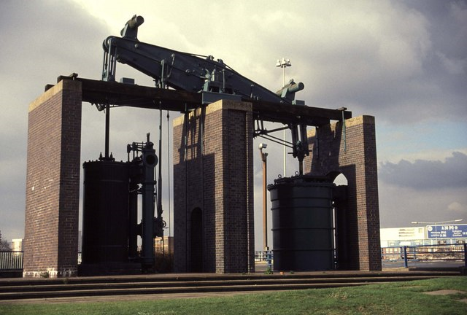
“Engining” is what Engines do, who needs theory?
Matthew Boulton and James Watt steam engine, 1817
Hero of Alexandria’s aeolipile steam engine

Slide 13
“Engining” is what Engines do, who needs theory?
Thomas Savery (1650-1715) adalah orang Inggris yang membuat mesin uap bolak-balik pertama, mesin ini tidak populer karena mesin sering meledak dan sangat boros uap
Denis Papin (1647-1712) membuat katup-katup pengaman dan mengemukakan gagasan untuk memisahkan uap air dan air dengan menggunakan torak
Gagasan Papin direspons oleh Thomas Newcomen ( 1663-1729) yang merancang dan membangun mesin menggunakan torak
James Watt selama kurang lebih 20 tahun ia mengembangkan dan memperbaiki kinerja dari mesin Newcomen. Gagasan James Watt yang paling penting adalah mengkonversi gerak bolak-balik menjadi geraka putar (1781).

Slide 14
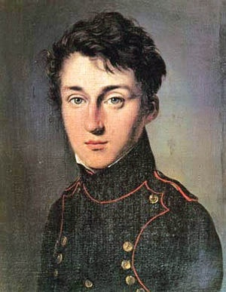
Nicolas Carnot (1796 – 1832)
Is the potential work available from a heat source potentially unbounded?
Can heat engines be improved by replacing the steam with some other fluid or gas?

Slide 15
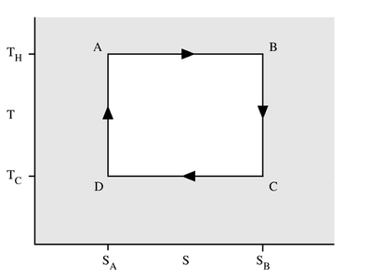
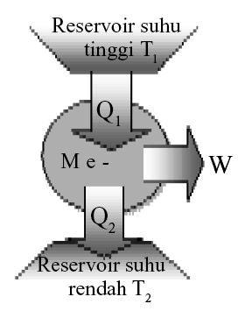
Carnot’s Answer
Efficiency of an ideal engine depends only on the temperature difference between the reservoirs

Slide 16
Carnot’s Answer
Hukum kedua termodinamika mengatakan bahwa aliran kalor memiliki arah
Dengan kata lain, tidak semua proses di alam semesta adalah reversible (dapat dibalikkan arahnya)
Sebagai contoh jika seekor beruang kutub tertidur di atas salju, maka salju dibawah tubuh nya akan mencair karena kalor dari tubuh beruang tersebut
  Akan tetapi beruang tersebut tidak dapat mengambil kalor dari salju tersebut untuk menghangatkan tubuhnya

Slide 17
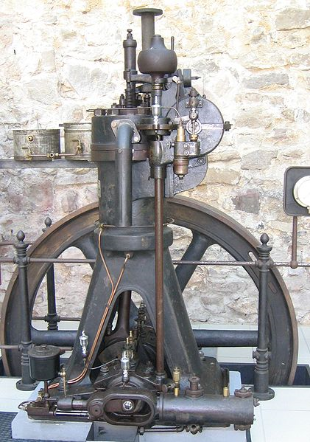
Does Theory Matter?
Theory and Construction of a Rational Heat-engine to Replace the Steam Engine and Combustion Engines Known Today
(Rudolf Diesel, 1893)

Slide 18
Theory
Drives
Practice
Drives
Theory

Slide 19
Exercise
Lakukan googling
Rangkumkan contoh teori/metode di bidang ilmu komputer di atas tahun 1980 yang baru dirasakan manfaatnya akhir-akhir ini
Siapa Penemu – Tahun – Deskripsi Teori/Metode – Pemanfaatan Saat ini (Produk, Alat, dsb)

Slide 20
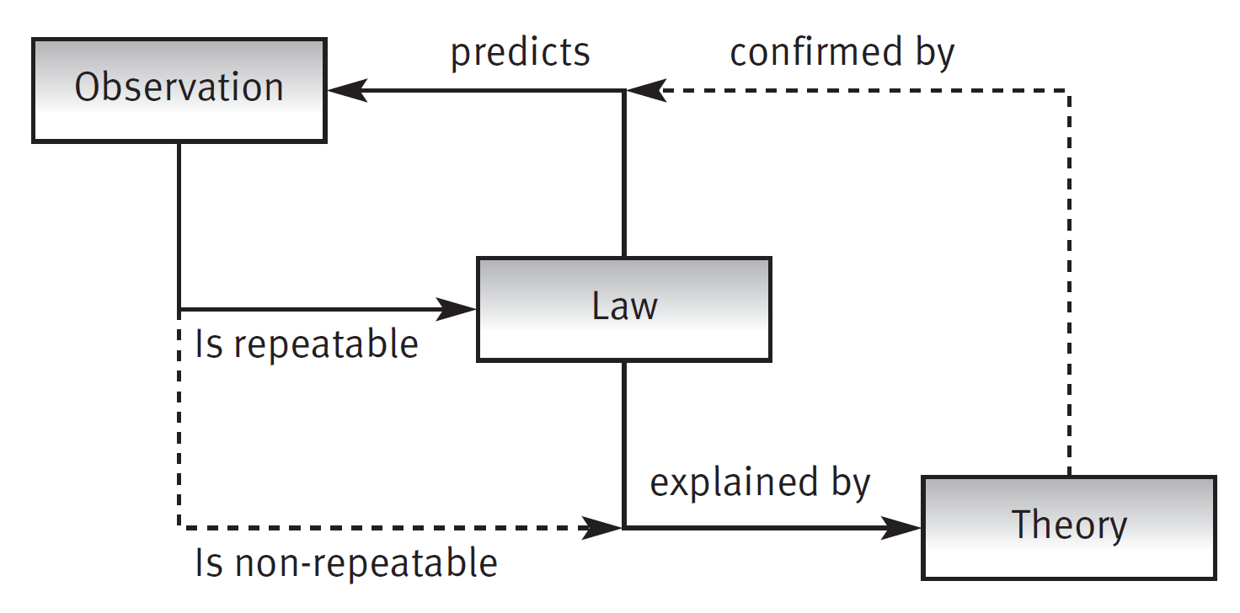
Observations, Laws and Theories
(Endres & Rombach, 2003)
Repeatable observations can often be stated as a law
Using this law, we can then make predictions about further observations
A law tells us how things occur, but not why. Theories explain why it is true and order our observations

Slide 21
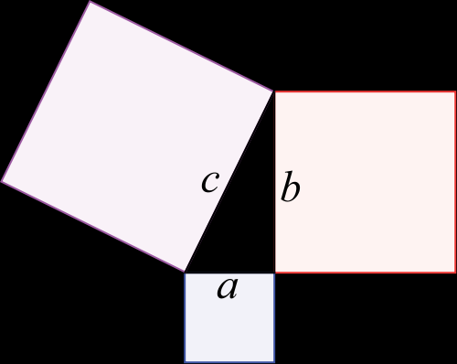
Math Theorem vs. Science Theory
Notes:
A theorem is a result that can be proven to be true from a set of axioms. The term is used especially in mathematics where the axioms are those of mathematical logic and the systems in question. A theorem is a statement which has been proved on the basis of explicit assumptions. Theorem is not self-evident but proved by a chain of mathematical reasoning.e.g Pythagoras theorem
A theory is a set of ideas used to explain why something is true, or a set of rules on which a subject is based on. Theory summarizes group of hypotheses that have been supported with repeated tests and evidences also best fits all available knowledge .Theory is valid as long as there is no evidence to dispute it.

Slide 22
Math Theorem vs. Scientific Theory
Math Theorem
Scientific Theory
Starts with a simple, well-define model
Deductive reasoning: Proven using logical deduction
Useful it if provides deep insights
Starts with the complex, messy universe
Inductive reasoning: “Proven” by lots of confirming observations and no non-conforming observations
Useful if it makes reliable predictions and helps us understand the universe
Even wrong theories are useful

Slide 23
Exercise
Lakukan googling
Berikan contoh tentang suatu Law dan Theory di bidang Software Engineering

Slide 24
Key Questions
“Is the potential work available from a heat source potentially unbounded?"
“Can heat engines be improved by replacing the steam with some other fluid or gas?”
Carnot’s questions about heat engines
“Can all problems be solved by computers?"
“Can computers solve more problems by changing their operation?”
Analogous questions about computers

Slide 25
Precise Definitions Needed
What is a problem?
What is a computer?
What does it mean for a computer to solve a problem?
How do we measure time?
Two Key Questions
What problems can a computer solve? (Computability)
What problems can a computer solve in a reasonable time?
(Complexity)

Slide 26
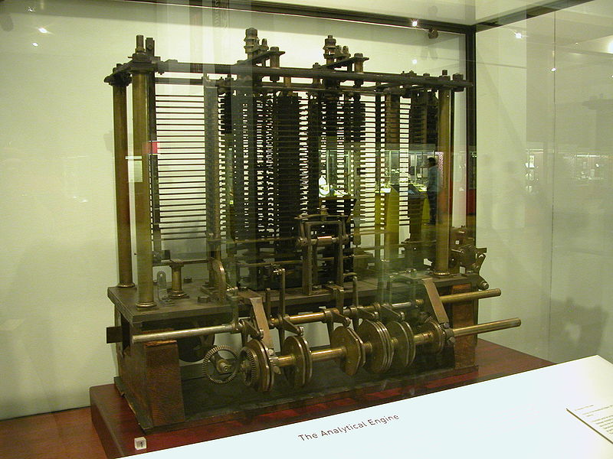
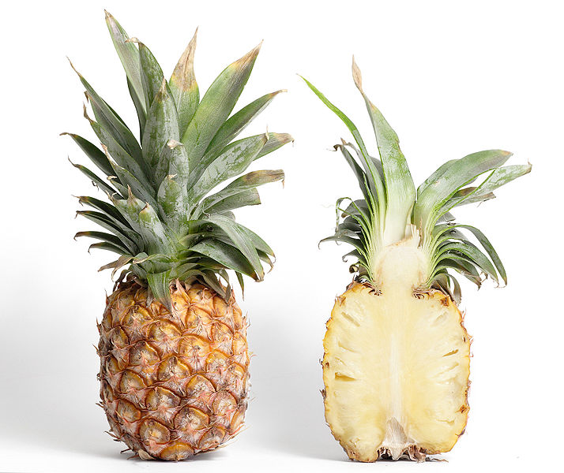
What Problems can a Computer Solve?
“During the last six months I have been contriving another engine of far greater power ... I am myself astonished at the powers I have given it.”
(Charles Babbage, 1835)
“It will not slice a pineapple.”
(Charles Babbage, 1852)
Answered (for a model) by Church and Turing (1930s)

Slide 27
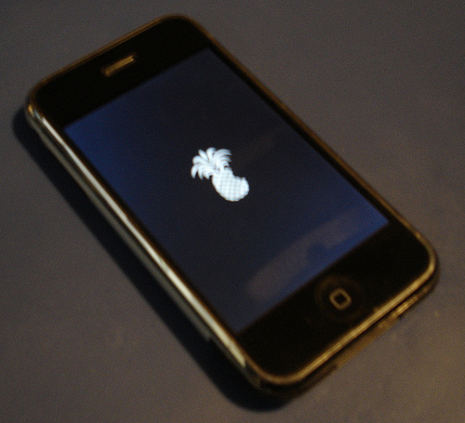
There’s an app for that?

Slide 28
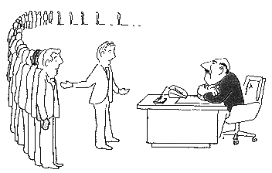
What Problems can Real Computers Solve in a Reasonable Time?
Theoretical version: (P = NP) posed by Stephen Cook in 1971
Open problem
Pragmatic version: do all computers in our universe have these limitations?
Open problem
I can't find an efficient algorithm, but neither can all these famous people

Slide 29
Exercise
Lakukan googling
Rangkumkan pendapat anda tentang masalah apa saja yang bisa dipecahkan oleh komputer, dan masalah apa saja yang tidak bisa

Slide 30
1.2 Automata, Computability and Complexity

Slide 31
Automata, Computability and Complexity
This course focuses on three traditionally central areas of the theory of computation:
  Automata
  Computability
  Complexity
They are linked by the question:
What are the fundamental capabilities and limitations of computers?

Slide 32
Complexity Theory
What makes some problems computationally hard and others easy?
You have several options when you confront a problem that appears to be computationally hard:
  By understanding which aspect of the problem is at the root of the difficulty, so that the problem is more easily solvable
  Be able to settle for less than a perfect solution to the problem. In certain cases, finding solutions that only approximate the perfect one is relatively easy
  Some problems are hard only in the worst case situation, but easy most of the time
  You may consider alternative types of computation, such as randomized computation, that can speed up certain tasks
One applied area that has been affected directly by complexity theory is the ancient field of cryptography

Slide 33
Computability Theory
Mathematicians discovered that certain basic problems cannot be solved by computers
  Example: the problem of determining whether a mathematical statement is true or false
The theories of computability and complexity are closely related
  Complexity theory: the objective is to classify problems as easy ones and hard ones
  Computability theory: the classification of problems is by those that are solvable and unsolvable
Computability theory introduces several of the concepts used in complexity theory

Slide 34
Automata Theory
Automata theory deals with the definitions and properties of mathematical models of computation
These models play a role in several applied areas of computer science:
  Finite automaton: used in text processing, compilers, and hardware design
  Context-free grammar: used in programming languages and artificial intelligence

Slide 35
Models of Computation
Machine-like | Language-like
Finite Automata | Regular Expressions
Pushdown Automata | Context-free Grammar
Turing machine | Unrestricted Grammar, Lambda Calculus

Slide 36
What is Theory of Computation?
What can or cannot be computed efficiently with given resources?
Can it be computed? – Computability Theory
Can it be computed quickly? – Complexity Theory

Slide 37
What is Theory of Computation?
Computability Theory | Complexity Theory
Problems are Solvable | Computationally Hard Problems
Problems are Not Solvable | Computationally Easy Problems

Slide 38
What is Theory of Computation?
The branch of computer science and mathematics that deals with how efficiently problems can be solved on a model of computation, using an algorithm
The field is divided into three major branches: automata theory and language, computability theory, and computational complexity theory, which are linked by the question: "What are the fundamental capabilities and limitations of computers?."

Slide 39
Exercise
Lakukan googling
Rangkumkan pendapat anda tentang masalah apa saja yang berat dipecahkan oleh komputer, dan masalah apa saja ringan

Slide 40
Referensi
Michael Sipser, Introduction to the Theory of Computation Third Edition, Cengage Learning, 2012
George Tourlakis, Theory of Computation, Wiley, 2012
John Martin, Introduction to Languages and the Theory of Computation, McGraw-Hill , 2010
Robert Sedgewick and Kevin Wayne, Introduction to Computer Science, Addison-Wesley, 2015 (http://introcs.cs.princeton.edu/java)
Albert Endres dan Dieter Rombach, A Handbook of Software and Systems Engineering, Pearson Education Limited, 2003

