Slide 1
Unified Modeling Language (UML)
Romi Satria Wahono romi@romisatriawahono.net http://romisatriawahono.net 08118228331

Slide 2

Romi Satria Wahono
SMA Taruna Nusantara Magelang (1993)
B.Eng, M.Eng and Ph.D in Software Engineering Saitama University Japan (1994-2004) Universiti Teknikal Malaysia Melaka (2014)
Core Competency in Enterprise Architecture, Software Engineering and Machine Learning
LIPI Researcher (2004-2007)
Founder and CEO:
PT Brainmatics Cipta Informatika (2005)
PT IlmuKomputerCom Braindevs Sistema (2014)
Professional Member of IEEE, ACM and PMI
IT and Research Award Winners from WSIS (United Nations), Kemdikbud, Ristekdikti, LIPI, etc
SCOPUS/ISI Indexed Q1 Journal Reviewer: Information and Software Technology, Journal of Systems and Software, Software: Practice and Experience, Empirical Software Engineering, etc
Industrial IT Certifications: TOGAF, ITIL, CCAI, CCNA, etc
Enterprise Architecture Consultant: KPK, RistekDikti, INSW, BPPT, Kemsos Kemenkeu (Itjend, DJBC, DJPK), Telkom, FIF, PLN, PJB, Pertamina EP, etc

Slide 3
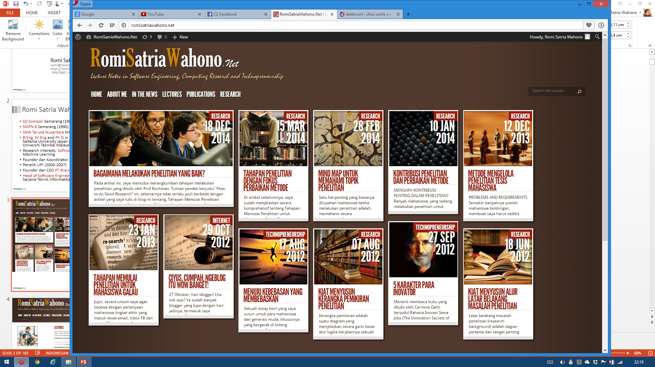
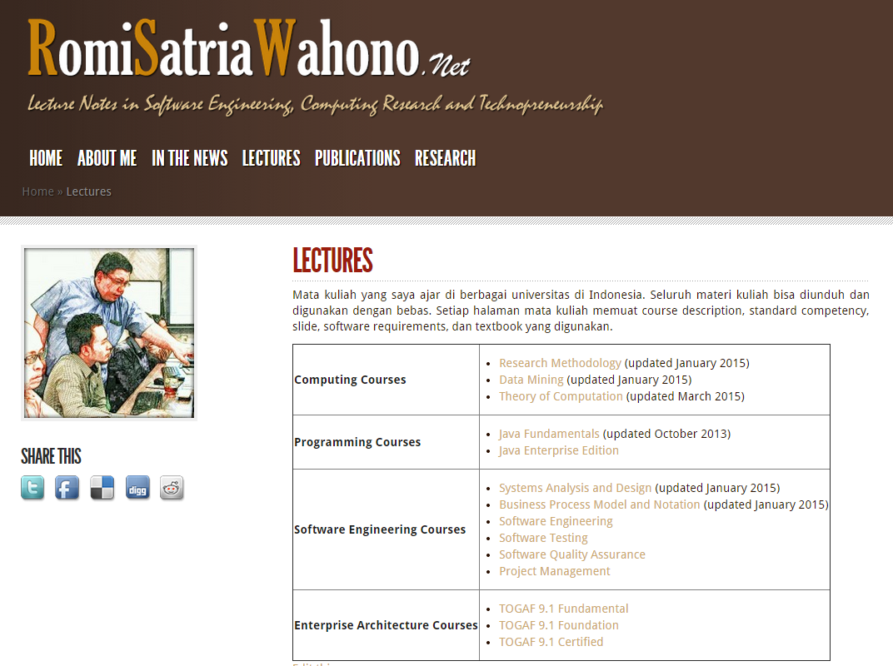
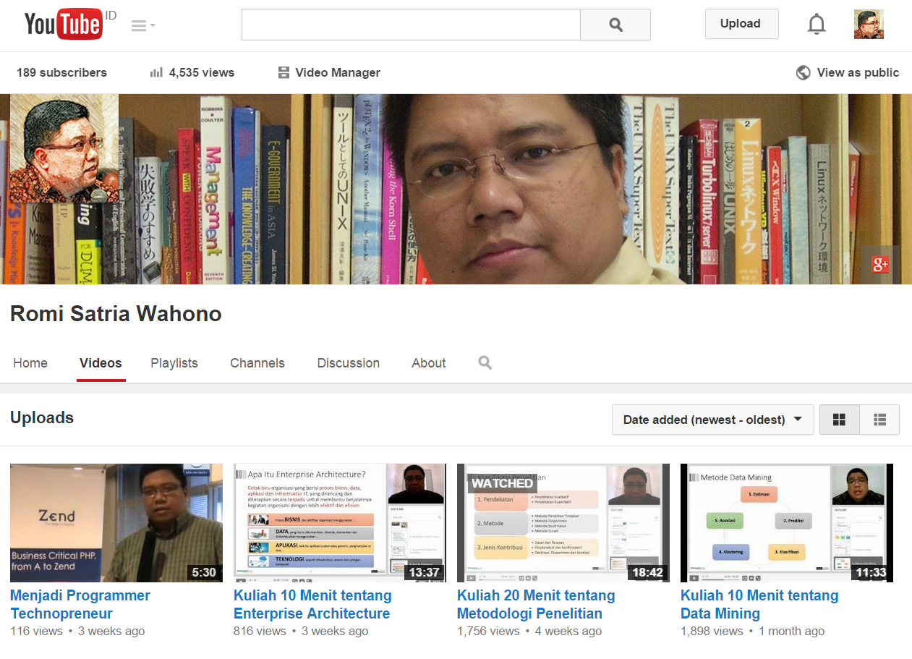

Slide 4
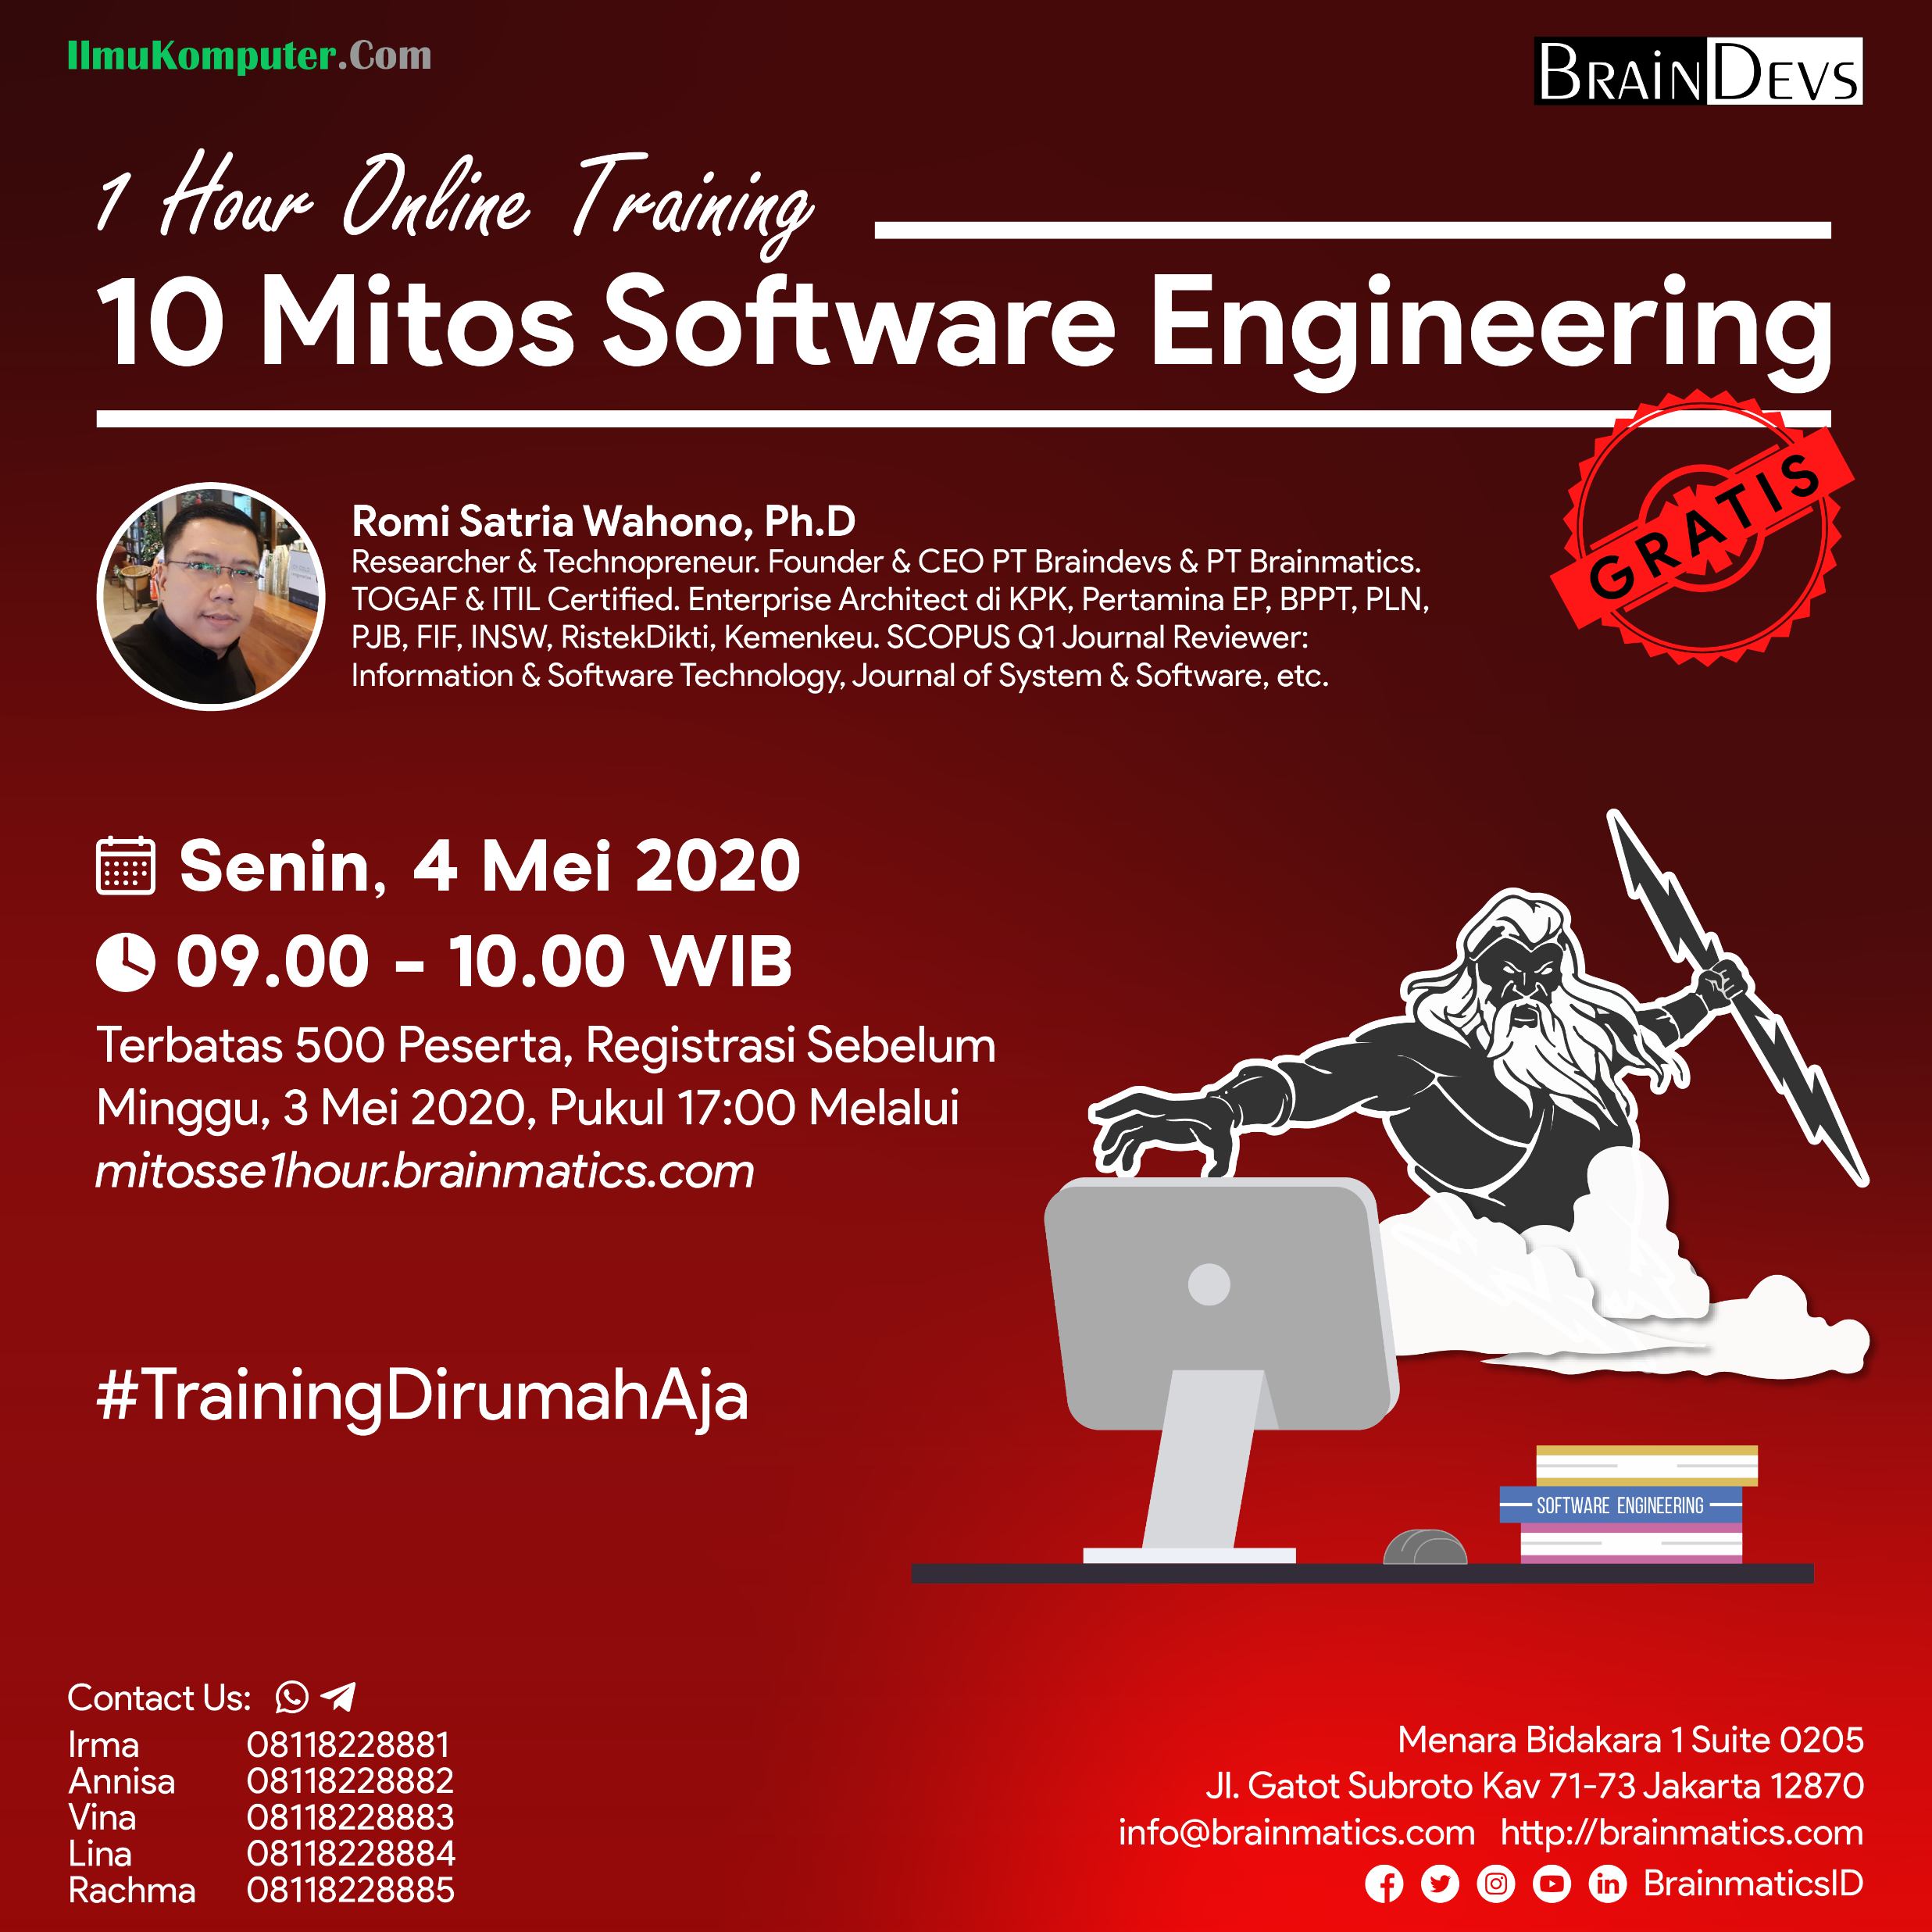

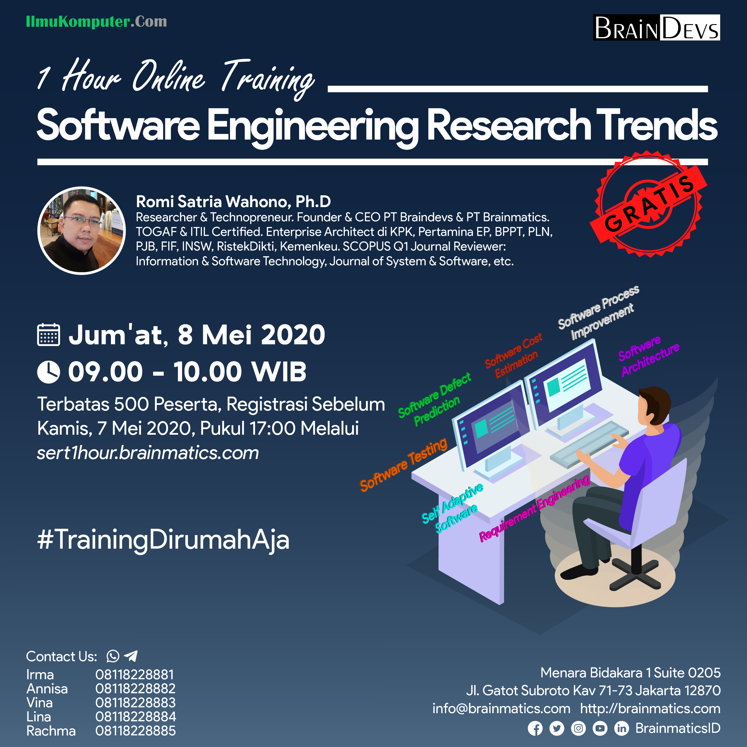

Slide 5
Course Outline
1. System Planning
1.1 Siklus dan Metodologi Pengembangan Software
2. Systems Analysis
2.1 Requirement Gathering
3. Systems Design
3.1 Perancangan Class Diagram
3.3 Perancangan User Interface Design
3.4 Perancangan Data Model
3.5 Perancangan Deployment Diagram
2.2 Identifikasi Proses Bisnis dengan Use Case Diagram
2.3 Pemodelan Proses Bisnis dengan AD atau BPMN
2.4 Realisasi Proses Bisnis dengan Sequence Diagram
1.2 System Request dan Feasibility Analysis

Slide 6
1. Systems Planning

Slide 7
1.1 Siklus dan Metodologi Pengembangan Software

Slide 8
Siklus Pengembangan Software: Alur, Peran, dan Tahapan (Deliverable) (Tilley, 2012) (Dennis, 2016) (Valacich, 2017)
User/Product Owner membawa permintaan kebutuhan (perubahan) software (System Request) ke System Analyst
System Analyst membuat analisis kelayakan (Feasibility Analysis) dari System Request tersebut
Setelah dinyatakan layak, System Analyst melakukan analysis dan design, dan hasilnya adalah System Specification
Business Analyst membantu System Analyst memahami proses bisnis dari software yang akan dibangun
System Specification diserahkan oleh System Anayst ke Programmer untuk dilakukan Konstruksi (Coding)
Hasil Konstruksi berupa Kode Program diserahkan ke Software Tester untuk dilakukan Pengujian (Unit, Integration, System, User Acceptance Testing)
Instalasi (delivery) software dan manajemen perubahan
Software = Kode Program + Dokumentasi (Pengembangan dan Penggunaan)
Siklus kembali ke 1 apabila ada permintaan perubahan (Permintaan Perubahan Software)
Planning (System Proposal)
Analysis and Design (System Specification)
Implementation (Software)
Maintenance (Updated Software)

Slide 9
Siklus Pengembangan Software
Implementation (New System)
Design (System Specification)
Analysis (System Specification)
Planning
(System Proposal)
(Tilley, 2012) (Dennis, 2016) (Valacich, 2017)

Slide 10
Metodologi Pengembangan Software (Model Process)
A formalized approach to implementing the Software Development Life Cycle (Dennis, 2012)
A simplified representation of a software process (Sommerville, 2015)
A distinct set of activities, actions, tasks, milestones, and work products required to engineer high quality software (Pressman, 2015)

Slide 11
Metodologi Pengembangan Software
Structured Design (Prescriptive) (1967- )
Waterfall method
Parallel development
Rapid Application Development (Iterative) (1985-)
Phased Development
Prototyping
Agile Development (Adaptive) (1995-)
Extreme Programming (XP)
Scrum
More Prescriptive/ Documentation
More Adaptive/ Communication
Compiled from (Dennis, Wixom and Tegarden, 2016)

Slide 12
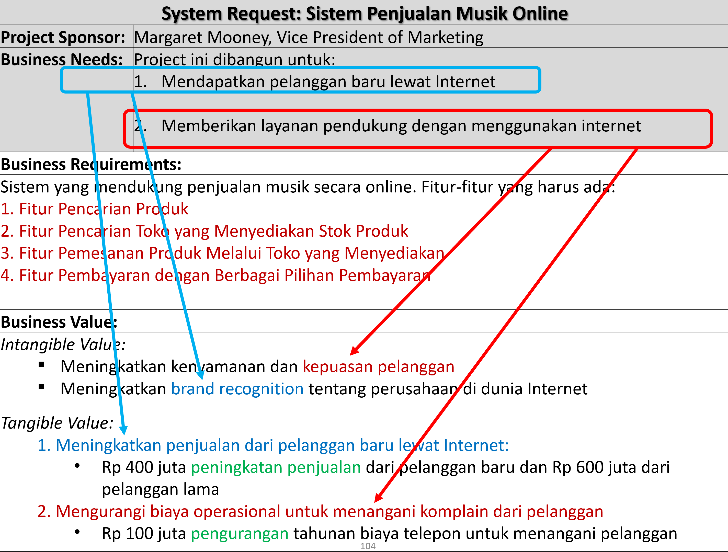
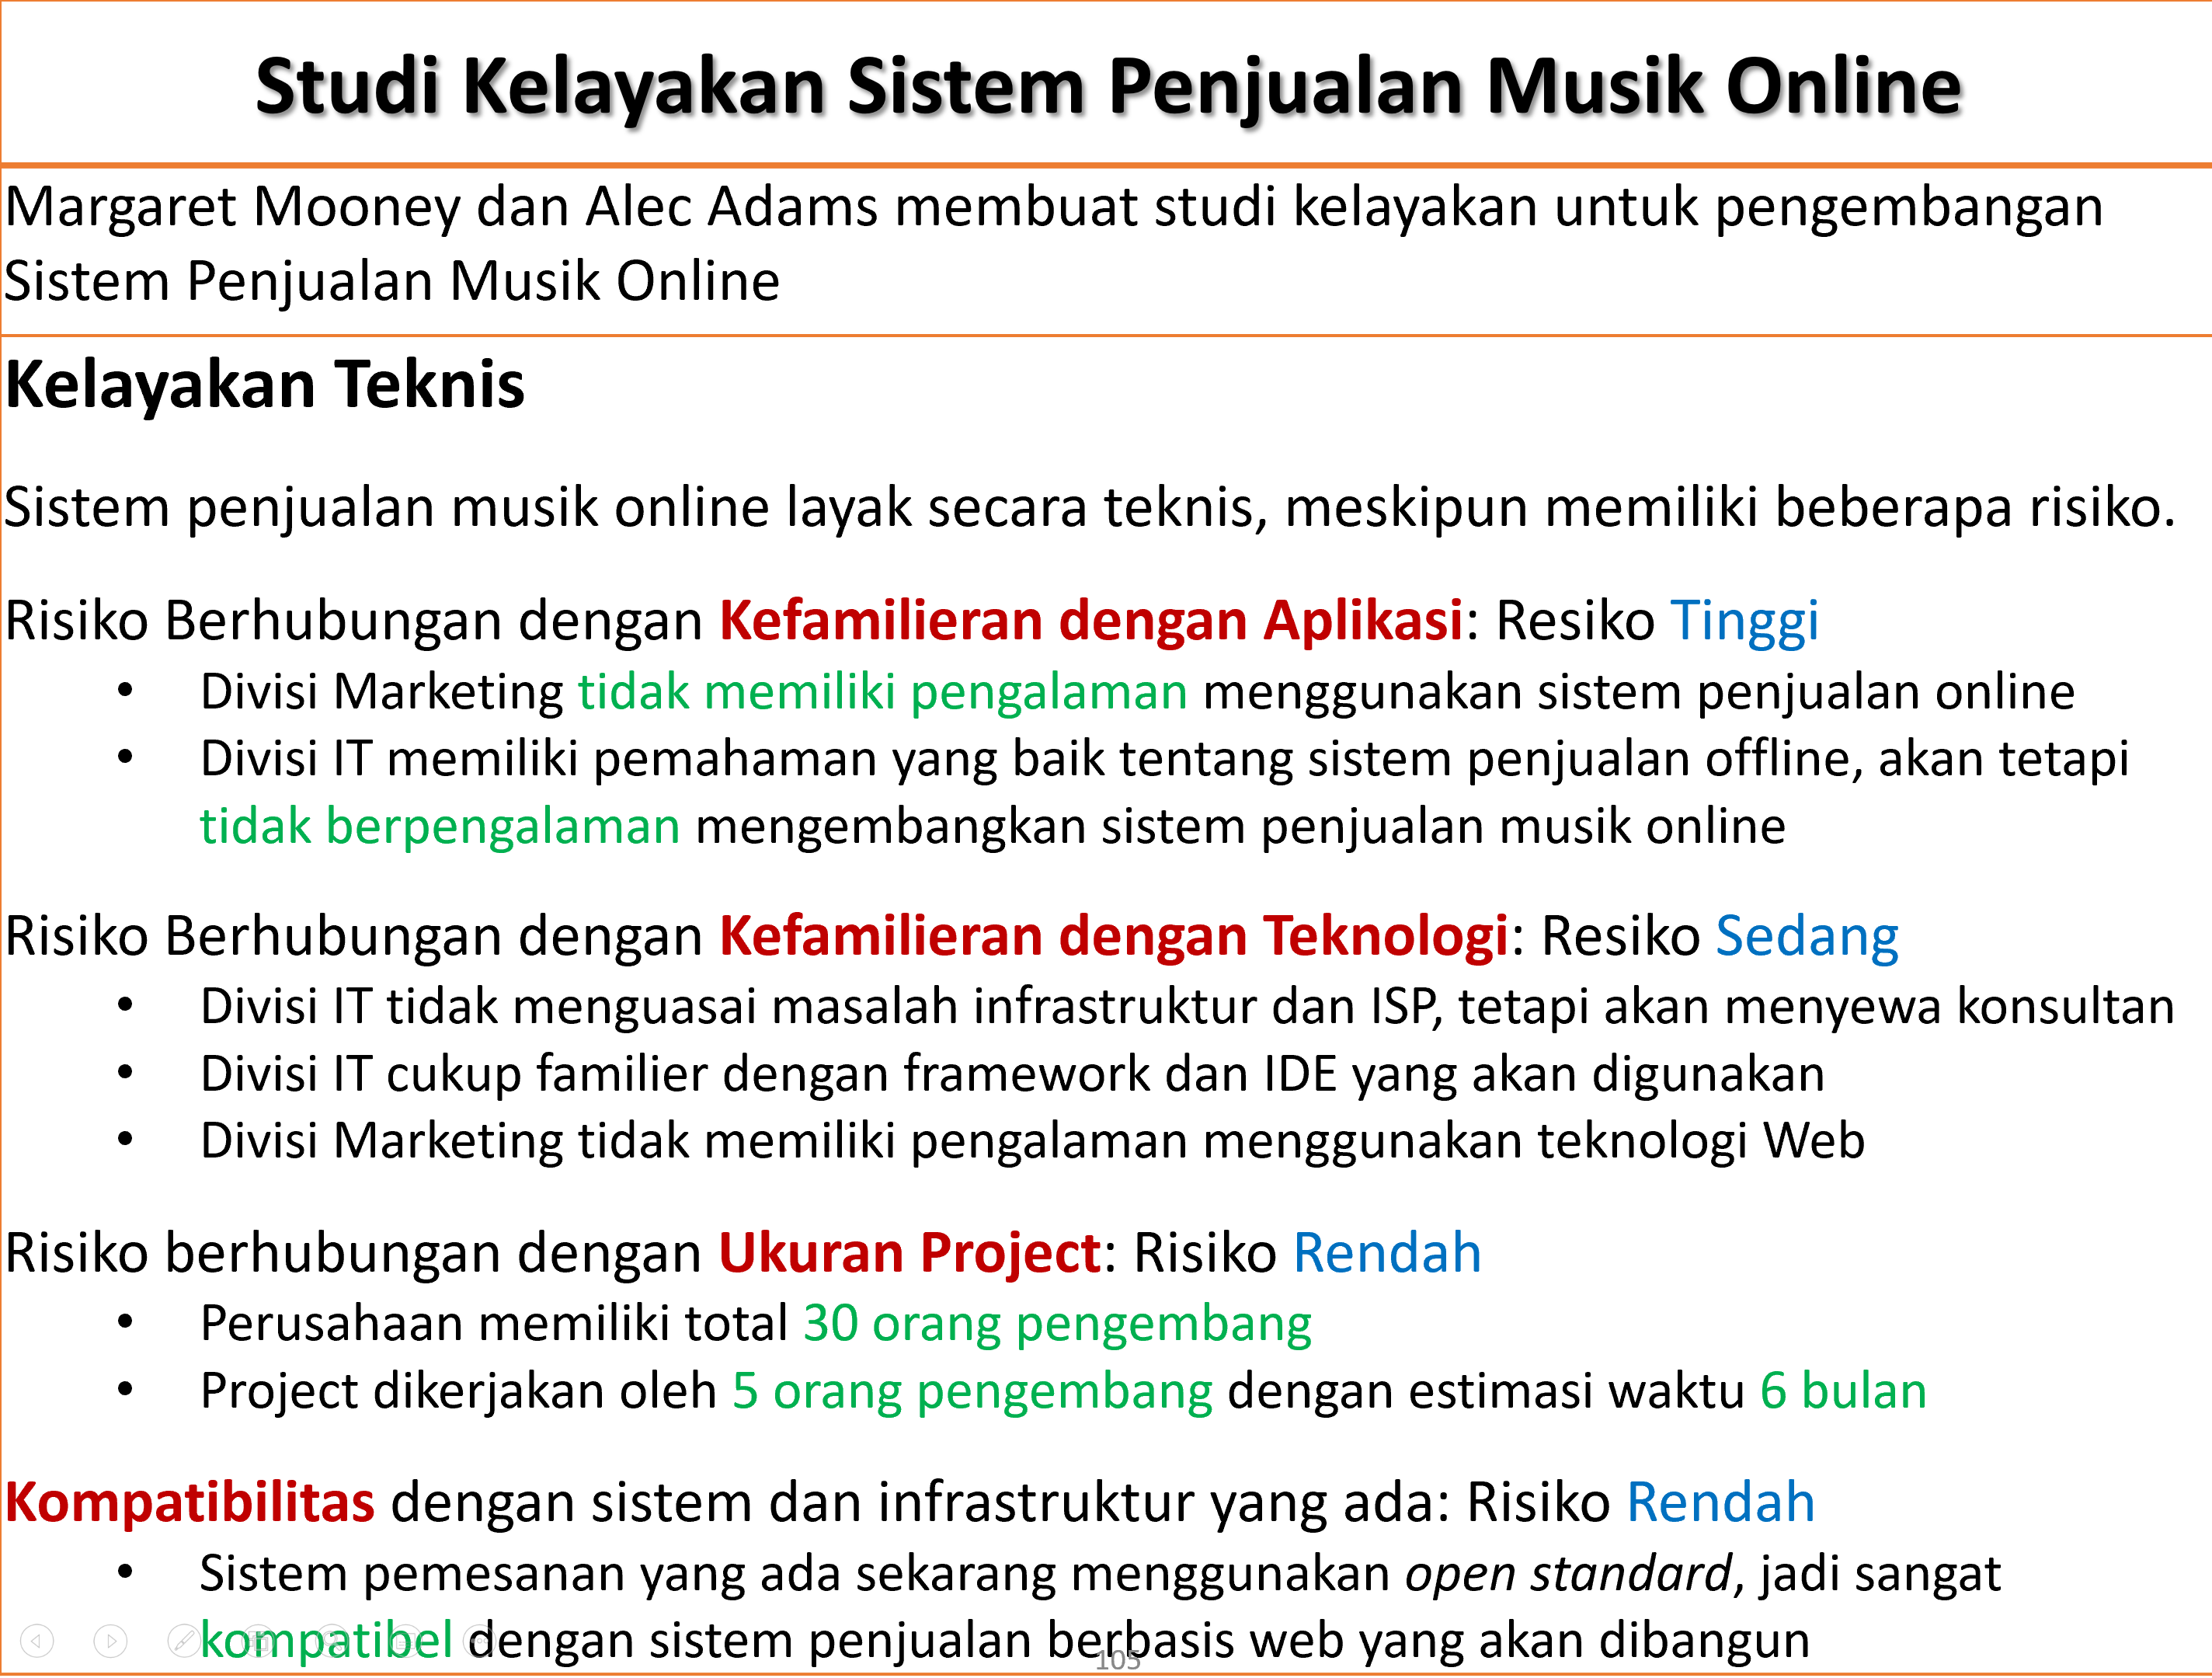
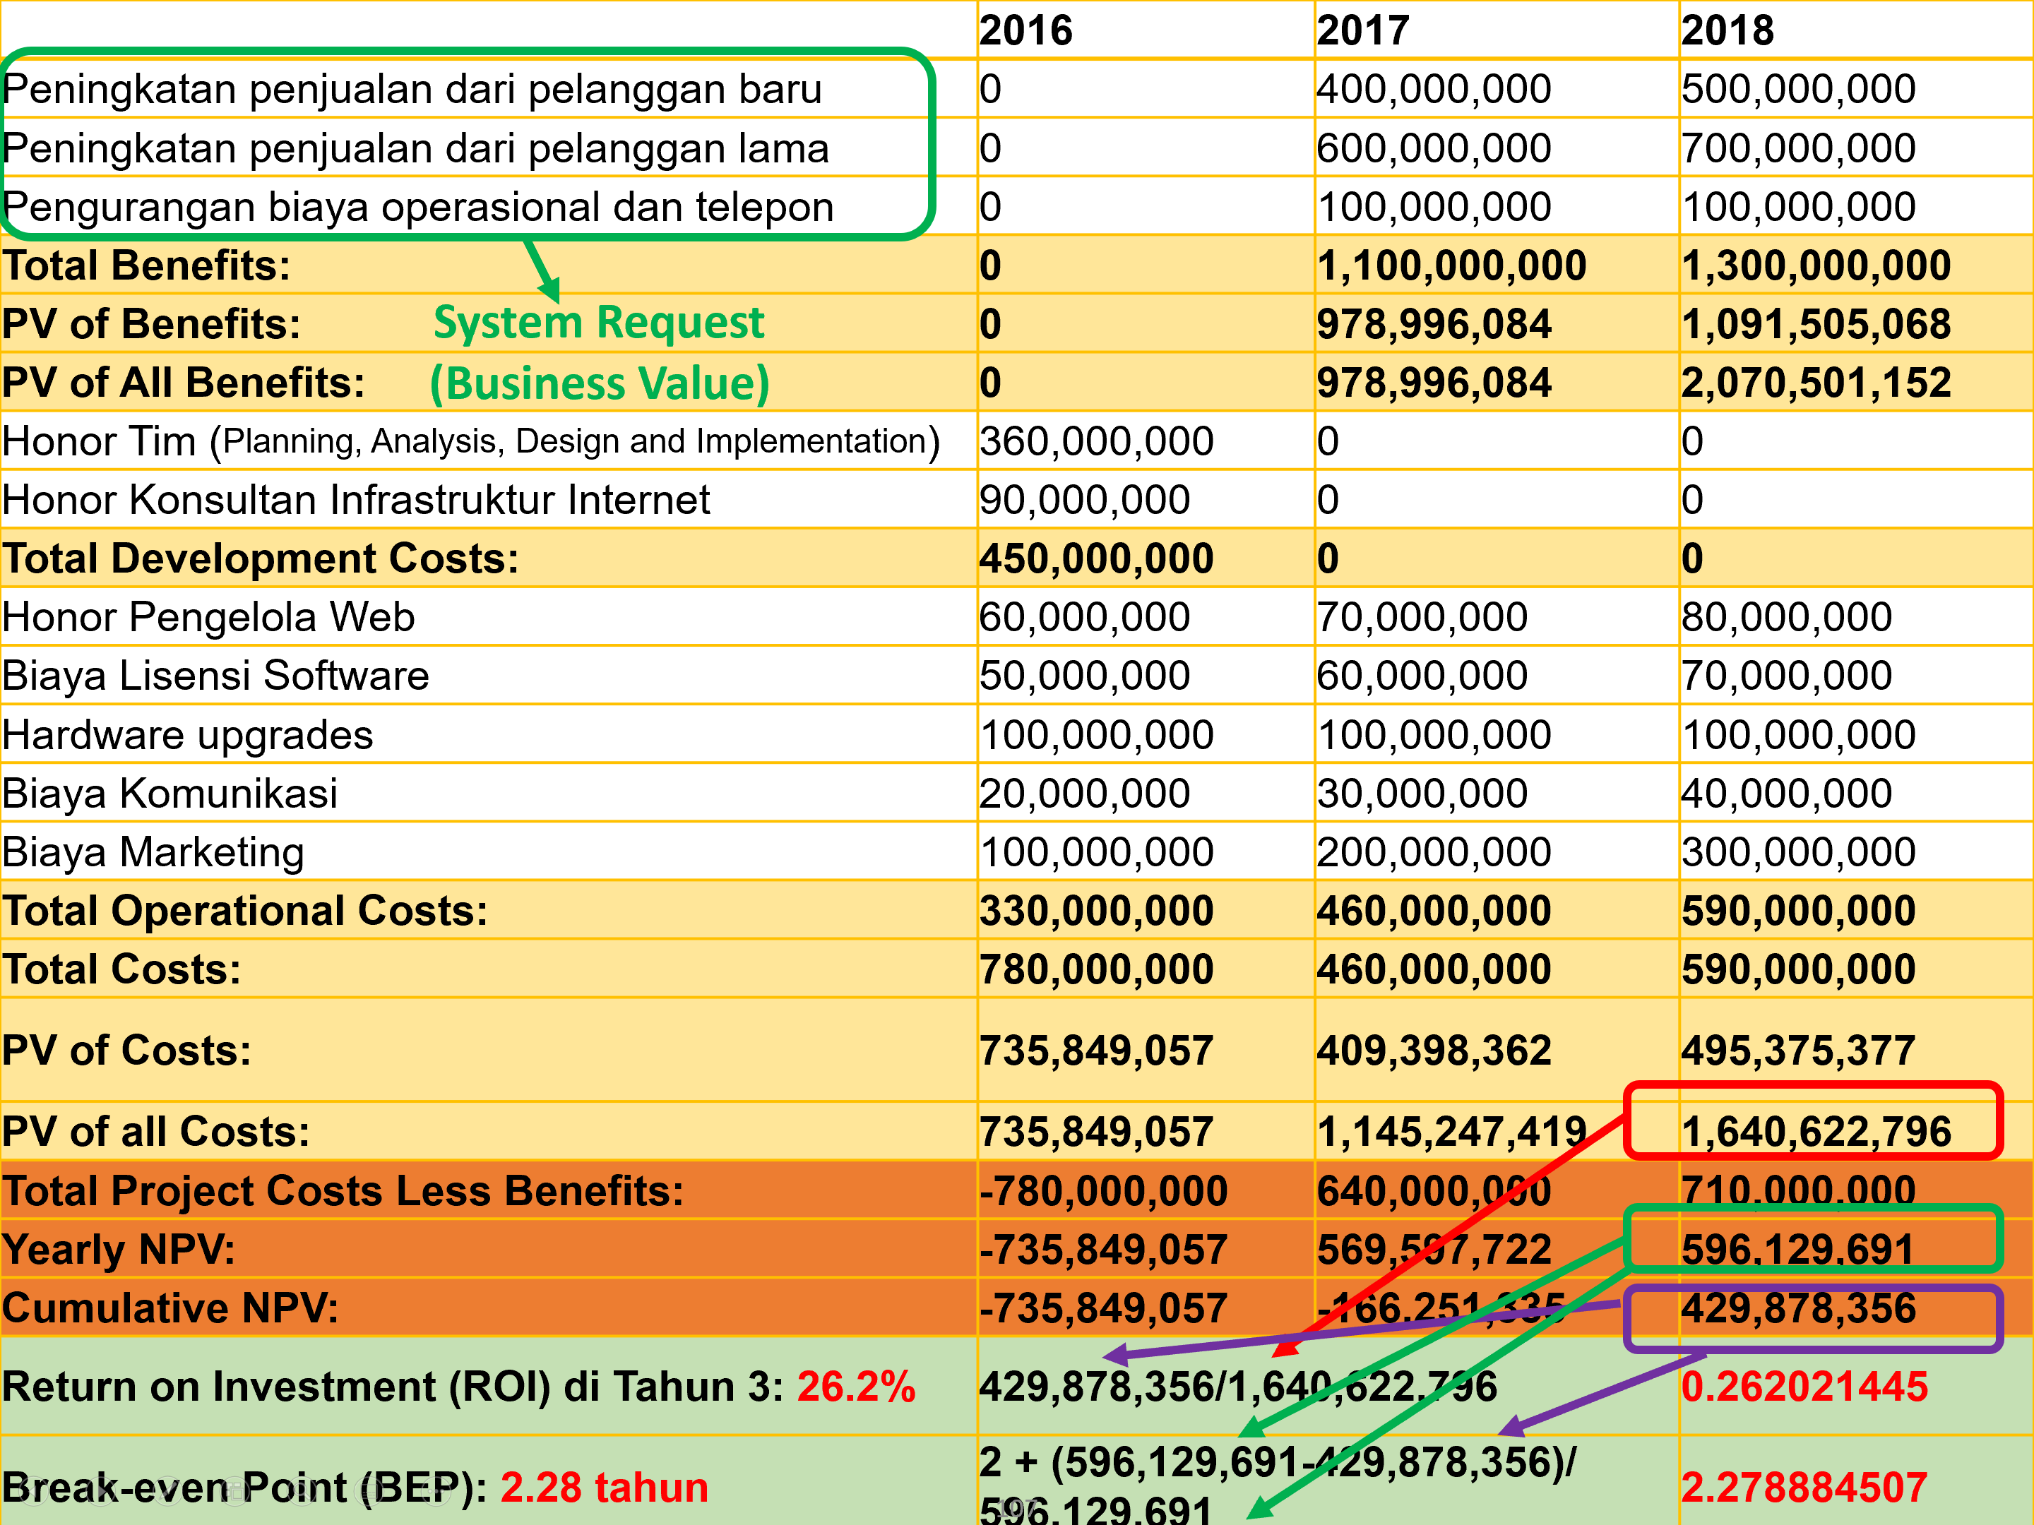
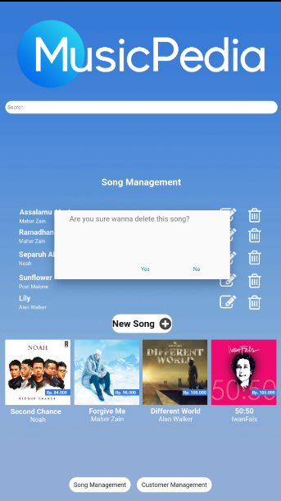
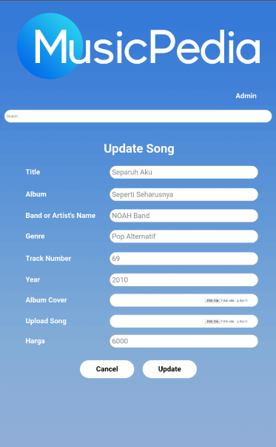
Planning
Analysis
Implementation
Design

Slide 13
Planning
Analysis
Versi 1
Versi 2
Implementation
Design

Slide 14
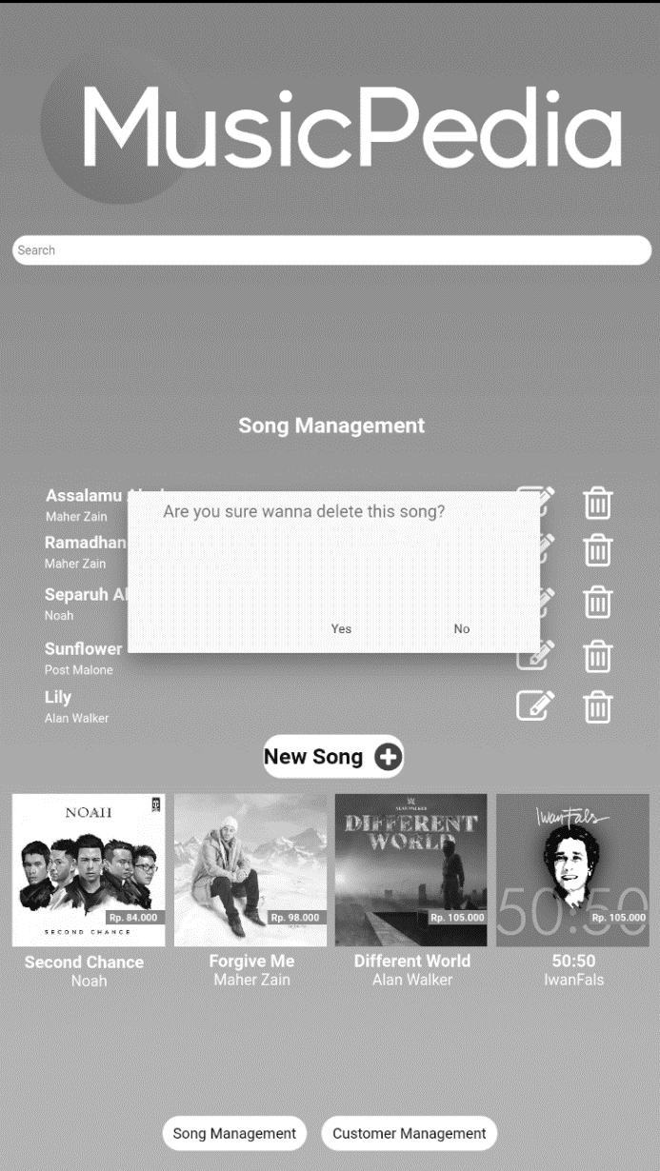
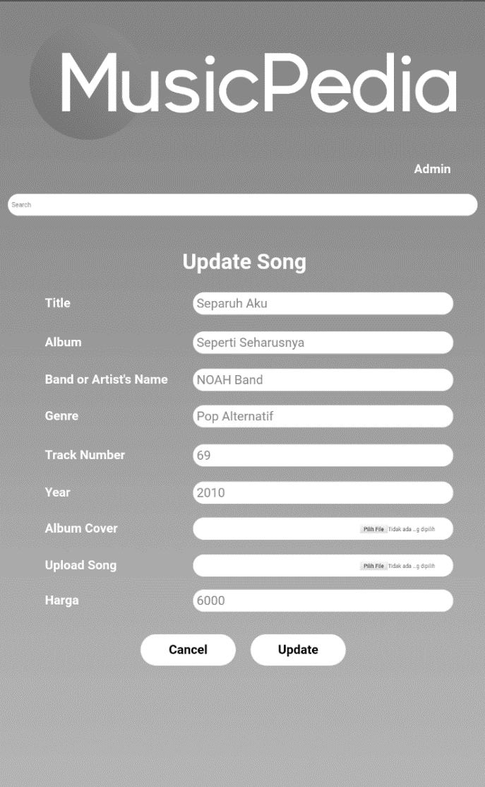
Prototype
Planning
Analysis
Implementation
Design

Slide 15
Planning
Analysis
Sprint 1
Sprint 2
Hasil Sprint 1
Hasil Sprint 2
Implementation
Design

Slide 16
1.2 System Request dan Feasibility Analysis

Slide 17
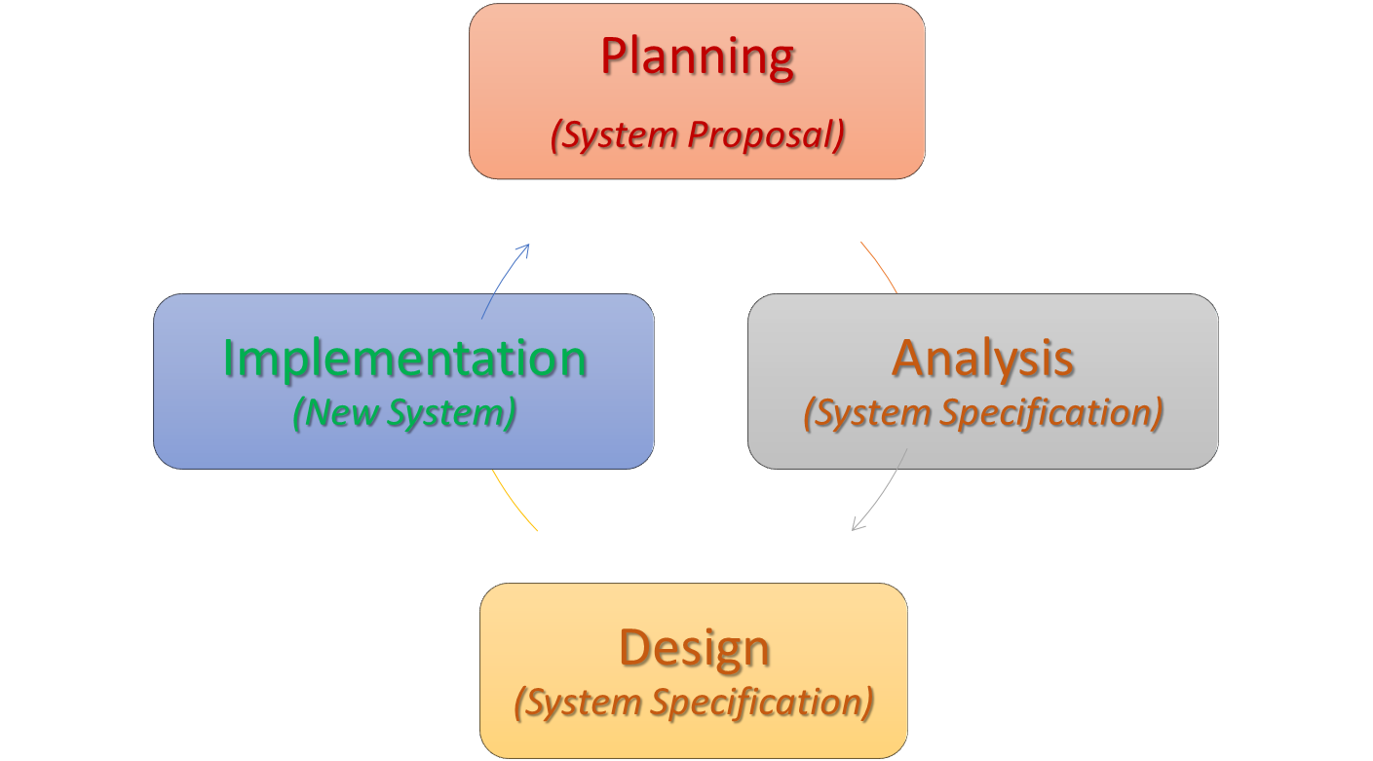
Siklus Pengembangan Software
Planning: Mengapa Software harus Dikembangkan?
System request
Feasibility Analysis (project size estimation)
Analysis: Siapa Pengguna dan Alur Kerja Software?
Requirement gathering
Business process modeling
Design: Bagaimana Komposisi dari Software?
Program design
User interface design
Data design
Implementation: Konstruksi dan Penyerahan Software
System construction
Testing
Documentation
Installation

Slide 18
Planning
System Request (Business Value Identification)
Lower Cost
Increase Profit
Feasibility Analysis
Technical (Capabilities)
Economic (ROI, BEP)
Organizational (Goals, Core Business)
Increase Productivity

Slide 19
System Request
Elemen | Deskripsi | Contoh
Business Need | The business-related reason for initiating the software development project Reason prompting the project, and why the project should be funded? | Meningkatkan penjualan Mengurangi biaya operasional Meningkatkan produktifitas pegawai Meningkatkan kualitas layanan Mengurangi kebocoran/kecurangan Mengurangi cacat produksi Meningkatkan efisiensi kerja
Business Value | The benefits that the software will create for the organization Tangible value (a quantiable value) and intangible value (intuitive believe) | Peningkatan penjualan 3% Pengurangan biaya operasional 10% Peningkatan produktifitas pegawai 10% (dihitung rasio pekerjaan dan gaji) Pengurangan cacat produksi 20% Peningkatan efisiensi kerja 20%
Business Requirements | The business capabilities that software will provide Can be replaced by Use Case Diagram | Fitur registrasi, login, dan logout Fitur pengelolaan data pengguna Fitur pengiriman notifikasi otomatis Fitur cetak laporan bulanan dan tahunan

Slide 20
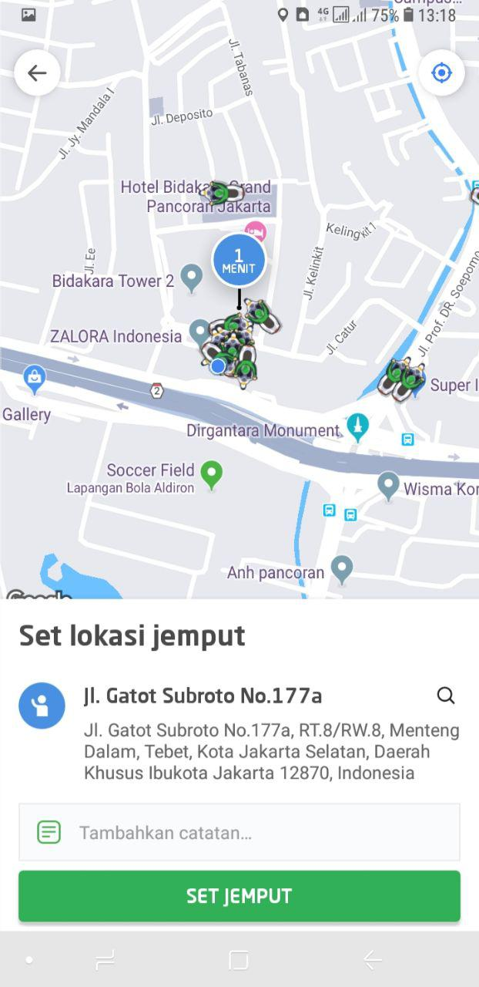
Software Berkualitas?
Business Requirements
Software quality is (IEEE, 1991):
The degree to which a system, component, or process meets specified requirements
The degree to which a system, component, or process meets customer or user needs or expectations (benefits)
Sesuai Kebutuhan
Ada Keuntungan
Business
Value

Slide 21
System Request: Sistem Penjualan Musik Online
Project Sponsor: | Margaret Mooney, Vice President of Marketing
Business Needs: | Project ini dibangun untuk: Mendapatkan pelanggan baru lewat Internet Meningkatkan efisiensi penanganan masalah pelanggan melalui internet
Business Requirements:
Sistem yang mendukung penjualan musik secara online. Fitur-fitur yang harus ada: Fitur Pencarian Produk Fitur Pencarian Toko yang Menyediakan Stok Produk Fitur Pemesanan Produk Melalui Toko yang Menyediakan Fitur Pembayaran dengan Berbagai Pilihan Pembayaran
Business Value:
Intangible Value: Meningkatkan kenyamanan dan kepuasan pelanggan Meningkatkan brand recognition tentang perusahaan di dunia Internet Tangible Value: 1. Meningkatkan penjualan dari pelanggan baru lewat Internet: Rp 400 juta peningkatan penjualan dari pelanggan baru dan Rp 600 juta dari pelanggan lama 2. Mengurangi biaya operasional untuk menangani komplain dari pelanggan Rp 100 juta pengurangan tahunan biaya telepon untuk menangani pelanggan

Slide 22
Studi Kelayakan Sistem Penjualan Musik Online
Margaret Mooney dan Alec Adams membuat studi kelayakan untuk pengembangan Sistem Penjualan Musik Online
Kelayakan Teknis Sistem penjualan musik online layak secara teknis, meskipun memiliki beberapa risiko. Risiko Berhubungan dengan Kefamilieran dengan Aplikasi: Resiko Tinggi Divisi Marketing tidak memiliki pengalaman menggunakan sistem penjualan online Divisi IT memiliki pemahaman yang baik tentang sistem penjualan offline, akan tetapi tidak berpengalaman mengembangkan sistem penjualan musik online Risiko Berhubungan dengan Kefamilieran dengan Teknologi: Resiko Sedang Divisi IT tidak menguasai masalah infrastruktur dan ISP, tetapi akan menyewa konsultan Divisi IT cukup familier dengan framework dan IDE yang akan digunakan Divisi Marketing tidak memiliki pengalaman menggunakan teknologi Web Risiko berhubungan dengan Ukuran Project: Risiko Rendah Perusahaan memiliki total 30 orang pengembang Project dikerjakan oleh 5 orang pengembang dengan estimasi waktu 6 bulan Kompatibilitas dengan sistem dan infrastruktur yang ada: Risiko Rendah Sistem pemesanan yang ada sekarang menggunakan open standard, jadi sangat kompatibel dengan sistem penjualan berbasis web yang akan dibangun

Slide 23
Kelayakan Ekonomi
Cost benefit analysis telah dilakukan. Sistem Penjualan musik online memiliki peluang yang baik untuk bisa meningkatkan pendapatan perusahaan. Return on Investment (ROI) setelah 3 tahun: 31% Break-even point (BEP): 2.25 tahun Total keuntungan setelah 3 tahun: Rp. 503.559.986,-
Kelayakan Organisasi
Secara organisasi, resikonya rendah. Tujuan dari pengembangan sistem penjualan musik online adalah meningkatkan penjualan perusahaan. Dan ini selaras dengan KPI marketing yang ke arah peningkatan kuantitas penjualan Project champion dari pengembangan sistem penjualan musik online ini adalah Margaret Mooney, Vice President of Marketing

Slide 24
 | 2019 | 2020 | 2021
Peningkatan penjualan dari pelanggan baru | 0 | 400,000,000 | 500,000,000
Peningkatan penjualan dari pelanggan lama | 0 | 600,000,000 | 700,000,000
Pengurangan biaya operasional dan telepon | 0 | 100,000,000 | 100,000,000
Total Benefits: | 0 | 1,100,000,000 | 1,300,000,000
PV of Benefits: | 0 | 978,996,084 | 1,091,505,068
PV of All Benefits: | 0 | 978,996,084 | 2,070,501,152
Honor Tim (Analysis, Design and Implementation) | 360,000,000 | 0 | 0
Honor Konsultan | 90,000,000 | 0 | 0
Total Development Costs: | 450,000,000 | 0 | 0
Honor Pengelola Web | 60,000,000 | 70,000,000 | 80,000,000
Biaya Lisensi Software | 50,000,000 | 60,000,000 | 70,000,000
Hardware upgrades | 100,000,000 | 100,000,000 | 100,000,000
Biaya Komunikasi | 20,000,000 | 30,000,000 | 40,000,000
Biaya Marketing | 100,000,000 | 200,000,000 | 300,000,000
Total Operational Costs: | 330,000,000 | 460,000,000 | 590,000,000
Total Costs: | 780,000,000 | 460,000,000 | 590,000,000
PV of Costs: | 735,849,057 | 409,398,362 | 495,375,377
PV of all Costs: | 735,849,057 | 1,145,247,419 | 1,640,622,796
Total Project Costs Less Benefits: | -780,000,000 | 640,000,000 | 710,000,000
Yearly NPV: | -735,849,057 | 569,597,722 | 669,811,321
Cumulative NPV: | -735,849,057 | -166,251,335 | 503,559,986
Return on Investment (ROI) di Tahun 3: 30.70% | -100.00% | -0.145166304 | 0.306932213
Break-even Point (BEP): 2.25 tahun |  |  | 2.248206218

Slide 25
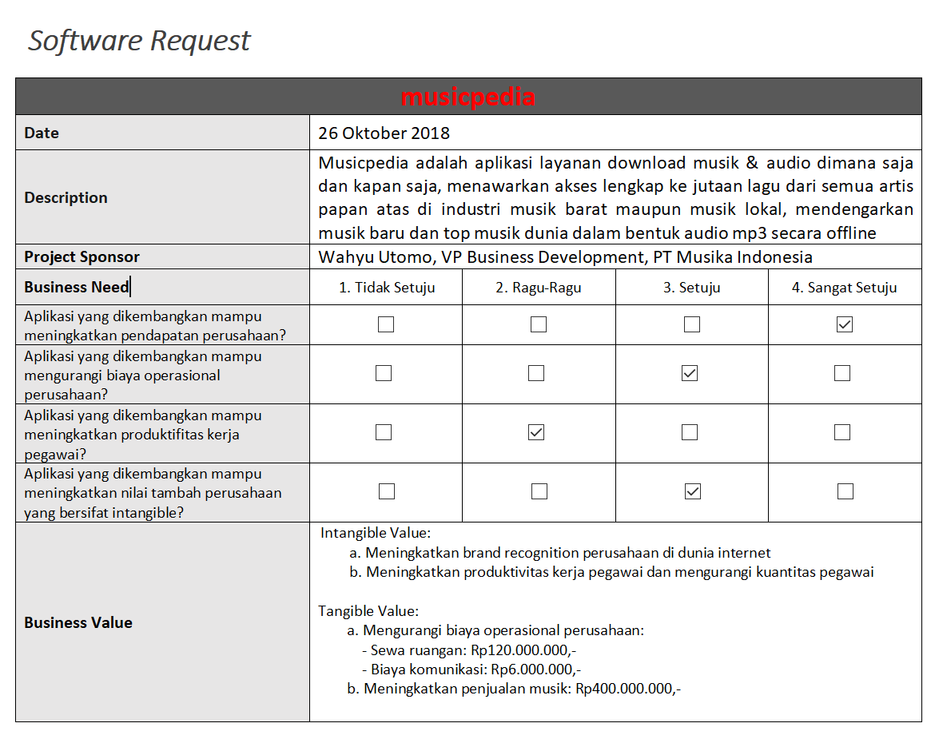

Slide 26
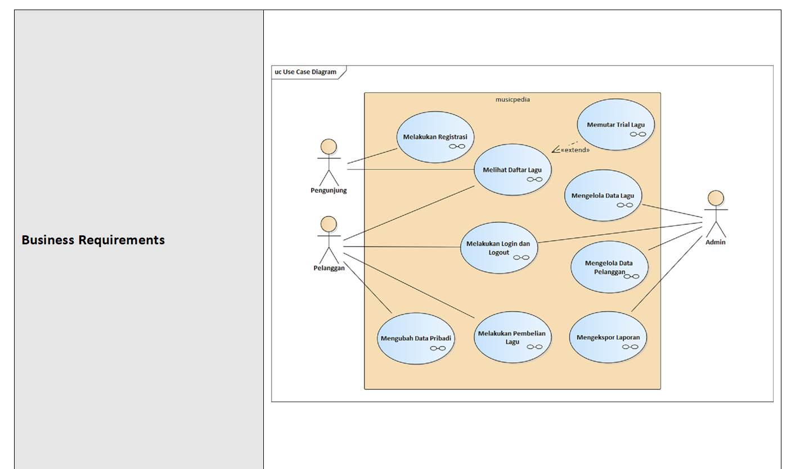

Slide 27
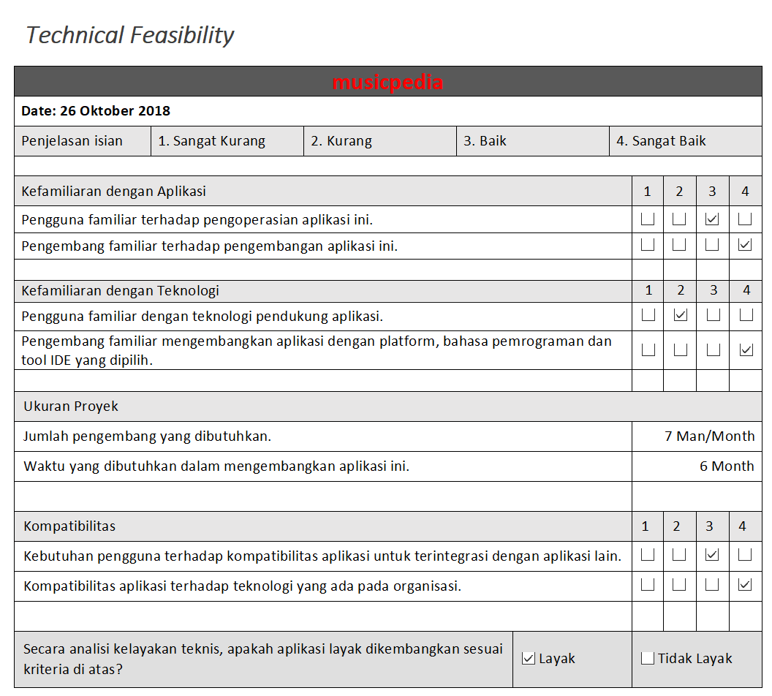

Slide 28
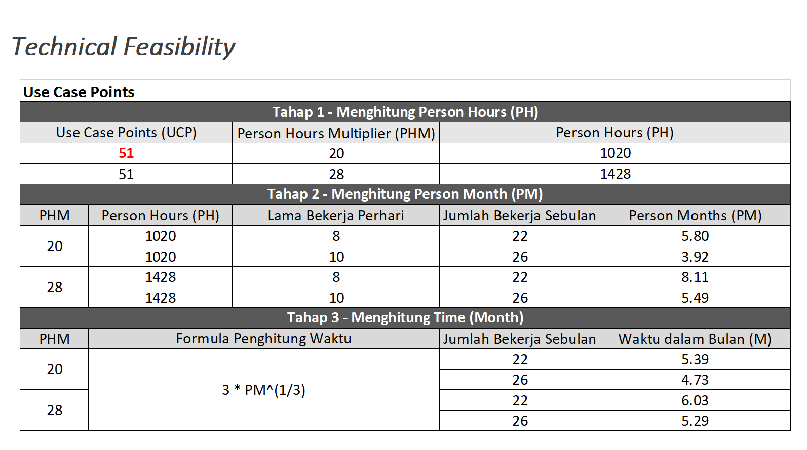

Slide 29
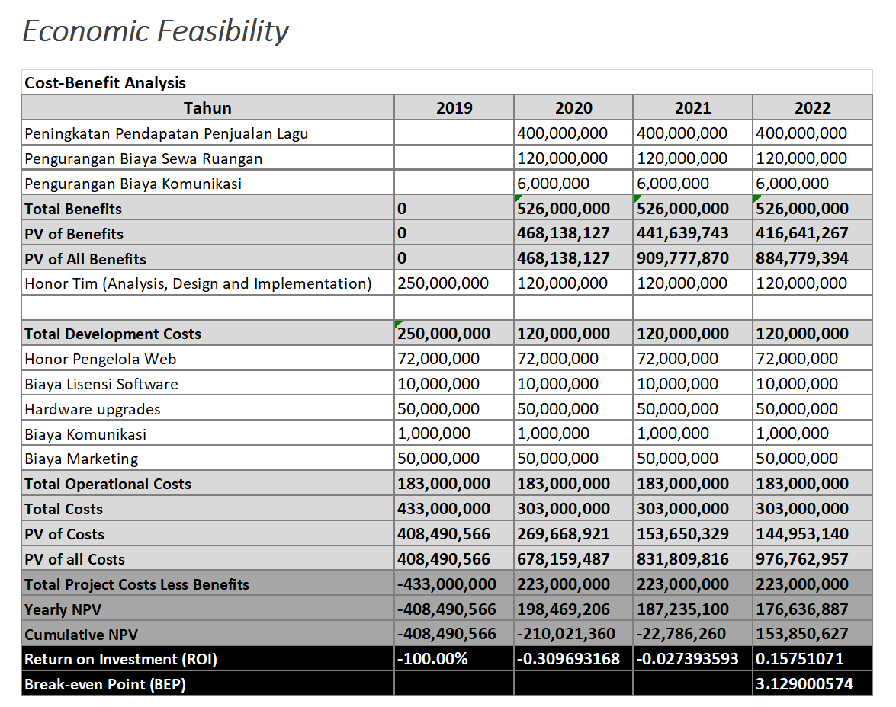

Slide 30
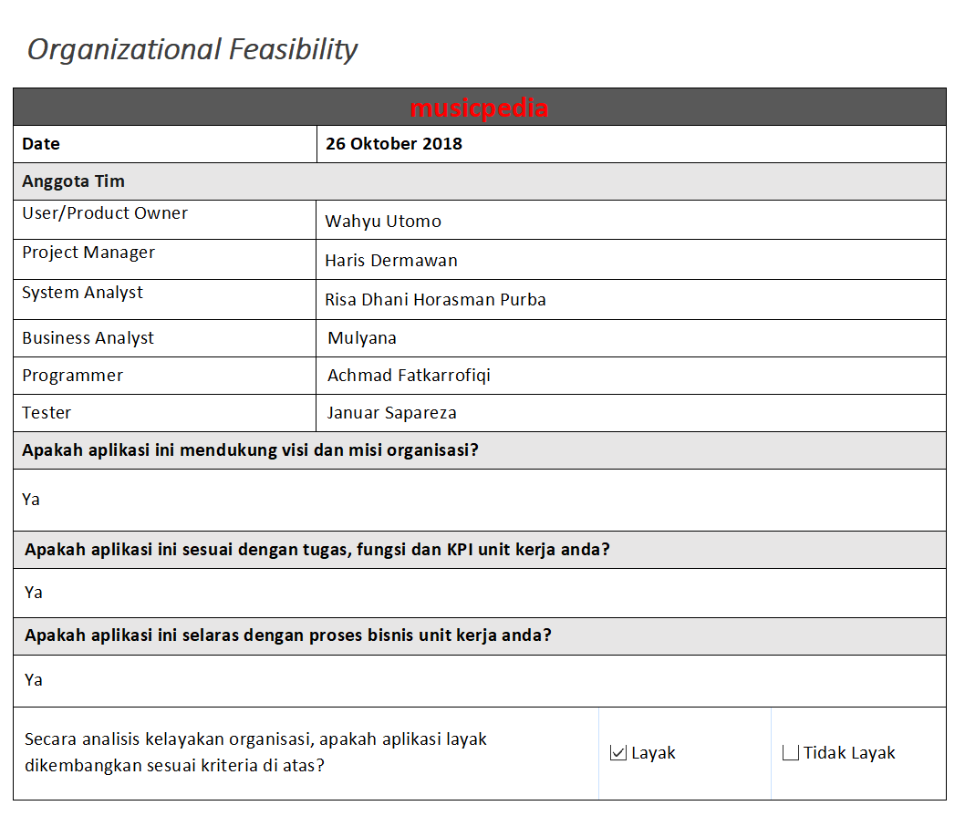

Slide 31
2. Systems Analysis

Slide 32
2.1 Requirement Gathering

Slide 33
Siklus Pengembangan Software
Implementation (New System)
Design (System Specification)
Analysis (System Specification)
Planning
(System Proposal)
(Tilley, 2012) (Dennis, 2016) (Valacich, 2017)

Slide 34
Boehm’s First Law
Errors are most frequent during the requirements and design activities, and are the more expensive the later they are removed
(Endres, 2003) [L2]

Slide 35
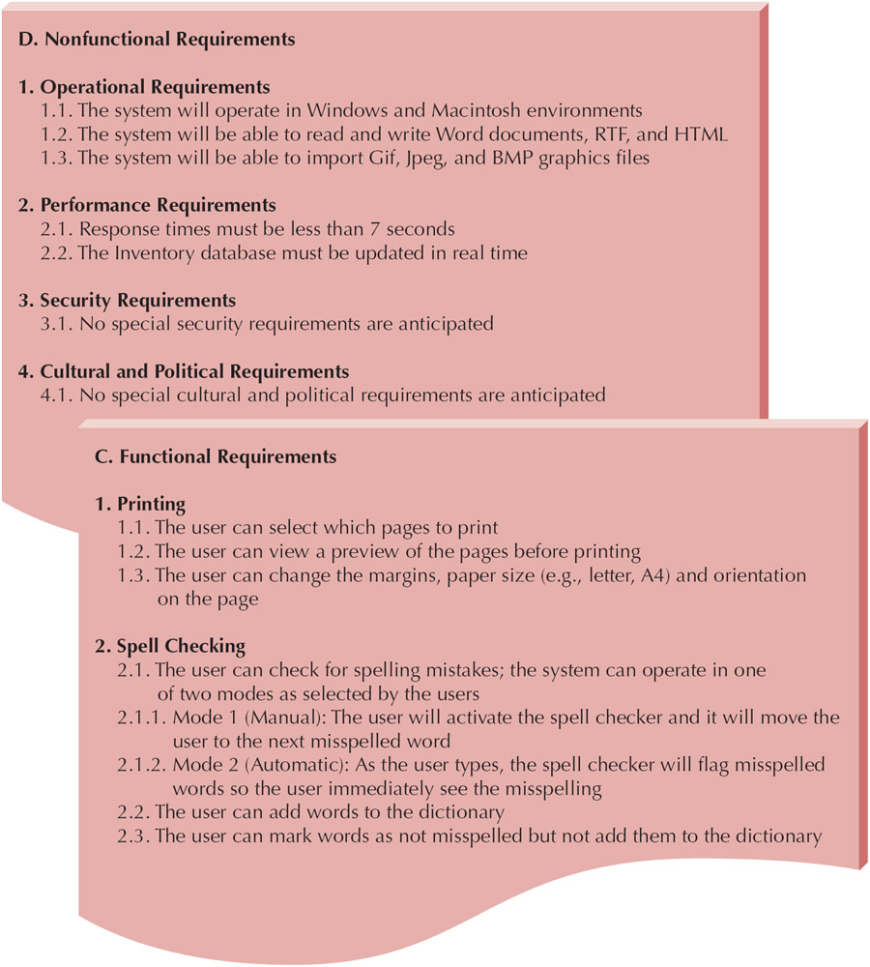
What is a Requirements
Business Requirements
Statement of what the system must do
Focus on what the system must do, not how to do it
There are 2 kinds of requirements
1. Functional Requirements
2. Nonfunctional Requirements

Slide 36
Contoh Template System Specification (SRS, BRD, FSD)
1. System Planning
1.1 Project Scope
1.2 Project Schedule
1.3 Project Team
2. System Design
2.1 Functional Requirements
2.1.1 Actor
2.1.2 Use Case Diagram
2.1.3 Activity Diagram (BPMN)
2.1.4 Sequence Diagram
2.1.5 Class Diagram
2.1.6 Data Model
2.1.7 User Interface Design
2.1.8 Deployment Diagram
2.1.9 Relational Matrices
2.1.9.1 Actor – Activity Diagram
2.1.9.2 Actor – Sequence Diagram
2.2 Nonfunctional Requirements
2.2.1 Operational
2.2.2 Performance
2.2.3 Security
2.2.4 Hardware
2.2.5 Development Platform
2.2.6 Deadline
3. System Implementation
3.1 Testing Strategy
3.2 Installation Strategy
3.3 Change Management Strategy

Slide 37
1. Functional Requirement
Kebutuhan tentang fungsi software secara menyeluruh
Pemodelan dengan UML, ataupun penjelasan fitur-fitur dalam bentuk problem statements, adalah termasuk dalam Functional Requirement
Diagrams:
Use Case Diagrams
Activity Diagrams
Problem Statements:
Must search for inventory
Must perform these calculations
Must produce a specific report

Slide 38
2. Nonfunctional Requirements
Operational – Physical/technical environment
Performance – Speed and reliability
Security – Who can use the system
Cultural & Political – Company policies, legal issues

Slide 39
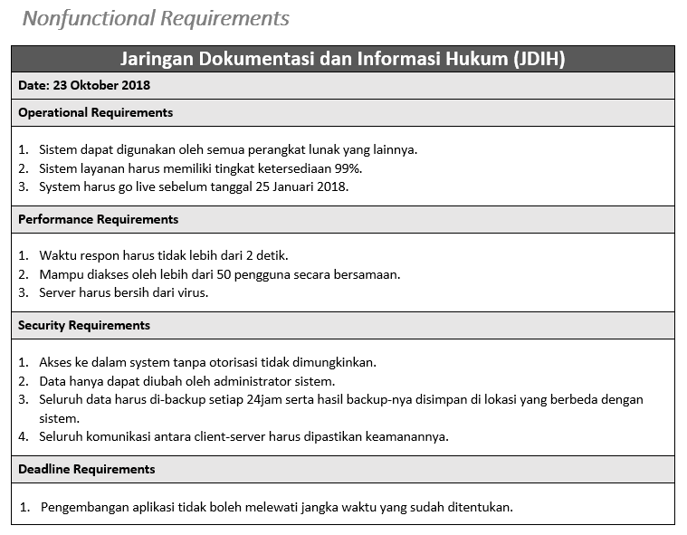

Slide 40
Metode Requirement Gathering
Document Analysis
Interviews
Joint Application Design (JAD)
Questionnaires
Observation

Slide 41
1. Document Analysis
Provides clues about the "formal" existing As-Is system
Typical documents
Forms
Reports
Policy manuals
Look for user additions to forms
Look for unused form elements
Do document analysis before interviews

Slide 42
2. Interviews
Most commonly used technique and very natural
If you need to know something, you ask someone
Five basic steps:
Selecting interviewees
Designing interview questions
Preparing for the interview
Conducting the interview
Post-interview follow-up

Slide 43
3. Joint Application Design (JAD)
Allows project managers, users, and developers to work together
May reduce scope creep by 50%
Avoids requirements being too specific or too vague
Include 10 to 20 users
Tend to last 5 to 10 days over a three-week period

Slide 44
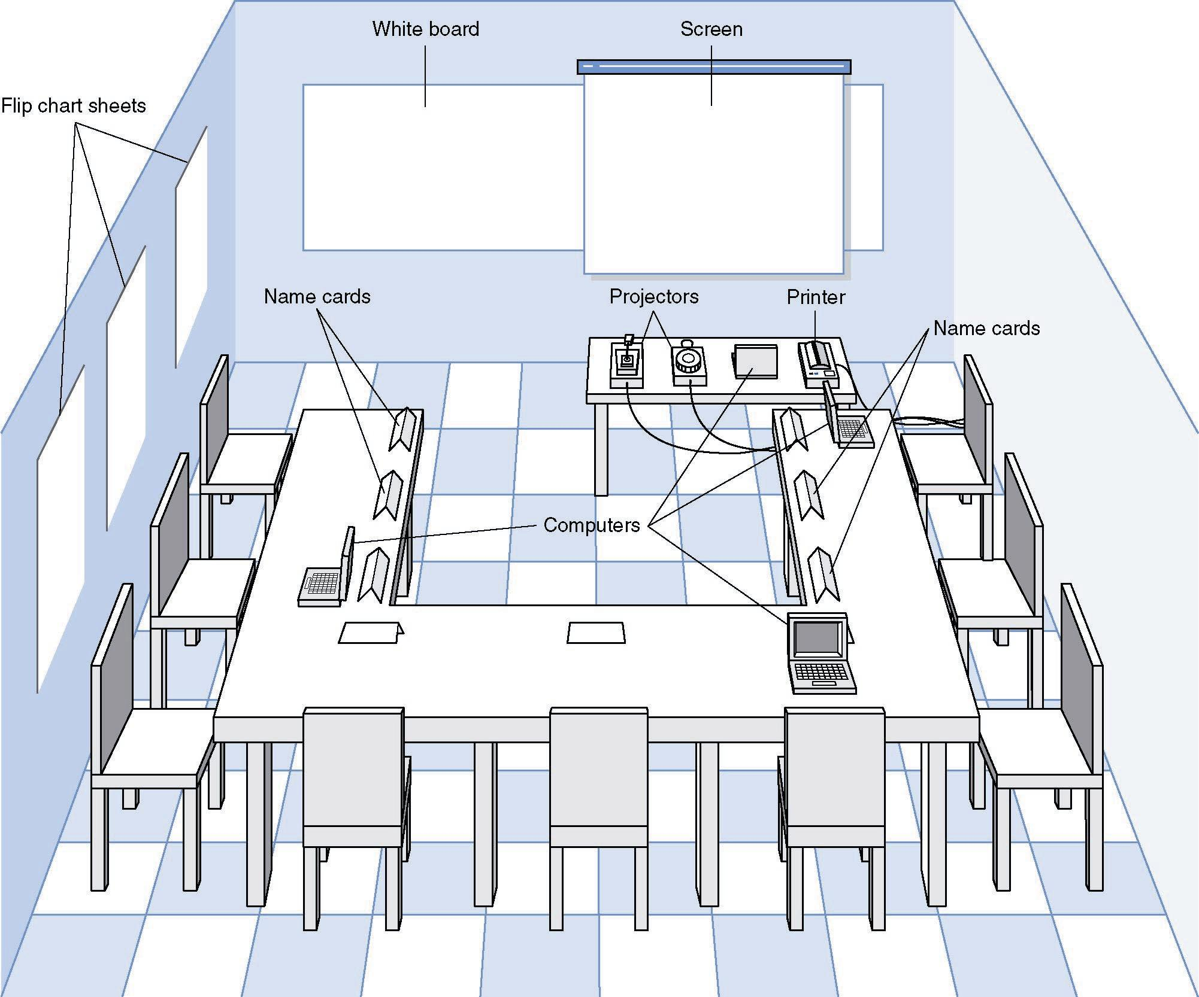
JAD Meeting Room
JPEG Figure 5-5 Goes Here

Slide 45
4. Questionnaire
Selecting participants
Using samples of the population
Designing the questionnaire
More important than interview questions
Prioritize questions to grab attention
Distinguish between:
Fact-oriented questions (specific answers)
Opinion questions (agree – disagree scale)
Administering the questionnaire
Explain its importance & how it will be used
Give expected response date
Follow up on late returns and have supervisors follow up
Promise to report results
Questionnaire follow-up
Send results to participants

Slide 46
5. Observation
Users/managers often don’t remember everything they do
Validates info gathered in other ways
Behaviors change when people are watched
Keep low profile, don’t change the process
Careful not to ignore periodic activities
Weekly … Monthly … Annual

Slide 47
Karakteristik Metode Requirement Gathering
Interviews JAD Questionnaires Document Observation
Analysis
Type of As-Is As-Is As-Is As-Is As-Is
Information Improve. Improve. Improve.
To-Be To-Be
Depth of High High Medium Low Low
Information
Breadth of Low Medium High High Low
Information
Integration Low High Low Low Low
of Info.
User Medium High Low Low Low
Involvement
Cost Medium Low- Low Low Low-
Medium Medium

Slide 48
Business Process Analysis Strategies
BPA (Business Process Automation)
Makes almost no changes to business processes, just makes them more efficient
BPI (Business Process Improvement)
Change what the users do, not just how efficiently they do it
BPR (Business Process Reengineering)
Throw away everything, start with a blank page

Slide 49
Business Process Analysis Strategies Comparison
Business Business Business
Process Process Process
Automation Improvement Reeingineering
Potential Business Low-Moderate Moderate High
Value
Project Cost Low Low-Moderate High
Breadth of
Analysis Narrow Narrow-Moderate Very Broad
Risk Low Low-Moderate Very High

Slide 50
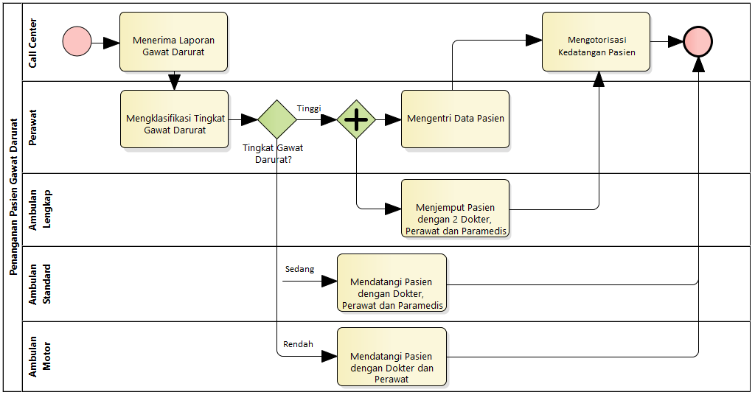
Business Process Simulation: Penanganan Pasien Gawat Darurat
Business Process Simulation
Logic Faults and
Deadlock Process
Service Level Agreement
of Processing Time
Over/Under Utilization of Resources
1. Process Validation
2. Time Analysis
3. Resource Analysis

Slide 51
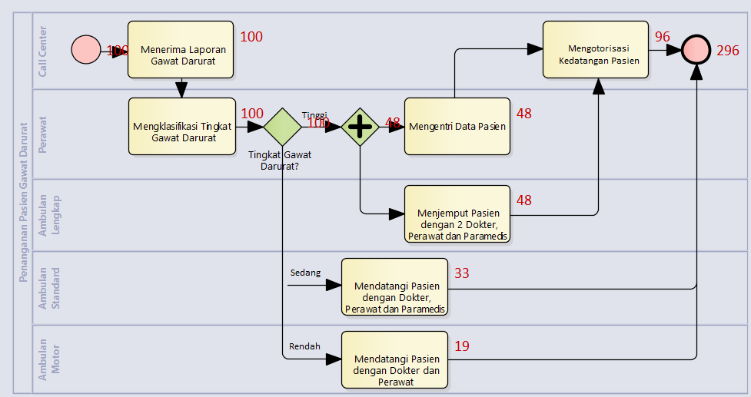
Validasi Proses Bisnis
Menangani 100 Orang Pasien
Seperti Menangani 296 Orang Pasien
PROSES BISNIS INI TIDAK EFISIEN!

Slide 52
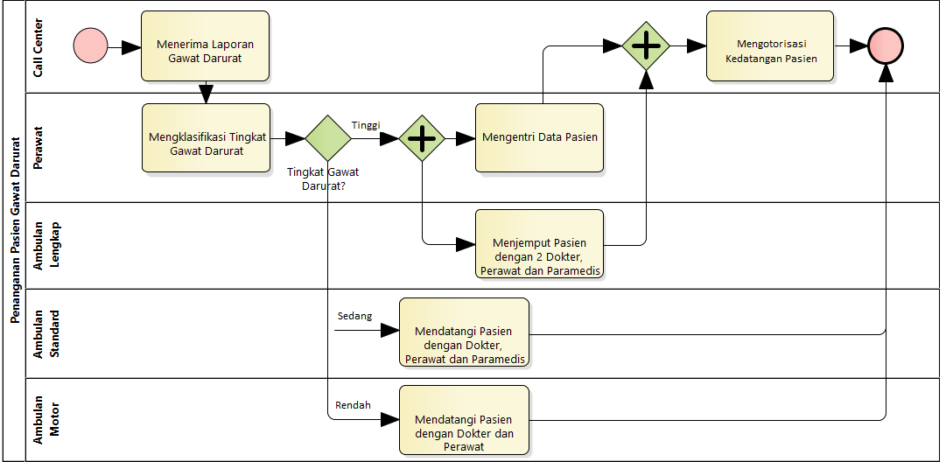
Validasi Proses Bisnis
Perlu Sinkronisasi Pekerjaan, Sebelum Otorisasi Kedatangan Dilakukan

Slide 53
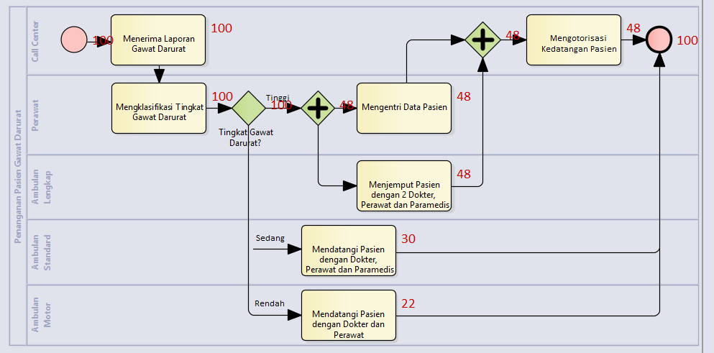
Validasi Proses Bisnis
Proses Bisnis Terbukti Valid dan 100 Pasien Tertangani dengan Efisien dan Efektif!

Slide 54
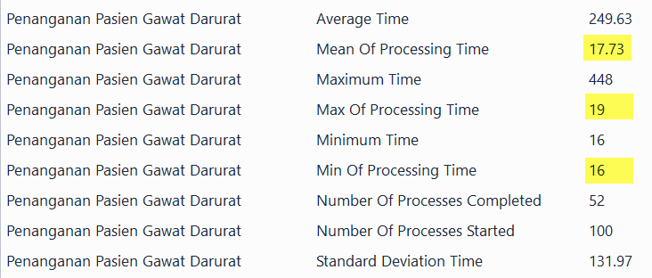
Analisis Waktu
Aktifitas | Waktu (Menit)
Menerima Laporan Gawat Darurat | 4
Mengklasifikasi Tingkat Gawat Darurat | 5
Mengentri Data Pasien | 11
Menjemput Pasien dengan Ambulan Lengkap | 20
Mendatangi Pasien dengan Ambulan Motor | 7
Mendatangi Pasien dengan Ambulan Standard | 10
Mengotorisasi Kedatangan Pasien | 4
4 Menit
Perlu Waktu 17.73 Menit untuk Menangani 1 Pasien

Slide 55
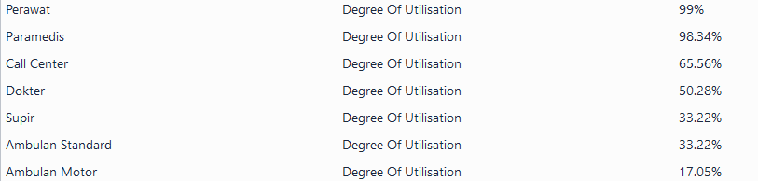
Analisis Sumber Daya Manusia
Sumber Daya | Kuantitas
Call center | 2
Perawat | 2
Ambulan Lengkap | 4
Ambulan Standar | 2
Ambulan Motor | 2
Resepsionis | 2
2 Orang
2 Orang
Overutilization
Underutilization

Slide 56
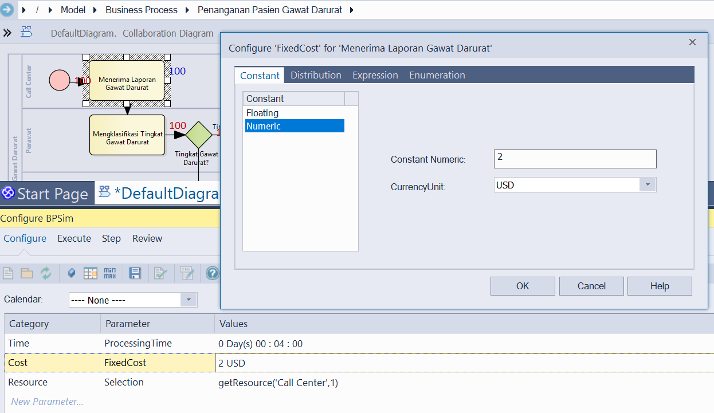
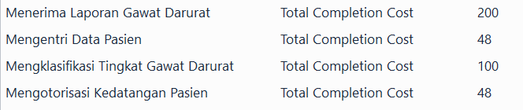
Analisis Biaya
2 USD/Penanganan
Total Biaya Perhari

Slide 57
Business Process Automation
Dikembangkan Sistem Cerdas yang membantu perawat dengan Mengautomasi Klasifikasi Tingkat Gawat Darurat
Pekerjaan “Mengklasifikasi Tingkat Gawat Darurat” yang sebelumnya perlu waktu 5 menit
Dengan sistem cerdas menjadi hanya 1 menit

Slide 58
Business Process Simulation
Aktifitas | Waktu (Menit)
Menerima Laporan Gawat Darurat | 4
Mengklasifikasi Tingkat Gawat Darurat | 5
Mengentri Data Pasien | 11
Menjemput Pasien dengan Ambulan Lengkap | 20
Mendatangi Pasien dengan Ambulan Motor | 7
Mendatangi Pasien dengan Ambulan Standard | 10
Mengotorisasi Kedatangan Pasien | 4
5 Menit
Perlu Waktu 17.73 Menit untuk Menangani 1 Pasien

Slide 59
Business Process Automation
Aktifitas | Waktu (Menit)
Menerima Laporan Gawat Darurat | 4
Mengklasifikasi Tingkat Gawat Darurat | 1
Mengentri Data Pasien | 11
Menjemput Pasien dengan Ambulan Lengkap | 20
Mendatangi Pasien dengan Ambulan Motor | 7
Mendatangi Pasien dengan Ambulan Standard | 10
Mengotorisasi Kedatangan Pasien | 4
1 Menit
Hanya Perlu Waktu 8 Menit untuk Menangani 1 Pasien

Slide 60
Tantangan di Requirement Gathering
The "Yes, But" syndrome
Stems from human nature and the users' inability to experience the software as they might a physical device
The “Undiscovered Ruins”
Searching for requirements is like searching for "Undiscovered Ruins“
The more you find, the more you know remain
The "User and the Developer" syndrome
Reflects the profound differences between these two, making communication difficult

Slide 61
The "Yes, But" Syndrome
For whatever reason, we always see two immediate, distinct, and separate reactions when the users see the system implementation for the first time
"Wow, this is so cool; we can really use this, what a neat job" and so on.
"Yes, but, hmmmm, now that I see it, what about this ... ? Wouldn't it be nice if . . . ? Whatever happened to . . . ?“

Slide 62
The "Undiscovered Ruins" Syndrome
In many ways, the search for requirements is like a search for undiscovered ruins
The more you find, the more you know remain
You never really feel that you have found them all, and perhaps you never will.
Indeed, software development teams always struggle to determine when they are done with requirements elicitation. When have they found
all the requirements
or at least enough requirements?

Slide 63
The "User and the Developer" Syndrome
Communication gap between the user and the developer
Users and developers are
typically from different worlds,
may even speak different languages,
have different backgrounds,
have different motivations, and
have different objectives

Slide 64
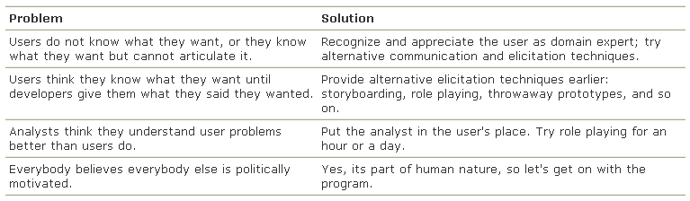
The "User and the Developer" Syndrome
Reasons for this problem and some suggested solutions

Slide 65
Evolusi Paradigma Analysis dan Design
 | Paradigm | Diagrams
1 | Process-oriented Paradigm | Flowchart
2 | Data-oriented Paradigm | DFD
3 | Object-oriented Paradigm (data + process) | UML

Slide 66
What is the UML?
UML: Unified Modeling Language
UML can be used for modeling all processes in the development life cycle and across different implementation technologies (technology and language independent)
UML is the standard language for visualizing, specifying, constructing, and documenting the artifacts of a software-intensive system
UML is a communication tool – for the team, and other stakeholders

Slide 67
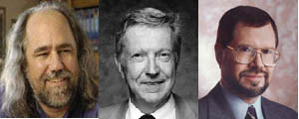
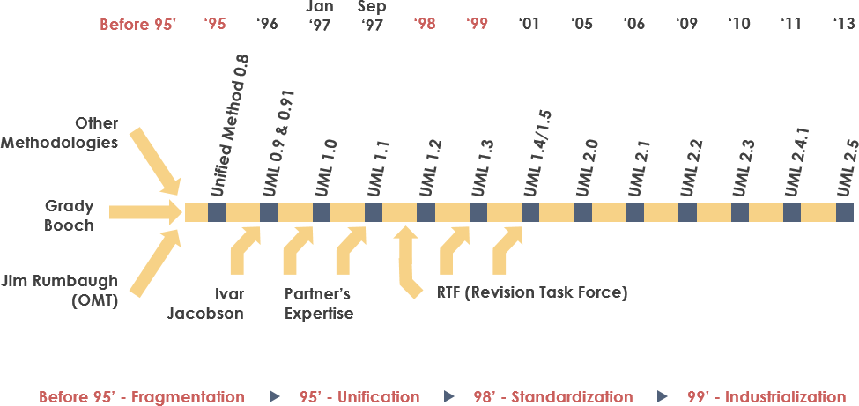
Sejarah UML
Booch, Jacobson, Rumbaugh

Slide 68
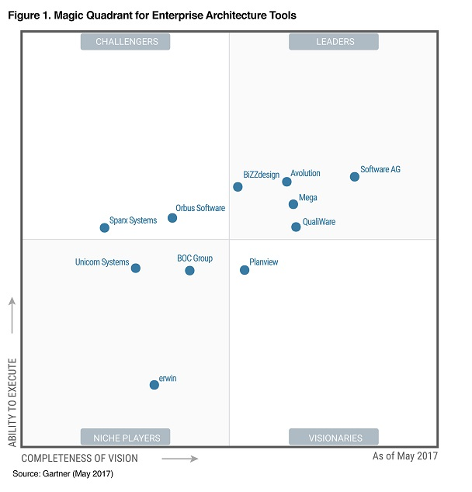
State of the Art UML Tools
Rational Rose
Visual Paradigm
Sparx Systems Enterprise Architect
Microsoft Visio
Star UML

Slide 69
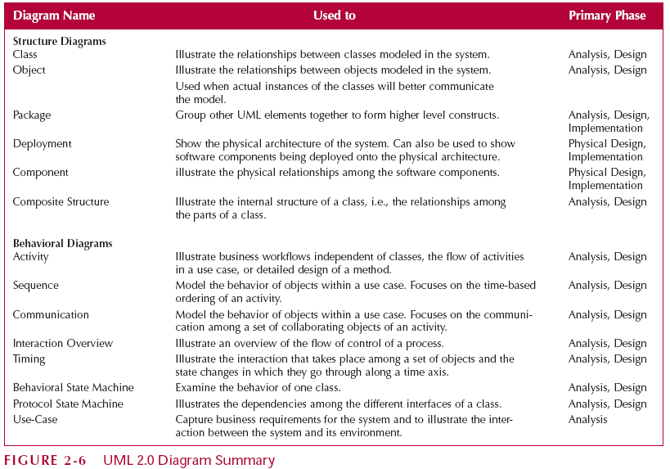
UML 2.0 Diagrams

Slide 70
UML Problems
UML is modeling notation, it is not a development process or a methodology
UML driven development process?
UML is too complex, difficult to understand quickly
Which UML diagrams should we use?

Slide 71
UML based Software Analysis and Design (Sparx Systems EA)
Display the boundary of a system and its major functions using use cases and actors
Model the organization’s business process with activity diagram
Illustrate use case realizations with sequence diagrams
Represent a static structure of a system using class diagrams
Reveal the physical implementation architecture with deployment diagrams

Slide 72
UML based Software Analysis and Design (Kendal, 2011)
A use case diagram, describing how the system is used. Analysts start with a use case diagram
An activity diagram, illustrating the overall flow of activities. Each use case may create one activity diagram
Sequence diagrams, showing the sequence of activities and class relationships. Each use case may create one or more sequence diagrams
Class diagrams, showing the classes and relationships. Sequence diagrams are used to determine classes
Statechart diagrams, showing the state transitions. Each class may create a statechart diagram, which is useful for determining class methods

Slide 73
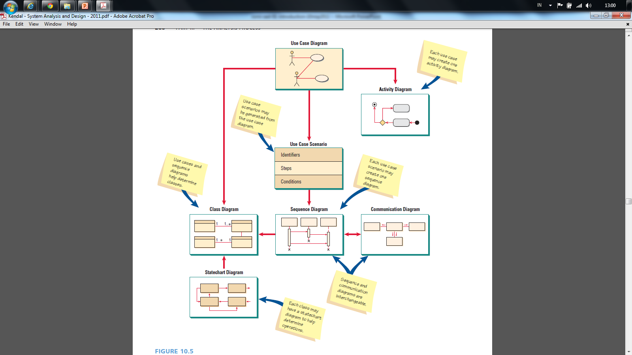
(Kendall and Kendall, 2011)

Slide 74
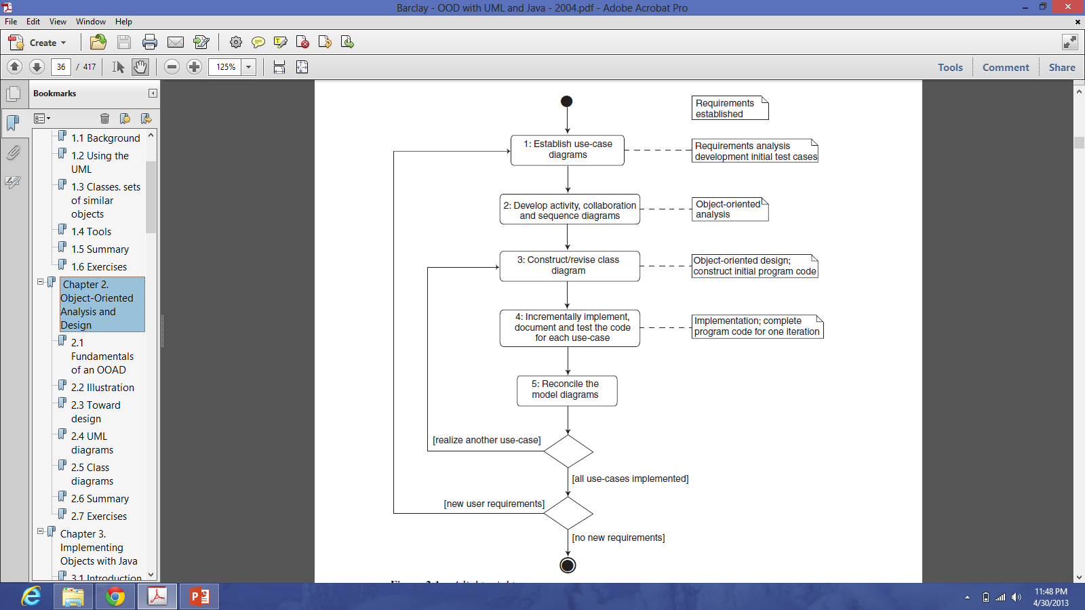
UML based Software Analysis and Design (Barclay, 2004)

Slide 75
UML based Software Analysis and Design (Wahono, 2009)
1. Systems Analysis
1.1 Identifikasi Proses Bisnis dengan Use Case Diagram
1.2 Pemodelan Proses Bisnis dengan Activity Diagram atau BPMN
2. Systems Design
2.1 Pemodelan Class Diagram
2.2 Pemodelan User Interface Design
1.3 Realisasi Proses Bisnis dengan Sequence Diagram (Boundary - Control - Entity)
2.3 Pemodelan Data Model
2.4 Pemodelan Deployment Diagram

Slide 76
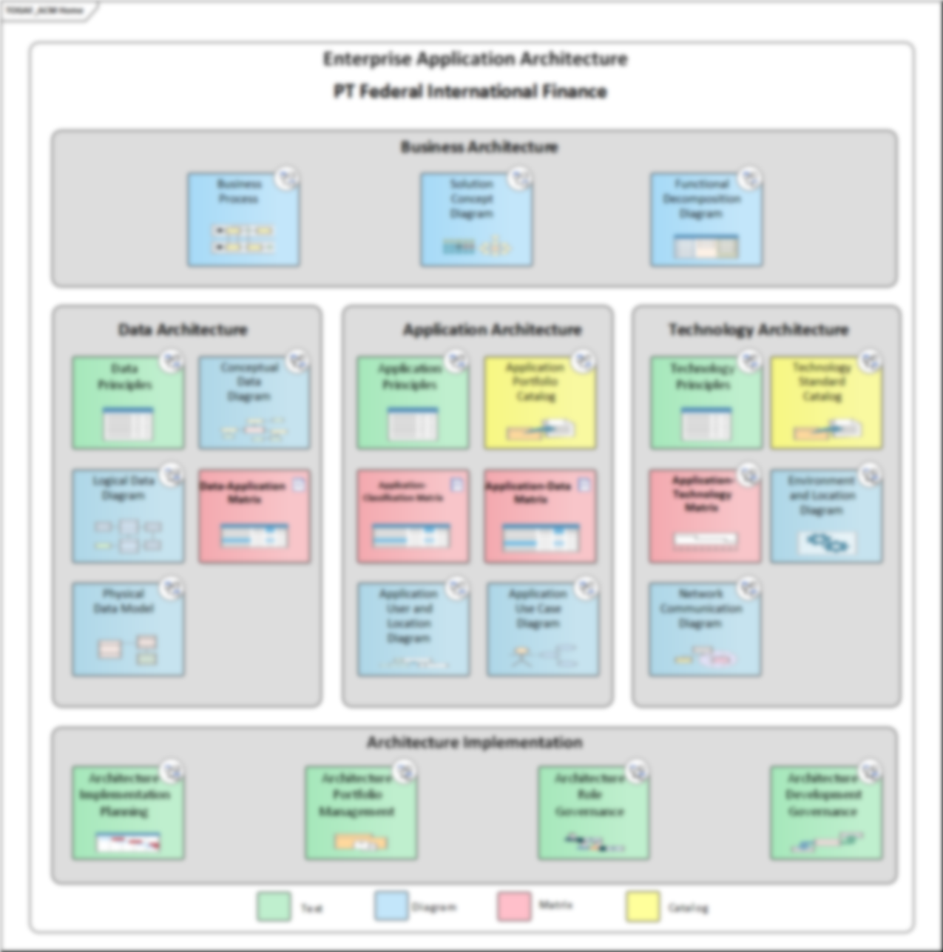
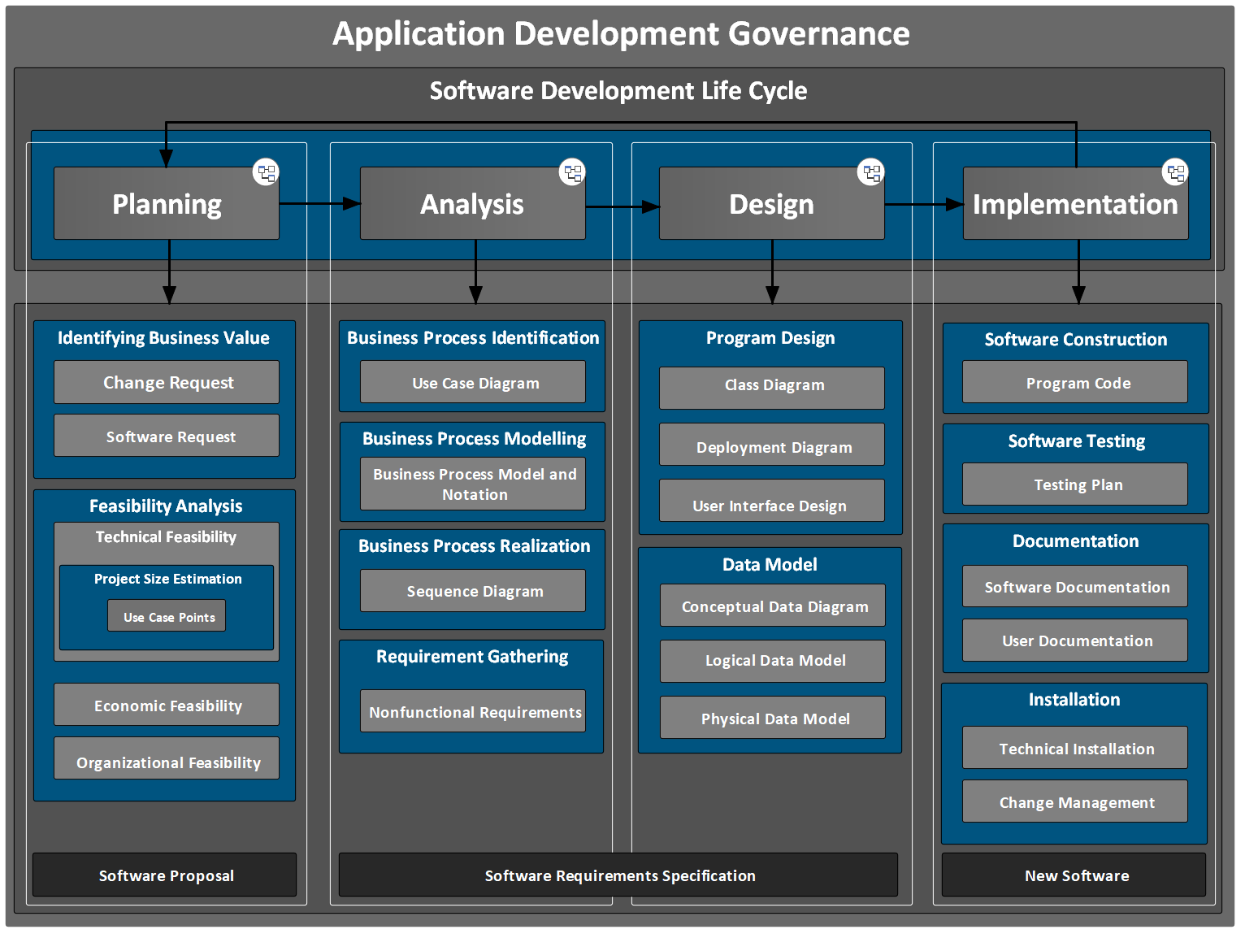
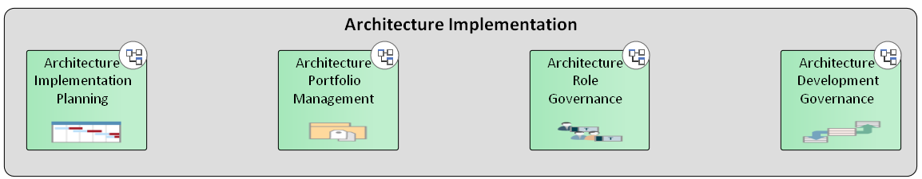

Slide 77
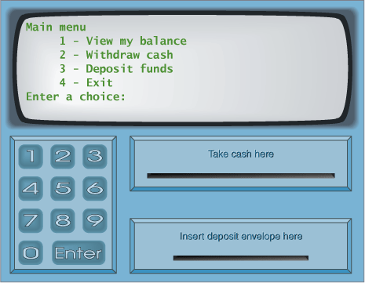
Studi Kasus: ATM System

Slide 78
ATM System
Layar
Kotak Uang
Kotak Kartu
Kotak Kuitansi

Slide 79
Menu PIN
Masukkan PIN:
Kotak Uang
Kotak Kartu
Kotak Kuitansi

Slide 80
Menu Utama
Mengecek Saldo
Mentransfer Uang
Mengambil Uang
Logout
Kotak Uang
Kotak Kartu
Kotak Kuitansi

Slide 81
Menu Pengecekan Saldo
Saldo anda adalah …
Kotak Uang
Kotak Kartu
Kotak Kuitansi

Slide 82
Menu Pengiriman Uang
No Account Penerima:
Kotak Uang
Kotak Kartu
Kotak Kuitansi

Slide 83
Menu Pengiriman Uang
Jumlah uang yang dikirim:
Kotak Uang
Kotak Kartu
Kotak Kuitansi

Slide 84
Menu Pengiriman Uang
Uang berhasil terkirim
Kotak Uang
Kotak Kartu
Kotak Kuitansi

Slide 85
Menu Pengambilan Uang
Jumlah uang yang diambil:
Kotak Uang
Kotak Kartu
Kotak Kuitansi

Slide 86
Menu Pengambilan Uang
Uang berhasil diambil
Kotak Uang
Kotak Kartu
Kotak Kuitansi

Slide 87
2.2 Identifikasi Proses Bisnis dengan Use Case Diagram

Slide 88
UML based Software Analysis and Design (Wahono, 2009)
1. Systems Analysis
1.1 Identifikasi Proses Bisnis dengan Use Case Diagram
1.2 Pemodelan Proses Bisnis dengan Activity Diagram atau BPMN
2. Systems Design
2.1 Pemodelan Class Diagram
2.2 Pemodelan User Interface Design
1.3 Realisasi Proses Bisnis dengan Sequence Diagram (Boundary - Control - Entity)
2.3 Pemodelan Data Model
2.4 Pemodelan Deployment Diagram

Slide 89
Use Case Diagram
Summarized into a single picture
All of the use cases for the part of the system being modeled
Use case represents the discrete activities performed by the user
Use Case Diagram tells what the system will do
Good for communicating with users

Slide 90
Use Case Diagram Syntax
Actor
person or system that derives benefit from and is external to the subject
Use Case
Represents a major piece of system functionality
Association Relationship
Include Relationship
Extend Relationship
Generalization Relationship
<<includes>>
<<extends>>

Slide 91
Use Case
A major piece of system functionality
Can extend other Use Cases
Placed inside system boundary
Labeled with descriptive verb - noun phrase
Use Case

Slide 92
System Boundary
Includes the name of the system inside or on top
Represents the scope of the system
Actors are outside the scope of the system
Boundary

Slide 93
Actor
A person or another system that interacts with the current system
A role, not a specific user
Provides input, receives output, or both
⟨⟨actor⟩⟩
Actor/Role

Slide 94
Association Relationship
Links actor and the Use Case
Shows two-way communication
If one-way, arrows are used

Slide 95
Extends Relationship
Extends Use Case to include Optional behavior
Arrow points from the extension Use Case to the base Use Case
⟨⟨extend⟩⟩
Make Payment
Arrangement
⟨⟨extend⟩⟩
Make Appointment

Slide 96
Include Relationship
Include one Use Case from within another
Arrow points from base Use Case to the included Use Case
⟨⟨include⟩⟩
Make New
Patient Appointment
⟨⟨include⟩⟩
Create New Patient

Slide 97
Generalization Relationship
A specialized Use Case to a more generalized Use Case
Arrow points from specialized to general Use Case
Make Old Appointment
Make Appointment

Slide 98
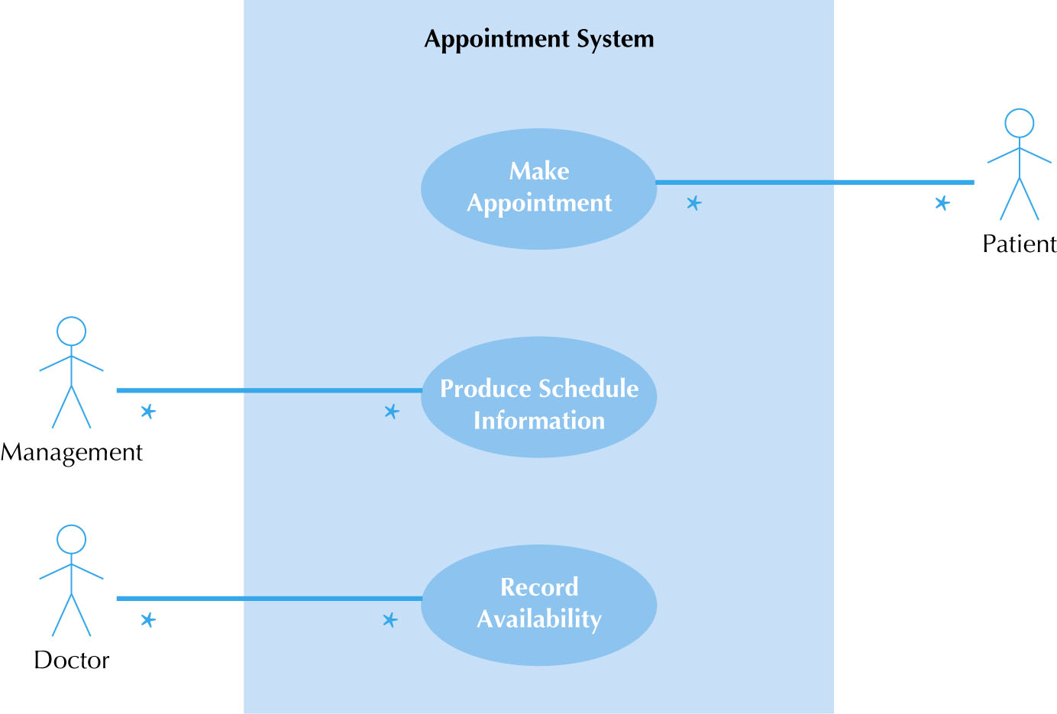
Use Case Diagram for Appointment System

Slide 99
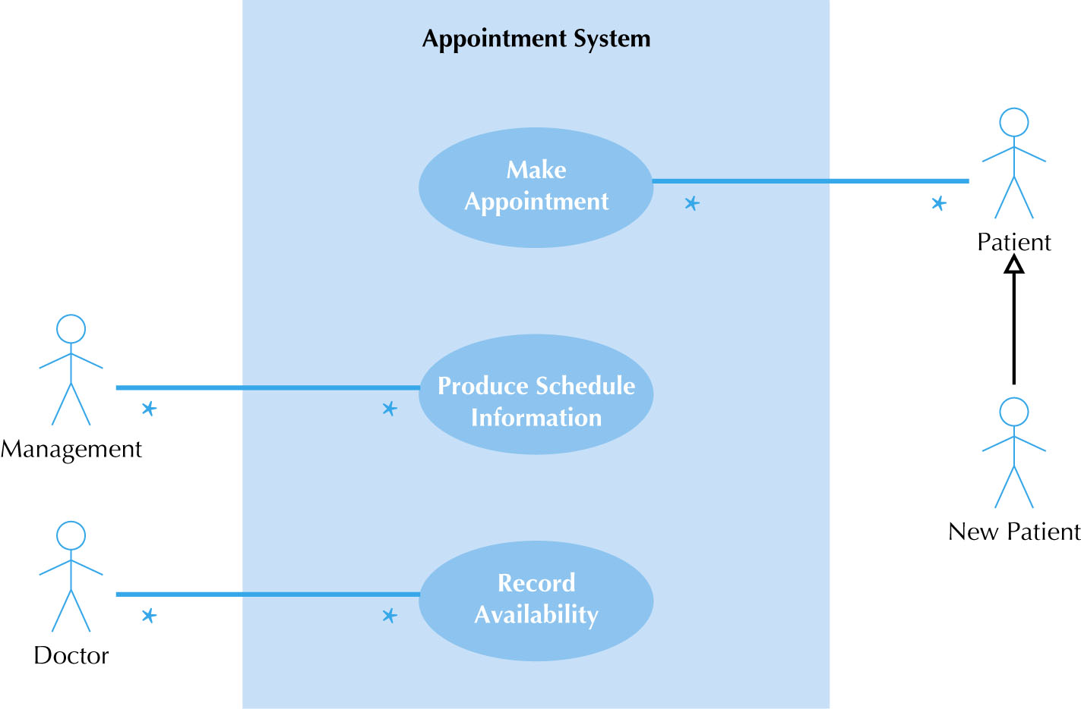
Use Case Diagram with Specialized Actor

Slide 100
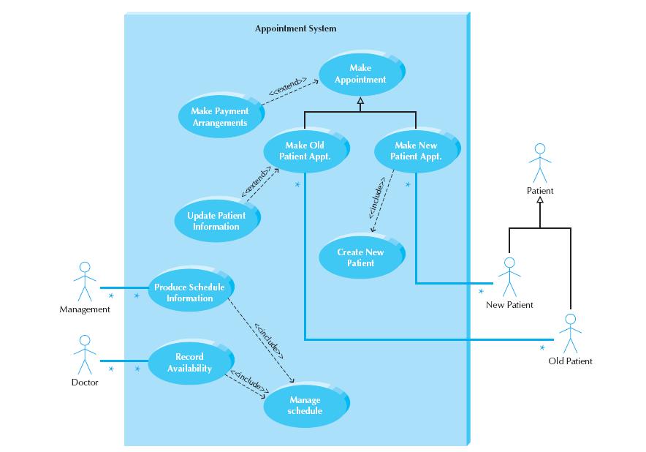
Extend and Include Relationships

Slide 101
Sistem Konsultasi Dokter Rumah Sakit

Slide 102
Studi Kasus: Use Case Diagram Sistem ATM

Slide 103
Use Case Diagram Sistem ATM (versi Sederhana)

Slide 104
Use Case Diagram Sistem ATM (Versi Include dan Extends)

Slide 105
Use Case Diagram ERP Perbankan (Sistem Lebih Kompleks)

Slide 106
Use Case Diagram Sistem ATM (Versi Normal)

Slide 107
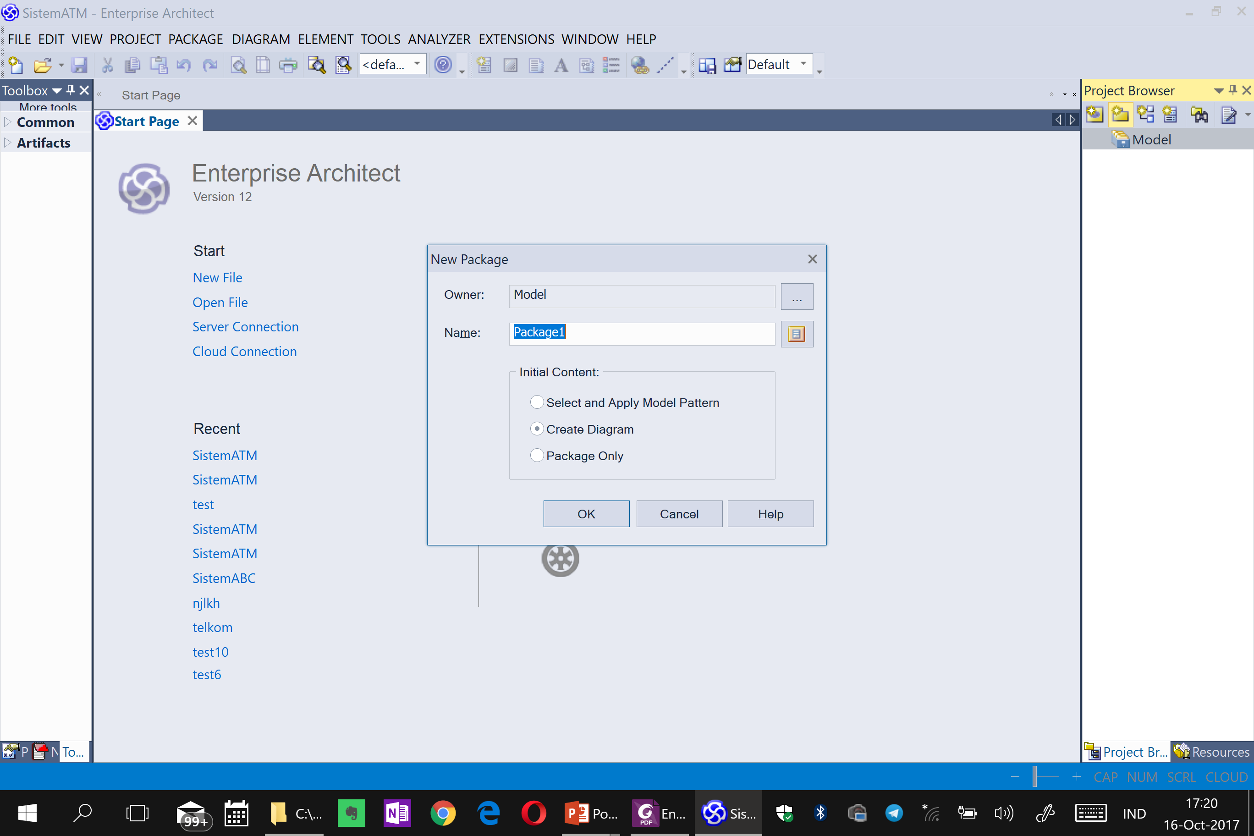

Slide 108
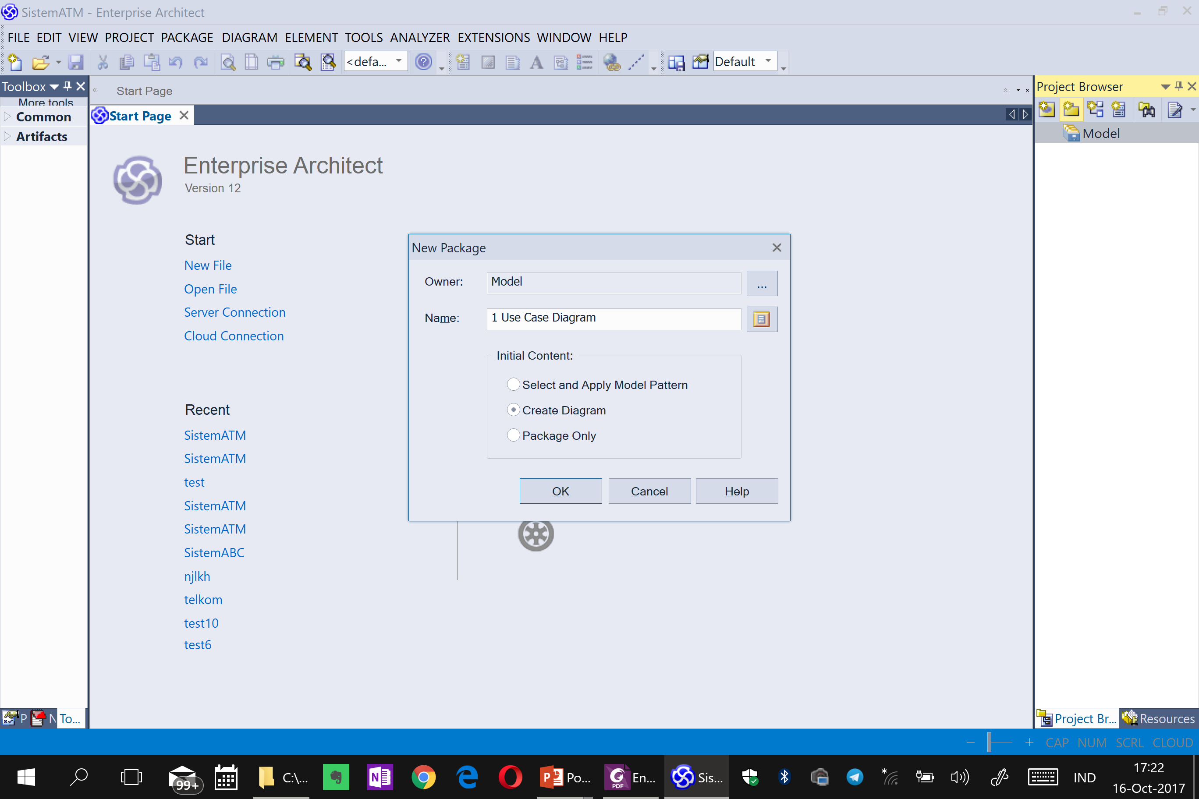

Slide 109
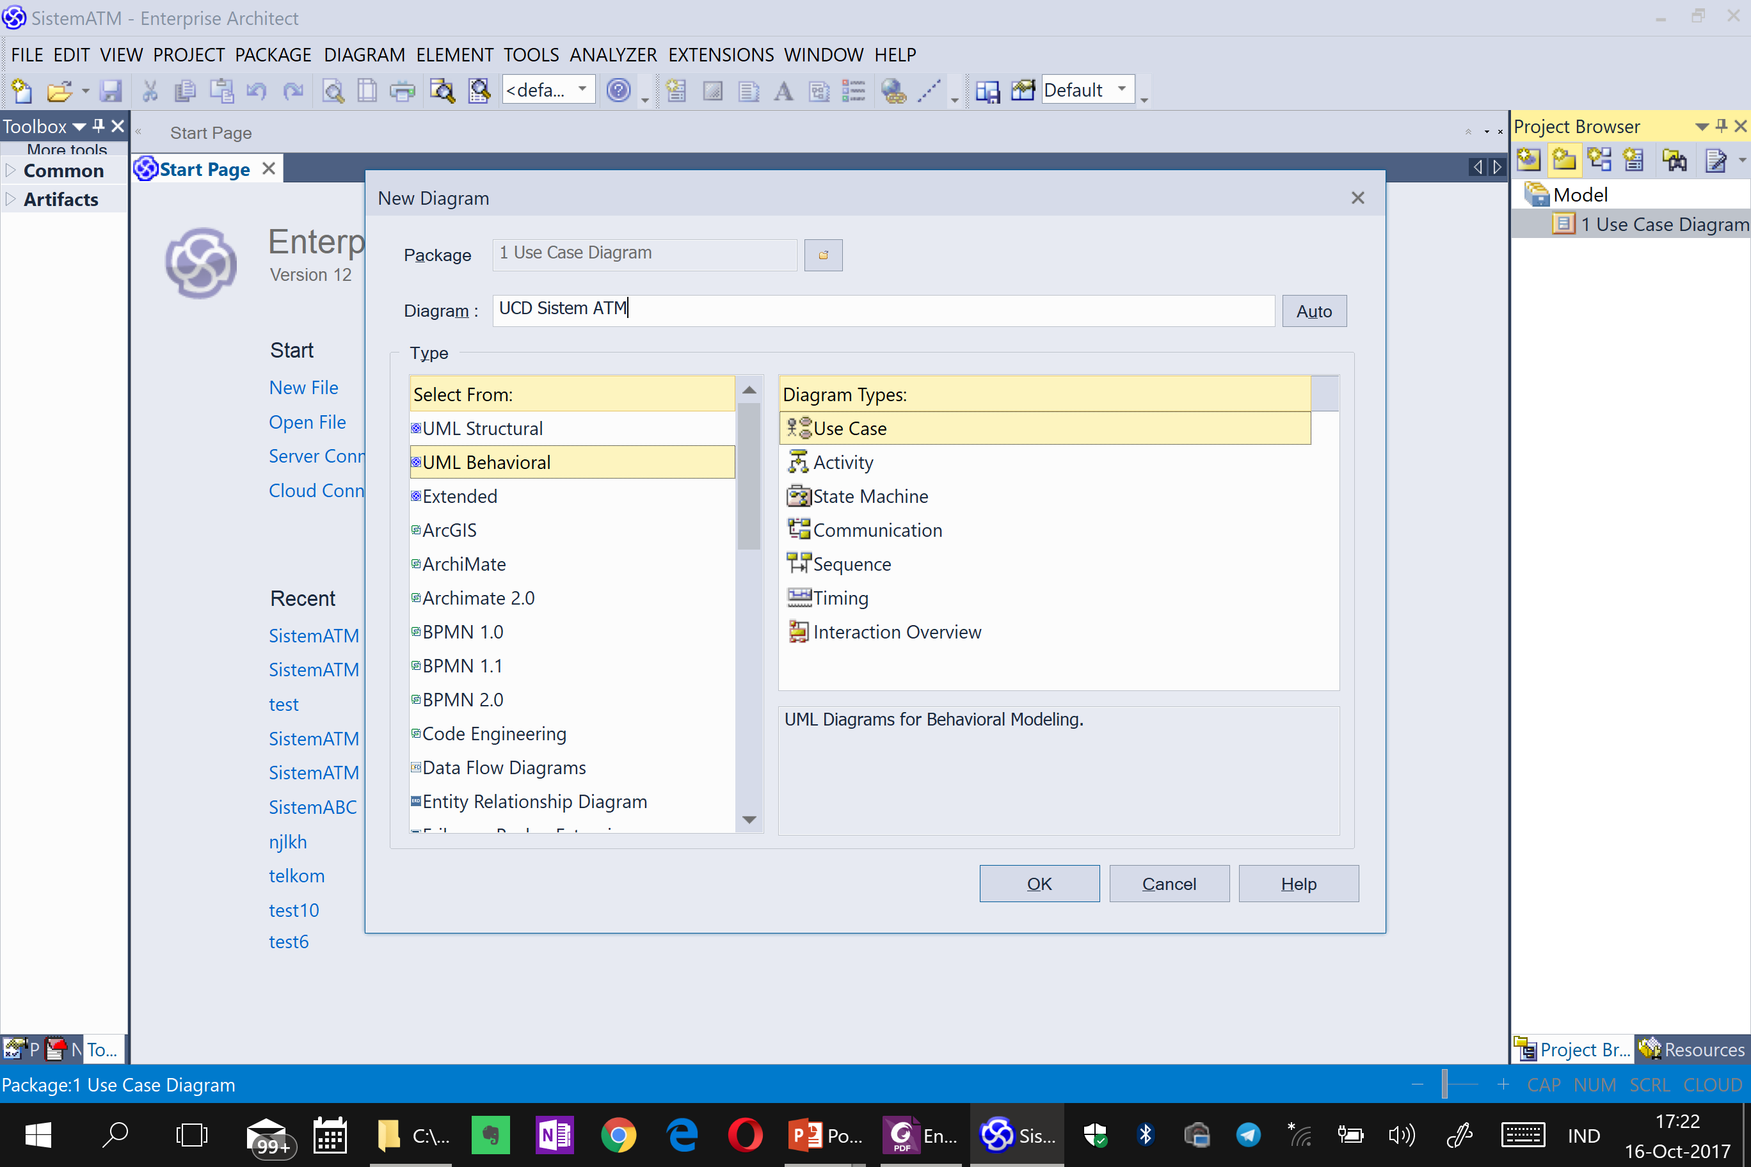

Slide 110
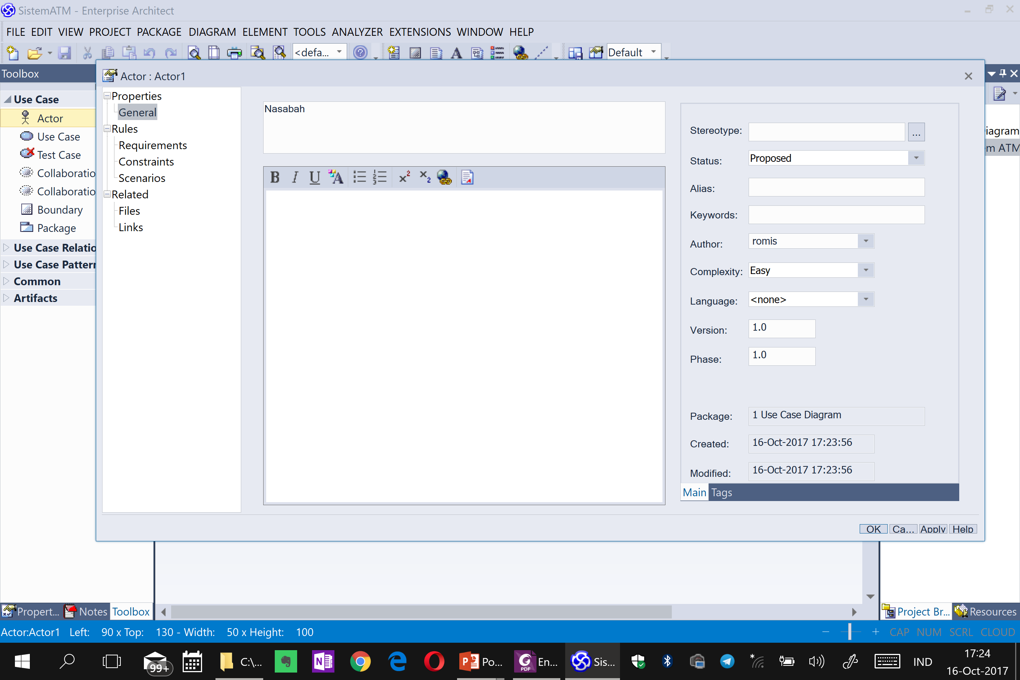

Slide 111
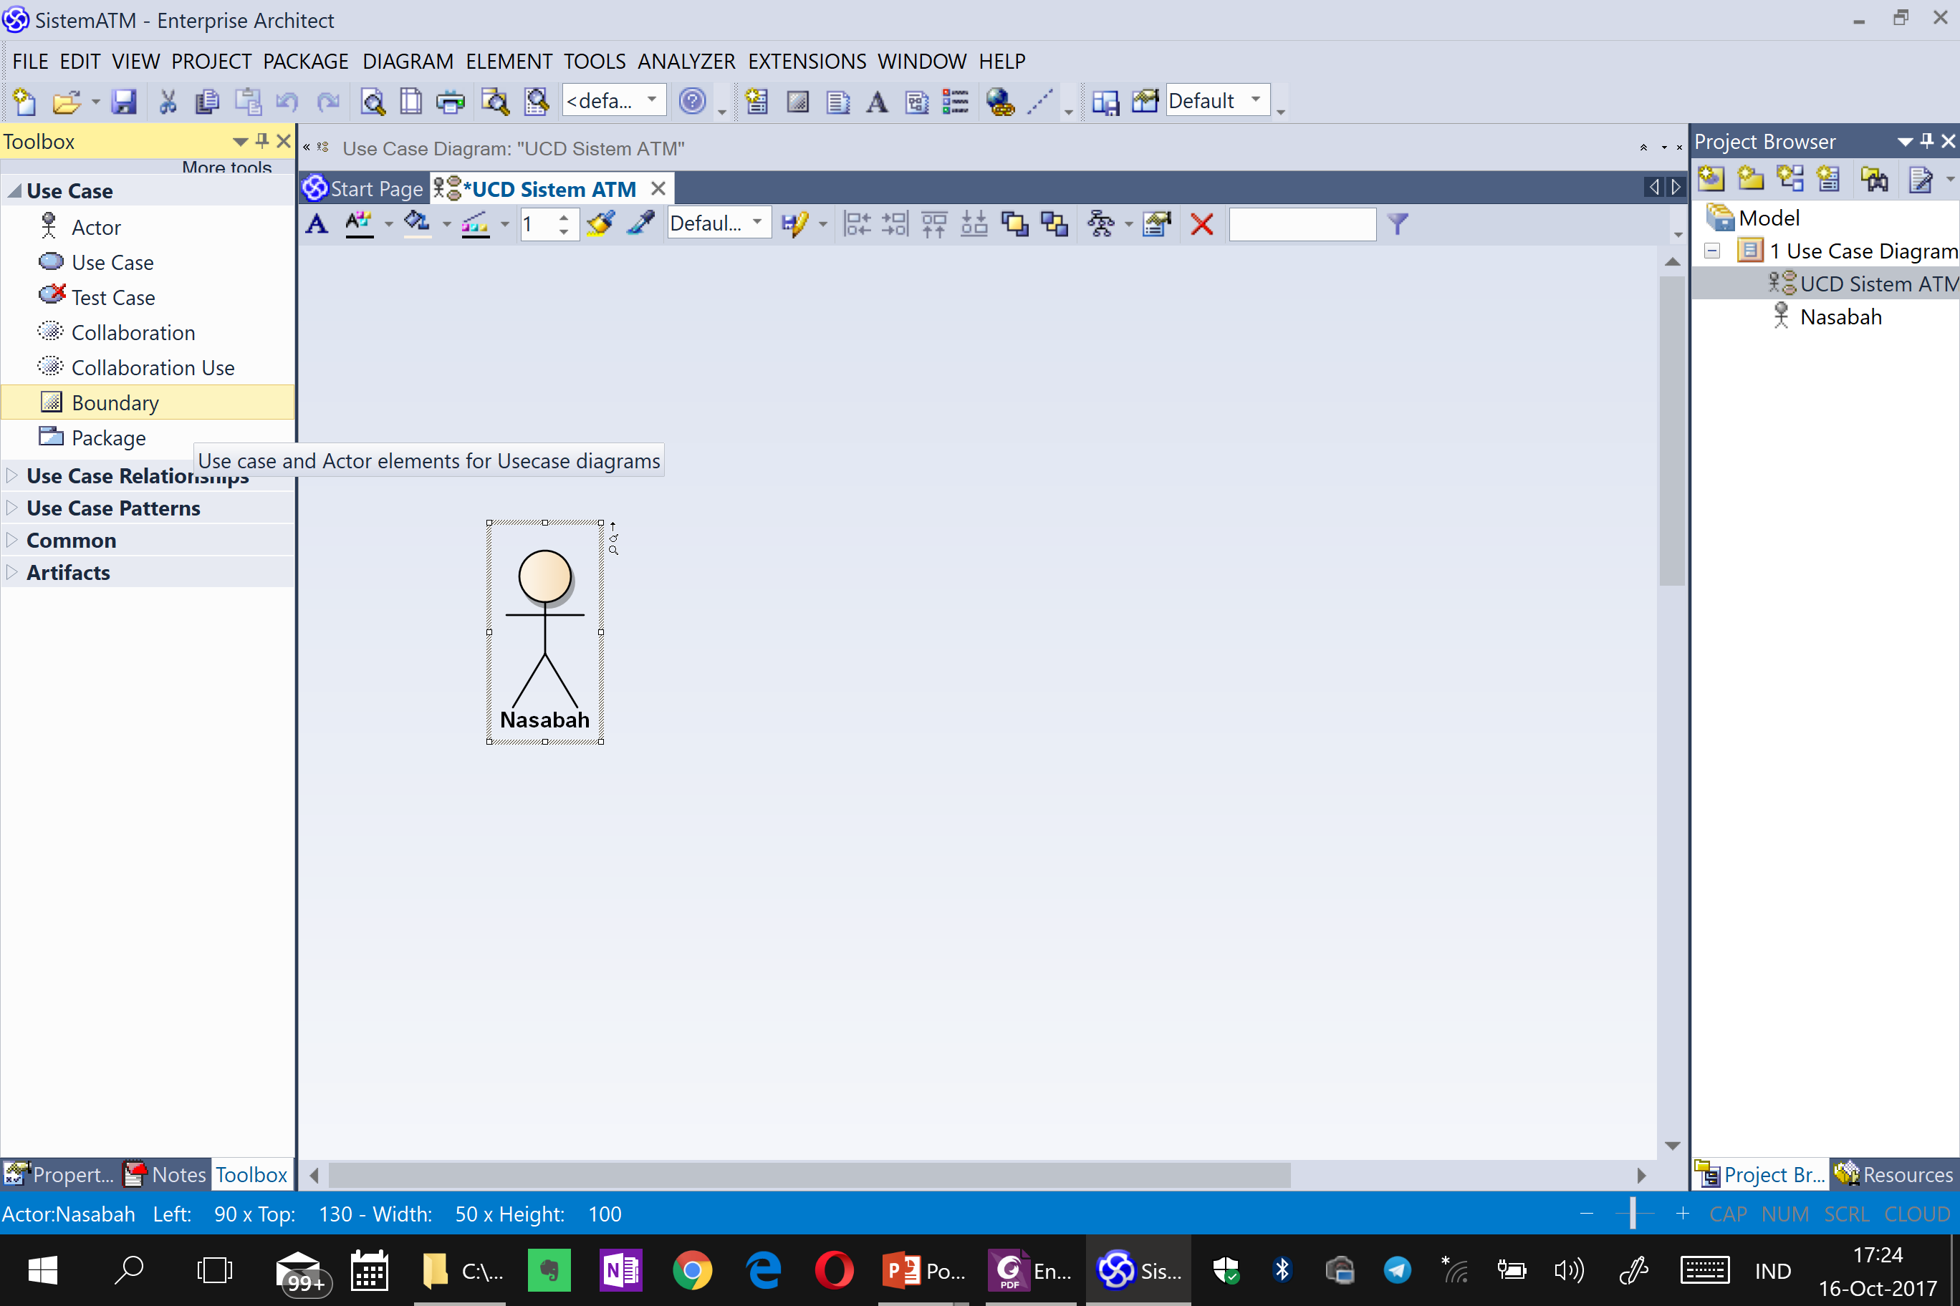

Slide 112


Slide 113


Slide 114

Use Case Diagram MusicPedia

Slide 115
2.3 Pemodelan Proses Bisnis dengan AD atau BPMN
2.3.1 Activity Diagram
2.3.2 Business Process Model and Notation (BPMN)

Slide 116
UML based Software Analysis and Design (Wahono, 2009)
1. Systems Analysis
1.1 Identifikasi Proses Bisnis dengan Use Case Diagram
1.2 Pemodelan Proses Bisnis dengan Activity Diagram atau BPMN
2. Systems Design
2.1 Pemodelan Class Diagram
2.2 Pemodelan User Interface Design
1.3 Realisasi Proses Bisnis dengan Sequence Diagram (Boundary - Control - Entity)
2.3 Pemodelan Data Model
2.4 Pemodelan Deployment Diagram

Slide 118
2.3.1 Activity Diagram

Slide 119

Activity Diagram Syntax

Slide 120
Studi Kasus: Activity Diagram Sistem ATM

Slide 121
Use Case Diagram Sistem ATM

Slide 122
Activity Diagram: Memasukkan Kartu

Slide 123
Activity Diagram: Memasukkan PIN

Slide 124
Activity Diagram: Mengecek Saldo

Slide 125
Activity Diagram: Mengambil Uang

Slide 126
Activity Diagram: Mengirim Uang

Slide 127
Activity Diagram: Mengupdate Informasi Kotak Deposit

Slide 128
Activity Diagram: Keluar Sistem

Slide 129
2.3.2 Business Process Model and Notation (BPMN)

Slide 130
Elemen BPMN
1. Swimlane
2. Connecting Object
3. Artifact
4. Flow Object

Slide 131
Elemen dan Notasi BPMN
ELEMEN | DESKRIPSI | NAMA NOTASI
Swimlane | Mekanisme untuk mengatur dan memisahkan peran atau penanggungjawab dari suatu proses | Pool
 |  | Lane
Connecting Object | Konektor dari obyek yang mengalir pada suatu proses | Sequence Flow
 |  | Message Flow
 |  | Association
Artifact | Informasi tambahan dalam suatu proses | Annotation
 |  | Group
 |  | Data Object
 |  | Data Store
Flow Object | Obyek yang mengalir pada suatu proses | Event
 |  | Activity
 |  | Gateway

Slide 132


Swimlane
Nama Notasi | Deskripsi | Notasi
Pool | Kontainer dari satu proses
Lane | Partisi dari suatu proses, yang menunjukkan sub organisasi, jabatan, peran atau penanggungjawab

Slide 133

Connecting Object
NAMA NOTASI | DESKRIPSI | NOTASI
Sequence Flow | Konektor yang menghubungkan antar obyek yang mengalir dalam satu proses (satu pool)
Message Flow | Konektor yang menghubungkan antar obyek yang mengalir antar proses (beda pool)
Association | Konektor yang menghubungkan obyek yang mengalir ke artifact

Slide 134

Swimlane - Proses Bisnis Organisasi
Lane
Pool

Slide 135

Swimlane - Proses Bisnis Sistem

Slide 136




Artifact
NAMA NOTASI | DESKRIPSI | NOTASI
Annotation | Penjelasan dari suatu obyek yang mengalir
Group | Pengelompokan dari beberapa obyek yang mengalir
Data Object | File dan dokumen yang digunakan dan dihasilkan oleh suatu aktifitas
Data Store | Sistem dan aplikasi yang digunakan dan dihasilkan oleh suatu aktifitas

Slide 137

Annotation, Data Object dan Data Store
Data Object
Data Store
Annotation

Slide 138

Event
Start Event
End Event

Slide 139

Activity
Task
Subprocess

Slide 140


Subprocess
Leveling pada proses bisnis menggunakan BPMN menggunakan subprocess

Slide 141


Gateway
Nama Notasi | Deskripsi | Notasi
Exclusive Gateway | Pilih salah satu
Parallel Gateway | Kegiatan bersamaan (paralel) dalam satu waktu

Slide 142

Exclusive Gateway
Exclusive Gateway

Slide 143

Parallel Gateway
Parallel Gateway

Slide 144
Studi Kasus: BPMN MusicPedia
User Interface Diagram langsung digambarkan (prototyping) untuk mempermudah pengguna memahami konteks dari alur proses berjalannya software

Slide 151
Use Case Diagram MusicPedia

Slide 152

BPMN Melakukan Registrasi

Slide 153


User Interface Design Melakukan Registrasi (versi Web dan versi Android)

Slide 154

BPMN Melihat Daftar Lagu

Slide 155

BPMN Memutar Trial Lagu

Slide 156

BPMN Mengelola Data Lagu

Slide 157

BPMN Melakukan Login dan Logout

Slide 158

BPMN Mengelola Data Pelanggan

Slide 159

BPMN Melakukan Pembelian lagu

Slide 160

BPMN Mengubah Data Pribadi

Slide 161

BPMN Mengekspor Laporan Penjualan Lagu

Slide 162
2.4 Realisasi Proses Bisnis dengan Sequence Diagram

Slide 163
UML based Software Analysis and Design (Wahono, 2009)
1. Systems Analysis
1.1 Identifikasi Proses Bisnis dengan Use Case Diagram
1.2 Pemodelan Proses Bisnis dengan Activity Diagram atau BPMN
2. Systems Design
2.1 Pemodelan Class Diagram
2.2 Pemodelan User Interface Design
1.3 Realisasi Proses Bisnis dengan Sequence Diagram (Boundary - Control - Entity)
2.3 Pemodelan Data Model
2.4 Pemodelan Deployment Diagram

Slide 164
Sequence Diagram
Sequence diagram menggambarkan interaksi antar object (class) dalam sofware pada suatu sekuensial waktu
Interaksi object (class) berdasarkan alur proses bekerjanya software, dimana interaksi tersebut menggambarkan pesan yang dikirimkan secara sekuensial antara object (class)
Garis vertikal (lifeline) menunjukkan object (class), garis horizontal menunjukkan pesan yang mengalir antara object (class) tersebut
Sequence diagram adalah alat komunikasi System Analyst dengan Programmer, menggambarkan alur proses bekerjanya software sekaligus dengan komposisi software akan seperti apa

Slide 165
Sequence Diagram Syntax
AN ACTOR
AN OBJECT
A LIFELINE
A FOCUS OF CONTROL
A MESSAGE
OBJECT DESTRUCTION
anObject:aClass
aMessage()
x

Slide 166

Object Lifeline
(Class Candidate)
Message (Method Candidate)

Slide 167


Slide 168

Denert’s Law (1991)
Separation of concerns leads to standard architectures
(Endres, 2003) [L9]
Boundary
Control
Entity

Slide 169

Sequence Diagram berbasis Arsitektur Boundary – Control – Entity
Boundary Class:
Class yang berinteraksi dengan aktor langsung (user interface)
Form, input, UI, dsb
Control Class:
Class yang berhubungan dengan pemrosesan, penghitungan, kalkulasi, komputasi, query, dst
Entity Class:
Class yang berhubungan dengan data, penyimpanan data/file

Slide 170
Control (Controller)
Boundary (View)
Entity (Model)

Slide 171
public class ManajerValidasi {
private Login m_Login;
public int validasiKartu(){
}
public int validasiPIN(){
int pin = m_Login.getPIN();
if(pin.equals(pinuser)){
MenuUtama.show()};
}
public void blokirKartu(){
}
}
public class Login {
public int getPIN(){
}
}

Slide 172
Sequence Diagram
Sequence Diagram dibuat untuk setiap Use Case yang dibuat
Dimulai dari menarik Actor yang ada di Use Case Diagram, dilanjutkan dengan membuat sequence detail dari alur proses berjalannya Use Case dengan message yang mengalir didalamnya
Catatan: Objek dari Lifeline di Sequence Diagram akan menjadi kandidat Class, karena itulah harus mengikuti arsitektur Boundary – Control – Class

Slide 173
Studi Kasus: Sequence Diagram Sistem ATM

Slide 174
Use Case Diagram Sistem ATM

Slide 175
Activity Diagram: Memasukkan Kartu

Slide 176
Activity Diagram: Memasukkan PIN

Slide 177
Activity Diagram: Mengecek Saldo

Slide 178
Activity Diagram: Mengambil Uang

Slide 179
Activity Diagram: Mengirim Uang

Slide 180
Activity Diagram: Mengupdate Informasi Kotak Deposit

Slide 181
Activity Diagram: Keluar Sistem

Slide 182
Sequence Diagram: Memasukkan Kartu

Slide 183
Sequence Diagram: Memasukkan PIN

Slide 184
Sequence Diagram: Mengecek Saldo

Slide 185
Sequence Diagram: Mengambil Uang

Slide 186
Sequence Diagram: Mengirim Uang

Slide 187
Sequence Diagram: Mengupdate Informasi Kotak Deposit

Slide 188
Sequence Diagram: Keluar Sistem

Slide 189
Studi Kasus: Sequence Diagram MusicPedia

Slide 190
Use Case Diagram MusicPedia

Slide 191

Sequence Diagram: Melakukan Registrasi

Slide 192

Sequence Diagram: Melihat Daftar Lagu

Slide 193

Sequence Diagram: Memutar Trial Lagu

Slide 194

Sequence Diagram: Melakukan Login dan Logout

Slide 195

Sequence Diagram: Mengelola Data Lagu

Slide 196

Sequence Diagram: Mengelola Data Pelanggan

Slide 197

Sequence Diagram: Mengubah Data Pribadi

Slide 198

Sequence Diagram: Melakukan Pembelian Lagu

Slide 199

Sequence Diagram: Mengekspor Laporan Penjualan

Slide 200
Catatan Pola Kesalahan
Gunakan pola Subject-Verb-Object (S-V-O) untuk use case diagram (Actor – Use Case) dan Activity Diagram (Partition – Action)
Use Case Diagram adalah apa yang dilakukan Actor di sistem, bukan apa yang dilakukan oleh sistem
Pada Sequence Diagram perhatikan transaksi yang harusnya datangnya dari actor, dan bukan dari object lain
Naming untuk object dan class adalah kata benda (noun), untuk message di Sequence Diagram (method) adalah kata kerja
Object lifeline dan message di Sequence Diagram dan nama class di Class Diagram, tidak boleh menggunakan spasi, karena akan jadi Class dan Method di kode program
Actor (manusia) akan mengirim message hanya ke Boundary Class, tidak ke Control atau Entity Class. Sedangkan Actor (System) akan mengirim message ke Control
Entity Class bukan consumer, jadi tidak pernah mengirim message ke Boundary atau Control Class
Boundary class akan menjadi UI Design, entity class akan menjadi Data Model
Class diagram tidak menunjukkan alur, tapi menunjukkan struktur dan komposisi dari sistem yg kita bangun

Slide 201
3. Systems Design

Slide 202
Siklus Pengembangan Software
Implementation (New System)
Design (System Specification)
Analysis (System Specification)
Planning
(System Proposal)
(Tilley, 2012) (Dennis, 2016) (Valacich, 2017)

Slide 204
3.1 Perancangan Class Diagram

Slide 205
UML based Software Analysis and Design (Wahono, 2009)
1. Systems Analysis
1.1 Identifikasi Proses Bisnis dengan Use Case Diagram
1.2 Pemodelan Proses Bisnis dengan Activity Diagram atau BPMN
2. Systems Design
2.1 Pemodelan Class Diagram
2.2 Pemodelan User Interface Design
1.3 Realisasi Proses Bisnis dengan Sequence Diagram (Boundary - Control - Entity)
2.3 Pemodelan Data Model
2.4 Pemodelan Deployment Diagram

Slide 206

Class
public class MenuPIN{
........
}

Slide 207
Attributes
Visibility of attributes
+ Public: not hidden from any object
# Protected: hidden from all but immediate subclasses
– Private: hidden from all other classes
Default is private

Slide 208

Class with Attribute and Method
public class ManajerValidasi {
private Login m_Login;
public int validasiKartu(){
return 0;
}
public int validasiPIN(){
return 0;
}
public void blokirKartu(){
}
}

Slide 209
Relationships
Generalization
“Is-A” relationship
Enables inheritance of attributes & operations
Subclasses and superclasses
Aggregation
“Has-A” relationship
Relates parts to wholes
Uses decomposition
Composition
“Has-A” relationship
Similar but stronger than Aggregation
Association
Relationships that don't fit “Is-A” or “Has-A”
Often a weaker form of “Has-A”
Miscellaneous relationships between classes

Slide 210

Class Association
public class ManajerValidasi {
private Login m_Login;
public int validasiKartu(){
return 0;
}
public int validasiPIN(){
int pin = m_login.getPIN();
return 0;
}
public void blokirKartu(){
}
}
public class Login {
public int getPIN(){
return 0;
}
}

Slide 211

Class Inheritance
public class MenuUtama {
......
}
public class MenuPengambilanUang extends MenuUtama {
.....
}

Slide 212
Class Diagram: Sistem ATM

Slide 213

Class Diagram: MusicPedia

Slide 214
3.2 Perancangan User Interface Design

Slide 215
UML based Software Analysis and Design (Wahono, 2009)
1. Systems Analysis
1.1 Identifikasi Proses Bisnis dengan Use Case Diagram
1.2 Pemodelan Proses Bisnis dengan Activity Diagram atau BPMN
2. Systems Design
2.1 Pemodelan Class Diagram
2.2 Pemodelan User Interface Design
1.3 Realisasi Proses Bisnis dengan Sequence Diagram (Boundary - Control - Entity)
2.3 Pemodelan Data Model
2.4 Pemodelan Deployment Diagram

Slide 216
Philosophy and Principles
Interface design is an art
Balance between
Making the interface useful and
Presenting too much information
Principles for User Interface Design:
Layout: Consistent use of screen area
Content awareness: Users know where they are
Aesthetics: White space vs. functionality
User experience: Ease of use vs. learning curve
Consistency: User can predict what will happen for each action
Minimal user effort: Simple to use, three click rule

Slide 217
BPMN Melakukan Registrasi

Slide 218
User Interface Design Melakukan Registrasi (versi Web dan versi Android)

Slide 219
3.3 Perancangan Data Model

Slide 220
UML based Software Analysis and Design (Wahono, 2009)
1. Systems Analysis
1.1 Identifikasi Proses Bisnis dengan Use Case Diagram
1.2 Pemodelan Proses Bisnis dengan Activity Diagram atau BPMN
2. Systems Design
2.1 Pemodelan Class Diagram
2.2 Pemodelan User Interface Design
1.3 Realisasi Proses Bisnis dengan Sequence Diagram (Boundary - Control - Entity)
2.3 Pemodelan Data Model
2.4 Pemodelan Deployment Diagram

Slide 221
Data Model Sistem ATM

Slide 222

Data Model MusicPedia

Slide 223
3.4 Perancangan Deployment Diagram

Slide 224



Deployment Diagram
Node
Servers
Mainframes, Minis, Micros
Clients
Input/Output HW used by users
Terminals, PCs, special purpose HW
Network
HW and SW to connect clients to servers
Nodes
Any piece of hardware in the model
A computational resource
Labeled by its name
Stereotype to label the type of node
Artifacts
Piece of the information system, such as software or a database table
Node with Deployed Artifact
Shows artifact placed on a physical node
Good for showing distribution data or software
Communication paths
Links between nodes of the network
Artifact
Node with Deployment Artifact
Communication Path

Slide 225

Diagram Examples

Slide 226
Deployment Diagram (3 Tier)

Slide 227
Rangkuman Studi Kasus Sistem ATM

Slide 228
Siklus Pengembangan Software
Implementation (New System)
Design (System Specification)
Analysis (System Specification)
Planning
(System Proposal)
(Tilley, 2012) (Dennis, 2016) (Valacich, 2017)

Slide 230
Planning
System Request (Business Value Identification)
Lower Cost
Increase Profit
Feasibility Analysis
Technical (Capabilities)
Economic (ROI, BEP)
Organizational (Goals, Core Business)
Increase Productivity

Slide 231
System Request: Sistem Penjualan Musik Online
Project Sponsor: | Margaret Mooney, Vice President of Marketing
Business Needs: | Project ini dibangun untuk: Mendapatkan pelanggan baru lewat Internet Memberikan layanan pendukung dengan menggunakan internet
Business Requirements:
Sistem yang mendukung penjualan musik secara online. Fitur-fitur yang harus ada: Fitur Pencarian Produk Fitur Pencarian Toko yang Menyediakan Stok Produk Fitur Pemesanan Produk Melalui Toko yang Menyediakan Fitur Pembayaran dengan Berbagai Pilihan Pembayaran
Business Value:
Intangible Value: Meningkatkan kenyamanan dan kepuasan pelanggan Meningkatkan brand recognition tentang perusahaan di dunia Internet Tangible Value: 1. Meningkatkan penjualan dari pelanggan baru lewat Internet: Rp 400 juta peningkatan penjualan dari pelanggan baru dan Rp 600 juta dari pelanggan lama 2. Mengurangi biaya operasional untuk menangani komplain dari pelanggan Rp 100 juta pengurangan tahunan biaya telepon untuk menangani pelanggan

Slide 232
Studi Kelayakan Sistem Penjualan Musik Online
Margaret Mooney dan Alec Adams membuat studi kelayakan untuk pengembangan Sistem Penjualan Musik Online
Kelayakan Teknis Sistem penjualan musik online layak secara teknis, meskipun memiliki beberapa risiko. Risiko Berhubungan dengan Kefamilieran dengan Aplikasi: Resiko Tinggi Divisi Marketing tidak memiliki pengalaman menggunakan sistem penjualan online Divisi IT memiliki pemahaman yang baik tentang sistem penjualan offline, akan tetapi tidak berpengalaman mengembangkan sistem penjualan musik online Risiko Berhubungan dengan Kefamilieran dengan Teknologi: Resiko Sedang Divisi IT tidak menguasai masalah infrastruktur dan ISP, tetapi akan menyewa konsultan Divisi IT cukup familier dengan framework dan IDE yang akan digunakan Divisi Marketing tidak memiliki pengalaman menggunakan teknologi Web Risiko berhubungan dengan Ukuran Project: Risiko Rendah Perusahaan memiliki total 30 orang pengembang Project dikerjakan oleh 5 orang pengembang dengan estimasi waktu 6 bulan Kompatibilitas dengan sistem dan infrastruktur yang ada: Risiko Rendah Sistem pemesanan yang ada sekarang menggunakan open standard, jadi sangat kompatibel dengan sistem penjualan berbasis web yang akan dibangun

Slide 233
Kelayakan Ekonomi
Cost benefit analysis telah dilakukan. Sistem Penjualan musik online memiliki peluang yang baik untuk bisa meningkatkan pendapatan perusahaan. Return on Investment (ROI) setelah 3 tahun: 31% Break-even point (BEP): 2.25 tahun Total keuntungan setelah 3 tahun: Rp. 503.559.986,- Keuntungan Intangible Meningkatkan kepuasaan pelanggan Meningkatkan branding perusahaan
Kelayakan Organisasi
Secara organisasi, resikonya rendah. Tujuan dari pengembangan sistem penjualan musik online adalah meningkatkan penjualan perusahaan. Dan ini selaras dengan KPI marketing yang ke arah peningkatan kuantitas penjualan Project champion dari pengembangan sistem penjualan musik online ini adalah Margaret Mooney, Vice President of Marketing

Slide 234
 | 2019 | 2020 | 2021
Peningkatan penjualan dari pelanggan baru | 0 | 400,000,000 | 500,000,000
Peningkatan penjualan dari pelanggan lama | 0 | 600,000,000 | 700,000,000
Pengurangan biaya operasional dan telepon | 0 | 100,000,000 | 100,000,000
Total Benefits: | 0 | 1,100,000,000 | 1,300,000,000
PV of Benefits: | 0 | 978,996,084 | 1,091,505,068
PV of All Benefits: | 0 | 978,996,084 | 2,070,501,152
Honor Tim (Analysis, Design and Implementation) | 360,000,000 | 0 | 0
Honor Konsultan | 90,000,000 | 0 | 0
Total Development Costs: | 450,000,000 | 0 | 0
Honor Pengelola Web | 60,000,000 | 70,000,000 | 80,000,000
Biaya Lisensi Software | 50,000,000 | 60,000,000 | 70,000,000
Hardware upgrades | 100,000,000 | 100,000,000 | 100,000,000
Biaya Komunikasi | 20,000,000 | 30,000,000 | 40,000,000
Biaya Marketing | 100,000,000 | 200,000,000 | 300,000,000
Total Operational Costs: | 330,000,000 | 460,000,000 | 590,000,000
Total Costs: | 780,000,000 | 460,000,000 | 590,000,000
PV of Costs: | 735,849,057 | 409,398,362 | 495,375,377
PV of all Costs: | 735,849,057 | 1,145,247,419 | 1,640,622,796
Total Project Costs Less Benefits: | -780,000,000 | 640,000,000 | 710,000,000
Yearly NPV: | -735,849,057 | 569,597,722 | 669,811,321
Cumulative NPV: | -735,849,057 | -166,251,335 | 503,559,986
Return on Investment (ROI) di Tahun 3: 30.70% | -100.00% | -0.145166304 | 0.306932213
Break-even Point (BEP): 2.25 tahun |  |  | 2.248206218

Slide 235
UML based Software Analysis and Design (Wahono, 2009)
1. Systems Analysis
1.1 Identifikasi Proses Bisnis dengan Use Case Diagram
1.2 Pemodelan Proses Bisnis dengan Activity Diagram atau BPMN
2. Systems Design
2.1 Pemodelan Class Diagram
2.2 Pemodelan User Interface Design
1.3 Realisasi Proses Bisnis dengan Sequence Diagram (Boundary - Control - Entity)
2.3 Pemodelan Data Model
2.4 Pemodelan Deployment Diagram

Slide 236
Use Case Diagram

Slide 237
Activity Diagram: Memasukkan Kartu

Slide 238
Activity Diagram: Memasukkan PIN

Slide 239
Activity Diagram: Mengecek Saldo

Slide 240
Activity Diagram: Mengambil Uang

Slide 241
Activity Diagram: Mengirim Uang

Slide 242
Activity Diagram: Mengupdate Informasi Kotak Deposit

Slide 243
Activity Diagram: Keluar Sistem

Slide 244
Sequence Diagram: Memasukkan Kartu

Slide 245
Sequence Diagram: Memasukkan PIN

Slide 246
Sequence Diagram: Mengecek Saldo

Slide 247
Sequence Diagram: Mengambil Uang

Slide 248
Sequence Diagram: Mengirim Uang

Slide 249
Sequence Diagram: Mengupdate Informasi Kotak Deposit

Slide 250
Sequence Diagram: Keluar Sistem

Slide 251
Class Diagram

Slide 252
Data Model

Slide 253

User Interface Design

Slide 254
User Interface Design (Sparx EA)

Slide 255


User Interface Design (Netbeans)

Slide 256
Deployment Diagram (3 Tier)

Slide 257
Contoh Template System Specification (SRS, BRD, FSD)
1. System Planning
1.1 Project Scope
1.2 Project Schedule
1.3 Project Team
2. System Design
2.1 Functional Requirements
2.1.1 Actor
2.1.2 Use Case Diagram
2.1.3 Activity Diagram (BPMN)
2.1.4 Sequence Diagram
2.1.5 Class Diagram
2.1.6 Data Model
2.1.7 User Interface Design
2.1.8 Deployment Diagram
2.1.9 Relational Matrices
2.1.9.1 Actor – Activity Diagram
2.1.9.2 Actor – Sequence Diagram
2.2 Nonfunctional Requirements
2.2.1 Operational
2.2.2 Performance
2.2.3 Security
2.2.4 Hardware
2.2.5 Development Platform
2.2.6 Deadline
3. System Implementation
3.1 Testing Strategy
3.2 Installation Strategy
3.3 Change Management Strategy

Slide 258
Terima Kasih
Romi Satria Wahono romi@romisatriawahono.net http://romisatriawahono.net 08118228331

