Slide 1
Software Engineering: 3. Methodology
Romi Satria Wahono romi@romisatriawahono.net http://romisatriawahono.net/se WA/SMS: +6281586220090

Slide 2
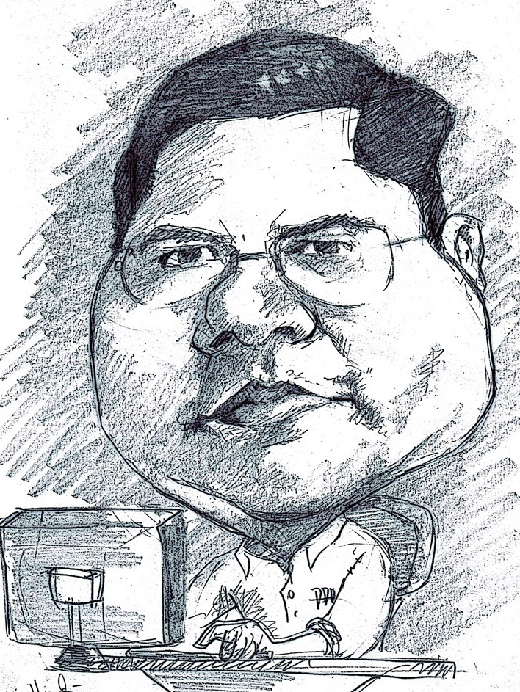
Romi Satria Wahono
SD Sompok Semarang (1987)
SMPN 8 Semarang (1990)
SMA Taruna Nusantara Magelang (1993)
B.Eng, M.Eng and Ph.D in Software Engineering from Saitama University Japan (1994-2004) Universiti Teknikal Malaysia Melaka (2014)
Research Interests: Software Engineering, Machine Learning
Founder dan Koordinator IlmuKomputer.Com
Peneliti LIPI (2004-2007)
Founder dan CEO PT Brainmatics Cipta Informatika

Slide 3
Course Outline
1. Introduction
2. Process
4. Quality
5. Research
3. Methodology

Slide 4
3. Methodology
3.1 Methodology (Model Process)
3.2 Structured Design
3.3 Rapid Application Development
3.4 Agile Development
3.5 Methodology Selection Strategy

Slide 5
3.1 Methodology (Model Process)

Slide 6
Software Development Life Cycle (SDLC)
Implementation
Design
Analysis
Planning
(Dennis, 2012)

Slide 7
Software Development Methodology (Model Process)
A formalized approach to implementing the Software Development Life Cycle (SDLC) (Dennis, 2012)
A simplified representation of a software process (Sommerville, 2015)
A distinct set of activities, actions, tasks, milestones, and work products required to engineer high quality software (Pressman, 2015)

Slide 8
Major Methodologies
More Prescriptive
More Adaptive
Structured Design
Waterfall method
Parallel development
Rapid Application Development
Phased Development
Prototyping
Throw-away Prototyping
Agile Development
Extreme Programming (XP)
Scrum
Lean Development
(Dennis, 2012)

Slide 9
Methodology Timeline

Slide 10
3.2 Structured Design

Slide 11
Structured Design
Projects move methodically from one to the next step
Generally, a step is finished before the next one begins
Type of Structured Desin:
Waterfall Method
Parallel Development

Slide 12
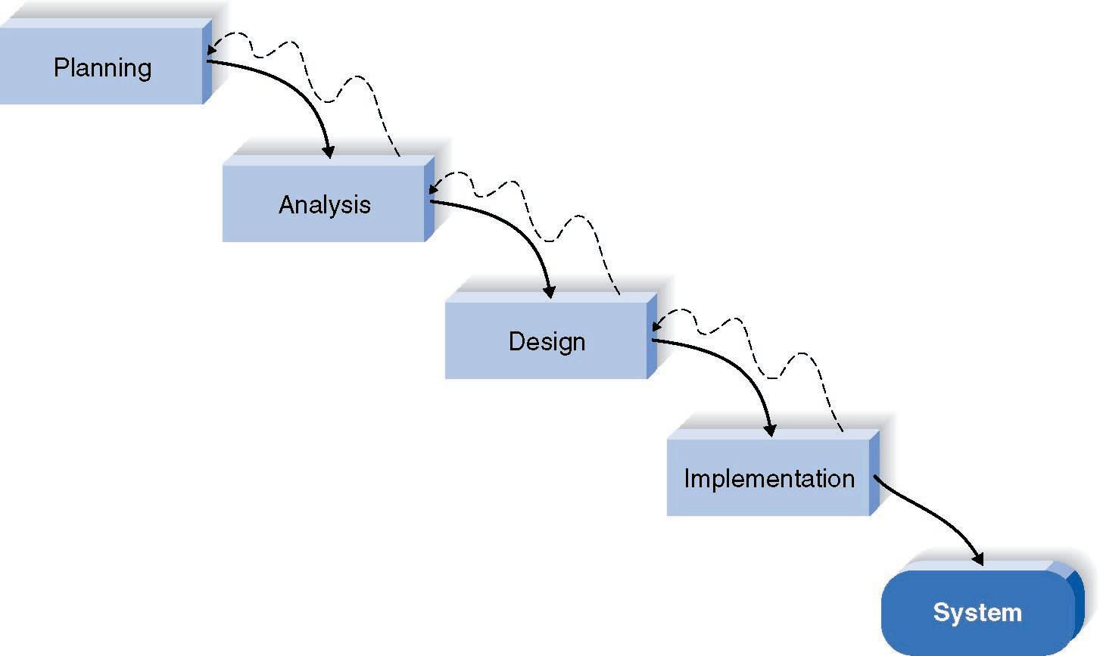
Waterfall Method
Pros | Cons
Identifies systems requirements long before programming Begins, it minimizes change to the requirements as the project proceed (mature) | Design must be specified on paper before programming begins
 | Long time between system proposal and delivery of new system
 | Rework is very hard

Slide 13
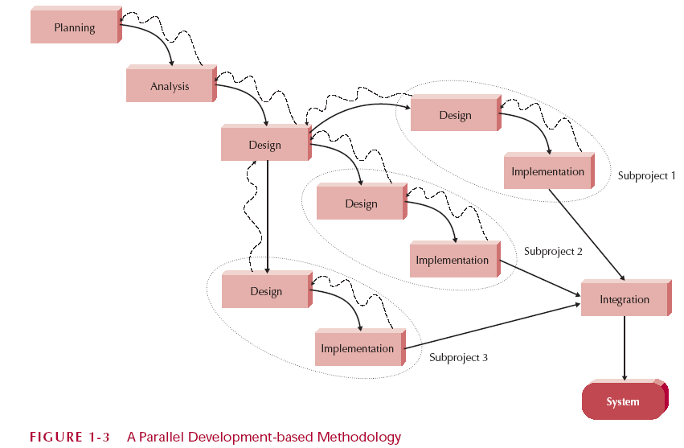
Parallel Development
Addresses problem of time gap between proposal and delivery:
Breaks project into parallel subproject
Integrates them at the end

Slide 14
3.3 Rapid Application Development

Slide 15
Rapid Application Development (RAD)
Type of RAD:
Phased development: a series of versions
Prototyping: System prototyping
Throw-away prototyping: design prototyping
Critical elements to speed up the SDLC:
CASE tools
Visual programming languages
Code generators

Slide 16
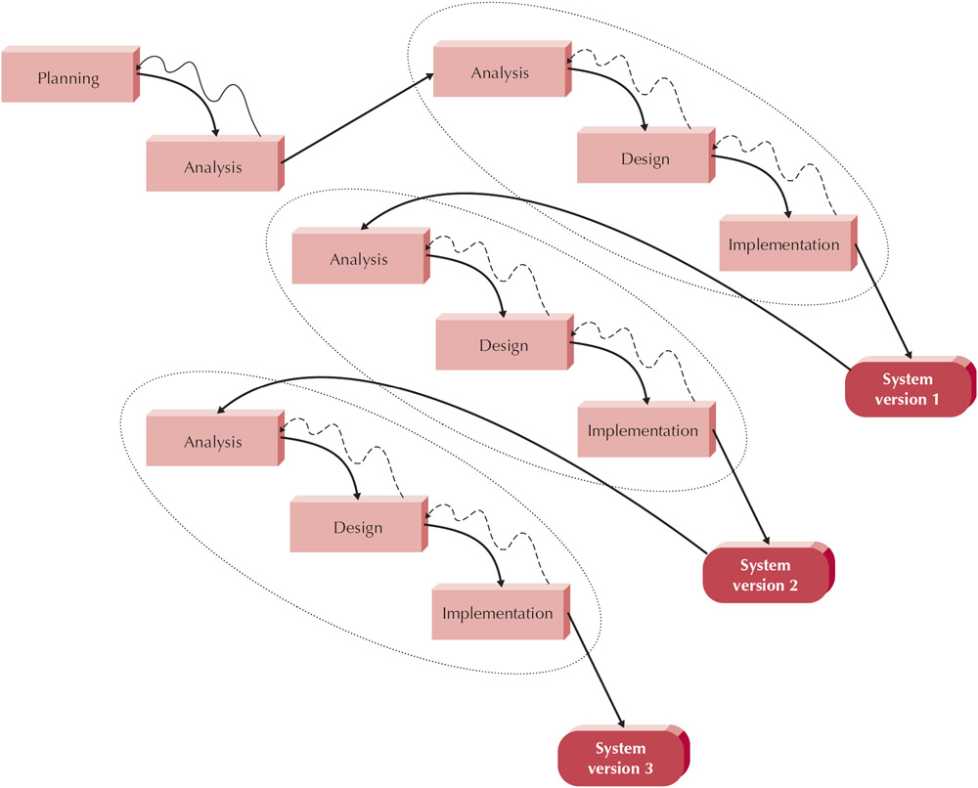
RAD: Phased Development
Pros | Cons
Gets useful system to users quickly | Initial system is intentionally incomplete
Most important functions tested most | System requirements expand as users see versions

Slide 17
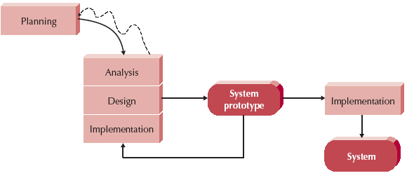
RAD: Prototyping
Analysis, Design, Implementation are performed concurrently
Start with a "quick-and-dirty" prototype, Provides minimal functionality
Repeat process, refining the prototype each time
Stop when prototype is a working system

Slide 18
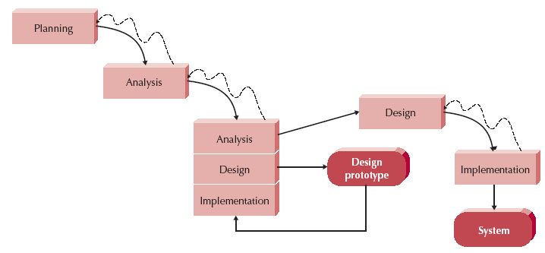
RAD: Throw-Away Prototyping
Use prototypes only to understand requirements
Example: use html to show UI
Prototype is not a working design
Once requirements are understood, the prototypes are thrown away

Slide 19
3.4 Agile Development

Slide 20
3. Agile Development
Just a few rules that are easy to learn and follow
Streamline the SDLC
Eliminate much of the modeling and documentation
Emphasize simple, iterative application development
Type of Agile Development:
Extreme Programming (XP)
Scrum
Lean Development
Dynamic Systems Development Model (DSDM)

Slide 21
Extreme Programming (XP)

Slide 22
Scrum
Project members form a Scrum Team consisting of 5–9 people
The goal of the Sprint is determined and the prioritized functionality is broken down into detailed tasks
The team is self-organized and the members have a joint responsibility for the results
Each Sprint enhances the product’s market value and adds new functions and improvements that can be delivered to the customer

Slide 23
Scrum

Slide 24
Iterative Scrum

Slide 25
Scrum

Slide 26
Scrum

Slide 27
Boards

Slide 28
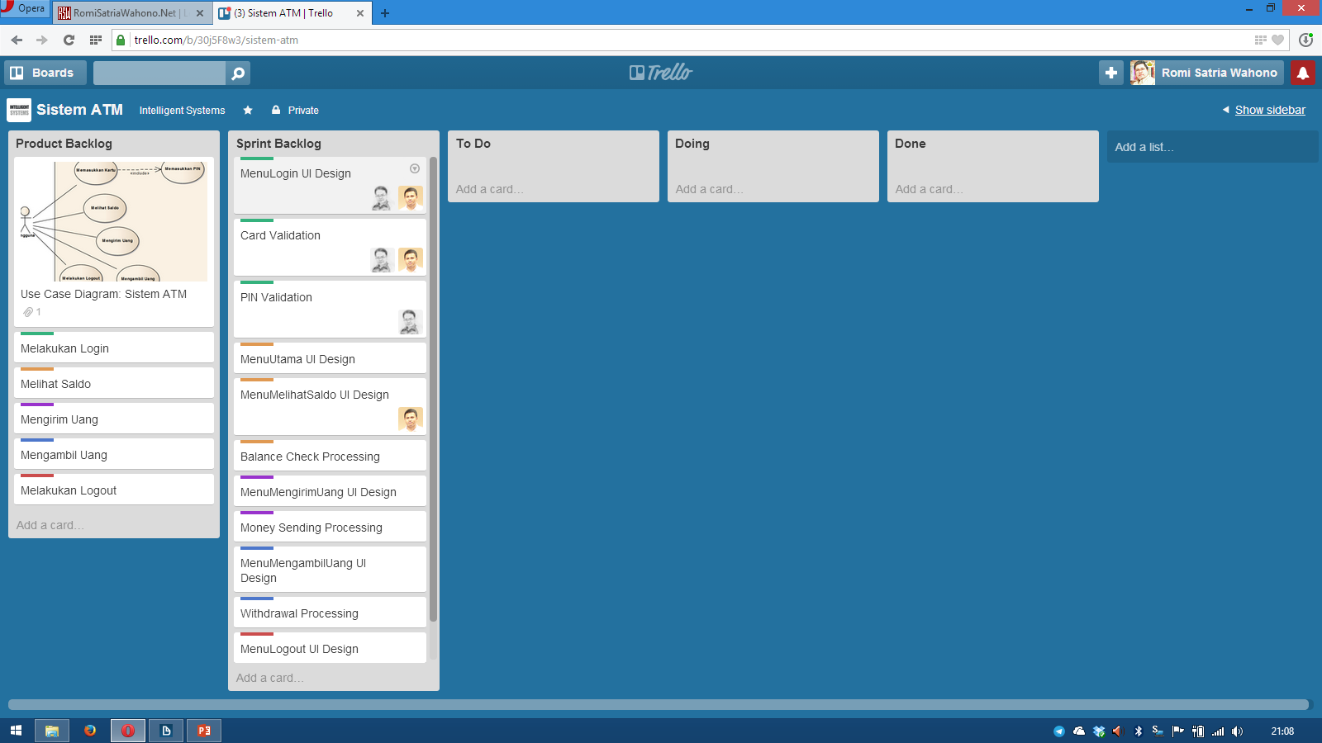

Slide 29
XP vs Scrum vs Lean
XP deals with how to work with programming
Scrum deals with how the project is organized and planned
Lean Development deals with which comprehensive principles should apply for the entire development organization

Slide 31
3.5 Methodology Selection Strategy

Slide 32
Selection Factors
Clarity of User Requirements
Familiarity with Technology
System Complexity
System Reliability
Short Time Schedules
Schedule Visibility

Slide 33
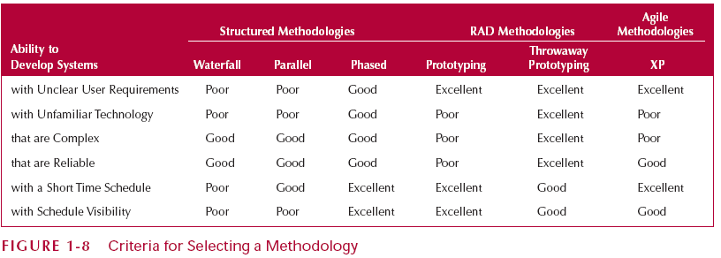
Selection Factors

Slide 34
Latihan Analisis Kasus: Memilih Metodologi yang Tepat
Seandainya, anda adalah seorang software engineer di perusahaan PT BlackSoft, sebuah perusahaan IT yang memiliki kantor cabang di berbagai tempat di dunia
PT BlackSoft ingin membangun sebuah sistem yang bisa menampilkan informasi tentang sumber daya manusia yang dimiliki, baik itu lokasi saat ini, latar belakang pendidikan, jadwal pekerjaan dan pengalaman kerja yang dimiliki
Asumsikan bahwa ini adalah ide baru yang belum pernah diimplementasikan di PT BlackSoft sebelumnya
PT BlackSoft memiliki jaringan internasional dimana kantor cabang di berbagai negara menggunakan hardware dan software yang berbeda
Manajemen ingin agar sistem dapat selesai dikerjakan dan mulai bisa berjalan dalam satu tahun

Slide 35
Latihan Kognitif
Jelaskan apa itu Software Development Life Cycle!
Jelaskan apa itu Software Development Methodology!
Jelaskan perbedaan diantara keduanya!

Slide 36
Reference (Foundation)
Ian Sommerville, Software Engineering 10th Edition, Addison-Wesley, 2015
Roger S. Pressman, Software Engineering: A Practitioner’s Approach 8th Edition, McGraw-Hill, 2014
P. Bourque and R.E. Fairley, eds., Guide to the Software Engineering Body of Knowledge Version 3.0, IEEE Computer Society, 2014
Albert Endres dan Dieter Rombach, A Handbook of Software and Systems Engineering, Pearson Education Limited, 2003
Yingxu Wang, Software Engineering Foundations: A Software Science Perspective, Auerbach Publications, Taylor & Francis Group, 2008

Slide 37
Reference (Process)
Alan Dennis et al, Systems Analysis and Design with UML – 4th Edition, John Wiley and Sons, 2012
Dan Pilone and Russ Miles, Head First Software Development, O’Reilly Media, 2008
Barclay and Savage, Object-Oriented Design with UML and Java, Elsevier, 2004
Kenneth E. Kendall and Julie E Kendall, Systems Analysis and Design 8th Edition, Prentice Hall, 2010
Hassan Gomaa, Software Modeling and Design: UML, Use Cases, Patterns, and Software Architectures, Cambridge University Press, 2011
Layna Fischer (edt.), BPMN 2.0 Handbook Second Edition, Future Strategies, 2012

Slide 38
Reference (Quality)
Daniel Galin, Software Quality Assurance, Addison-Wesley, 2004
Kshirasagar Naik and Priyadarshi Tripathy, Software Testing and Quality Assurance, John Wiley & Sons, Inc., 2008
Jeff Tian, Software Quality Engineering, John Wiley & Sons, Inc., 2005
G. Gordon Schulmeyer, Handbook of Software Quality Assurance Fourth Edition, Artech House, 2008

Slide 39
Reference (Research)
Christian W. Dawson, Project in Computing and Information System a Student Guide 2nd Edition, Addison-Wesley, 2009
Mikael Berndtsson, Jörgen Hansson, Björn Olsson, Björn Lundell, Thesis Projects - A Guide for Students in Computer Science and Information System 2nd Edition, Springer-Verlag London Limited, 2008
Mary Shaw, Writing Good Software Engineering Research Papers, Proceedings of the 25th International Conference on Software Engineering, 2003
C. Wohlin, P. Runeson, M. Host, M. C. Ohlsson, B. Regnell, and A. Wesslen, Experimentation in Software Engineering, Springer, 2012
P. Runeson, M. Host, A. Rainer, and B. Regnell, Case Study Research in Software Engineering: Guiidelines and Examples, John Wiley & Sons, Inc., 2012

