Slide 1
Java Fundamentals: 6. Java Database
Romi Satria Wahono romi@romisatriawahono.net http://romisatriawahono.net +6281586220090

Slide 2
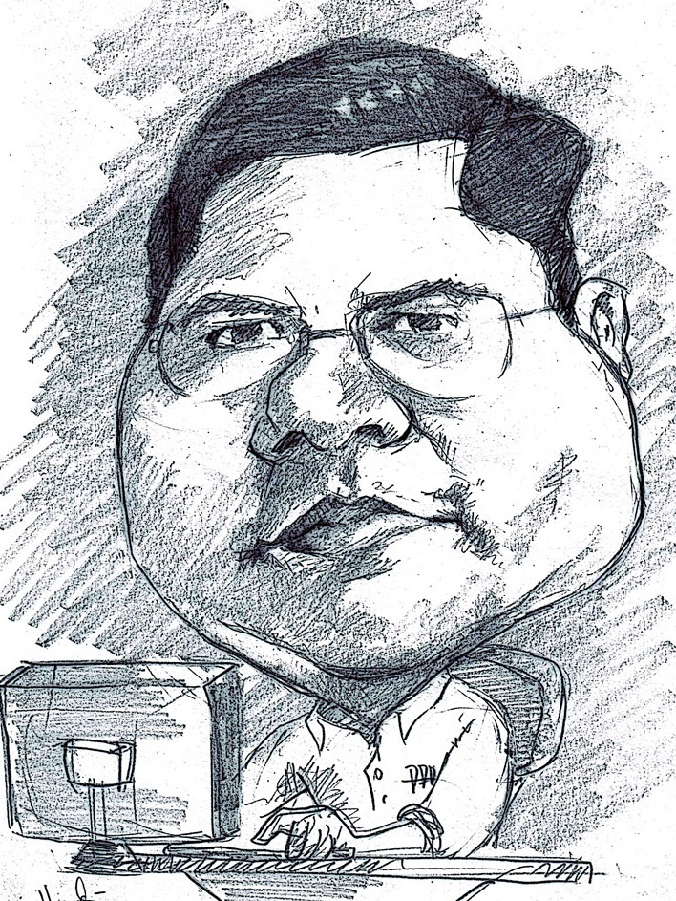
Romi Satria Wahono
SD Sompok Semarang (1987)
SMPN 8 Semarang (1990)
SMA Taruna Nusantara, Magelang (1993)
S1, S2 dan S3 (on-leave) Department of Computer Sciences Saitama University, Japan (1994-2004)
Research Interests: Software Engineering, Intelligent Systems
Founder dan Koordinator IlmuKomputer.Com
Peneliti LIPI (2004-2007)
Founder dan CEO PT Brainmatics Cipta Informatika

Slide 3
Course Outline
OOP Concepts: Konsep dan Paradigma Object-Oriented
Java Basics: Memahami Sintaks dan Grammar Bahasa Java
Java GUI: Swing, GUI Component, Event Handling, Pengembangan Aplikasi GUI
Java Algorithms: Pengantar Algoritma, Struktur Data, Algorithm Analysis
Java Advanced: Eksepsi, Thread, Java API
Java Database: Koneksi ke Database, Pengembangan Aplikasi Database

Slide 4
6. Java Database

Slide 5
Java Database
Pengantar Database
Pengantar SQL
Koneksi Aplikasi Java ke Database
Studi Kasus Aplikasi Java Database

Slide 6
6.1 Pengantar Database

Slide 7
Introduction to Database
Database system is a computer based record keeping system
It is a system whose overall purpose is to record and maintain information that is deemed important to the organization
Database is collection of stored operational data which can be used and shared by different applications and users of any organization

Slide 8
Why Database
Database system provides the organization with centralized control of its operational data, which is one of its most valuable assets
This is totally opposite of the situation that is happening in many organizations, where typically each application has its own private files (flat file). This makes the operational data widely dispersed and difficult to control

Slide 9
Advantage of Centralized Database
Redundancy can be reduced
Inconsistency can be avoided
Data can be shared
Standards can be enforced
Security restrictions can be applied
Integrity can be maintained
Conflicting requirements can be balanced

Slide 10
Disadvantage of Database Systems
Database is more vulnerable to destruction thru:
machine malfunction
personal error
Deliberate human tampering
Cost: the cost of required hardware, DB development, and DB maintenance is high
Complexity: Due to its complexity, the user should understand it well enough to use it efficiently and effectively

Slide 11
Database Models - Product - Vendor
MODEL PRODUCT VENDOR
1. Relational DB2 IBMSQL/DS Ingress Relational Tech.
Oracle Oracle corp
Access Microsoft
PostgreSQL
MySQL
2. Network DMS100 Unysis
IDMS Cullinet
3. Heirarchical IMS IBM
System 2000 Intel
4. Object oriented Starburst IBM
Gemstone
Orion

Slide 12
Relational Database
Relational database is a collection of tables
Formally a table is called a relation
Database is a structure that can hold information about tables, rows, and columns

Slide 13
Relational Database
Relational Relational Traditional
Model DBMS File System
Relation Table File
Tuple Row Record
Attribute Column Field
Primary Key (PK) Primary Key (PK) Search Key
Relationship (FK) Relationship (FK) Not Used

Slide 14
Relational Database
Primary Key (PK): An attribute which can uniquely identify each record (tuple) of a relation (table)
Foreign Key (FK): An attribute which is a regular attribute in one table but a primary key in another table

Slide 15
Example of a Relational Database
Relation Name
Attribute
Primary Key (PK)
Sale
SalesNO Name Rate City Dept#
10 James 10 Dallas A211
12 Black 15 Denver F654
48 Black 8 WashDC A211
Tuple (record)
Notes:
kjdfhg;jklsdfhg;sdjkhfg
sdl;fkgj;sdklfjg;lsdkjfg;lksdr
sd;klfg;lsdkjfg;lksdjfg’sd
lskdfg;’lksdjfgl;kdjfg
l;kasdfg;’lkdjfgl;kdsfg
;lkjglkajl;’ksdjfg
‘aksdjgflkasdjg kljlksdjfg
‘lkjsdfglkjasdfglk

Slide 16
Example of a Relational Database
Customer
CustID Name Balance City SaleNo
132 Black 2000.00 Dallas 10
135 Tom 129.89 Denver 12
198 Tom (132.90) Dallas 10
SalesNO is PK in Sales table
Sales
SalesNO Name Rate City Dept#
10 James 10 Dallas A211
12 Black 15 Denver F654
48 Black 8 WashDC A211
Notes:
kjdfhg;jklsdfhg;sdjkhfg
sdl;fkgj;sdklfjg;lsdkjfg;lksdr
sd;klfg;lsdkjfg;lksdjfg’sd
lskdfg;’lksdjfgl;kdjfg
l;kasdfg;’lkdjfgl;kdsfg
;lkjglkajl;’ksdjfg
‘aksdjgflkasdjg kljlksdjfg
‘lkjsdfglkjasdfglk

Slide 17
Example of a Relational Database
Customer
CustID Name Balance City SaleNo
132 Black 2000.00 Dallas 10
135 Tom 129.89 Denver 12
198 Tom (132.90) Dallas 10
SalesNO is PK in Sales table and FK in Customer table
Sales
SalesNO Name Rate City Dept#
10 James 10 Dallas A211
12 Black 15 Denver F654
48 Black 8 WashDC A211
Notes:
kjdfhg;jklsdfhg;sdjkhfg
sdl;fkgj;sdklfjg;lsdkjfg;lksdr
sd;klfg;lsdkjfg;lksdjfg’sd
lskdfg;’lksdjfgl;kdjfg
l;kasdfg;’lkdjfgl;kdsfg
;lkjglkajl;’ksdjfg
‘aksdjgflkasdjg kljlksdjfg
‘lkjsdfglkjasdfglk

Slide 18
Example: Order Entry Database
Order
OrderLine
ONO DATE CustID SalesNO
102 11/2/94 132 10
199 2/15/95 135 12
92 10/4/94 102 53
ONO Oline# Part# Qty Part#
102 1 12.00 10 EX454
102 2 129.89 1 DE012
199 1 32.90 3 DC810
Customer
CustID Name Balance City SaleNo
132 Black 2000.00 Dallas 10
135 Tom 129.89 Denver 12
198 Tom (132.90) Dallas 10
Sales
SalesNO Name Rate City Dept#
10 James 10 Dallas A211
12 Black 15 Denver F654
48 Black 8 WashDC A211
Notes:
kjdfhg;jklsdfhg;sdjkhfg
sdl;fkgj;sdklfjg;lsdkjfg;lksdr
sd;klfg;lsdkjfg;lksdjfg’sd
lskdfg;’lksdjfgl;kdjfg
l;kasdfg;’lkdjfgl;kdsfg
;lkjglkajl;’ksdjfg
‘aksdjgflkasdjg kljlksdjfg
‘lkjsdfglkjasdfglk

Slide 19
Functionality of a DBMS
The programmer sees SQL, which has two components:
Data Definition Language (DDL)
Data Manipulation Language (DML)
Behind the scenes the DBMS has:
Query engine
Query optimizer
Storage management
Transaction Management (concurrency, recovery)

Slide 20
How the Programmer Sees the DBMS
1. Start with DDL to create tables:
2. Continue with DML to populate tables:
CREATE TABLE Students (
Name CHAR(30)
SSN CHAR(9) PRIMARY KEY NOT NULL,
Category CHAR(20)
) . . .
INSERT INTO Students
VALUES(‘Charles’, ‘123456789’, ‘undergraduate’)
. . . .

Slide 21
Transactions
Enroll “Mary Johnson” in “CSE444”:
BEGIN TRANSACTION;
INSERT INTO Takes
SELECT Students.SSN, Courses.CID
FROM Students, Courses
WHERE Students.name = ‘Mary Johnson’ and
Courses.name = ‘CSE444’
-- More updates here....
IF everything-went-OK THEN COMMIT;
ELSE ROLLBACK
If system crashes, the transaction is still either committed or aborted

Slide 22
Transactions
A transaction = sequence of statements that either all succeed, or all fail
Transactions have the ACID properties:
A = atomicity (a transaction should be done or undone completely )
C = consistency (a transaction should transform a system from one consistent state to another consistent state)
I = isolation (each transaction should happen independently of other transactions )
D = durability (completed transactions should remain permanent)

Slide 23
Queries
Find all courses that “Mary” takes
What happens behind the scene ?
Query processor figures out how to answer the query efficiently.
SELECT C.name FROM Students S, Takes T, Courses C WHERE S.name=“Mary” and S.ssn = T.ssn and T.cid = C.cid

Slide 24
Queries, Behind the Scene
Declarative SQL query
Imperative query execution plan:
sname
SELECT C.name
FROM Students S, Takes T, Courses C
WHERE S.name=“Mary” and
S.ssn = T.ssn and T.cid = C.cid
cid=cid
sid=sid
name=“Mary”
Students
Takes
Courses
The optimizer chooses the best execution plan for a query

Slide 25
6.2 Pengantar SQL

Slide 26
SQL Introduction
Standard language for querying and manipulating data
SQL = Structured Query Language
Many standards out there:
ANSI SQL
SQL92 (a.k.a. SQL2)
SQL99 (a.k.a. SQL3)
Vendors support various subsets of these
What we discuss is common to all of them

Slide 27
SQL
Data Definition Language (DDL)
Create/alter/delete tables and their attributes
Data Manipulation Language (DML)
Query one or more tables
Insert/delete/modify tuples in tables
Transact-SQL
Idea: package a sequence of SQL statements → server

Slide 28
Data Types in SQL
Characters:
CHAR(20) -- fixed length
VARCHAR(40) -- variable length
Numbers:
BIGINT, INT, SMALLINT, TINYINT
REAL, FLOAT -- differ in precision
MONEY
Times and dates:
DATE
DATETIME -- SQL Server
Others... All are simple

Slide 29
SQL Data Type vs Java Data Type
SQL Data Type | Java Data Type
INTEGER or INT | int
REAL | float
DOUBLE | double
DECIMAL(m, n) | Fixed-point decimal numbers with m total digits and n digits after the decimal point; similar to BigDecimal.
BOOLEAN | Boolean
VARCHAR(n) | Variable-length String of length up to n
CHARACTER(n) or CHAR(n) | Fixed-length String of length n

Slide 30
Tables in SQL
Table name
Attribute names
Product
PName | Price | Category | Manufacturer
Gizmo | $19.99 | Gadgets | GizmoWorks
Powergizmo | $29.99 | Gadgets | GizmoWorks
SingleTouch | $149.99 | Photography | Canon
MultiTouch | $203.99 | Household | Hitachi
Tuples or rows

Slide 31
Tables Explained
A tuple = a record
Restriction: all attributes are of atomic type
A table = a set of tuples
Like a list…
…but it is unorderd: no first(), no next(), no last().
No nested tables, only flat tables are allowed!

Slide 32
Tables Explained
The schema of a table is the table name and its attributes:
Product(PName, Price, Category, Manfacturer)
A key is an attribute whose values are unique; we underline a key
Product(PName, Price, Category, Manfacturer)

Slide 33
SQL Query
Basic form: (plus many many more bells and whistles)
SELECT attributes
FROM relations (possibly multiple, joined)
WHERE conditions (selections)

Slide 34
Simple SQL Query
Product
PName | Price | Category | Manufacturer
Gizmo | $19.99 | Gadgets | GizmoWorks
Powergizmo | $29.99 | Gadgets | GizmoWorks
SingleTouch | $149.99 | Photography | Canon
MultiTouch | $203.99 | Household | Hitachi
SELECT * FROM Product WHERE category=‘Gadgets’
PName | Price | Category | Manufacturer
Gizmo | $19.99 | Gadgets | GizmoWorks
Powergizmo | $29.99 | Gadgets | GizmoWorks
“selection”

Slide 35
Simple SQL Query
Product
PName | Price | Category | Manufacturer
Gizmo | $19.99 | Gadgets | GizmoWorks
Powergizmo | $29.99 | Gadgets | GizmoWorks
SingleTouch | $149.99 | Photography | Canon
MultiTouch | $203.99 | Household | Hitachi
SELECT PName, Price, Manufacturer FROM Product WHERE Price > 100
“selection” and
“projection”
PName | Price | Manufacturer
SingleTouch | $149.99 | Canon
MultiTouch | $203.99 | Hitachi

Slide 36
A Notation for SQL Queries
Input Schema
Product(PName, Price, Category, Manfacturer)
SELECT PName, Price, Manufacturer FROM Product WHERE Price > 100
Answer(PName, Price, Manfacturer)
Output Schema

Slide 37
Selections
What goes in the WHERE clause:
x = y, x < y, x <= y, etc
For number, they have the usual meanings
For CHAR and VARCHAR: lexicographic ordering
Expected conversion between CHAR and VARCHAR
For dates and times, what you expect...
Pattern matching on strings: s LIKE p

Slide 38
The LIKE operator
s LIKE p: pattern matching on strings
p may contain two special symbols:
% = any sequence of characters
_ = any single character
Product(Name, Price, Category, Manufacturer)
Find all products whose name mentions ‘gizmo’:
SELECT * FROM Products WHERE PName LIKE ‘%gizmo%’

Slide 39
Eliminating Duplicates
Category
Gadgets
SELECT category
FROM Product
Gadgets
Photography
Household
Compare to:
Category
SELECT DISTINCT category
FROM Product
Gadgets
Photography
Household

Slide 40
Ordering the Results
SELECT pname, price, manufacturer
FROM Product
WHERE category=‘gizmo’ AND price > 50
ORDER BY price, pname
Ordering is ascending, unless you specify the DESC keyword.
Ties are broken by the second attribute on the ORDER BY list, etc.

Slide 41
Ordering the Results
SELECT Category
FROM Product
ORDER BY PName
PName | Price | Category | Manufacturer
Gizmo | $19.99 | Gadgets | GizmoWorks
Powergizmo | $29.99 | Gadgets | GizmoWorks
SingleTouch | $149.99 | Photography | Canon
MultiTouch | $203.99 | Household | Hitachi
?

Slide 42
Ordering the Results
Category
Gadgets
Household
Photography
SELECT DISTINCT category
FROM Product
ORDER BY category
Compare to:
SELECT DISTINCT category
FROM Product
ORDER BY PName
?

Slide 43
Joins in SQL
Connect two or more tables:
Product
PName | Price | Category | Manufacturer
Gizmo | $19.99 | Gadgets | GizmoWorks
Powergizmo | $29.99 | Gadgets | GizmoWorks
SingleTouch | $149.99 | Photography | Canon
MultiTouch | $203.99 | Household | Hitachi
Company
CName | StockPrice | Country
GizmoWorks | 25 | USA
Canon | 65 | Japan
Hitachi | 15 | Japan
What is
the Connection
between
them ?

Slide 44
Joins
Join between Product and Company
SELECT PName, Price FROM Product, Company WHERE Manufacturer=CName AND Country=‘Japan’ AND Price <= 200

Slide 45
Joins in SQL
Product
Company
PName | Price | Category | Manufacturer
Gizmo | $19.99 | Gadgets | GizmoWorks
Powergizmo | $29.99 | Gadgets | GizmoWorks
SingleTouch | $149.99 | Photography | Canon
MultiTouch | $203.99 | Household | Hitachi
Cname | StockPrice | Country
GizmoWorks | 25 | USA
Canon | 65 | Japan
Hitachi | 15 | Japan
SELECT PName, Price FROM Product, Company WHERE Manufacturer=CName AND Country=‘Japan’ AND Price <= 200
PName | Price
SingleTouch | $149.99

Slide 46
Joins
Product (pname, price, category, manufacturer)
Company (cname, stockPrice, country)
Find all countries that manufacture some product in the ‘Gadgets’ category.
SELECT Country FROM Product, Company WHERE Manufacturer=CName AND Category=‘Gadgets’

Slide 47
Joins in SQL
Product
Company
PName | Price | Category | Manufacturer
Gizmo | $19.99 | Gadgets | GizmoWorks
Powergizmo | $29.99 | Gadgets | GizmoWorks
SingleTouch | $149.99 | Photography | Canon
MultiTouch | $203.99 | Household | Hitachi
Cname | StockPrice | Country
GizmoWorks | 25 | USA
Canon | 65 | Japan
Hitachi | 15 | Japan
SELECT Country FROM Product, Company WHERE Manufacturer=CName AND Category=‘Gadgets’
What is
the problem ?
What’s the solution ?
Country
??
??

Slide 48
Joins
Product (pname, price, category, manufacturer)
Purchase (buyer, seller, store, product)
Person(persname, phoneNumber, city)
Find names of people living in Seattle that bought some product in the ‘Gadgets’ category, and the names of the stores they bought such product from
SELECT DISTINCT persname, store FROM Person, Purchase, Product WHERE persname=buyer AND product = pname AND city=‘Seattle’ AND category=‘Gadgets’

Slide 49
Disambiguating Attributes
Sometimes two relations have the same attribute: Person(pname, address, worksfor) Company(cname, address)
Which address ?
SELECT DISTINCT pname, address FROM Person, Company WHERE worksfor = cname
SELECT DISTINCT Person.pname, Company.address FROM Person, Company WHERE Person.worksfor = Company.cname

Slide 50
Tuple Variables
Product (pname, price, category, manufacturer)
Purchase (buyer, seller, store, product)
Person(persname, phoneNumber, city)
Find all stores that sold at least one product that the store ‘BestBuy’ also sold:
SELECT DISTINCT x.store
FROM Purchase AS x, Purchase AS y
WHERE x.product = y.product AND y.store = ‘BestBuy’
Answer (store)

Slide 51
Tuple Variables
General rule: tuple variables introduced automatically by the system:
Product ( name, price, category, manufacturer)
Becomes:
Doesn’t work when Product occurs more than once:
In that case the user needs to define variables explicitely.
SELECT name
FROM Product
WHERE price > 100
SELECT Product.name
FROM Product AS Product
WHERE Product.price > 100

Slide 52
Renaming Columns
Product
PName | Price | Category | Manufacturer
Gizmo | $19.99 | Gadgets | GizmoWorks
Powergizmo | $29.99 | Gadgets | GizmoWorks
SingleTouch | $149.99 | Photography | Canon
MultiTouch | $203.99 | Household | Hitachi
SELECT Pname AS prodName, Price AS askPrice FROM Product WHERE Price > 100
prodName | askPrice
SingleTouch | $149.99
MultiTouch | $203.99
Query with renaming

Slide 53
6.3 Koneksi Aplikasi Java ke Database

Slide 54
Tahapan Akses Database dengan JDBC
Driver
DriverManager
Connection
Statement
ResultSet
user
password
url
MySQL
PostgreSQL
select
update
create
insert
Oracle
host
database

Slide 55
JDBC (Java DB Connectivity)
Java application
{ ...
"SELECT ... FROM ... WHERE"
... }
DBMS

Slide 56
JDBC Drivers
Java
application
JDBC-API
JDBC-
Driver manager
Native
Protocol driver
JDBC-
Net-driver
JDBC-ODBC
bridge
Native
API-driver
DB-
Middleware
ODBC
Client library
Client library

Slide 57
Running a JDBC Application
Phase
Task
Relevant java.sql classes
Initialisation
Load driver
Create connection
DriverManager
Connection
Processing
Generate SQL statements
Process result data
Statement
ResultSet etc.
Termination
Terminate connection
Release data structures
Connection
Statement etc.

Slide 58
A Simple JDBC application
import java.sql.*;
public class jdbctest {
public static void main(String args[]){
try{
Class.forName("org.postgresql.Driver");
Connection con = DriverManager.getConnection
("jdbc:postgresql://lsir-cis-pc8:5401/pcmdb", "user", "passwd");
Statement stmt = con.createStatement();
ResultSet rs = stmt.executeQuery
("select name, number from pcmtable where number < 2");
while(rs.next())
System.out.println(rs.getString(1) + " (" + rs.getInt(2) + ")");
stmt.close()
con.close();
} catch(Exception e){
System.err.println(e);
}
}}
loadDriver
getConnection
createStatement
execute(SQL)
Result handling
yes
More
results ?
no
closeStatment
closeConnection

Slide 59
Loading of Driver
Creates an instance of the driver
Registers driver in the driver manager
Explicit loading String l_driver = "org.postgresql.Driver"; Class.forName(l_driver);
Several drivers can be loaded and registered

Slide 60
Implicit Driver Loading
Setting system property: jdbc.drivers
A colon-separated list of driver classnames
Can be set when starting the application
java -Djdbc.drivers=org.postgresql.Driver application
Can also be set from within the Java application
Properties prp = System.getProperties();
prp.put("jdbc.drivers" "com.mimer.jdbc.Driver:org.postgresql.Driver");
System.setProperties(prp);
The DriverManager class attempts to load all the classes specified in jdbc.drivers when the DriverManager class is initialized

Slide 61
Addressing Database
A connection is a session with one database
Databases are addressed using a URL of the form "jdbc:<subprotocol>:<subname>"
Examples
jdbc:postgresql:database
jdbc:postgresql://host/database
jdbc:postgresql://host:port/database
Defaults: host=localhost, port=5432

Slide 62
Connecting to Database
Connection is established Connection con = DriverManager.getConnection(URL,USERID,PWD);
Connection properties (class Properties)
Close the connection con.close();

Slide 63
Simple SQL Statements
Statement object for invocation stmt = conn.createStatement(); ResultSet rset= stmt.executeQuery( "SELECT address,script,type FROM worklist");
ResultSet object for result processing

Slide 64
6.4 Studi Kasus Aplikasi Database

Slide 65
Aplikasi Database
Aplikasi Telepon
Aplikasi Guru
Aplikasi Bank
Aplikasi Penjualan Barang

Slide 66
Aplikasi Telepon

Slide 67
Aplikasi Telepon
Ekstrak xampplite dan jalankan xampp_start.exe untuk mengaktifkan Apache dan MySQL
Buka browser, arahkan url ke http://localhost dan klik link ke phpMyAdmin
Buat database telepon
Buat satu table bukutelepon, yang berisi field dengan id sebagai primary key (PK):
id integer (auto increment)
nama varchar(20)
alamat varchar(50)
telepon varchar(20)
handphone varchar(20)

Slide 68
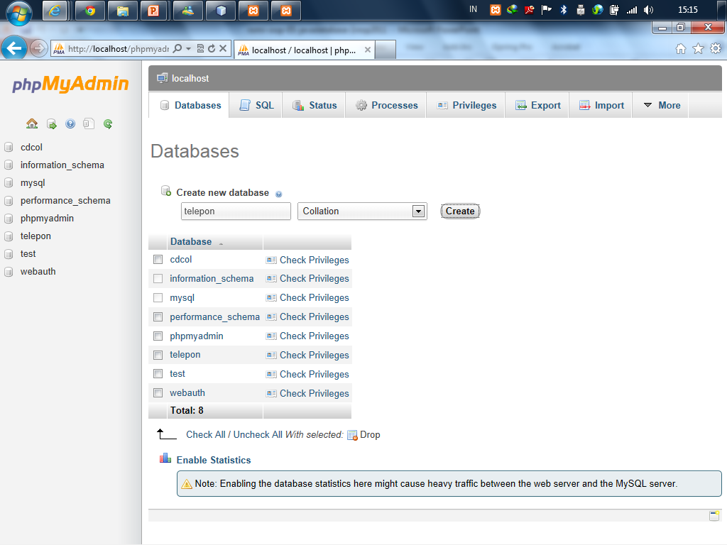

Slide 69
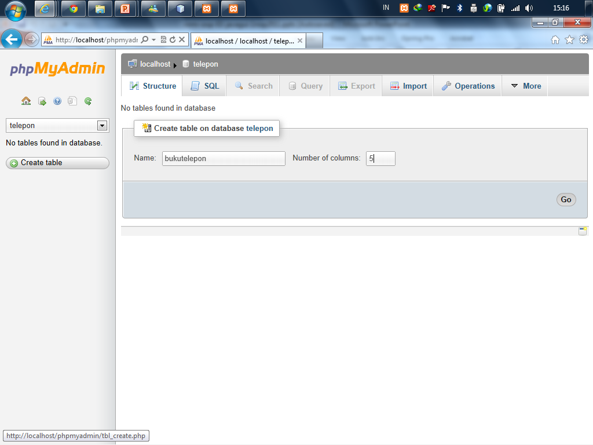

Slide 70
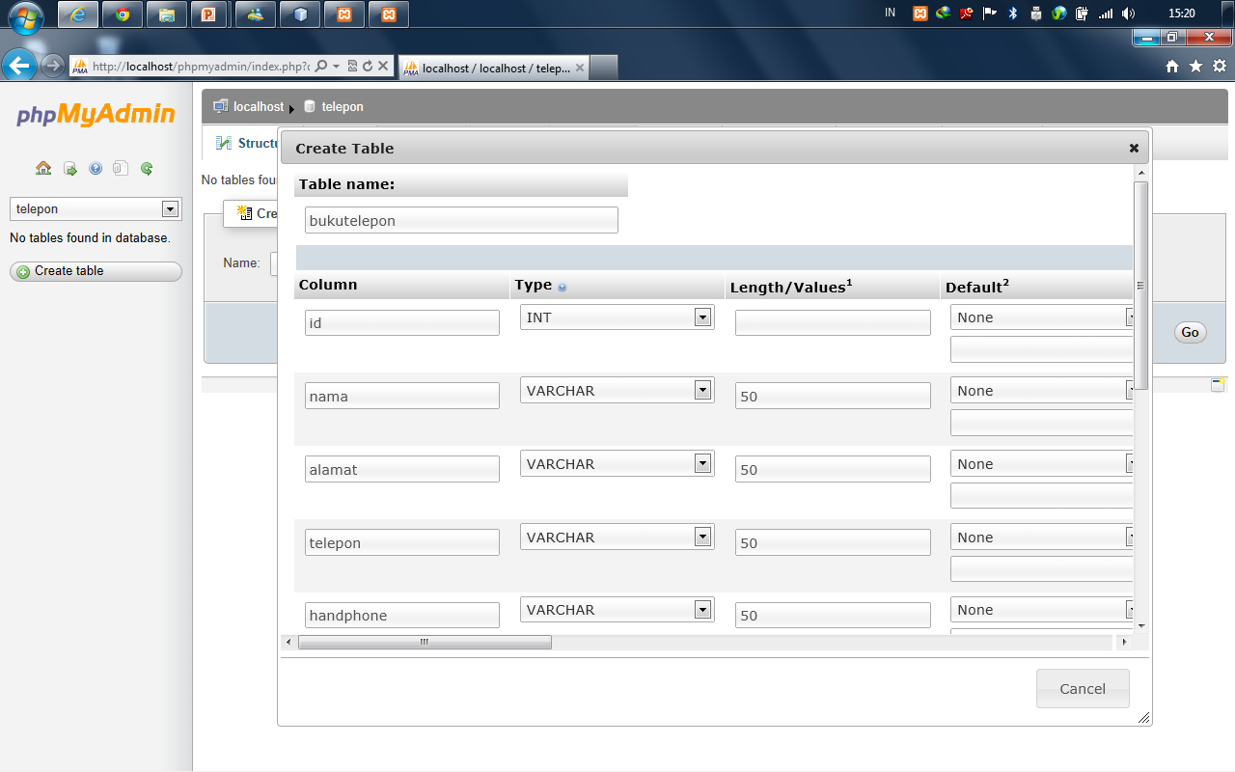

Slide 71
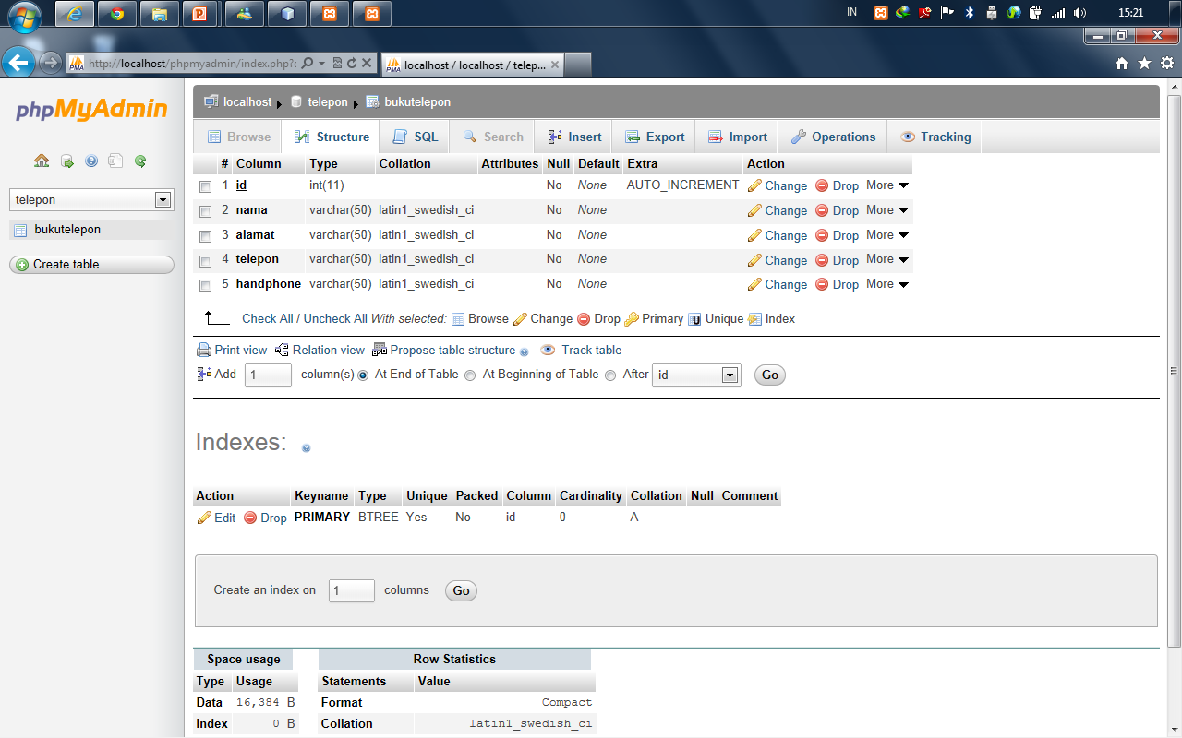

Slide 72
Autoincrement di PostgreSQL
CREATE SEQUENCE bukutelepon_id_seq;
ALTER TABLE bukutelepon
ALTER COLUMN id
SET DEFAULT NEXTVAL('bukutelepon_id_seq');
UPDATE bukutelepon
SET id = NEXTVAL('bukutelepon_id_seq');

Slide 73
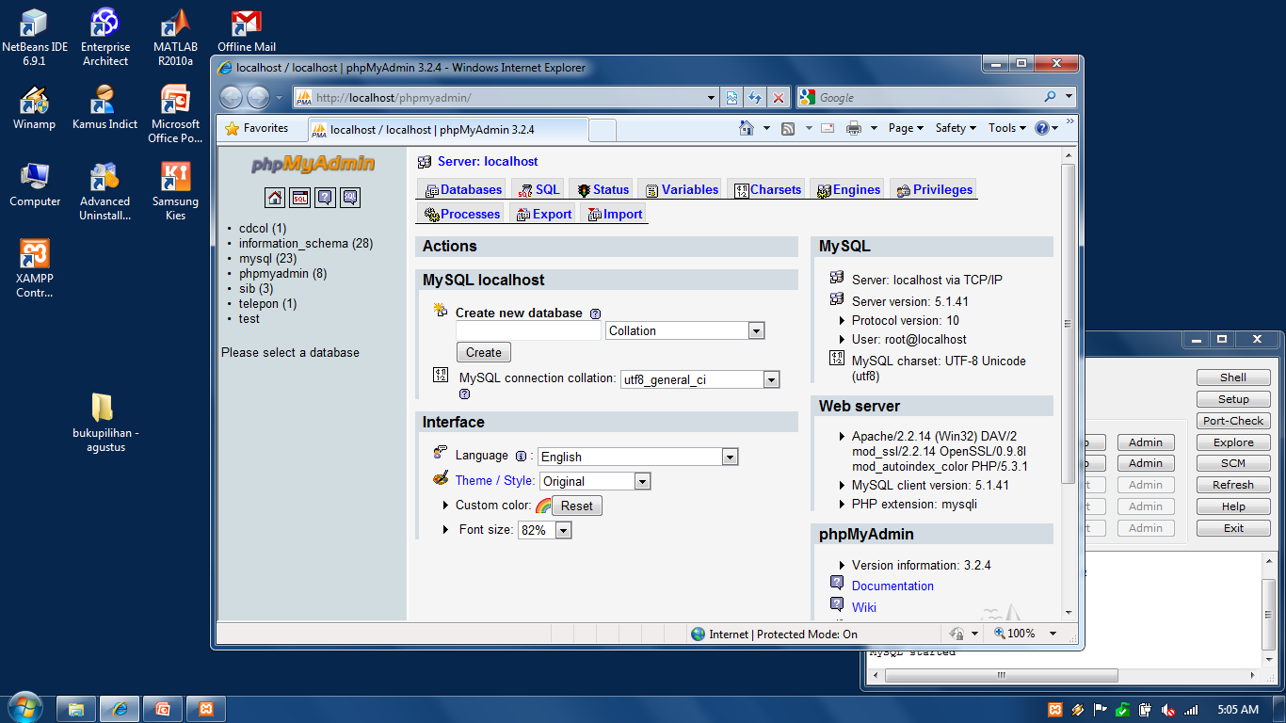

Slide 74
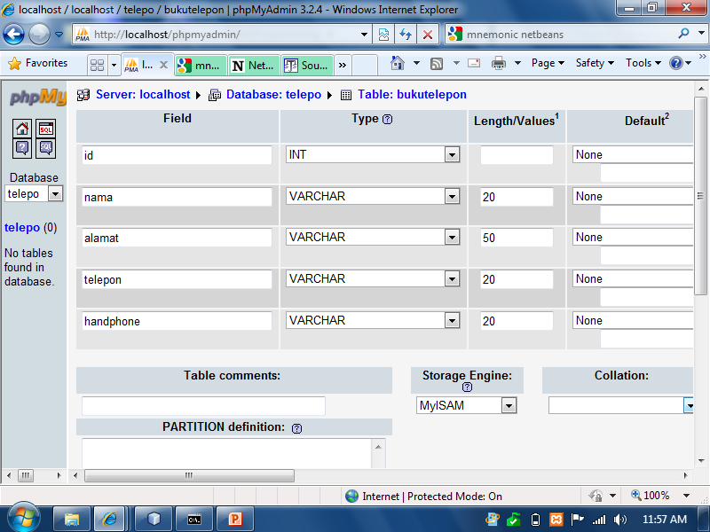

Slide 75
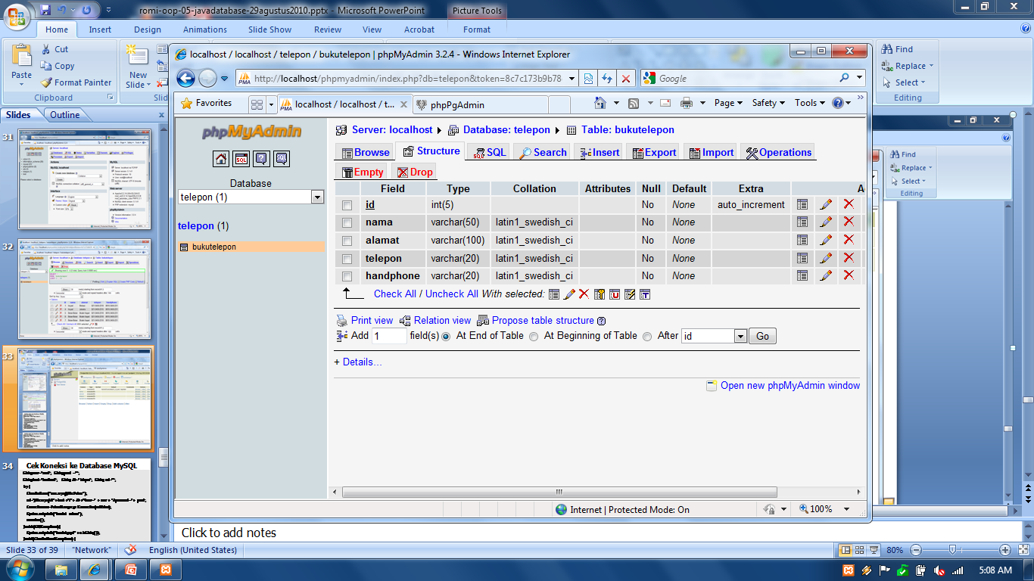

Slide 76
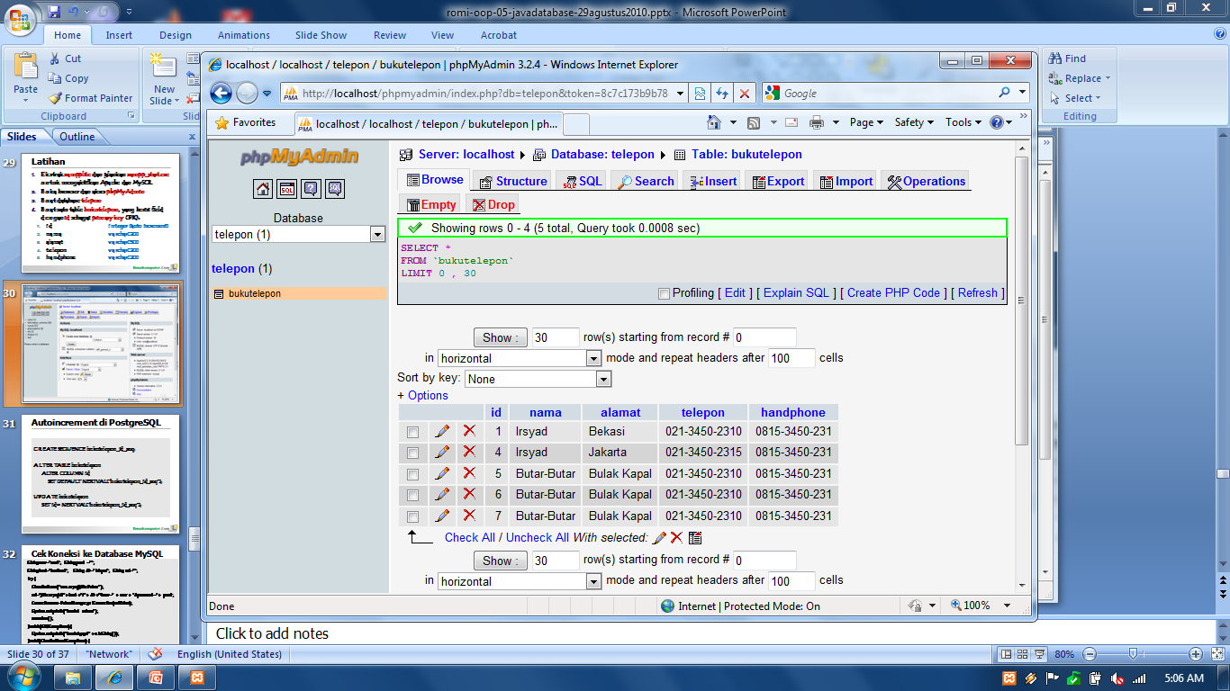

Slide 77
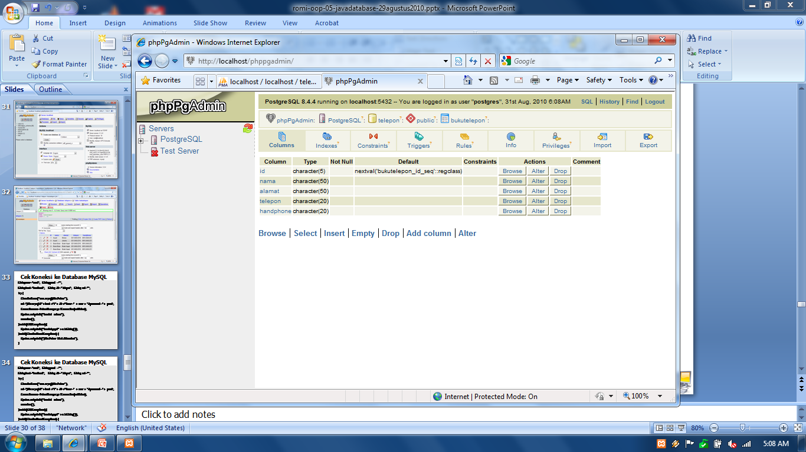

Slide 78
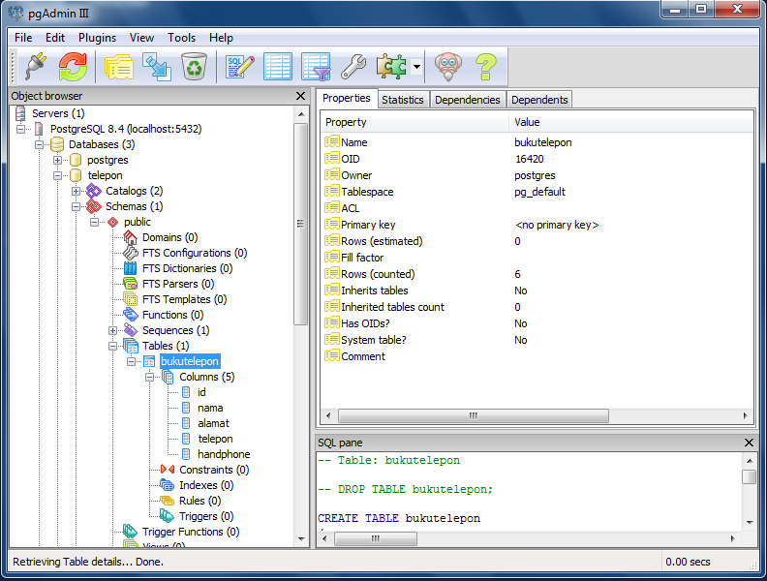

Slide 79
Aplikasi Telepon
Extract dan copy folder 05 JAVA DATABASE di NetbeansProject anda
Di Netbeans buka file tersebut melalui Open project
Cek package db.mysql (versi text) dan dbgui.mysql (versi gui)
Program yang ada di kedua package tersebut akan mengakses dan melakukan query ke database telepon (table bukutelepon)

Slide 80
Cek Koneksi ke Database MySQL
String user="root"; String pswd ="";
String host="localhost"; String db="telepon"; String url="";
try {
Class.forName("com.mysql.jdbc.Driver");
url="jdbc:mysql://"+ host +"/"+ db +"?user=" + user + "&password="+ pswd;
Connection conn=DriverManager.getConnection(urlValue);
System.out.println("koneksi sukses");
conn.close();
} catch (SQLException e){
System.out.println("koneksi gagal " + e.toString());
} catch(ClassNotFoundException e) {
System.out.println("jdbc.Driver tidak ditemukan");
}

Slide 81
Cek Koneksi ke Database PostgreSQL
String user="root"; String pswd ="";
String host="localhost"; String db="telepon"; String url="";
try {
Class.forName(“org.postgresql.Driver");
url="jdbc:postgresql://"+ host +"/"+ db +"?user=" + user + "&password="+ pswd;
Connection conn=DriverManager.getConnection(urlValue);
System.out.println("koneksi sukses");
conn.close();
} catch (SQLException e){
System.out.println("koneksi gagal " + e.toString());
} catch(ClassNotFoundException e) {
System.out.println("jdbc.Driver tidak ditemukan");
}

Slide 82
Aplikasi Guru

Slide 83
Aplikasi Guru
Buat database Guru
Buat satu table dataguru, yang berisi field dengan nip sebagai primary key (PK). Field yang lain adalah seperti di bawah:
nip integer (auto increment)
nama varchar(30)
status varchar(20)
institusi varchar(30)
kota varchar(30)
handphone varchar(20)
jeniskelamin varchar(20)
bidangstudi varchar(30)

Slide 84
Tugas: Aplikasi Guru
Pahami program yang ada di package db.mysql
Buat 5 class java yang melakukan query ke database Guru:
GuruConnection.java
GuruInsert.java
GuruRead.java
GuruUpdate.java
GuruDelete.java

Slide 85
Tugas: Aplikasi Guru
Pahami program yang ada di package dbgui.mysql
Buat 1 class MenuUtama dan 4 class java GUI yang melakukan query ke database Guru:
GuruInsertUI.java
GuruReadUI.java
GuruUpdateUI.java
GuruDeleteUI.java
MenuUtama.java

Slide 86
Aplikasi Bank

Slide 87
Aplikasi Bank
Pahami dengan baik Case Study: A Bank Database yang terdapat pada buku Hortsmann (halaman 871)
Buat dua tabel database: BankCustomer dan Account
Buat dua class yang mendefinisikan dan mengoperasikan aplikasi Bank: Bank.java dan BankAccount.java
Buat satu class yang berisi method main yang mengeksekusi aplikasi bank

Slide 88
Aplikasi Penjualan Barang

Slide 89
Aplikasi Penjualan Barang (Quantum)
Ekstrak quantum.zip
Buat database sib di MySQL dan import sib.sql
Open project quantum
Lakukan pengecekan dan perbaikan error yang ada (klik kanan di project dan pilih Resolve Reference Problem)
Build dan jalankan program
Pelajari dengan baik source codenya

Slide 90
Tugas
Kembangkan aplikasi java berbasis GUI yang mengakses database MySQL. Fitur utama dari aplikasi adalah kemampuan untuk CRUD (create, read (listing), update, delete) data dari database MySQL dan fitur transaksi serta reporting. Gunakan lebih dari satu table
Pilih aplikasi dari list di bawah (digit terakhir NIM):
Kirimkan file-file di bawah ke romi@brainmatics.com subject email [OOP5-Universitas] Nama-NIM
Source project netbeans dari aplikasi yang dibuat
Ekspor (dumped) database MySQL (*.sql)
Deadline: 2 Minggu
Nyontek akan diberi nilai 0
1. Aplikasi Online Penjualan Buku
2. Aplikasi Online Penjualan Handphone
3. Aplikasi Online Pengelolaan KRS
4. Aplikasi Online Penjualan Tiket Pesawat
5. Aplikasi Online Penjualan Tiket Kereta
6. Aplikasi Sirkulasi Perpustakaan
7. Aplikasi Rental Mobil
8. Aplikasi Penjualan Handphone
9. Aplikasi Penjualan CD Musik
0. Aplikasi Sewa PC

Slide 91
Referensi
Sharon Zakhour et al, The Java Tutorial Fourth Edition, http://java.sun.com/docs/books/tutorial
Cay Horstmann, Big Java: Earl Objects 5th Edition, John Wiley & Sons, 2013
Deitel & Deitel, Java Howto Program 9th Edition, Prentice Hall, 2012
Richard M. Reese, Oracle Certified Associate Java SE 7 Programmer Study Guide, Packt Publishing, 2012
Walter Savitch, Absolute Java 5th Edition, Pearson Education, 2013
Mark Allen Weiss, Data Structures and Algorithm Analysis in Java 3rd Edition, Pearson Education, 2012
Anany Levitin, Introduction to the Design and Analysis of Algorithms 3rd Edition, Pearson Education, 2012
Ying Bai, Practical Database Programming with Java, John Wiley & Sons, 2011

